Slide 2
Adult Guidance
This PowerPoint contains eleven interesting winter photographs. It has been designed to stimulate talk and encourage children to share experiences and talk about what they can see.
Follow the children’s lead and talk about the things they are interested in.
Try to keep questions to a minimum. The aim of displaying these photos is to use them as a stimulus and to provoke an emotional response.
Try displaying the image and leaving it available for children to talk about as they play and explore.
Use these photo pages over time.
You may wish to display a photo after children have discovered something for themselves. For example, display the frozen leaves or cobweb image if they have seen frost outside.
If the children are not interested in the photo, then move on to another photo.

Slide 3
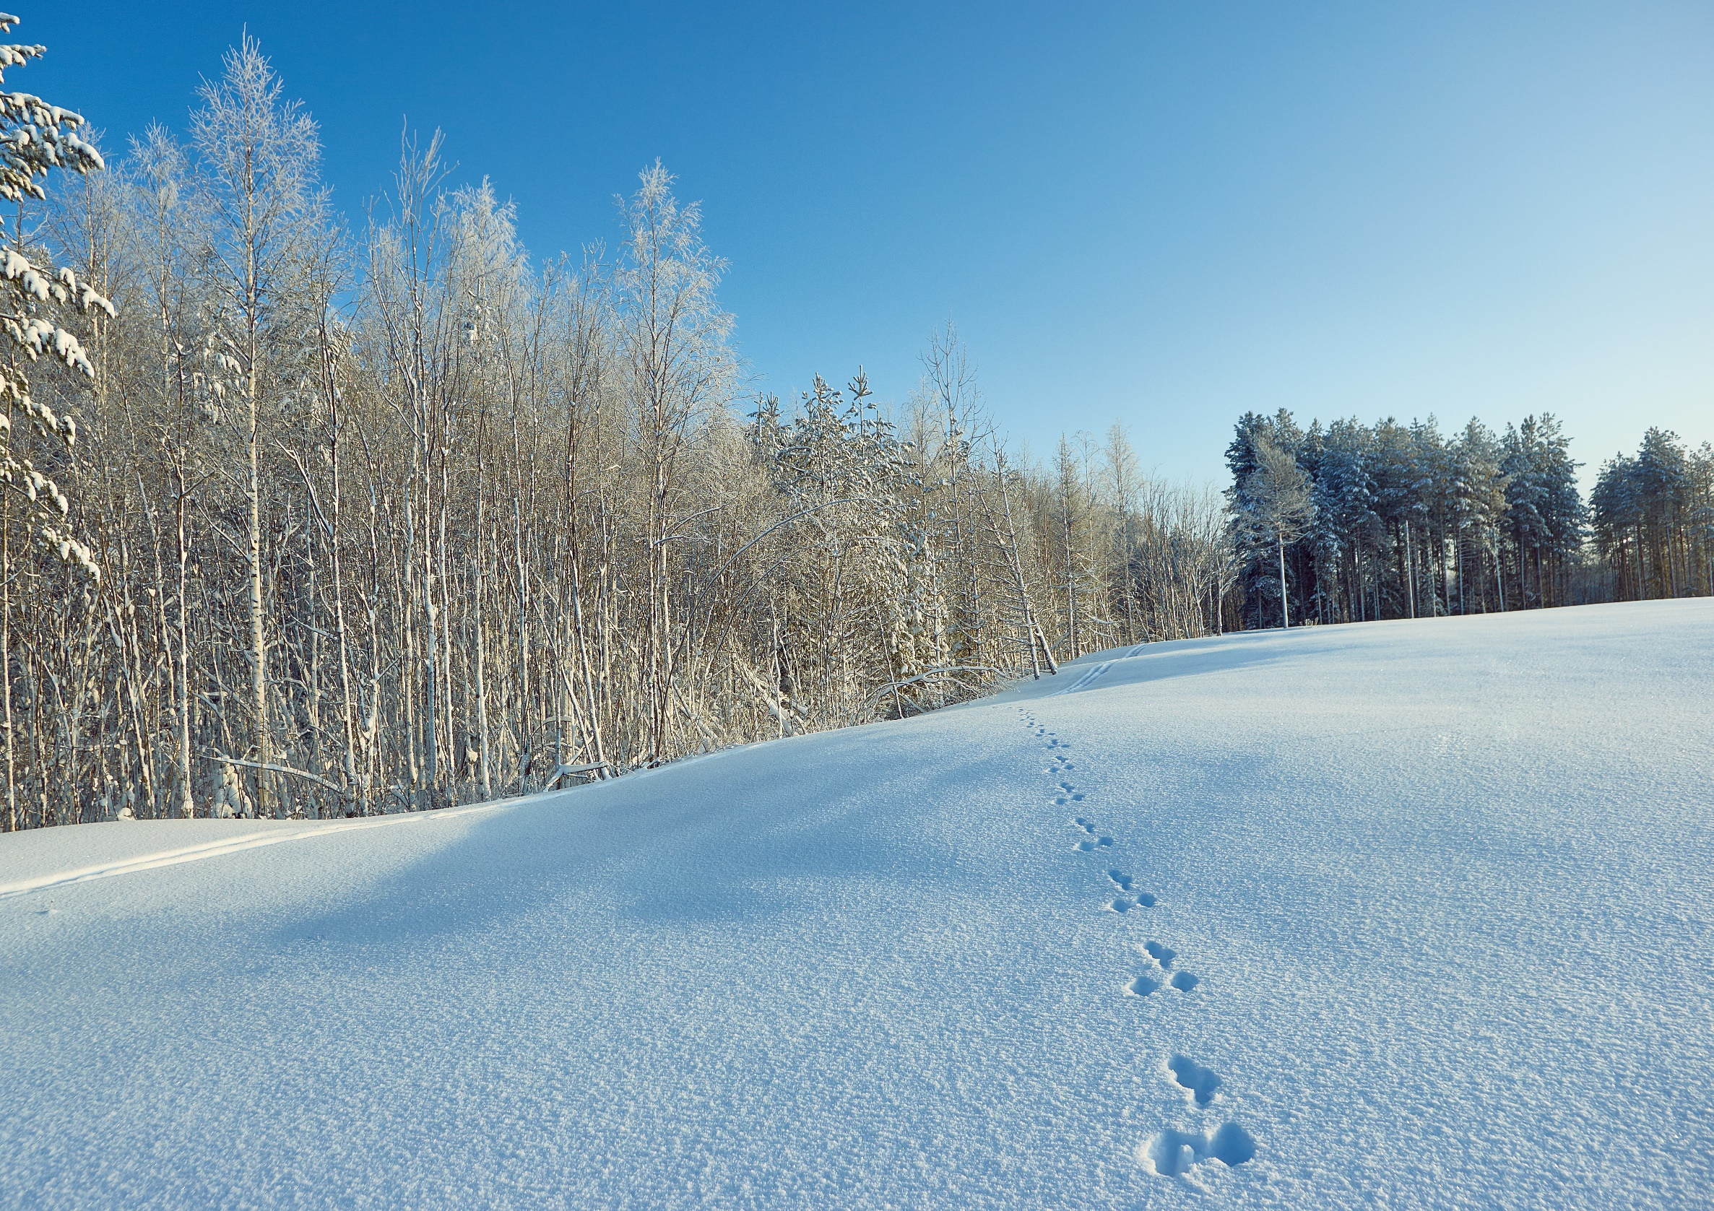
Tell Me What You See

Slide 4
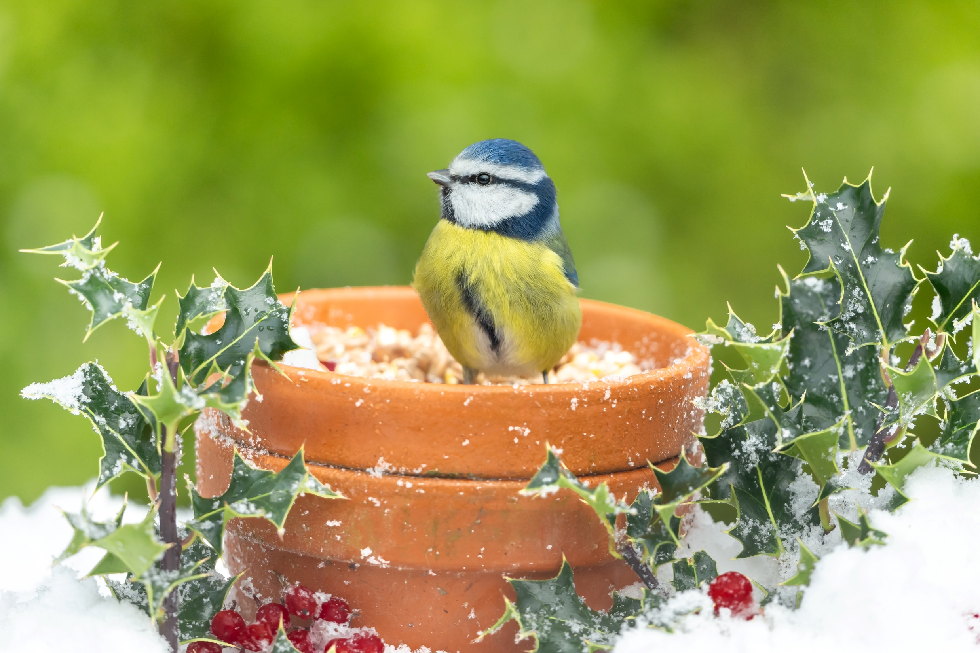
Tell Me What You See

Slide 5
Tell Me What You See

Slide 6
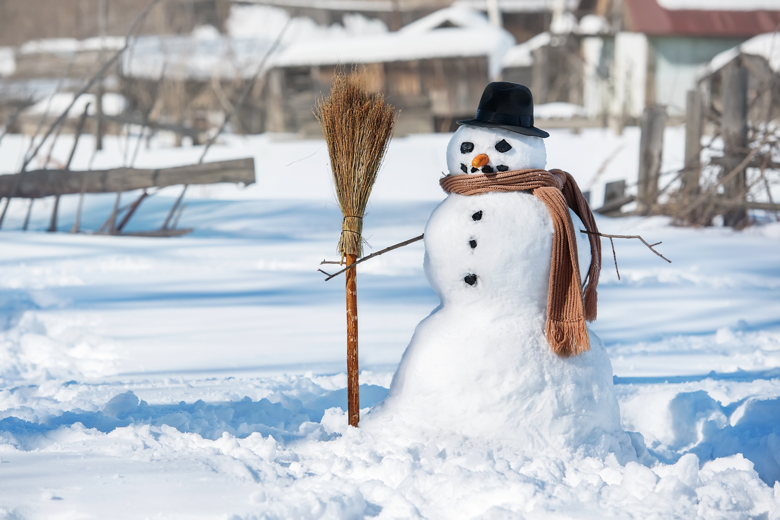
Tell Me What You See

Slide 7
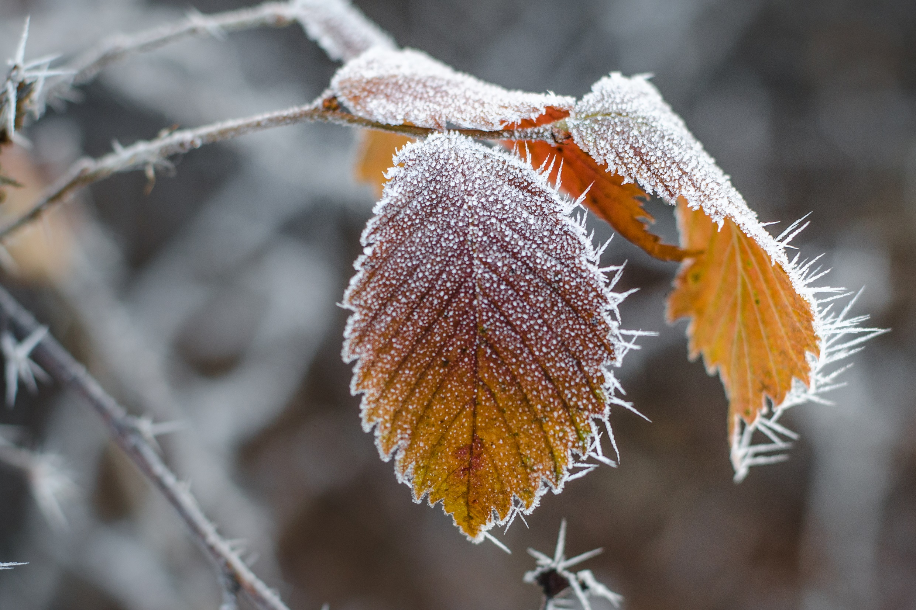
Tell Me What You See

Slide 8
Tell Me What You See

Slide 9
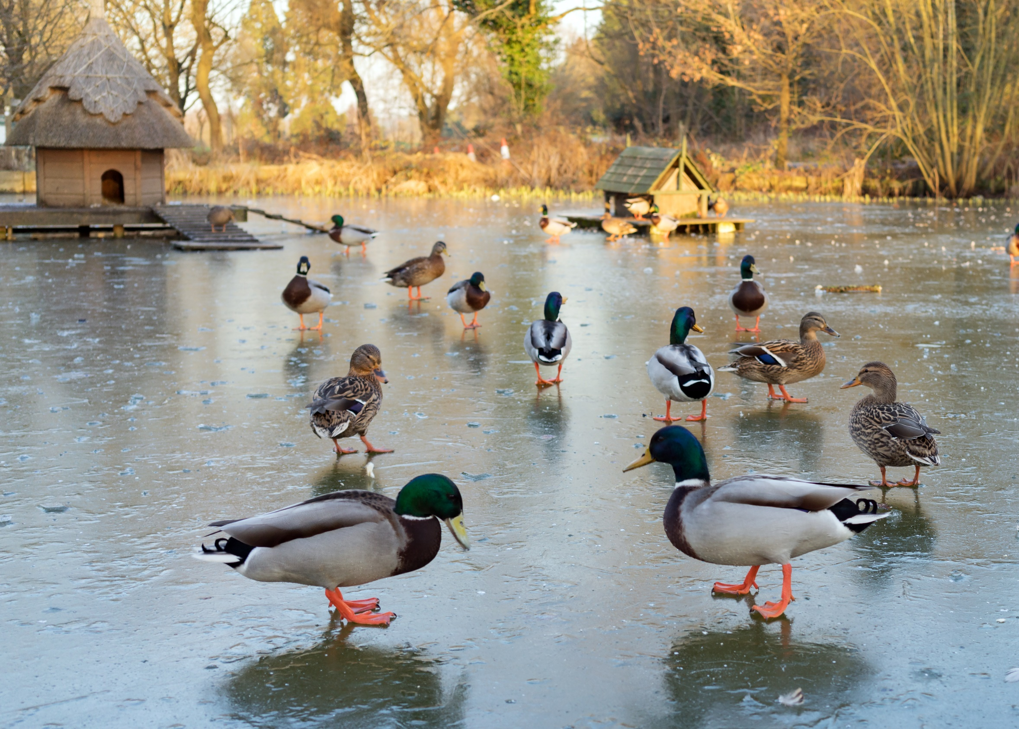
Tell Me What You See

Slide 10
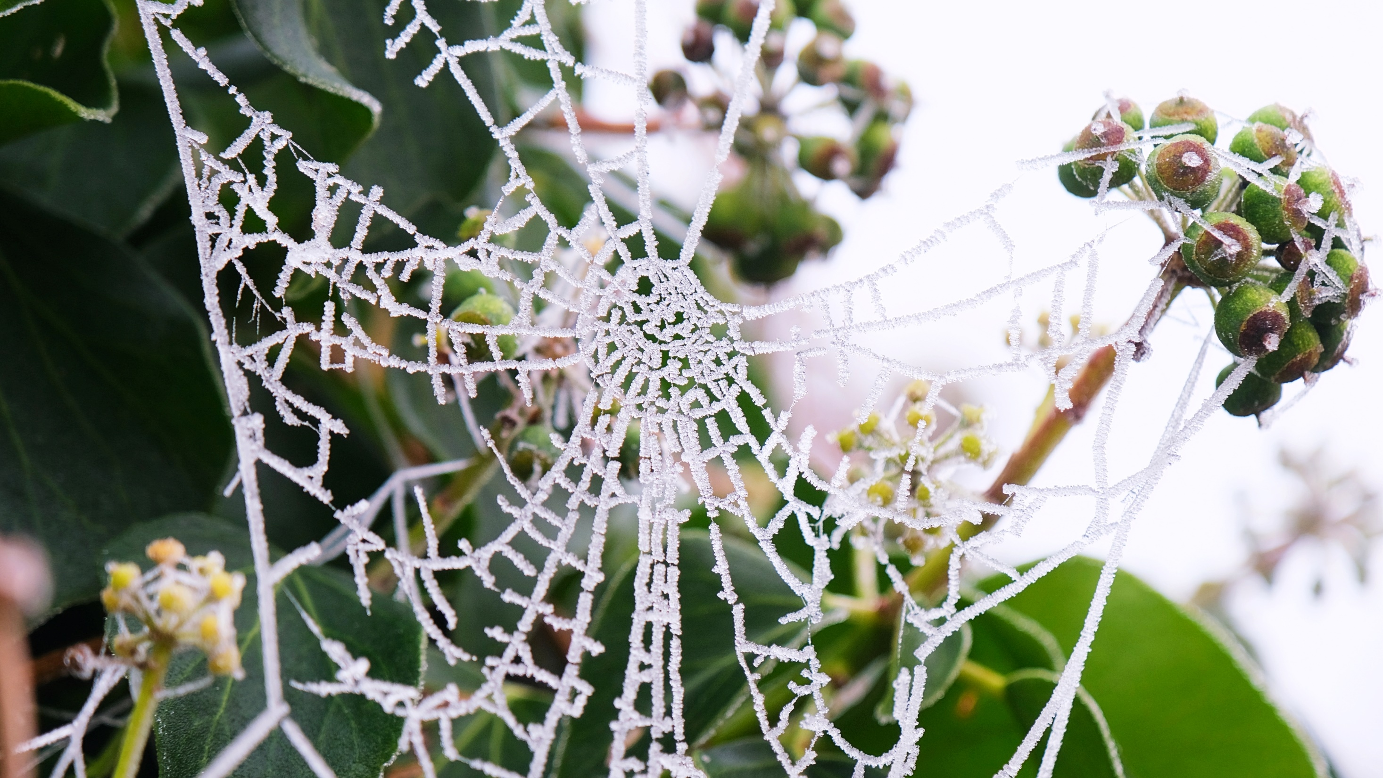
Tell Me What You See

Slide 11
Tell Me What You See

Slide 12
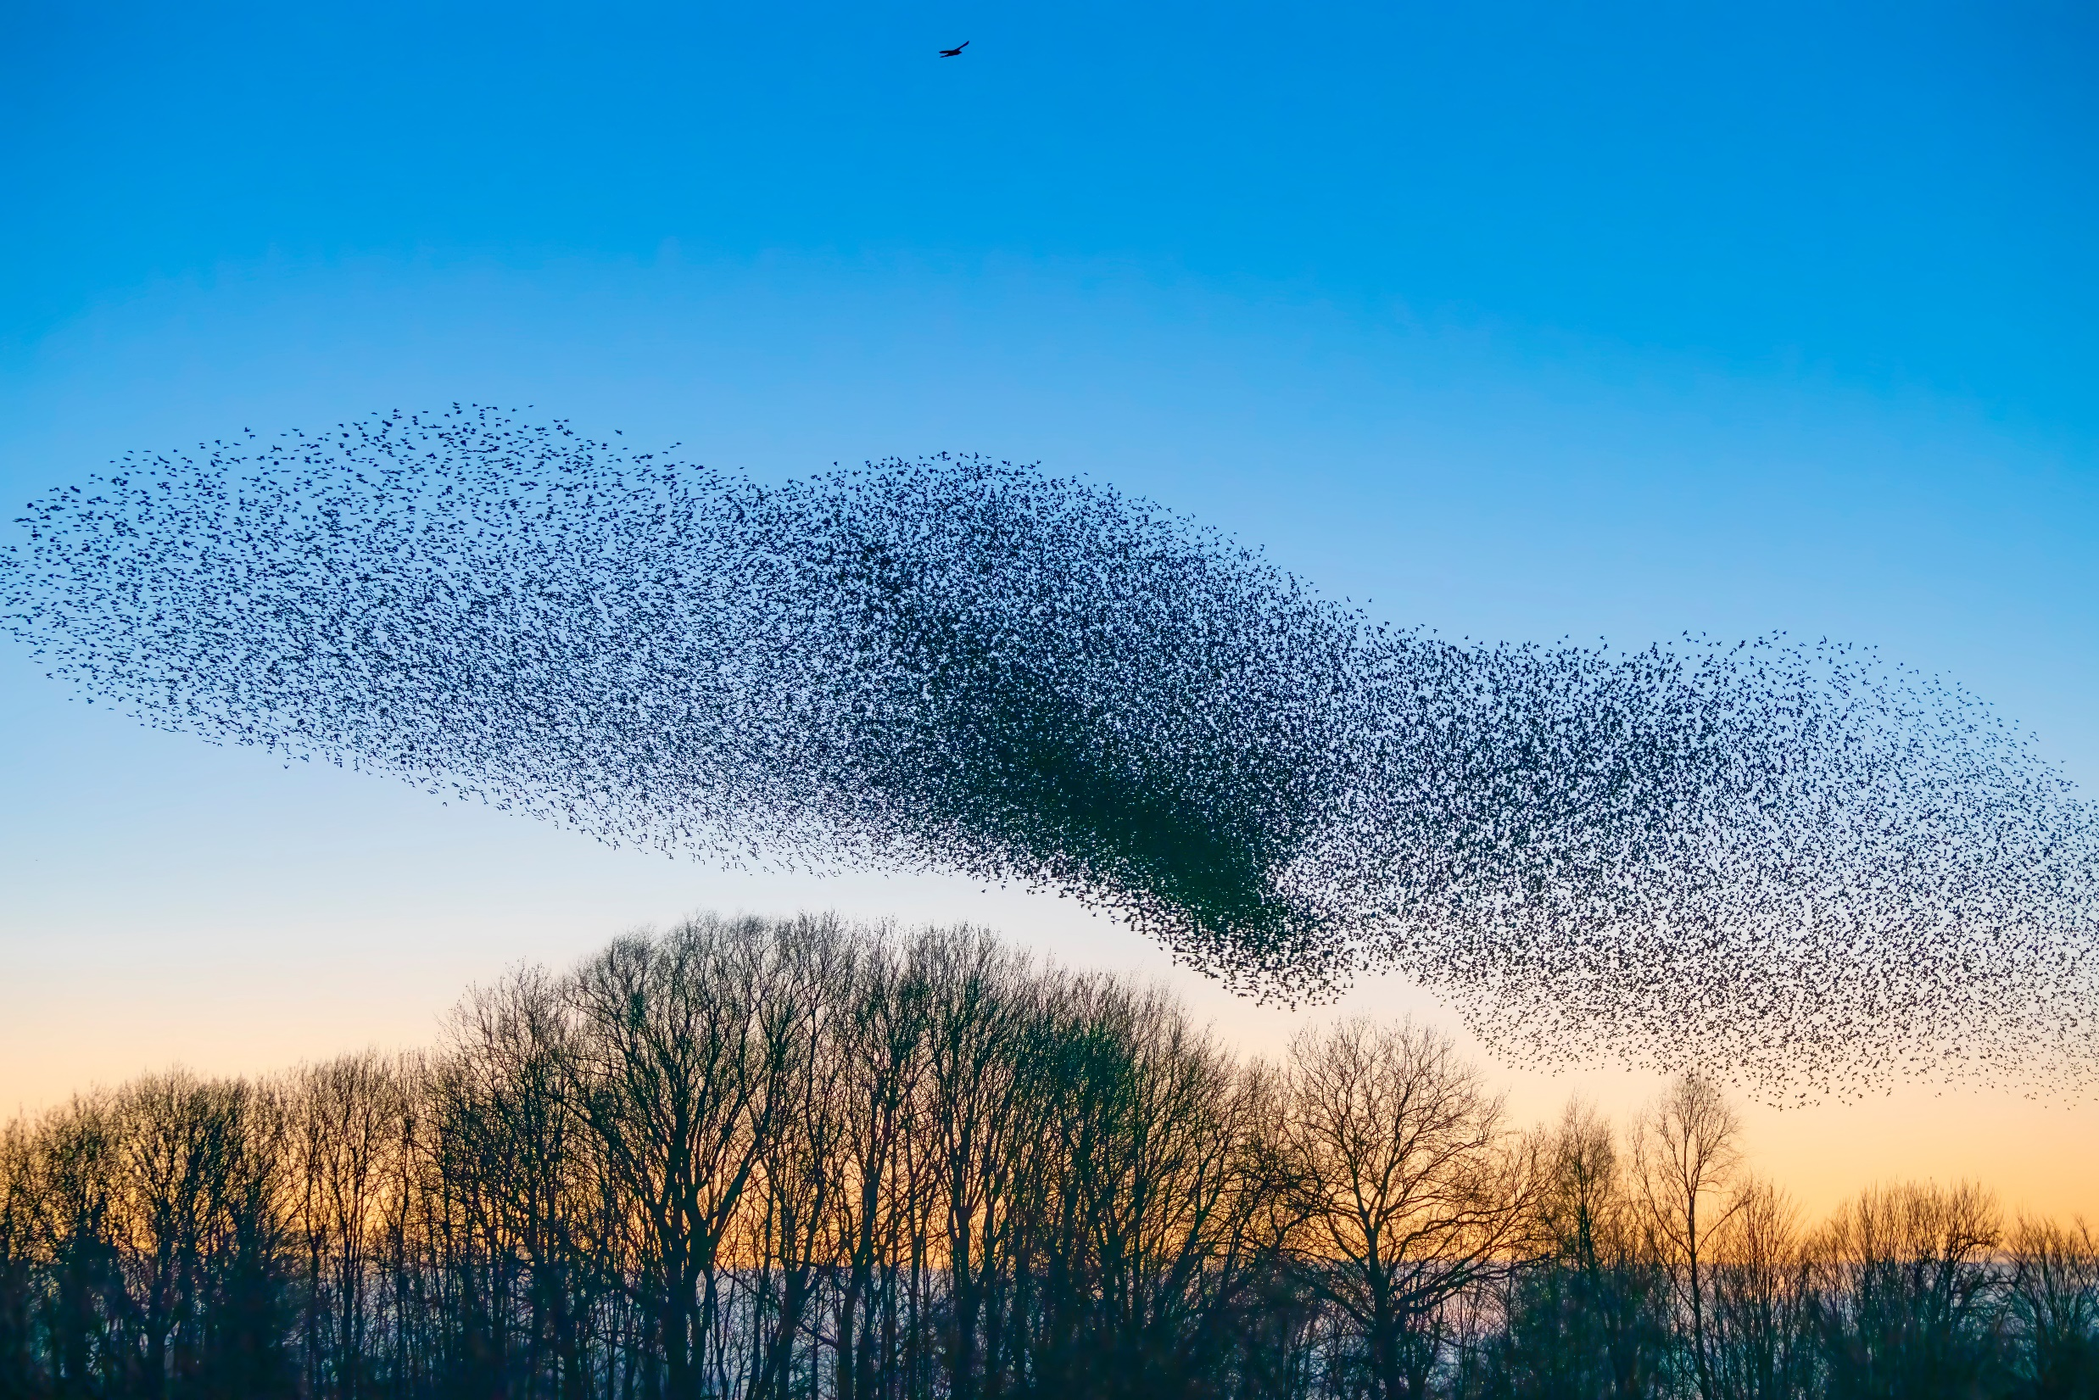
Tell Me What You See

Slide 13
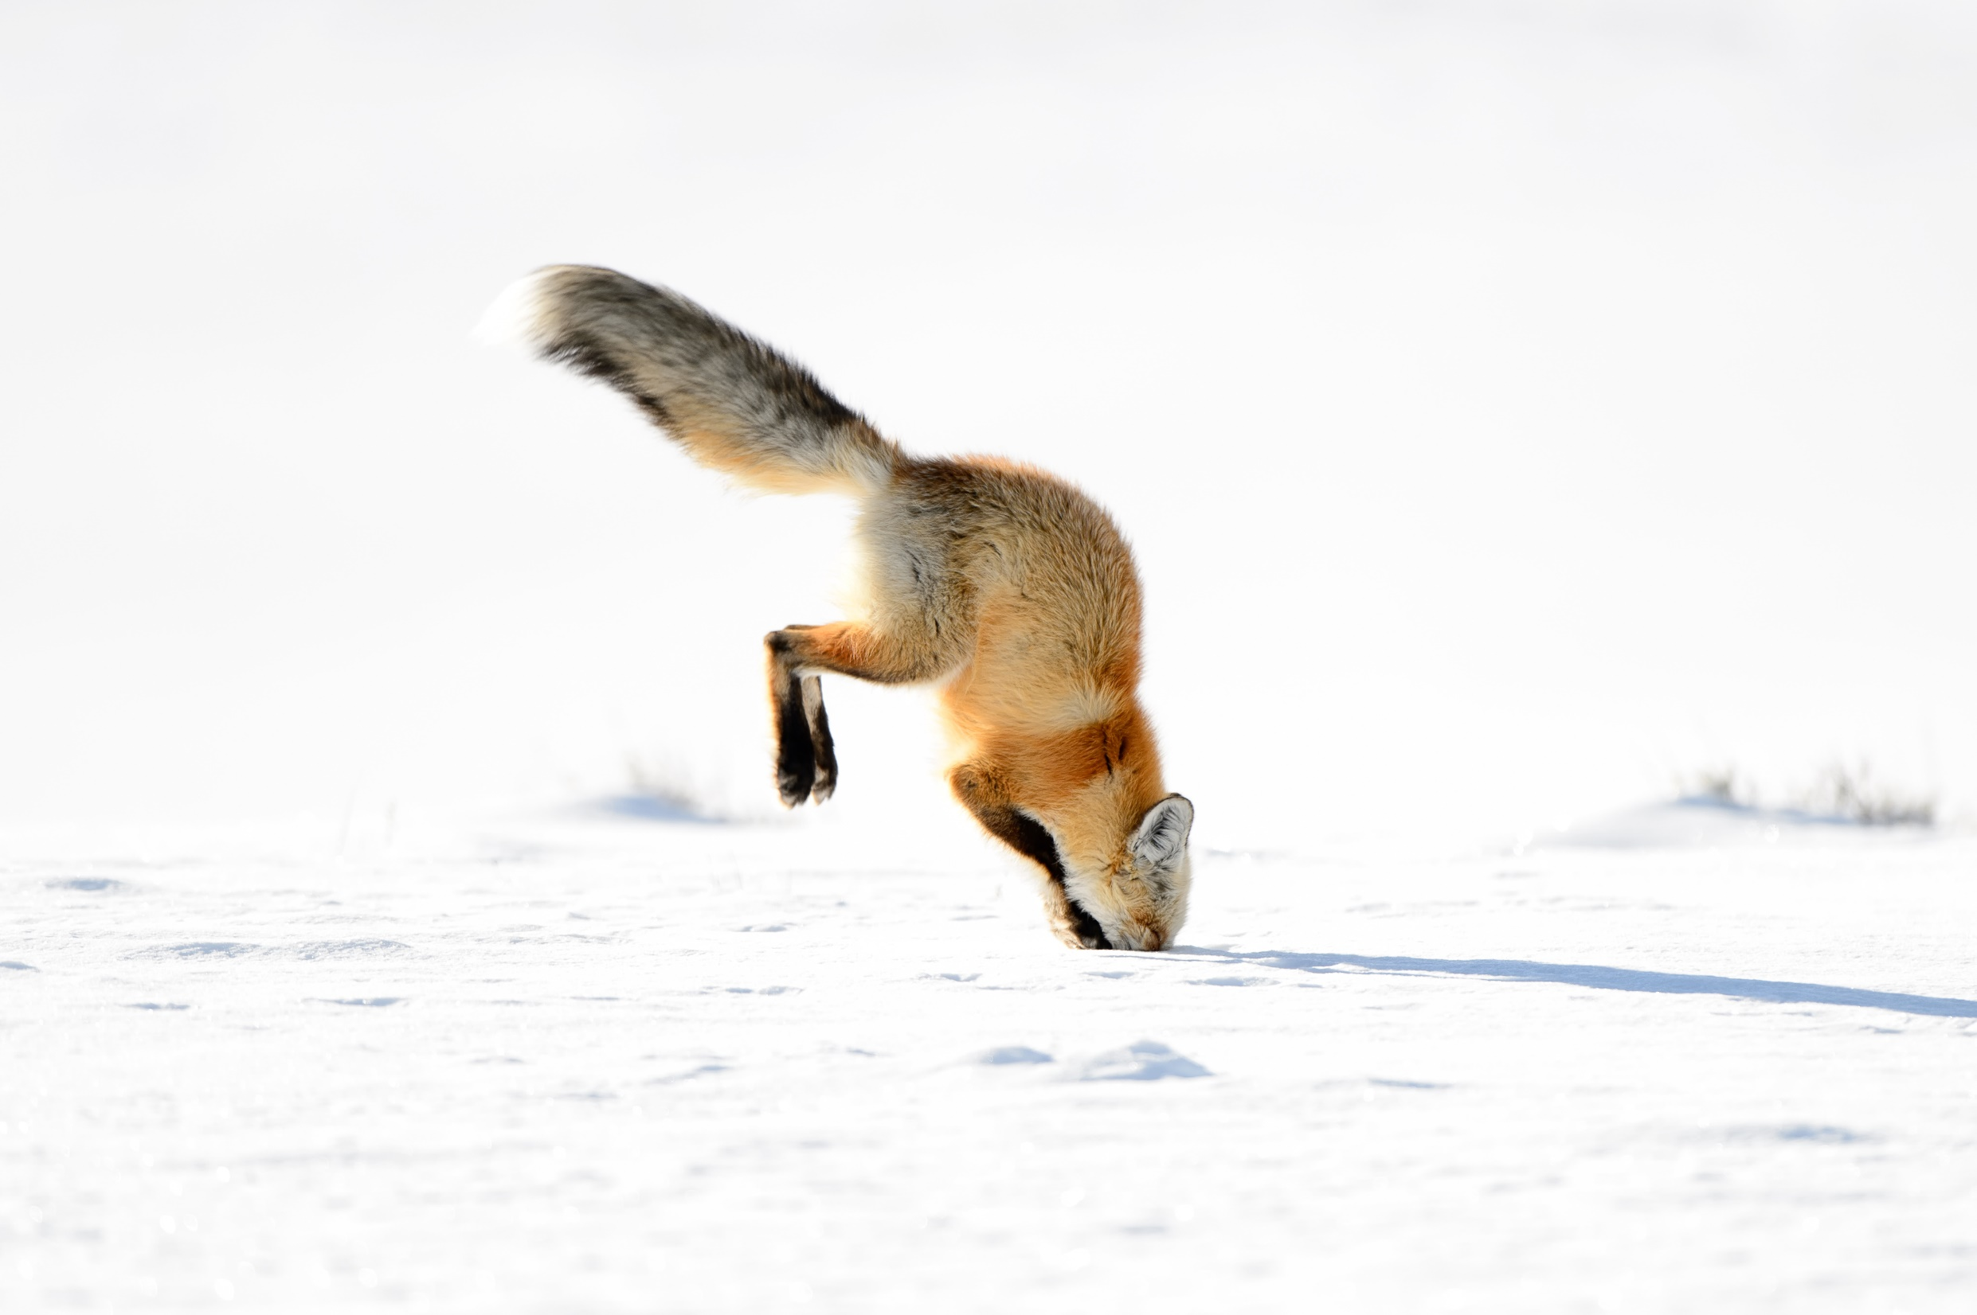
Tell Me What You See

