Slide 1
Keeping Children Safe Outside of School
Graham James Primary Academy

Slide 2
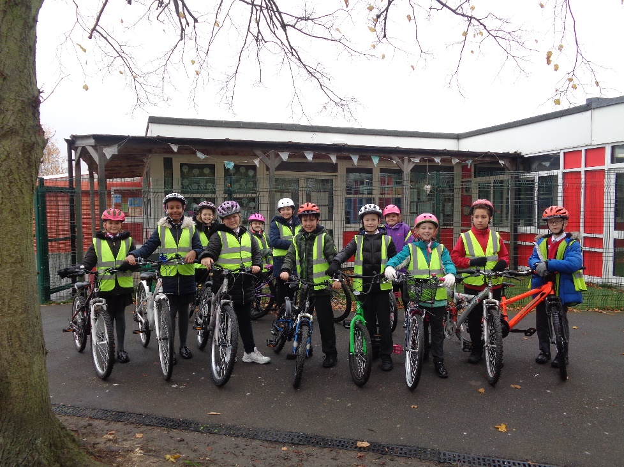
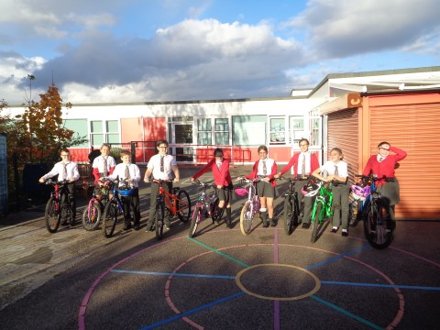
Year 4 Level 1; Year 6 Level 2 Bikeability – Autumn Term

Slide 3
NSPCC Speak Out, Stay Safe – January 2024
9th January 24

Slide 4
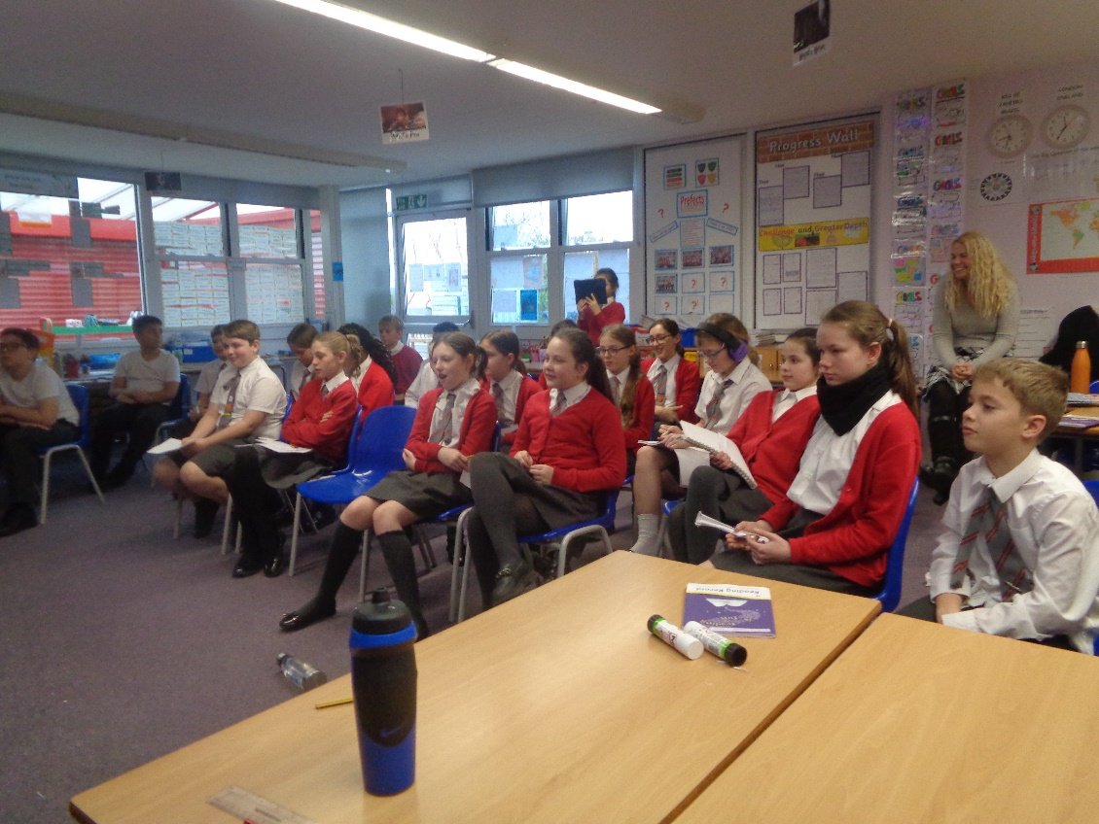
Year 6 – Knife Crime and Cyber Safety – Police and Fire Service - January

Slide 5
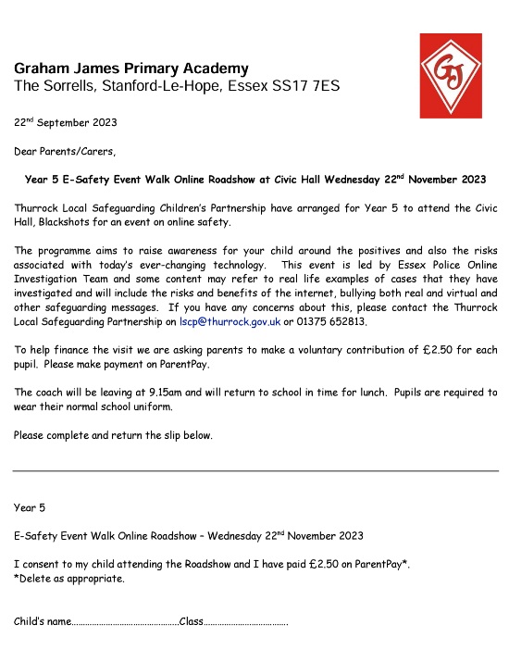
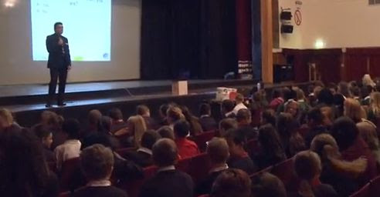
Walk Online Roadshow – Year 5 – November

Slide 6
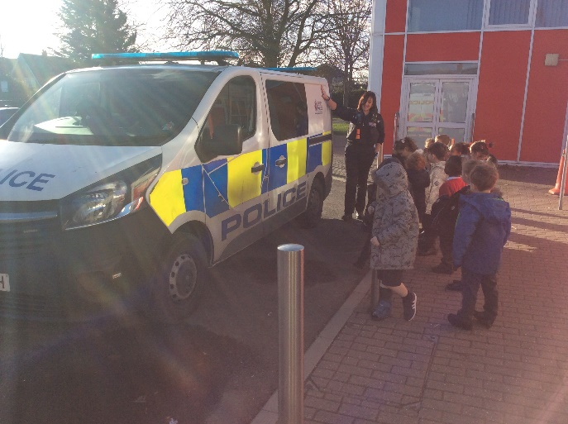
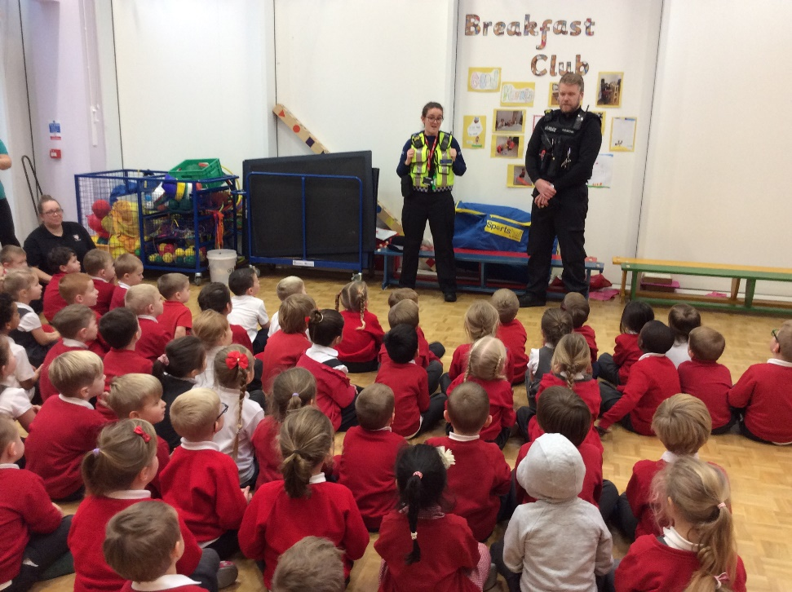
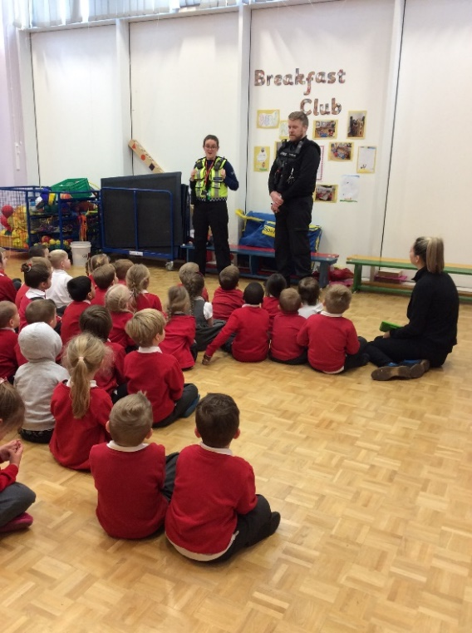
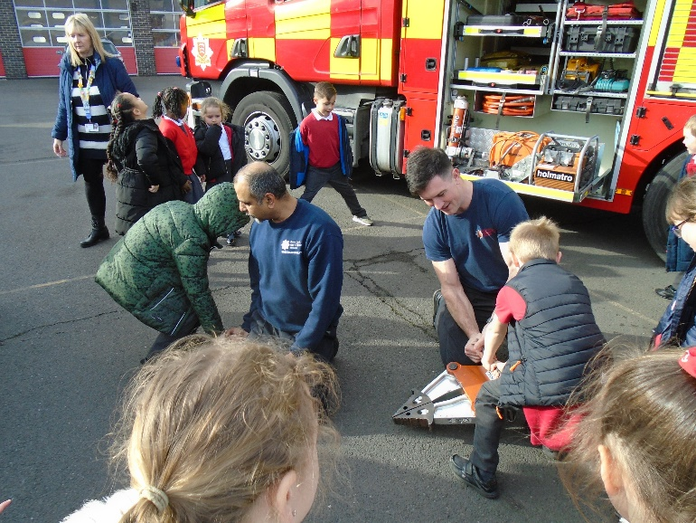
People Who Help Us Police and Fire Service Visit – EYFS Essex Fire Museum Visit– Year 2

Slide 7
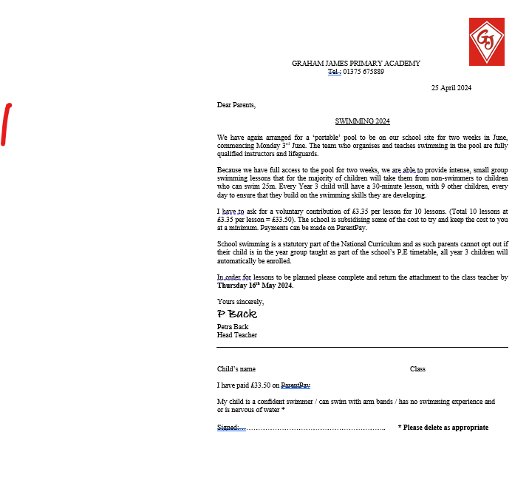
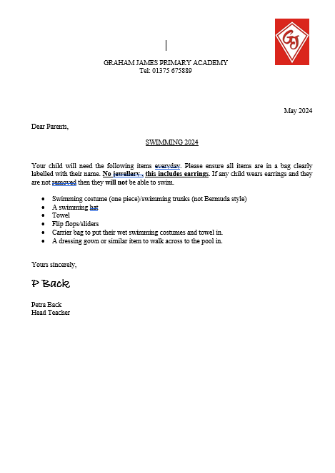
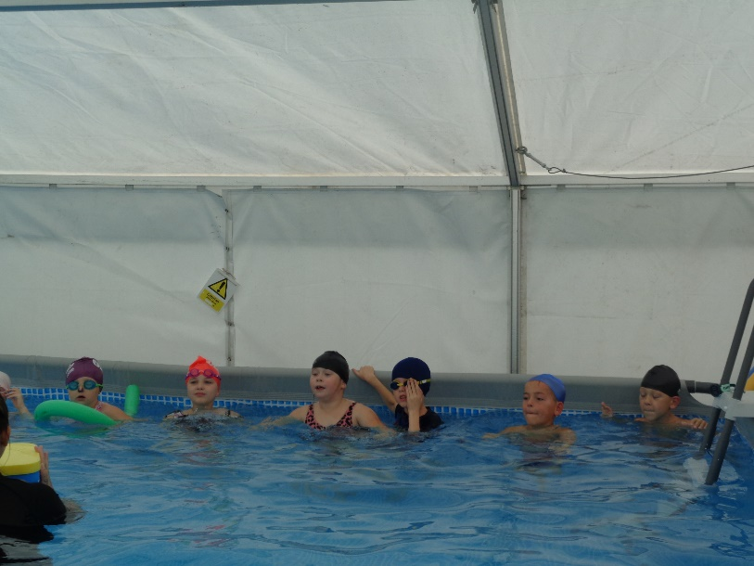
Swimming – Year 3 - ongoing

Slide 8
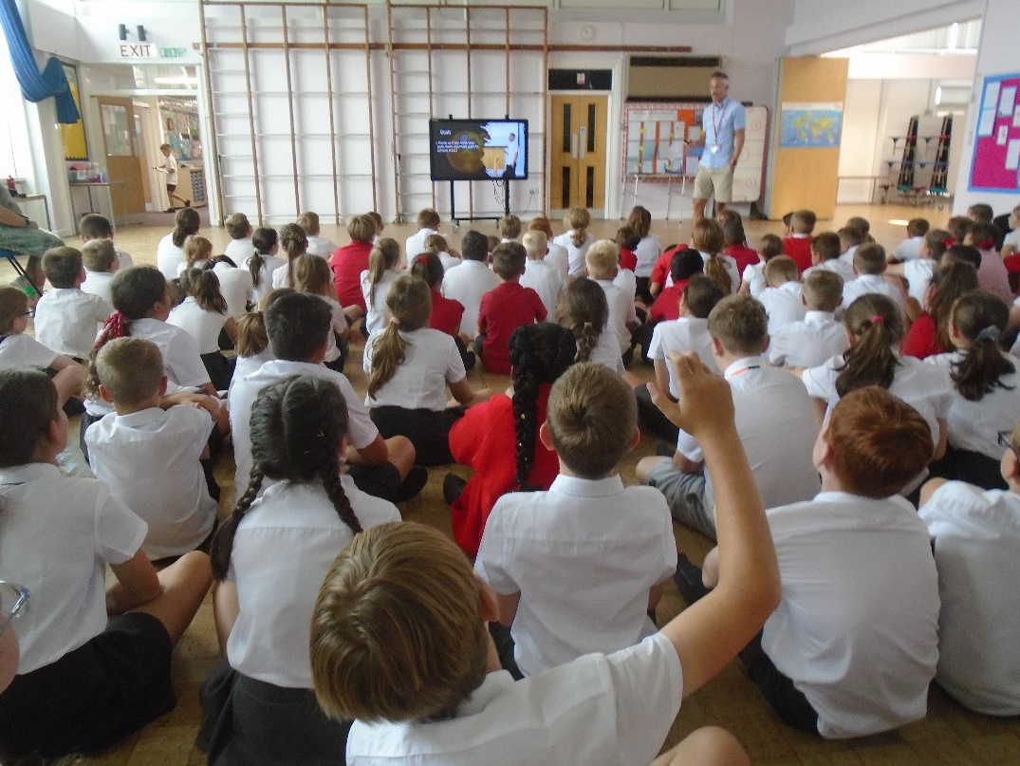
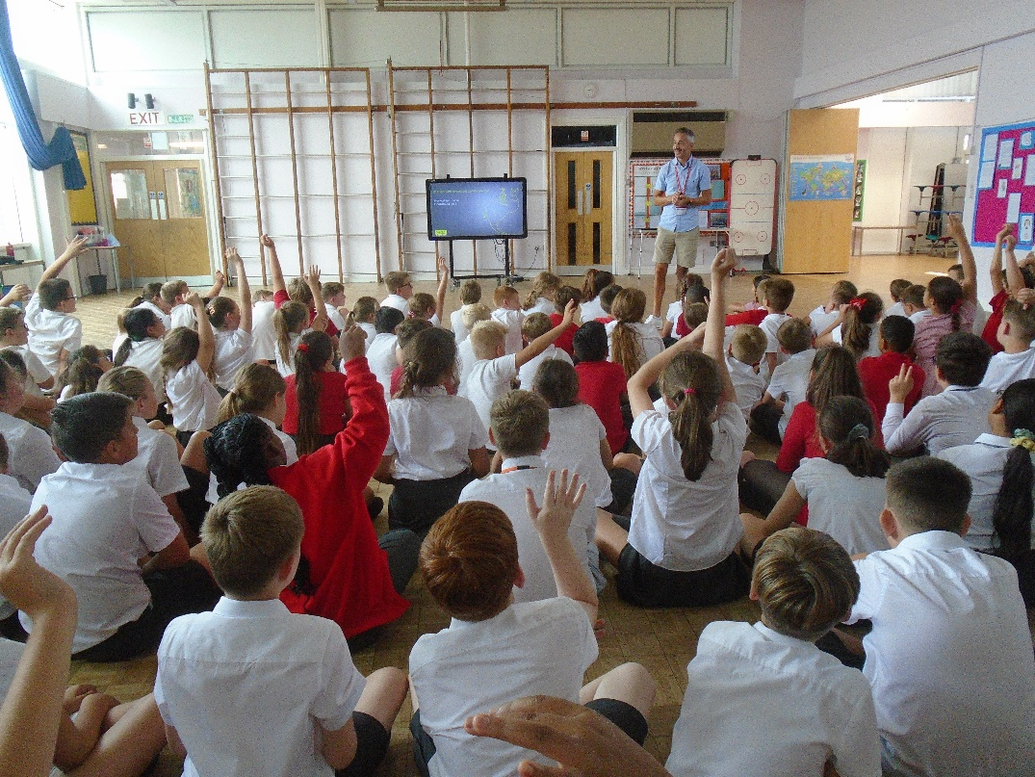
Resilience and Wellbeing for Year 6 - in and out of School

Slide 9
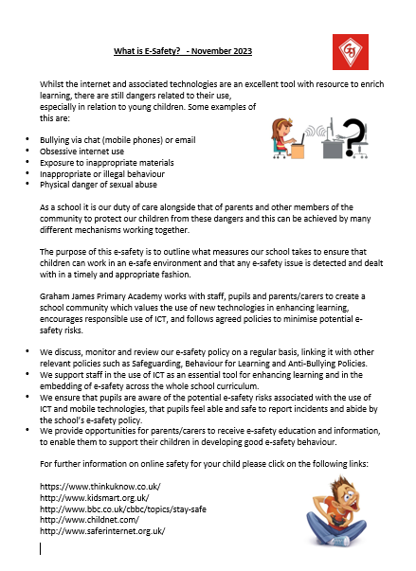
E-Safety Newletters

Slide 10
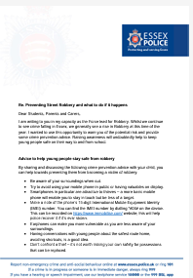
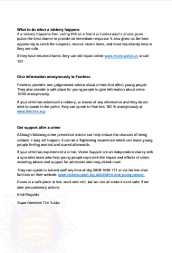
Keeping your children safe Find out what is happening in your local area Click on the links below:
Find out what is happening in your local area, visit Your area | Essex Police
Report non-emergency crime: Report a crime | Essex Police

