Slide 3
How many does each tally represent?
a) b)
Draw tallies to show
a) 7 b) 11
3) Complete the tally chart.
Button Colour | Tally | Total
pink
blue
green

Slide 4
How many does each tally represent?
a) b)
Draw tallies to show
a) 7 b) 11
3) Complete the tally chart.
9
22
Button Colour | Tally | Total
pink
blue
green
3
6
4

Slide 6
Ron and Amir have been tallying the vehicles which drive past their window.
Can you help to complete the tally chart?
Type of vehicle | Tally | Total
car
bus
lorry
motorcycle
10
2
6
4
Have a think

Slide 7
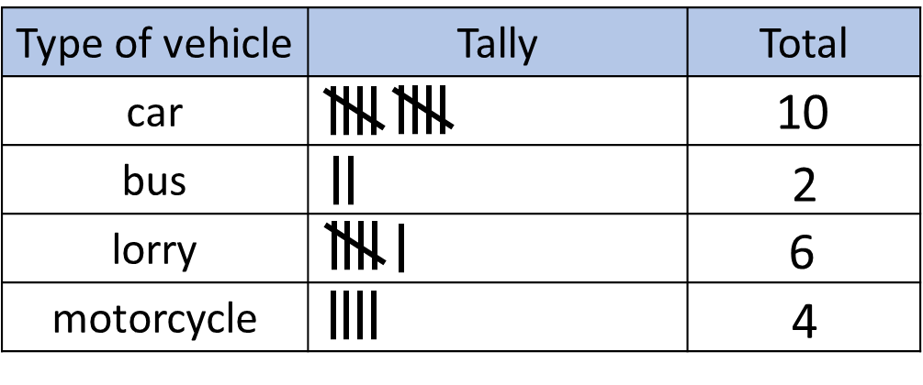
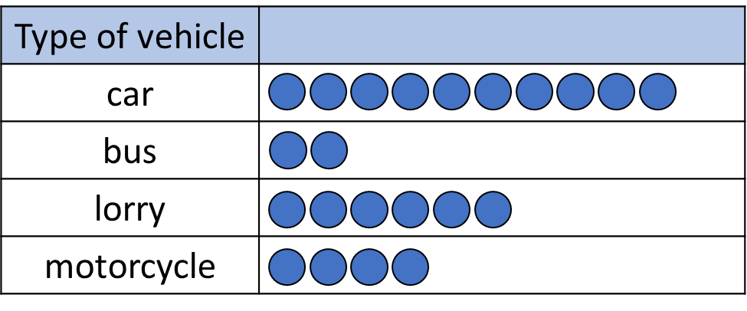
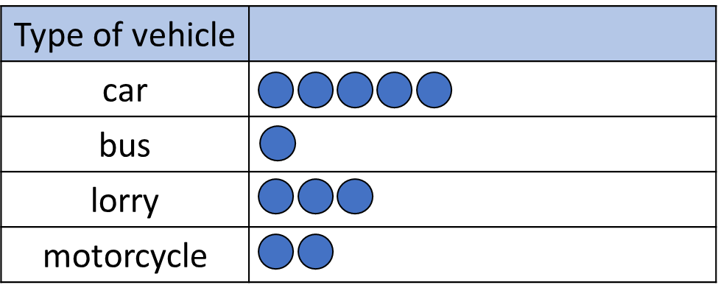
They use their tally to draw pictograms.
Key $=$1 vehicle
Key $=2$ vehicles
Amir hasn’t drawn enough circles.

Slide 8
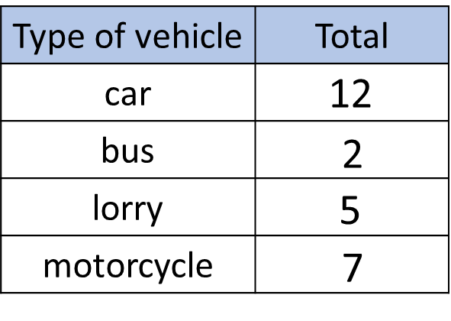
Why don’t you have a go Tiny?
Key $=2$ vehicles
Type of vehicle
car
bus
lorry
motorcycle
Ok I will!
Have a think

Slide 9
Day | Minutes spent reading
Monday | 20
Tuesday | 25
Wednesday | 10
Thursday | 15
Friday | 30
Saturday | 55
Sunday | 45
Key = ________ minutes
or 5
10
Have a think

Slide 10
Key = 10 minutes
Monday
Tuesday
Wednesday
Thursday
Friday
Saturday
Sunday
Can you see how many minutes Alex read in total?
200 minutes or 3 hours and 20 minutes

Slide 11
Have a go at all of the questions on the worksheet

