Slide 2
What Is a Subordinating Conjunction?
A subordinating conjunction is a word which still links two clauses together in a sentence, but the subordinate clause it adds does not make sense on its own.
Let’s look at a few examples:
I will be late if I don’t get on the next bus.
Main Clause
Subordinating Conjunction
Subordinate Clause
‘I will be late’ is the main clause. This clause makes sense on its own.
The subordinating conjunction in this sentence is ‘if’. It starts the subordinate clause.
‘if I don’t get on the next bus’ is the subordinate clause. This doesn’t make sense on its own but does add extra information to the main clause.

Slide 3
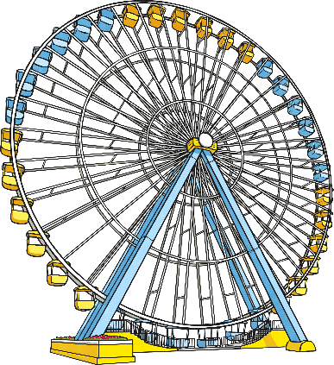
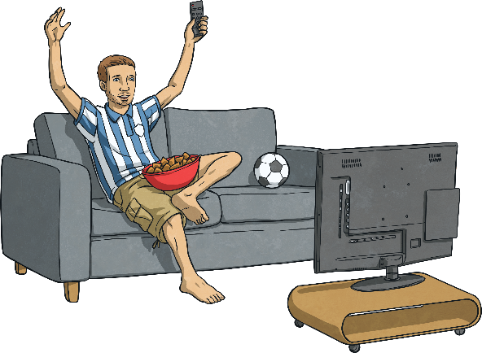
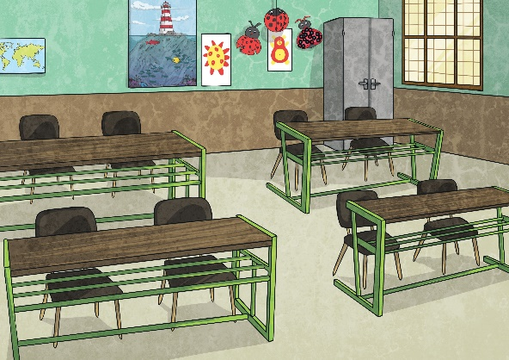
Which Conjunction Makes Sense?
Read the main and subordinate clauses below and decide which subordinating conjunction would make the most sense.
Beth was a little bit scared the ride was spinning quickly.
Hazim cheered loudly his favourite player scored a goal.
I didn’t go to school it was closed for the summer holidays.
If Since As When Although While After Before Until Because!

Slide 4
Which Conjunction Makes Sense?
Did you manage to choose a subordinating conjunction which makes sense in the sentence?
Beth was a little bit scared as the ride was spinning quickly.
In this sentence, the conjunctions ‘because’, ‘when’ and ‘while’ also make sense.
Hazim cheered loudly when his favourite player scored a goal.
In this sentence, the conjunctions ‘because’, ‘as’, ‘while’ and ‘after’ also make sense.
I didn’t go to school while it was closed for the summer holidays.
In this sentence, the conjunctions ‘because’, ‘since’, ‘as’ and ‘when’ also make sense.

Slide 5
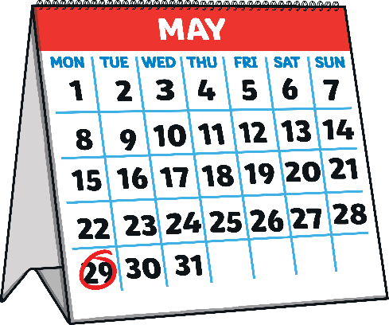
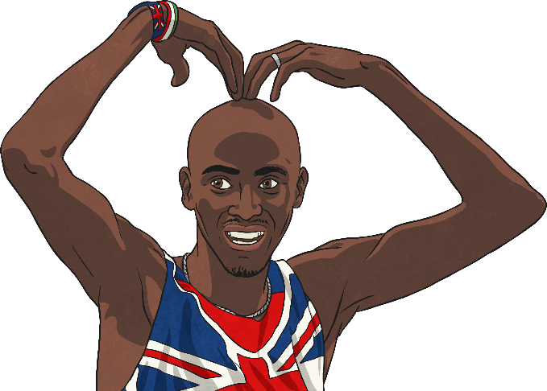
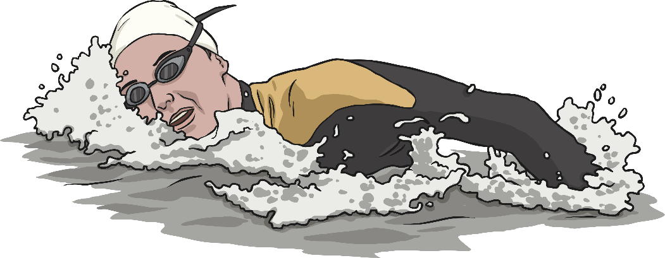
Where Is the Subordinate Clause?
Read the following sentences and write only the subordinate clause on your whiteboard.
Siobhan had not seen her auntie since she met her at the cinema last Friday.
Mo smiled for the cameras as he crossed the finish line.
Keri was tired after completing her marathon swim.
Top tip: A subordinate clause does not make sense on its own.

Slide 6
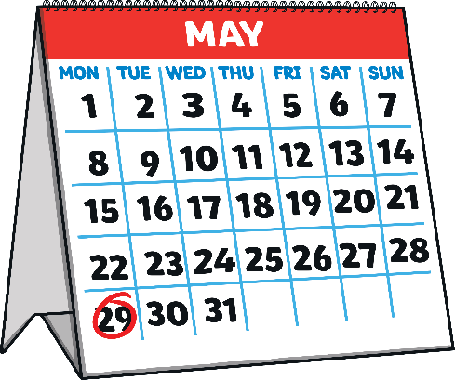
Where Is the Subordinate Clause?
The subordinate clauses in these sentences are underlined. They always start with a subordinating conjunction.
Siobhan had not seen her auntie since she met her at the cinema last Friday.
Mo smiled for the cameras as he crossed the finish line.
Keri was tired after completing her marathon swim.

Slide 7
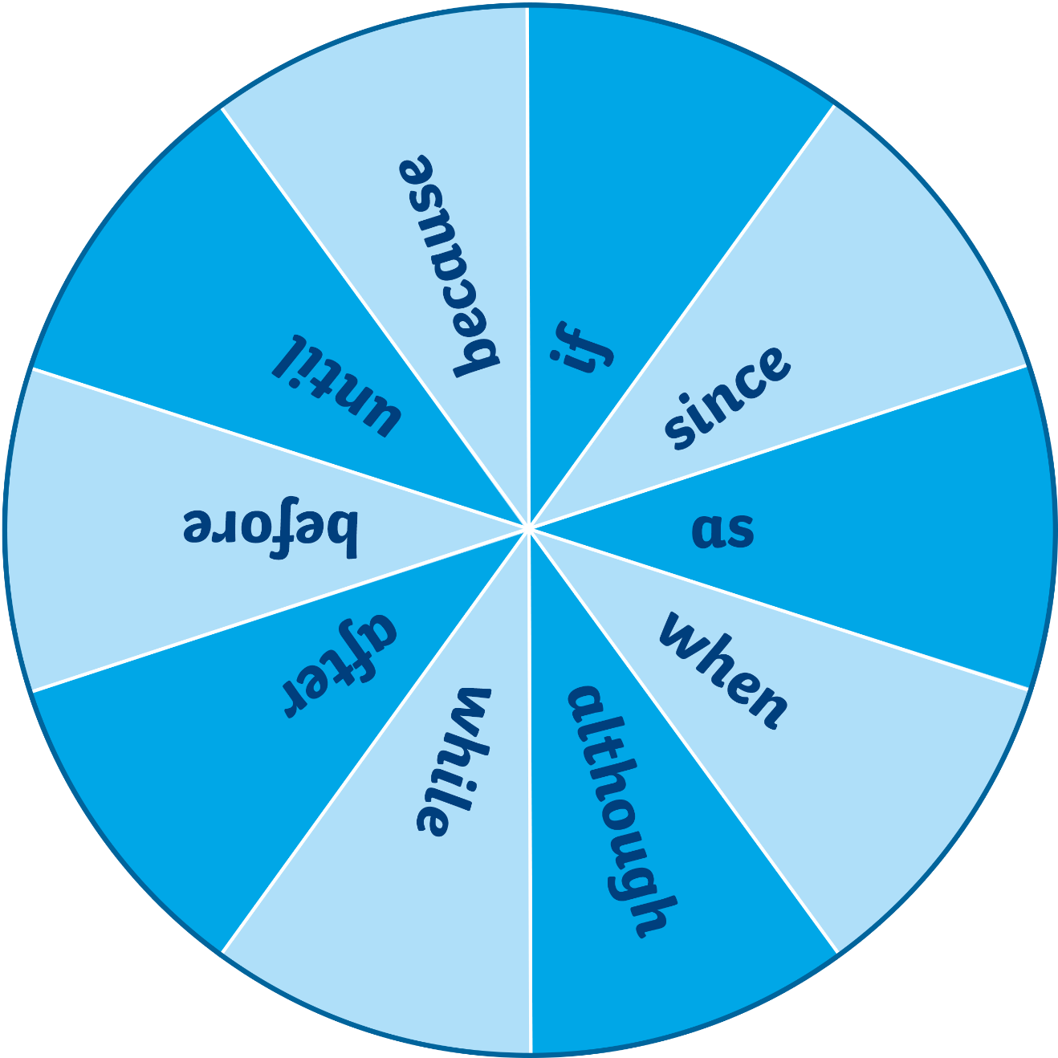
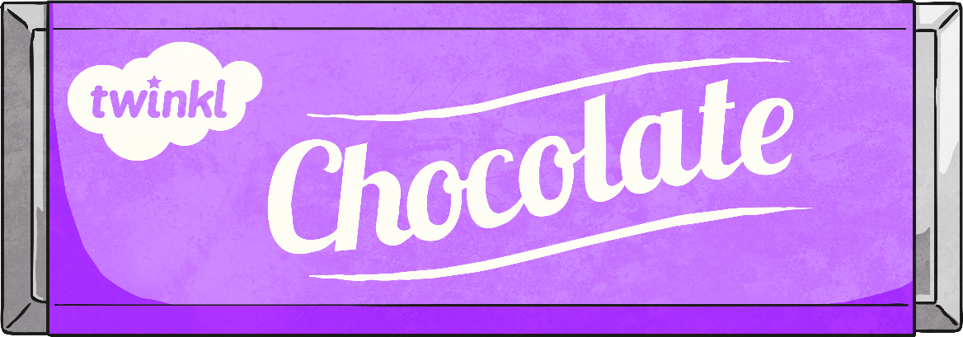
Spin the Wheel!
Spin the wheel to select a subordinating conjunction.
Spin the wheel to choose a subordinating conjunction. On your whiteboards, write your own sentence about chocolate including that conjunction to start a subordinate clause.
Spin

Slide 8
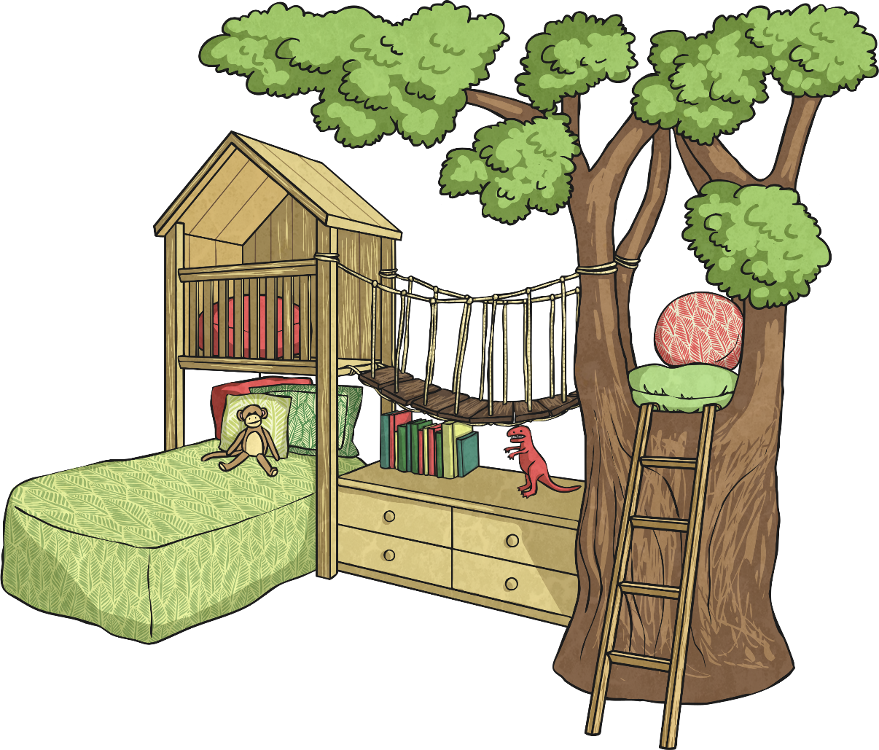
Spin the Wheel!
Spin the wheel to select a subordinating conjunction.
Spin the wheel to choose a subordinating conjunction. On your whiteboards, write your own sentence about the treehouse bed including that conjunction to start a subordinate clause.
Spin

Slide 9
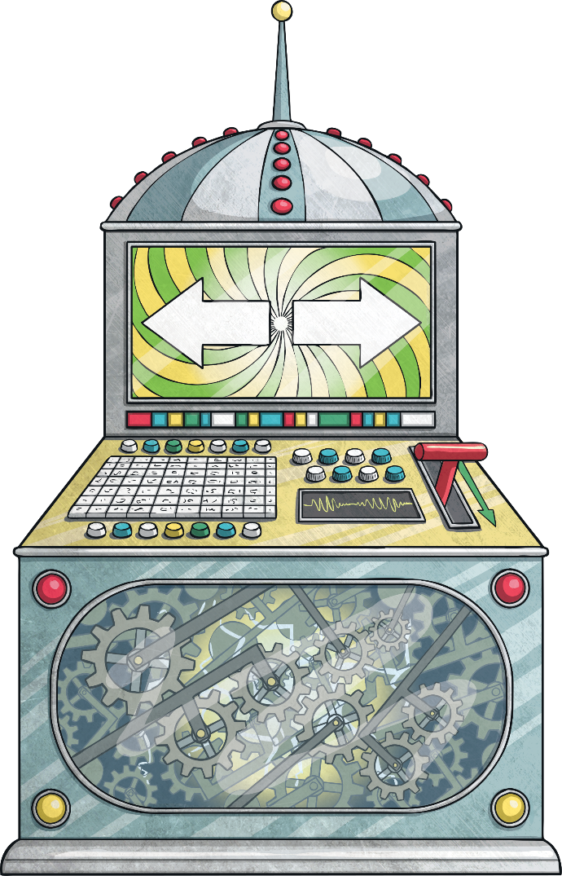
Spin the Wheel!
Spin the wheel to select a subordinating conjunction.
Spin the wheel to choose a subordinating conjunction. On your whiteboards, write your own sentence about the time machine including that conjunction to start a subordinate clause.
Spin

Slide 10
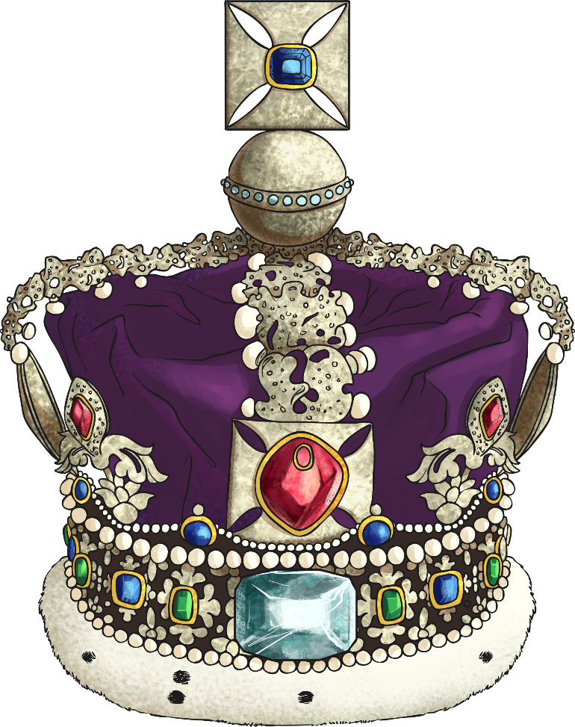
Spin the Wheel!
Spin the wheel to select a subordinating conjunction.
Spin the wheel to choose a subordinating conjunction. On your whiteboards, write your own sentence about the queen’s crown including that conjunction to start a subordinate clause.
Spin

Slide 11
Silly Sentences
Choose a main clause, a subordinating conjunction and a subordinate clause to make the silliest sentences you can that still make sense.
Main Clauses | Subordinating Conjunctions | Subordinate Clauses
Jimmy was crying Laura needed a bag The job was finished School was closed She put the flowers in the vase I love crisps | because until although while before when | they are salty. she dropped her shopping. he lost his sock. the painting was done. she bought them. the end of the day.

Slide 12
Block Busters
Fill in the missing words by choosing an appropriate subordinating conjunction. Use the first letter of each answer to spell out the hidden word.
a
a
i
2
4
6
1
3
5
w
s
b
Li listened to some music he waited.
I ate my dessert I ate my dinner.
It has been a long time I have seen my auntie.
I tried my best on the test it was hard.
Paul must tidy up the mess his Granny sees it.
You would be very tired you had just finished a marathon.

Slide 13
Block Busters
a
a
i
2
4
6
1
3
5
w
s
b
Li listened to some music while he waited.
I ate my dessert after I ate my dinner.
It has been a long time since I have seen my auntie.
I tried my best on the test although it was hard.
Paul must tidy up the mess before his Granny sees it.
You would be very tired if you had just finished a marathon.
What does the hidden word mean? Look it up in a dictionary! Can you write it in a sentence using a subordinating conjunction?

Slide 14
Subordinate Clause Quick Quiz
Take a quiz to see if you are an expert!
In this sentence is it the main clause or the subordinate clause that is underlined?
Vivian was tired as she hadn’t slept.
main
subordinate
You’re correct. How did you know?

Slide 15
Subordinate Clause Quick Quiz
Take a quiz to see if you are an expert!
In this sentence is it the main clause or the subordinate clause that is underlined?
Greg put up an umbrella when it started raining.
main
subordinate
We know it’s a main clause because it makes sense on its own.

Slide 16
Subordinate Clause Quick Quiz
Take a quiz to see if you are an expert!
In this sentence is it the main clause or the subordinate clause that is underlined?
We could not go to the swimming baths because it was closed.
main
subordinate
You’re correct. How did you know?

Slide 17
Subordinate Clause Quick Quiz
Take a quiz to see if you are an expert!
In this sentence is it the main clause or the subordinate clause that is underlined?
Don’t go into the sea until the waves calm down.
main
subordinate
Which word in this sentence is the subordinating conjunction?

Slide 18
Subordinate Clause Quick Quiz
Take a quiz to see if you are an expert!
In this sentence is it the main clause or the subordinate clause that is underlined?
Zhou could not go on holiday although she really wanted to.
main
subordinate
Why is this the main clause?

Slide 19
Subordinate Clause Quick Quiz
Take a quiz to see if you are an expert!
In this sentence is it the main clause or the subordinate clause that is underlined?
I can spot subordinate clauses as I am a SPaG genius!
main
subordinate
You must be a genius because that’s right!

