Slide 2
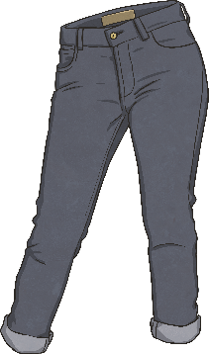
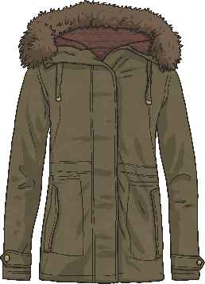
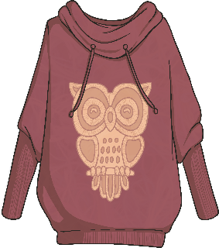
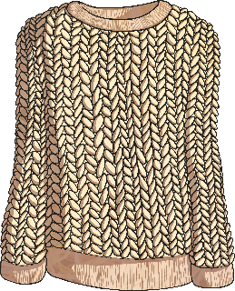
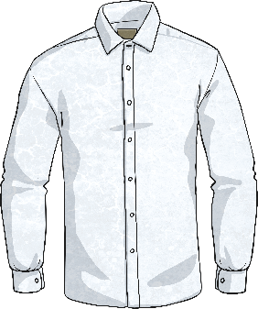
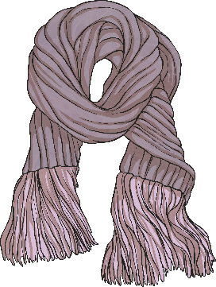
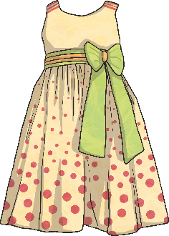
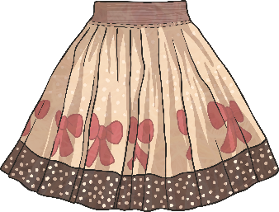
Les vêtements Clothes
Click play buttons throughout to hear phrases and words.
Qu’est ce-que c’est ?
un pantalon
un manteau
un pull
un cardigan
une robe
une jupe
une chemise
une écharpe

Slide 3
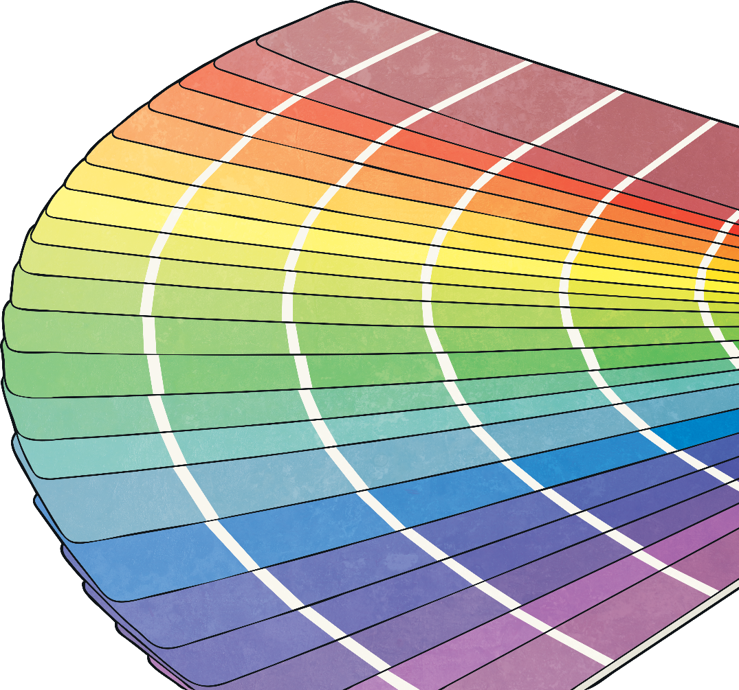
Les vêtements Clothes
Quelle couleur ?
rose
violet
bleu
vert
jaune
orange
rouge
marron
blanc
gris
noir

Slide 4
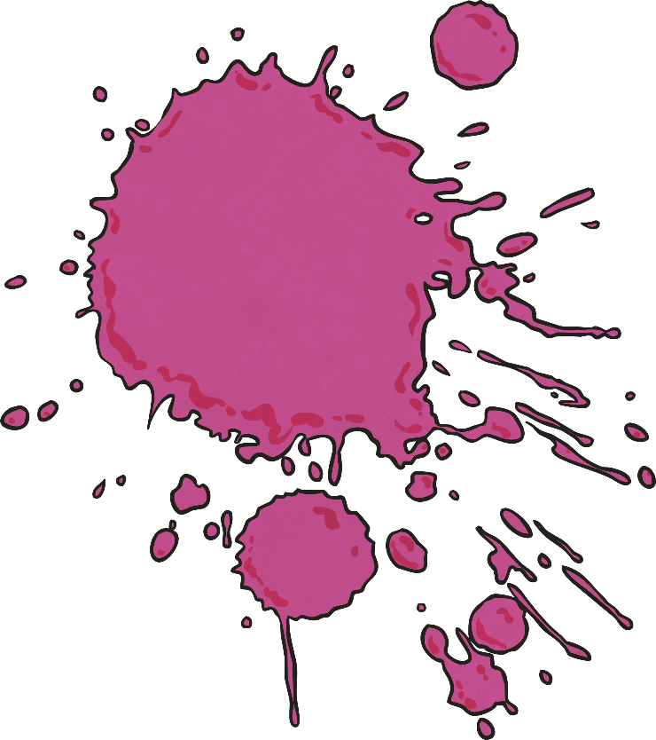
Feminine Form of Some Colours
Colours are adjectives. When they describe a noun, they agree with its gender (whether it is masculine or feminine).
Colour
blanc
violet
noir
gris
bleu
vert
Feminine Form
blanche
violette
noire
grise
bleue
verte
These colours stay the same
orange
rouge
rose
marron
jaune

Slide 5
Feminine Form of Some Colours
Colours are adjectives. When they describe a noun, they agree with its gender (whether it is masculine or feminine).
Colour
blanc
violet
noir
gris
bleu
vert
Feminine Form
blanche
violette
noire
grise
bleue
verte
These colours stay the same
Listen to how the adjectives for colours change in pronunciation.
orange
rouge
rose
marron
jaune
Did you notice which colours sound the same in masculine and feminine?

Slide 6
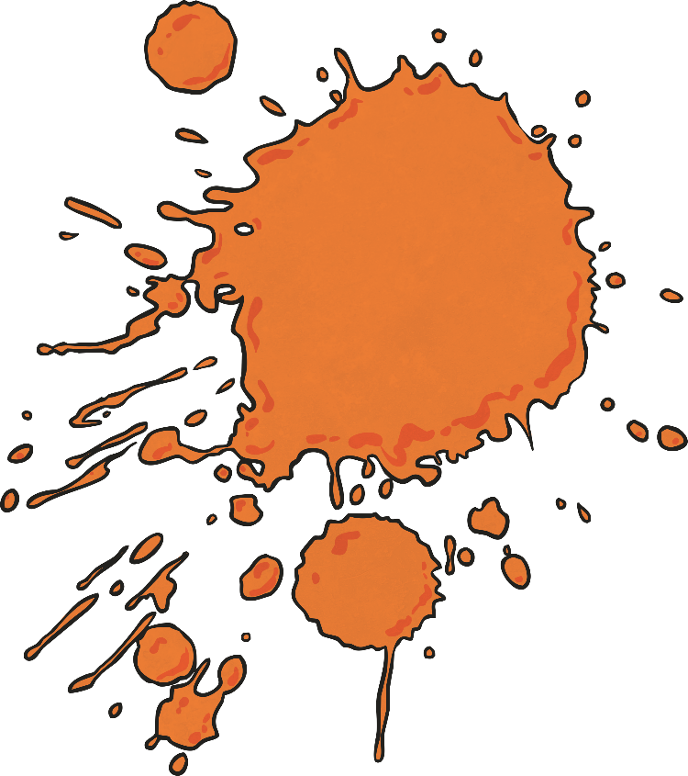
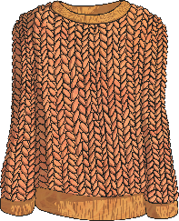
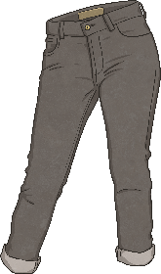
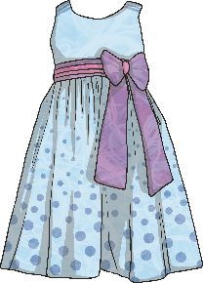
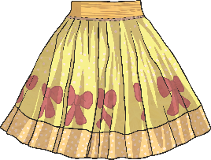
Feminine Form of Some Colours
These colours stay the same
These colours change when describing a feminine noun
orange
rouge
rose
marron
jaune
orange
rouge
rose
marron
jaune
blanche
violette
noire
grise
bleue
verte
blanc
violet
noir
gris
bleu
vert
une jupe jaune
un cardigan orange
un pantalon gris
une robe bleue

