Slide 2
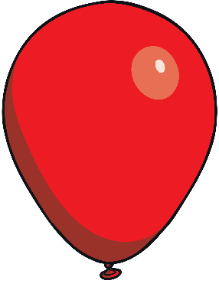
jab
jig
j
jug
jet
jar
job
jam
jog
jazz
Next

Slide 3
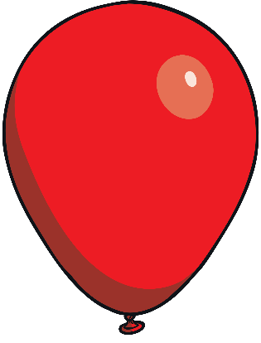
v
van
visit
giving
vet
Next

Slide 4
w
win
wet
wing
weep
week
web
wig
wax
Next

Slide 5
x
exit
mix
box
wax
six
fix
Next

Slide 6
y
yap
yum
yam
yes
yell
Next

Slide 7
z
zap
zoom
zit
zig-zag
zip
Next

Slide 8
zz
fuzz
buzz
jazz
fizz
Next

Slide 9
qu
quack
quick
quit
quiz
liquid
quill
Next

Slide 10
chair
chin
ch
chop
chat
chip
march
chick
chum
cheek
chart
porch
Next

Slide 11
sheep
shed
sh
shop
shark
ship
hush
cash
shell
shock
fish
wish
short
Next

Slide 12
path
th
moth
thin
thick
bath
teeth
thorn
Next

Slide 13
king
gong
ng
sing
hang
wing
ding
ping
long
song
thing
dong
ring
Next

Slide 14
ai
wait
tail
rain
aim
pain
sail
nail
bait
Next

Slide 15
feel
queen
ee
see
week
cheek
seed
teeth
free
reef
sheep
feet
weep
Next

Slide 16
might
igh
moonlight
tight
light
night
sight
midnight
thigh
high
fighters
right
Next

Slide 17
boat
road
oa
goal
toad
goat
loaf
soap
oak
coat
Next

Slide 18
doom
hoof
roof
long oo
pool
zoom
moon
goo
food
loop
tool
boot
booth
zoo
Next

Slide 19
hook
took
look
short oo
cook
book
foot
hood
wood
shook
wool
soot
woof
Next

Slide 20
art
dark
farm
ar
car
tart
march
card
shark
sharp
jar
bark
hard
park
Next

Slide 21
short
born
or
horn
worn
thorn
morning
corn
torn
north
cord
torch
fork
porch
Next

Slide 22
fur
ur
hurt
turn
curl
surf
turnip
church
burn
burger
Next

Slide 23
flower
ow
how
gown
powder
cow
town
owl
down
Next

Slide 24
soil
oi
toil
boil
toilet
coil
coin
foil
join
oil
Next

Slide 25
tear
ear
beard
year
ear
fear
hear
near
gear
Next

Slide 26
air
chair
pair
fair
air
hair
Next

Slide 27
manure
ure
picture
pure
mixture
vulture
cure
Next

Slide 28
farmer
river
er
person
rocker
kerb
finger
ladder
dinner
boxer
fern
summer
mixer
Next

