Slide 1
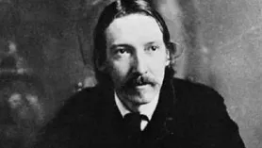
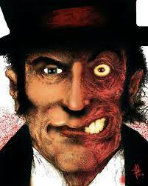
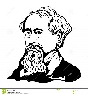
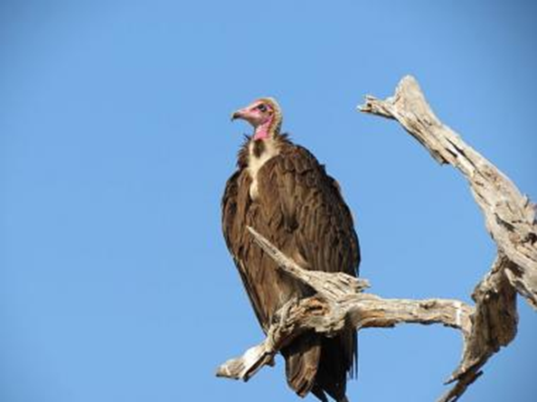
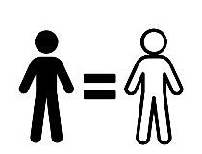
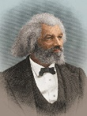
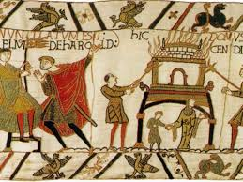
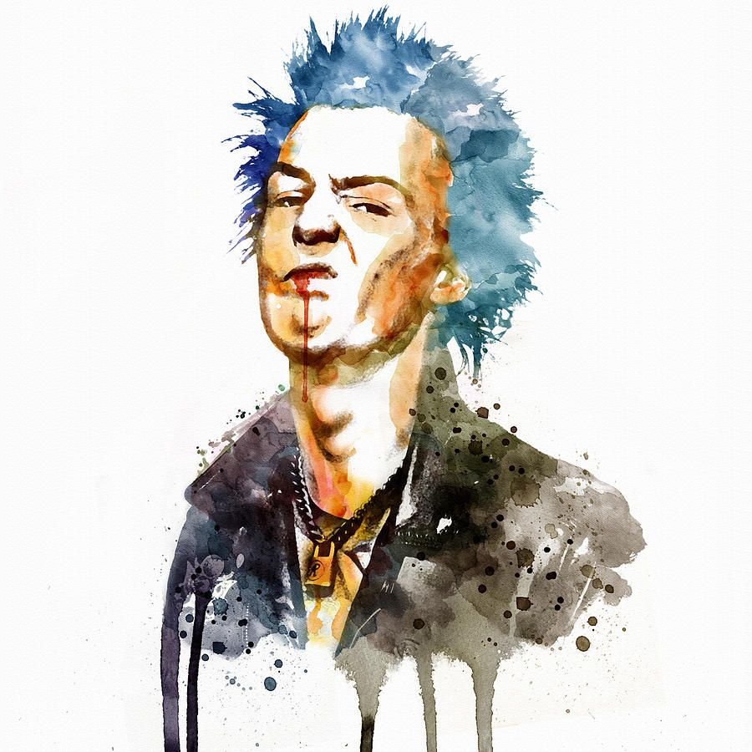
Shipston High: English Curriculum
This curriculum map is relevant to curriculum from Sept. 2023 – some areas subject to change.
Unseen Poetry, Power and Conflict Poetry and Telling Tales (Lit Paper 2):
Unseen analysis format introduced. Analysis of AQA poetry and prose anthologies, including context, language and structure.
Year 11 Mock Exams: English Language Paper 1
English Literature Paper 2
Spring Term Exams:
Literature Paper 1
English Language Paper 2.
English Literature Paper 1: Romeo and Juliet and Christmas Carol Revision
GCSE Examination season:
English Language and
English Literature.
Year 11
English Language Paper 1 Reading: Retrieval, Language, Structure, Implication
English Language Paper 2: Revision
English Literature Paper 2: Telling Tales Short Stories and Power and Conflict Prose
Students recap/catch-up on prose and poetry anthologies
Telling Tales: AQA Short Story Anthology. A comparison of how character and themes are presented
English Language Paper 2 Section A Reading Skills: Retrieval, Summary, Language and Inference comparison
English Literature Paper 1: A Christmas Carol:
Focus on reading the novel and understanding, characterisation, themes, motifs etc.
English Literature Paper 1: A Christmas Carol: Students learn who Charles Dickens was and which contextual factors contributed to his writing. Call upon knowledge of Victorian London to assist
Year 10 Exams.
Literature Paper 1
English Language Paper 2.
English Language Paper 2, Section B Writing Skills:
Students recap and revise the five non-fiction writing styles: essay, article, leaflet, letter and speech.
English Literature Paper 1 Romeo and Juliet: Focus on reading the play and understanding characterisation, themes and motifs.
Year 10
Rhetoric and the Spoken Word:
A study of speeches and prepare a presentation completed by all students.
GCSE Language Skills: A revision of KS3 fiction reading and writing and application to GCSE Paper 1
World and Lives Poetry: A study of selection of poetry from AQA World and Lives Anthology
The Tempest:
Students to particularly focus on how relationships and patriarchy are developed in the play, The Tempest
GCSE Language Skills: A revision of KS3 non-fiction reading and writing and application to GCSE Paper 2
Year 9 Exams: End of KS3 Assessment
The Tempest:
Students develop their knowledge of Shakespeare and context from Year 7 and 8.
Gothic Reading and Writing:
Functions and features of an exposition (language and structure). You will create their own gothic expositions.
Dr. Jekyll and Mr. Hyde:
Focus on reading the novel and understanding characterisation, themes, motifs etc.
Dr Jekyll and Mr. Hyde:
Students use their knowledge of the gothic genre and which contextual factors contributed to the creation of the novel.
Gothic Reading:
What are the conventions of a Gothic text? Focusing on gothic language techniques
Gothic Writing:
What is the Gothic genre?
Who are the writing influencers?
Dr Jekyll and Mr Hyde:
Students complete a GCSE style question using an extract and a copy of the novella.
Travel Writing:
This look at non-fiction will build upon the skills learned in “Walking the Road To Freedom”
Myths and Legends: We will be looking at how these myths inspired modern literature and how writers have modernised these stories to portray the heroes and monsters.
Year 9
Travel Writing: We will use various non-fiction source to examine how various groups of people have been affected by different types of migration throughout history, the effects of this and how it has been represented and reported.
:
Myths and Legends
We will explore the changing stories and characters of mythology through the reading and analysis of a variety of extracts from Greek, Norse, and Anglo-Saxon myths.
.
Culture and Identity in Poetry:
How does poetry present the world to us?
Culture and Identity in Poetry: We will be studying various poems to analyse how structure and language affect meaning. The poems selected have significant cultural and political inferences.
Disease and Disorder: You will study how illness is presented in different texts and how these differ in their interpretation, style, voice, theme and cultural reaction to the illnesses presented.
We will then aim to use the stimulus presented through the authors work to create our own distinct response and reaction to physical and psychological illness.
My Sister Lives on the Mantelpiece: You will also be able to understand the relationship between plot and theme, as well as making contextual links to the author, the key concepts of the novel and critical theory that surrounds the novel.
My Sister Lives on the Mantelpiece:
The skills of reading fiction and recalling previous learning assessed
The Merchant of Venice: A study of how the audience should react to the character of Shylock.
The Merchant of Venice: A study of Shakespeare’s play with a focus on the character and treatment of Shylock as well as examining gender roles and how relationships are presented in the play.
Disease and Disorder: A study of how mental and physical illness is presented in 19th, 20th and 21st Century fiction
My Sister Lives on the Mantelpiece: We will be reading the novel in order to further develop our understanding of fiction and to help us to understand the issues of: bereavement, racism and changing family dynamics.
Year 8
Character and Voice Poetry: . We will develop an understanding of language and structural techniques used by poets
Introduction to Shakespeare:
The life of William Shakespeare. Students to look into his background and contextual information.
Short Stories:
Considering how structural features add to effects
Outsiders:
We will use various fiction extracts to examine how various groups of people have ostracized from society and how literature presents and subverts views places on ‘outsiders’.
Introduction to Shakespeare:
Students to explore extracts from Shakespeare’s plays and see how language is used to shape meaning and reveal relationships.
Short Stories:
Reading of the stories, drawing links with characters and relevant history.
Short Stories:
Understanding how language creates character.
Outsiders: You will be assessed in your ability to recognised implications in a text
Welcome to English at Shipston High – the adventure starts here!
Walking the Road to Freedom: Examination of:roots of slavery; Colonialism; Anti-Semitism; oppression
Roots of English:
Understanding the cultures and languages that have contributed to the creation of the English Language.
Year 7
Character and Voice Poetry: We will explore different poems which depict a narrative persona as the speaker or the focus of the speaker’s attention
Walking the Road to Freedom: Continuations of the investigation of texts from a range of historical periods.
Roots of English:
The variations of English including over time - etymology, accent, dialect, sociolect and idiolect

