Slide 1
My Story About Pandemics and the Coronavirus - Carol Gray

Slide 2
This story is about pandemics and the Coronavirus. A pandemic is when many people in a large area become sick. A pandemic is usually caused by a new virus.

Slide 3
The Coronavirus is a virus that is spreading fast and causing a worldwide pandemic now. Viruses are so small that it takes an electron microscope to see them. People can’t see if a virus is near them.

Slide 4
People are smart. Even though they can’t see the Coronavirus, they know what to do. They use healthy habits and work together to make it harder for the Coronavirus to spread. This helps to keep people healthy during the pandemic.

Slide 5
People wash their hands really well and often during a pandemic. Adults make sure kids know how to wash their hands well. And, adults remind kids to wash their hands a lot.

Slide 6
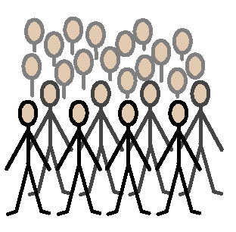
The Coronavirus has been traveling fast from one person to another. If many people are close together in the same place, that makes it easier for a virus to spread. More people become sick faster.

Slide 7
Sometimes schools close during a pandemic. That way, children are farther apart from one another and it’s harder for a virus to spread.

Slide 8
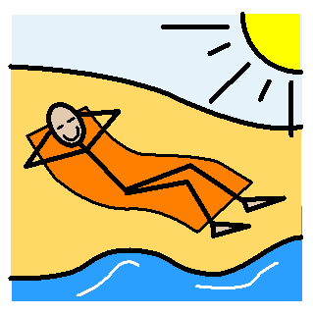
A pandemic can cause people to reschedule their vacation plans. This is because vacations are often in fun and crowded places. People try to avoid crowds in a pandemic. They may re-schedule their trip.

Slide 9
My parents are learning more about the Coronavirus every day. They watch the news and look for information. They are watching out for me, too. If I have questions, they can help.

Slide 10
It’s good to know that pandemics don’t happen very often. They occur about once every twenty-five or thirty years, or about three times every one hundred years. It’s also helpful to remember that the Coronavirus pandemic will end; probably not by tomorrow morning, but it will end.

