Slide 1
Take One Picture Animation
Holy Trinity CE Primary School

Slide 2
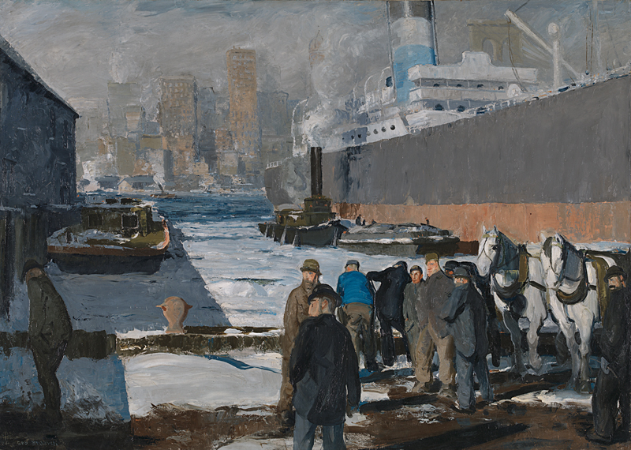
Take One Picture – National Gallery
Men of the Docks by George Bellows

Slide 3
Take One Picture – National Gallery
Men of the Docks by George Bellows
This year, we were part of London National Gallery’s Take One Picture programme. We had to focus on a painting – Men of the Docks by George Bellows - and respond creatively to it.
The painting was produced in 1912 and shows a New York harbour where the men were waiting for the arrival of the Titanic. We linked this to our Erasmus work and decided to make an animation about immigrants searching for the American Dream. These men in the front are the immigrants looking for work to feed their families. As you can see, there’s one man on he left who has been rejected because he was not strong enough.

Slide 4
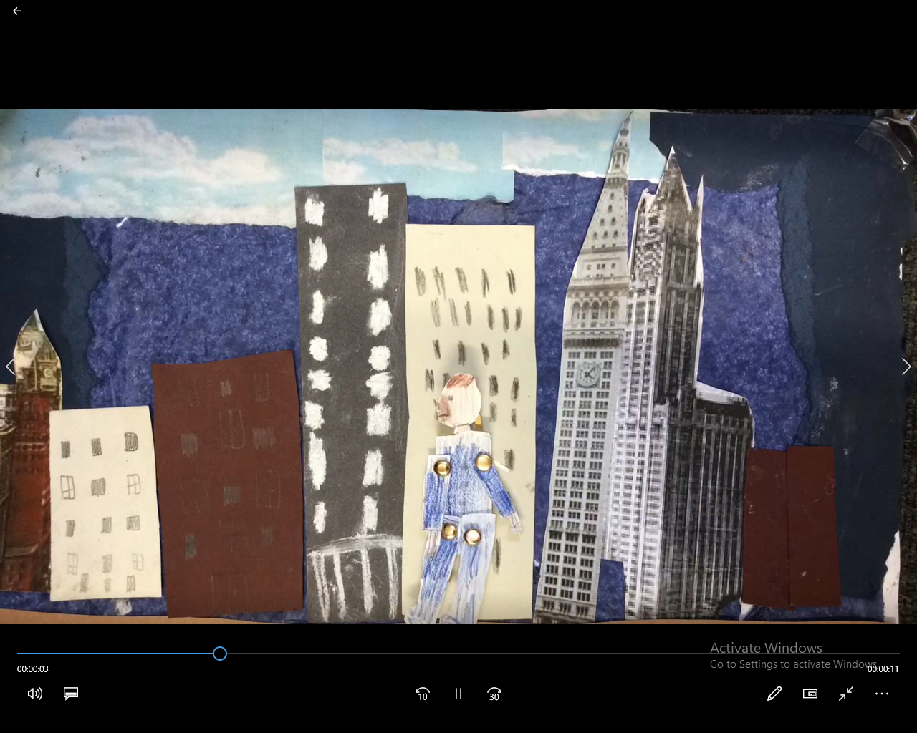
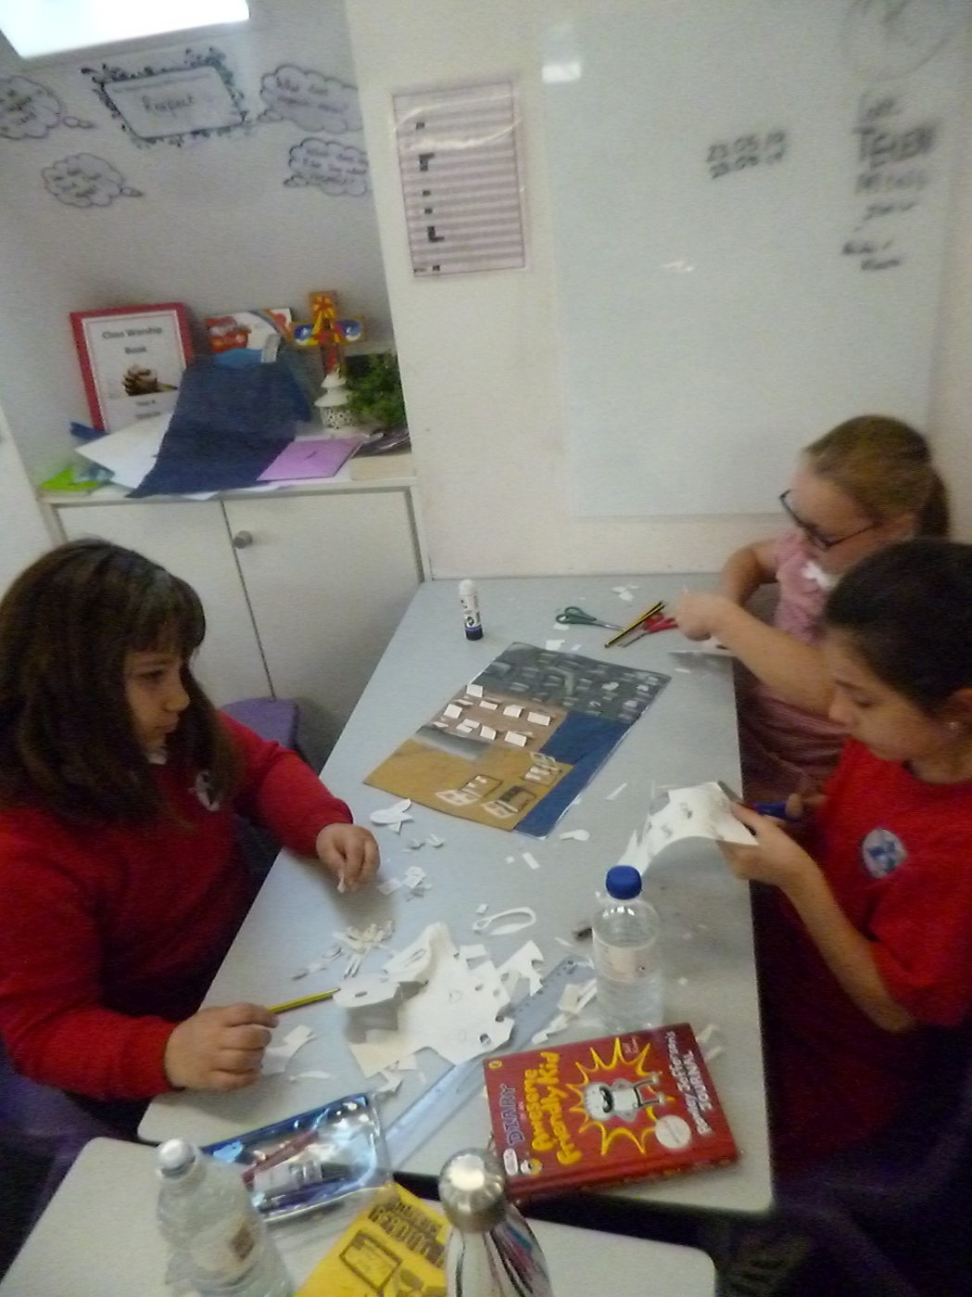
Year 4 Project – Rags to Riches Animation
Year 4 were particularly interested in that isolated man in the painting. They decided that they wanted to tell the man’s story from the point that he “walked off the canvas”.

Slide 5
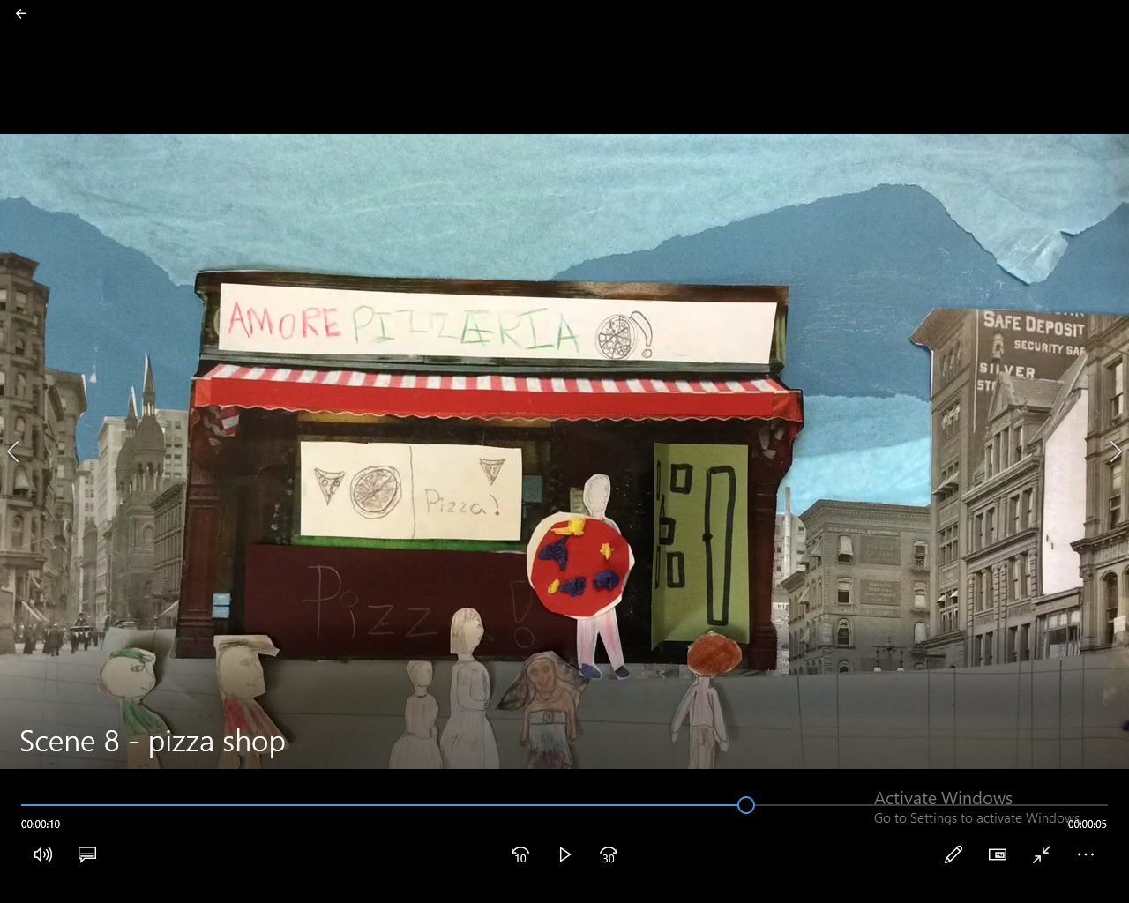
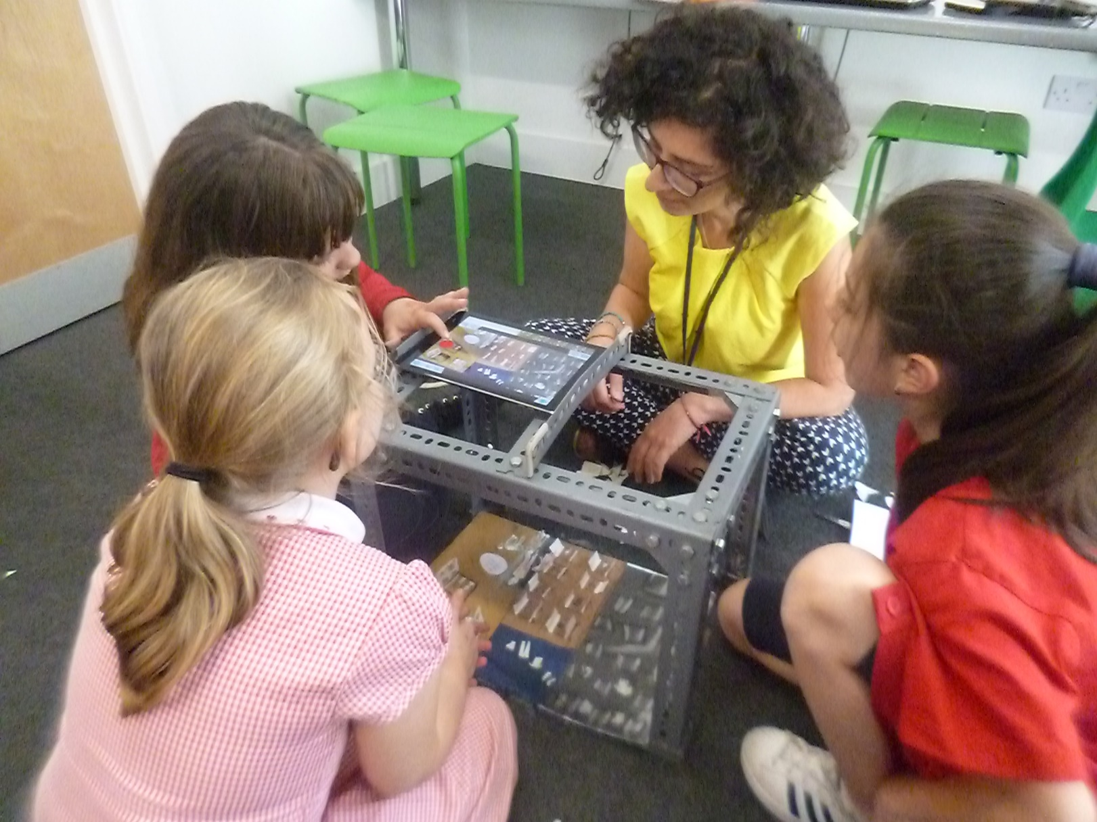
Year 4 Project – From Rags to Riches Animation
The class decided that they would apply their stop-frame animation skills to telling the man’s story. After much discussion, the class settled on a happy future for the man, who eventually realises his American Dream and ends up owning a pizza restaurant chain.

Slide 6
Year 4 Project – Rags to Riches Animation
Year 4 Class teacher: Sotira Styllis

Slide 7
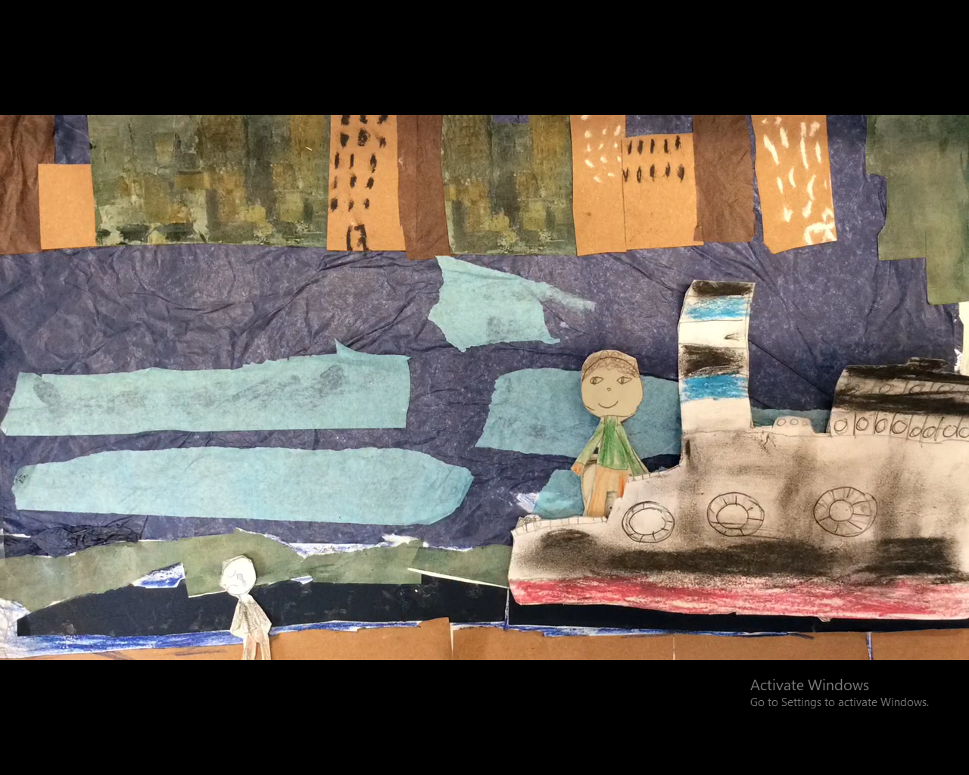
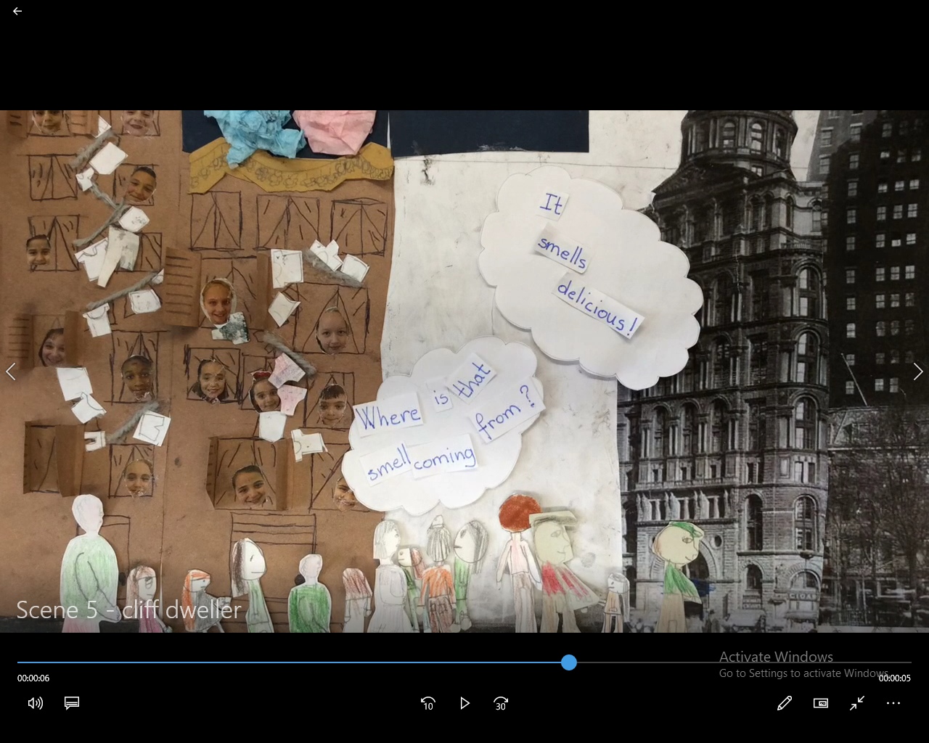
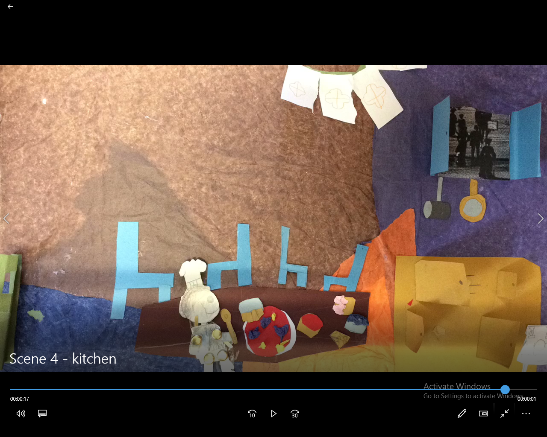
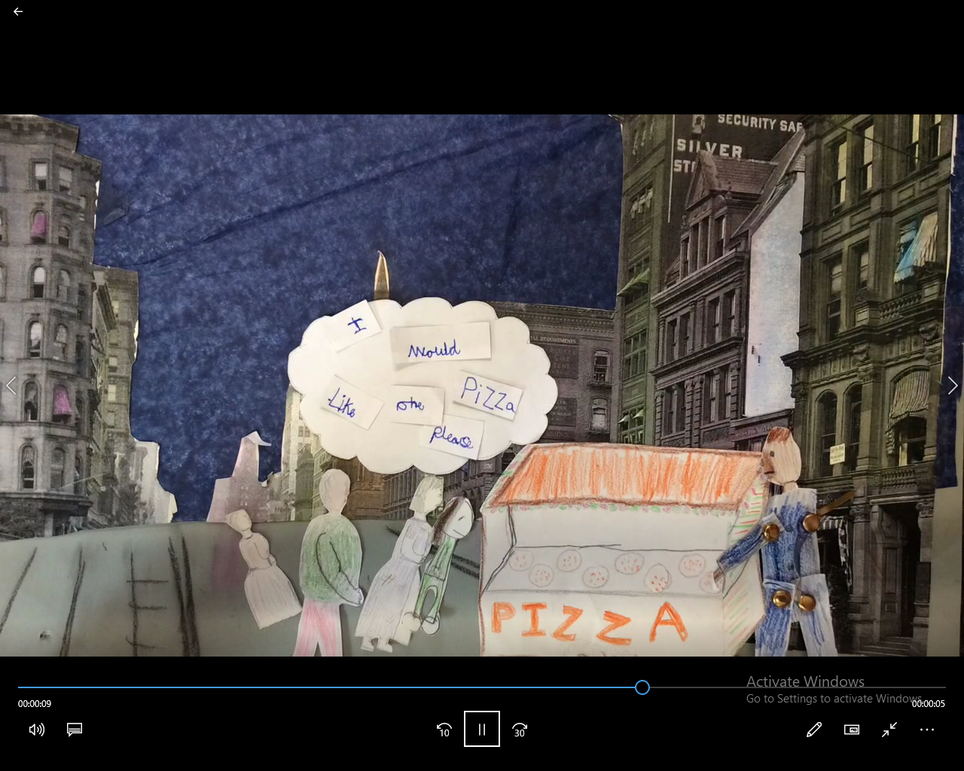
Year 4 Project – From Rags to Riches

Slide 8
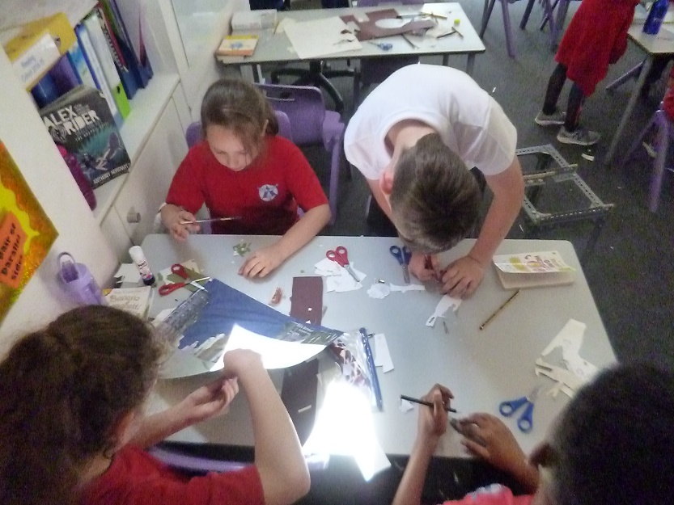
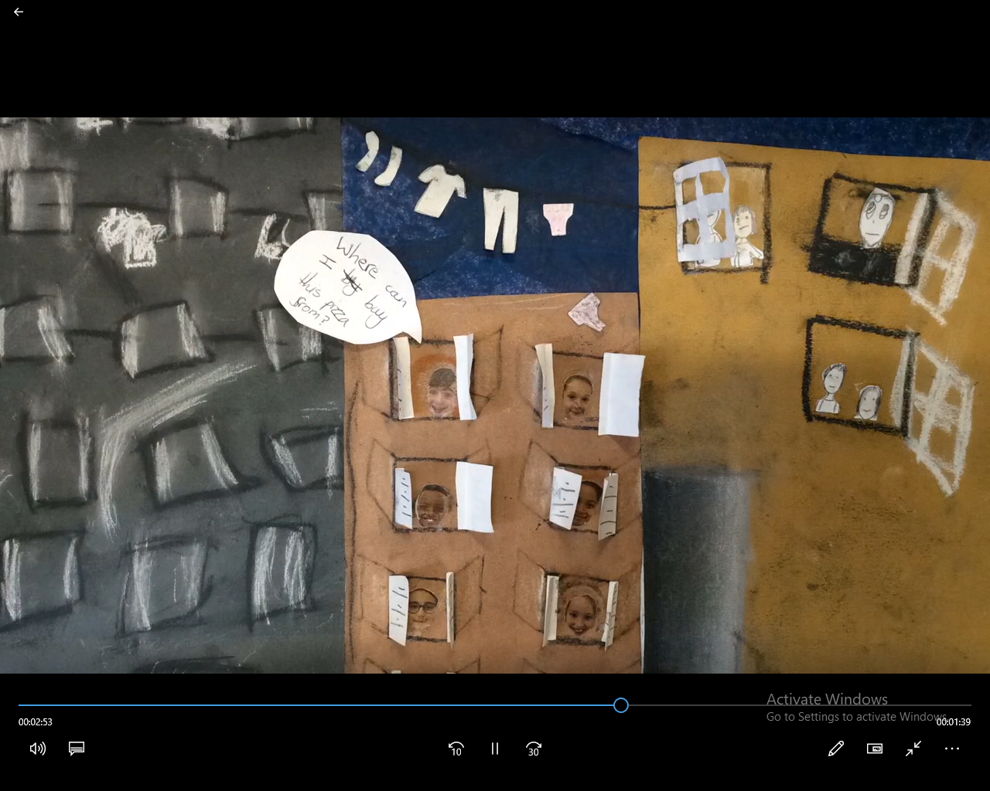
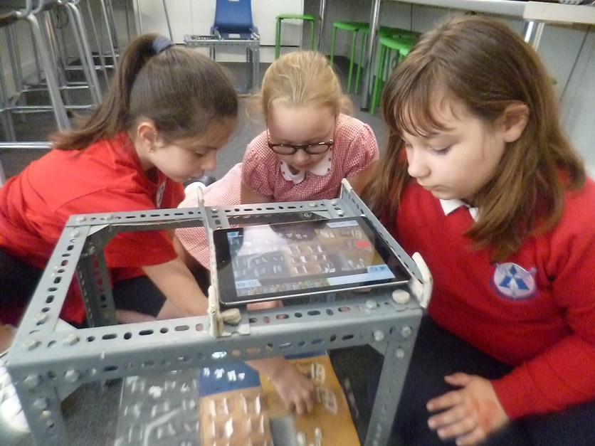
This project really involved using the 3Cs In terms of creativity,
We had to first analyse the painting that we were given and then use our imagination to come up with ideas linked to it. Based on the artwork, we decide on a storyline. If we hadn’t used our imagination, our animation would just have been a recreation of the painting, which is something that we did not want.
Together we thought deeply about the original painting and about how we wanted our final piece to look. As a result, we decided on using a limited colour palette to tie our work in with the original painting, to make it look more realistic and to ensure that each scene flowed together.

Slide 9
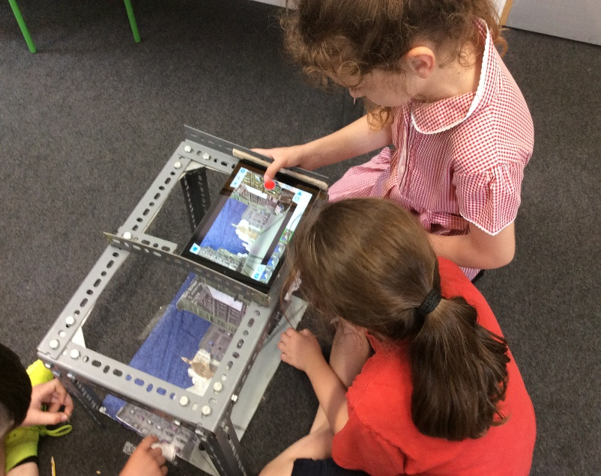
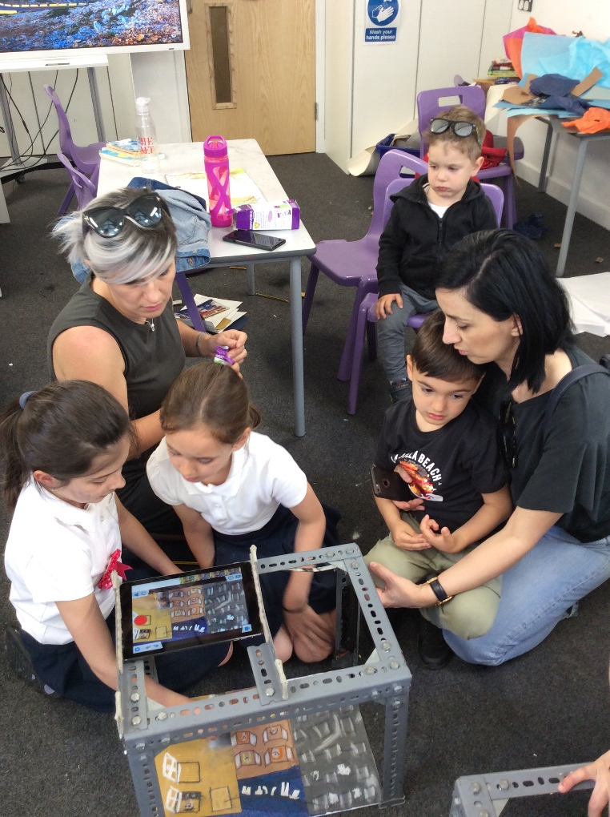
Communication
Communication was key to this project because we had to share our ideas, listening and respecting each other.
Before deciding on our final outcome, we had to think of ideas and then speak clearly and explain and justify our suggestions to the class,
Another important point was that we had to effectively communicate our story to a wider audience who were not familiar with the painting or our ideas. We also had to make our animation engaging for our audience to capture their interest.

Slide 10
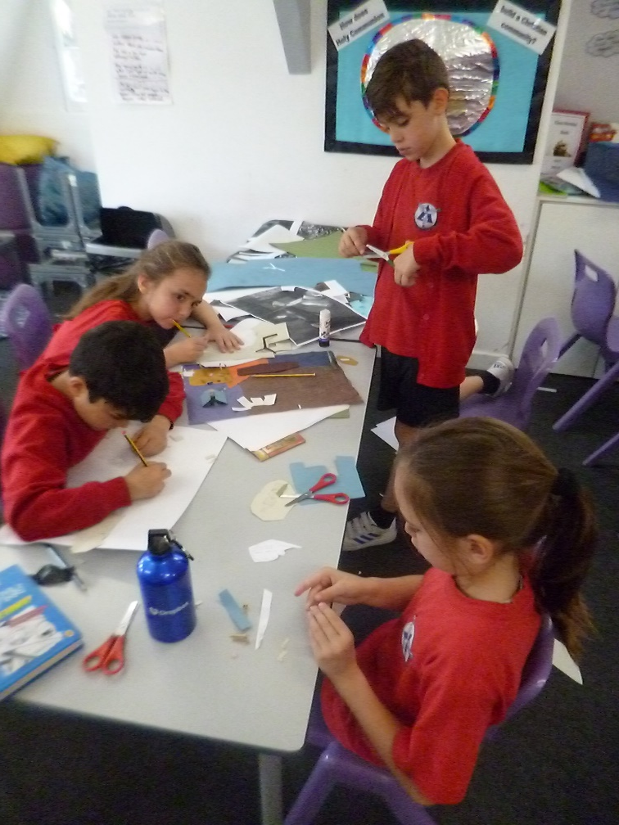
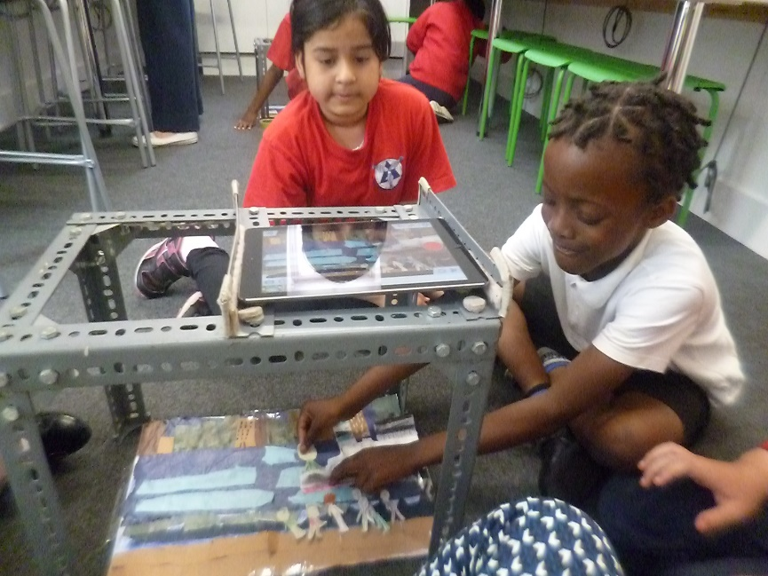
Collaboration
Compromising with others was key to this project because all our ideas could not have been selected. Therefore, we shared our ideas and merged them together to create one.
We allocated roles to each member of the group to make sure that everyone was included.
We also had the opportunity to work with children that we don’t normally work with, which was a good chance to develop our collaborative skills. We realised that it is nice to be grouped with people that we don’t usually work with in a class and to hear other people’s ideas.

