Slide 1
The dinosaur age
BY MAXIMO MONGE CALAVIA

Slide 2
The dinosaur age
The dinosaur age was 231 and 243 million years ago.

Slide 3
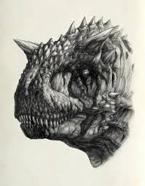
The Carnotaurus
The Carnotaurus was a carnivore that ate other dinosaurs. Its size was 7.6m (25ft) and were found in Argentina.

Slide 4
What the Carnotaurus facts are
The name Carnotaurus means meat eating bull
Carnotaurus lived around 66 million years ago, before the mass extinction event that occurred at the end of the Cretaceous Period.
Did you know that Jose Bonaparte and Fernando Novas named the large carnivorous dinosaur Abelisaurus
Carnotaurus jaws were designed to produce weak bites. However, scientists estimate that it could chomp down twice as hard as modern alligators do.

Slide 5
About the bones
Carnotaurus had very powerful thighs, strong shins, high ankle joints and large supporting toes.
They had short and thick horns and their eyes could see sideways and forward.
Their teeth were long and delicate. The lower jaw of the carnotaurus is another mystery of this unusual theropod because its teeth were not really good for hunting, but it had a unique hunting strategy. They might have been scavengers, which means they ate dead animals.

