Slide 1
Blackwood Comprehensive School
Mrs Tracy Davies -
Head of Key Stage 3 (Transition)
Questions and answers resulting from the survey completed by you.

Slide 2
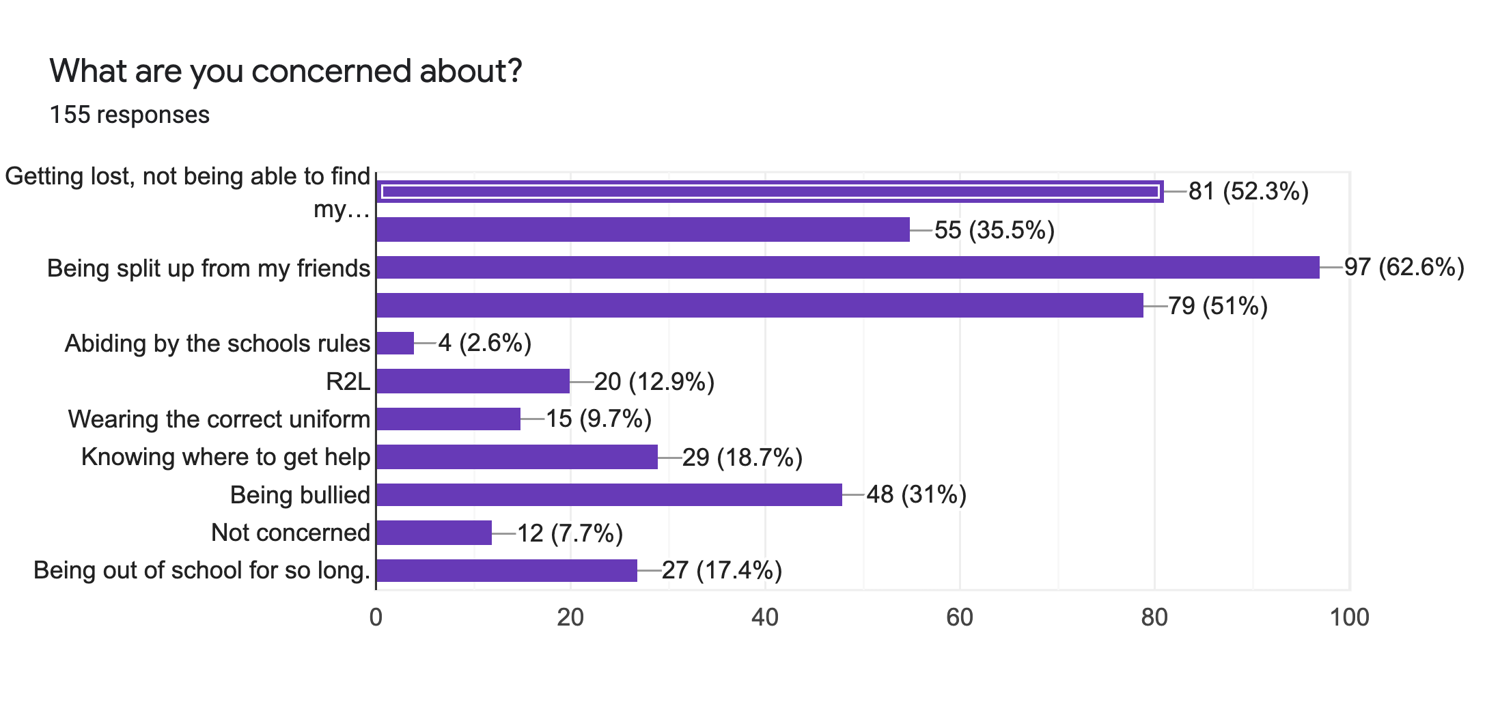

Slide 3
What are your main concerns and worries?
Being split up from my friends;
Getting lost and not being able to find my way around a larger school site;
Not understanding the work or the work being too hard;
Being on my own and not knowing anyone;
Being bullied;
Knowing where to find help, if it is needed.

Slide 4
Being split up from my friends - Year 7 pupil
Your Year 6 teachers will send me friendship lists so that I can ensure you are put into a form class with some of your friends.
You will be put into a form class with at least three other members of your primary school.
Obviously you will be split up from some of your friends as there will be 7 form classes in total, but look at this positively. This will be an opportunity to make new friends, form new friendship groups and learn new skills.

Slide 5
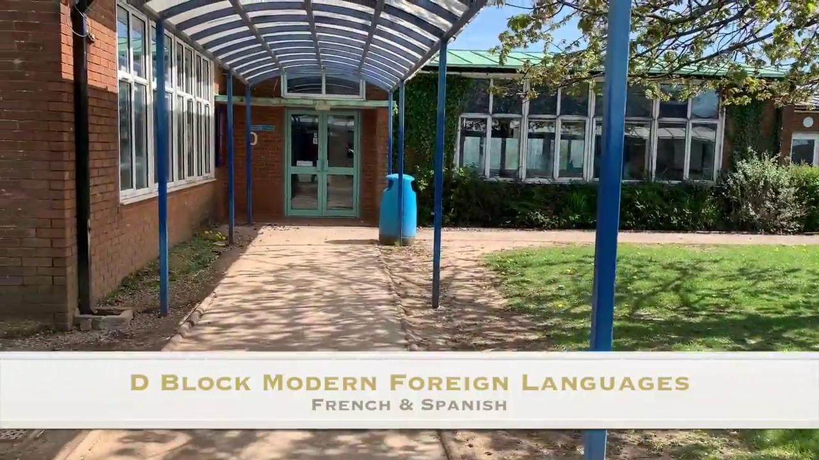
Getting lost and not being able to find my way around a larger school site.
Please watch the virtual tour of the school, which shows the school site and buildings.
You will also have year 9 buddies, (if covid restristrictions will allow), members of staff and other pupils to help you to find your way and answer any questions you have.
Click on this link to see a map of the school.
Map of the school

Slide 6
Not understanding the work or the work being too hard.
Secondary School is a lot like primary school as you will still get support from a number of people:
Your Form Tutor;
Subject Teachers;
Year 7 Progress Managers (Mrs Colley and Mr Williams);
Head of Key Stage 3 (Mrs Davies)
Other pupils and peers;
Learning Support Assistants;
the Senior Leadership Team.

Slide 7
Being on my own and not knowing anybody
You will be placed in a form with at least 3 other members of your primary school so you will definitely know somebody.
You will be encouraged to make new friends and we really hope that you take this opportunity.
We have two areas of the school called the Cwtch and the Llwyddo that can offer you a place to go and make new friends during break and lunch times.
There are lots of extra curricular clubs and opportunities on offer. Please join as many of these as you can to help you make new friends with people who have similar interests or want to meet new people and learn new skills. (again this depends on covid restrictions)

Slide 8
Being bullied
We do not tolerate any form of bullying in school.
If you feel that you are being bullied there are a number of people that can help:
Pupil Anti-bullying Ambassadors who have been specifically trained to help
Your Form Tutor
Your Subject Teachers
Your Progress Managers (Mrs Colley, Mr Williams)
Head of Key Stage 3 (Mrs Davies)
Pastoral staff and Manager
SLT (Senior Leadership Team)

Slide 9
Knowing where to find help
For your first two weeks in school you will have Year 9 buddies helping you to find your way around. Taking you from lessons to other lessons. (If covid restrictions allow)
It’s surprising how quickly you will learn your way around.
Other people to help are:
Your friends, other pupils, form tutor, progress manager, subject teachers, Head of Key Stage 3, pastoral staff, associative staff and the receptionist.

Slide 10
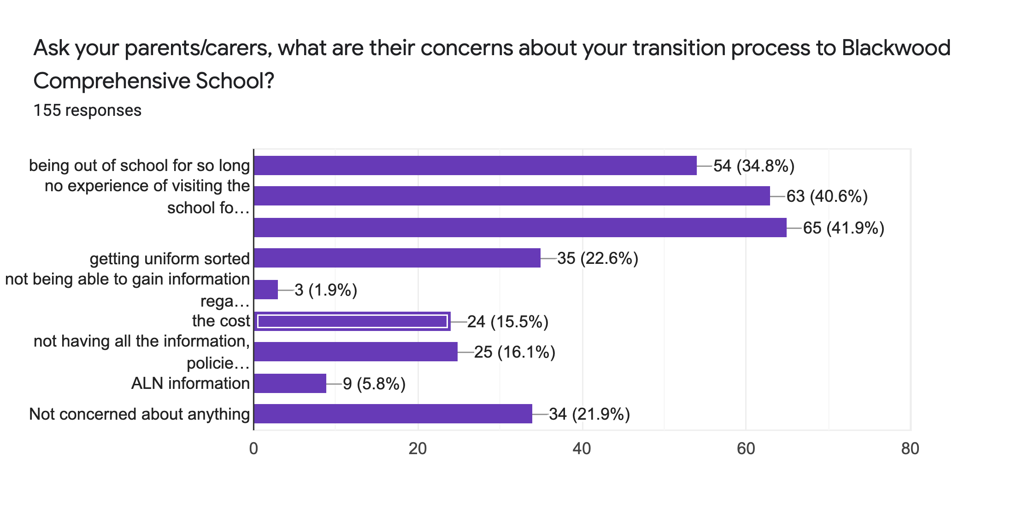

Slide 11
What were your parents/carers concerned about?
Not having a proper closure of primary school before attending secondary school
No experience of visiting the school for a transition day
Being out of school for so long
Not being prepared for secondary school by their Year 6 teacher
How pupils will be placed into classes
Getting uniform sorted

Slide 12
Not having a proper closure of primary school before attending secondary school
We are hoping now that all pupils will be able to have a full term of education with face to face learning. This will allow the Primary Schools to say their goodbyes as they usually would.

Slide 13
No experience of visiting the school for a transition day
This is also an area of concern for us. Covid restrictions make this very difficult and virtually impossible.
As covid restrictions are being removed I am hoping that i will be able to visit the primary schools to say hello in person.
Depending upon the removal of covid restrictions It maybe possible that some individual pupils that need enhanced transition may be able to visit our school site at various times.
Unfortunately, at the moment I think it is very unlikely that we will be able to have the whole new Year 7 cohort in for a transition day as we usually would.
If and when we can, a visit to the school will be our priority.

Slide 14
Being out of school for so long.
Like yourselves and your child, we have never been in this situation before but are really looking forward to you starting in september.
We will do everything we possibly can to settle them into the school routine.

Slide 15
Not being prepared for secondary school.
I have been working alongside your Year 6 primary school teachers for a number of years. They are experts in this! We work very closely together to make sure you will have a smooth transition.

Slide 16
How pupils will be placed into classes
There are going to be 7 forms in Year 7.
Pupils will be placed in a form with hopefully at least 3 of their friends from primary school. They are all mixed ability except for 2 forms.
These 2 forms are: our LLwyddo ‘nurture’ form; and our catch up form, for pupils who need extra educational support.

Slide 17
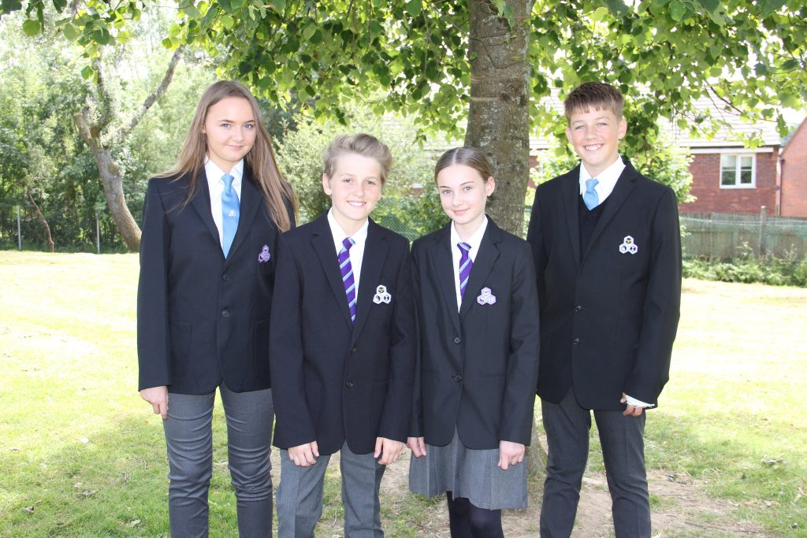
Getting uniform sorted
Uniform can be purchased at the moment online from various retail outlets and our school uniform providers (see next slide)
We are very proud of our School Council who created a recycling uniform shop. This recycled uniform will be available from school reception for a small donation.
Ties and badges for blazers are sold from school reception.

Slide 18
Uniform
Click her to go to: the Schools website regarding what uniform is needed.

Slide 19
What type of activities would you like to see at Blackwood Comprehensive School that you currently enjoy in your Primary School?

Slide 20
Sports clubs (netball, football, rugby, gymnastics, tae-kwon-do)
Expressive arts clubs (art, drama, music, fashion design)
Breakfast club
Technology clubs (Cooking club)
Fashion design
Science clubs
Maths clubs
ICT clubs (movie making)
Lockers
Daily mile
Well being - ELSA
Outside lessons
Gardening club
Humanities clubs
English clubs

Slide 21
Other questions that were asked?

Slide 22
What can you do at home to help anxious pupils prior to starting school?
Encourage your child to talk about their anxieties/concerns and try to reassure them.
Share and talk about any of the information that you see regarding transition.
There is a lot of information shared on our school website in the ‘supporting wellbeing’ section that may be of use as well as the transition section.
Link to school website:
School Website

Slide 23
What is R2L?
R2L (Ready 2 Learn) is our behaviour policy that all staff and pupils abide by.
The aim is to make sure that everyone in school is ready to learn at all times.
If a pupil is not ready to learn then they are given a verbal warning by a member of staff. If they choose not to alter their behaviour then they are sent straight to the R2L room.
This is managed by the Senior Leadership Team. Once referred the pupil than has to spend; 5 lessons, a different break and lunch time to other pupils and a 30 minute detention after school. They complete the 5 lessons in silence. Work from their timetabled subject is given to them to carry on their education. Parents/carers are informed via classcharts.
RR22L is abbreviated from ‘Ready 2 Learn’ R2

Slide 24
What is ALN?
ALN stands for (Additional Learning Needs)
Mrs Rudman who is our ALNCO will help you with any queries if you feel your child needs support in this area. Please email:
rudmac@blackwood.caerphilly.sch.uk

Slide 25
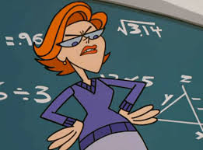
Are teachers strict?
The teachers at Blackwood Comprehensive School are friendly, approachable, kind and helpful. However, if a pupil does not behave appropriately or does not allow others to learn, then the teacher will follow the schools’ behaviour policy. Some of you may see this as being strict!

Slide 26
How will parents, carers and pupils be kept informed?
The School Website page. http://www.blackwood.caerphilly.sch.uk/
The School Instagram page - blackwoodcomp
The School Twitter Page - @Blackwood_Comp
Information via your Year 6 teachers.
Or any urgent queries than please email Mrs Davies on: daviet3@blackwood.caerphilly.sch.uk

Slide 27
Covid
Unfortunately we do not know what is covid restrictions are going to be in place in September as they change so quickly. We are hoping that education will be back to normal!
Please keep an eye on the school website.
School website
Will school start times and finish times still be staggered in September?
Will masks need to be worn?
Will pupils in different classes be able to mix?

Slide 28
Will there be a lot of people?
There are going to be 205 pupils in your year group with a total of approximately 1000 pupils in the school alongside teachers, support staff, canteen staff, admin staff.

Slide 29
Work and Homework - How much? ALN? differentiated.
Homework is set by subject teachers and varies between each department. My advice is to do your homework on the day you are given it so it is fresh in your mind and out of the way.
All classwork and homework is differentiated to the needs of each child?

Slide 30
How many lessons/subjects will i have?
Click on this link to the school website which gives you information on: Subjects/timetables in Year 7
Below is a list of the subjects you will study in Year 7 and the number of lessons over the two weeks you will have:
English – 7 lessons
Mathematics – 7 lessons
Science – 6 lessons
Expressive Arts – Drama, music and Art 5 lessons
Technology – 4 lessons
Geography – 2 lessons
History – 3 lessons
Physical Education – 4 lessons
Religious Studies – 2 lesson
PSHE – 1 lesson
Welsh – 3 lessons
French – 4 lessons
IT – 2 lessons

Slide 31
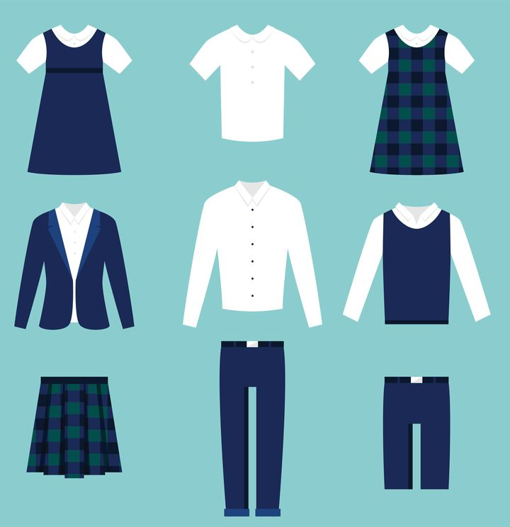
Applying for bus passes, uniform grants, Free School Meals (FSM)
Information on bus passes
FSM - this should automatically transfer from primary to secondary school
Uniform grant. - unfortunately no information until July

Slide 32
Finally, some friendly hello’s and advice from 3 of our Year 7 pupils.

