Slide 1
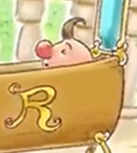
Riquet with the Tuft
(Riquet à la houppe)
by Charles Perrault

Slide 2
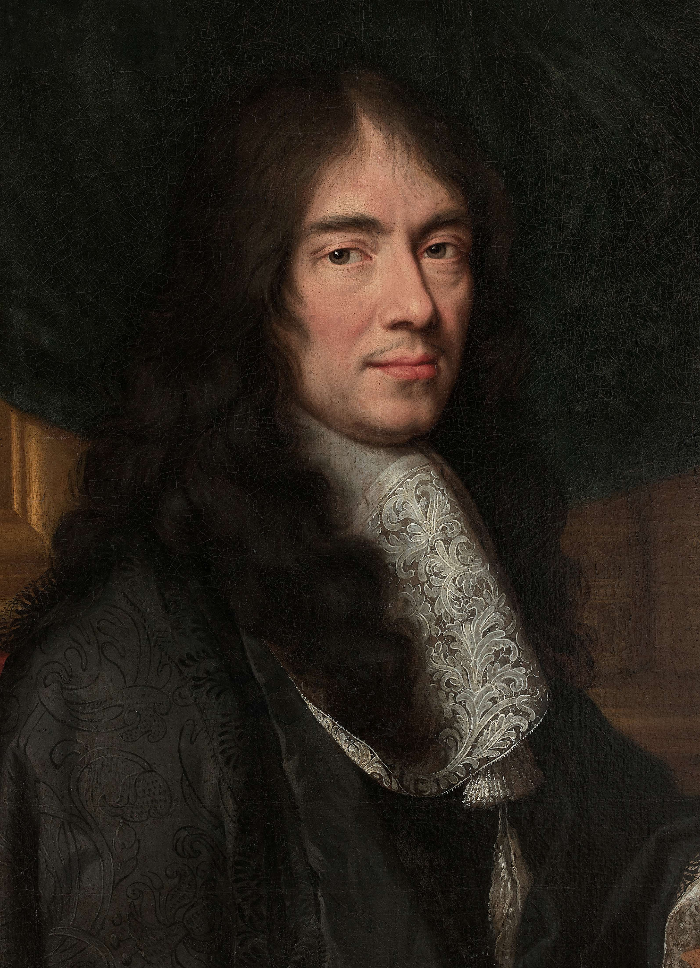
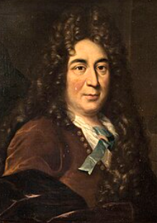
Charles Perrault
Charles Perrault (12 January 1628 – 16 May 1703) was a French author. He laid the foundations for a new literary genre - the fairy tale!
The best known of his tales include:
"Le Petit Chaperon Rouge" ("Little Red Riding Hood")
"Cendrillon" ("Cinderella")
"Le Maître chat ou le Chat botté" ("Puss in Boots")
"La Belle au bois dormant" ("Sleeping Beauty")

Slide 3
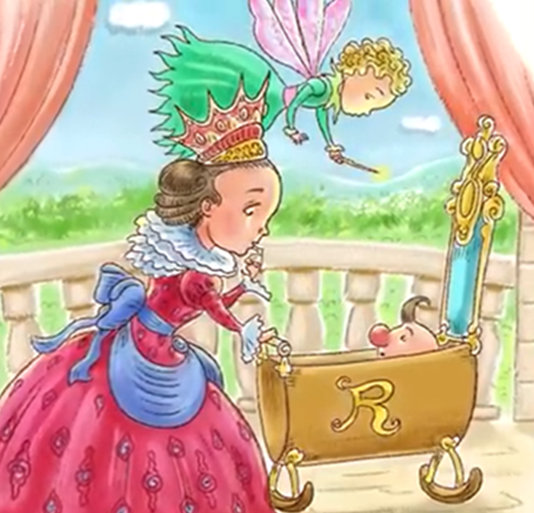
L.O. To orally retell a narrative.
Once upon a time there was a king and queen.The queen had a baby who came out so ugly and misshapen that he barely looked human. The queen worried about her poor son. A fairy at the prince’s birth told the queen not to worry because the boy would be as smart as he was ugly. The fairy blessed the boy with a special gift. The prince would be able to give the gift of wisdom to the woman he loves.

Slide 4
L.O. To orally retell a narrative.
The boy grew to be one of the smartest people. He was also kind, thoughtful, and charming. People lovingly began to call him Riquet with the Tuft. That is because his family’s last name was Riquet and he was born with a little tuft of hair on the top of his head. Many called him Tufty for short.

Slide 5
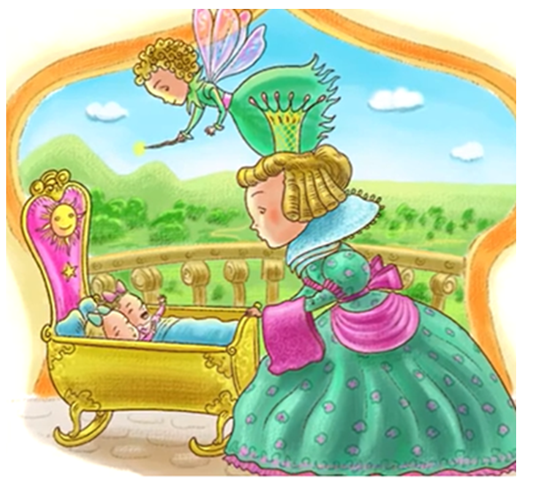
L.O. To orally retell a narrative.
Several years later, a queen in a nearby kingdom gave birth to twin girls. The same fairy was at this birth, too. The first baby to come out was so beautiful that the queen worried that she was too beautiful. The fairy told her not to worry for the princess would be as dumb as she was beautiful. This did not make the queen feel any better. Then when the second baby came out, she felt even worse, for this baby was as ugly as her twin was beautiful.

Slide 6
L.O. To orally retell a narrative.
“Don’t worry,” said the fairy. “This princess will be so smart that no one will notice that she is ugly.”
“I hope you are right,” said the queen. “But is there any way to make the oldest twin any smarter?”
“I can’t help her with that,” said the fairy. “But I shall give her this gift. She will have the power to turn the man she loves into the most handsome person.”

Slide 7
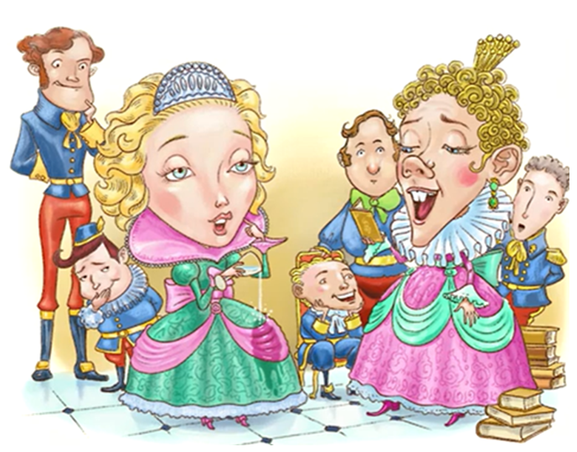
L.O. To orally retell a narrative.
As the twin princesses grew, so did their gifts. The older twin became more beautiful and the younger twin became smarter. Unfortunately, as the older twin grew,
she became dumber. By the time she was 20, people found it nearly impossible to have a conversation with her. Everyone preferred to hang out with the ugly princess because she was funny and clever. The pretty princess had no friends and felt quite lonely.

Slide 8
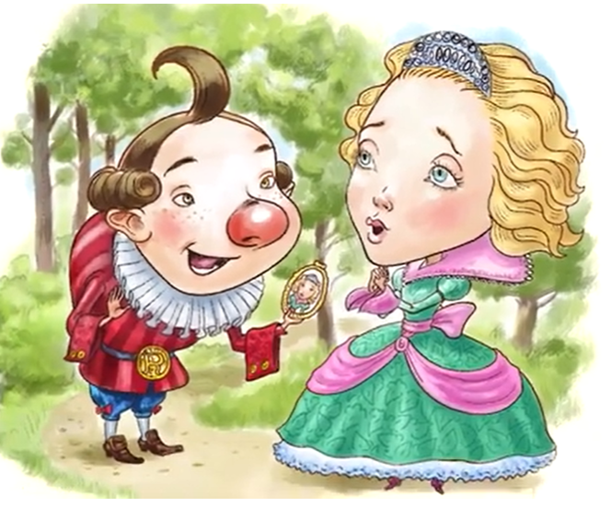
L.O. To orally retell a narrative.
Sadly, the pretty princess was smart enough to know that she was dumb. Sometimes she went off to the woods to
cry.
One day, a very odd-looking young man rode by and stopped to talk to her.
“How can someone so beautiful be so sad? It is much easier to be beautiful than ugly,” said Tufty.
“No,” said the princess. “I would rather be ugly and smart than beautiful and dumb.”
“Is that all that bothers you,” asked Tufty. “I can help. If you marry me, I can make you as smart as I am.”

Slide 9
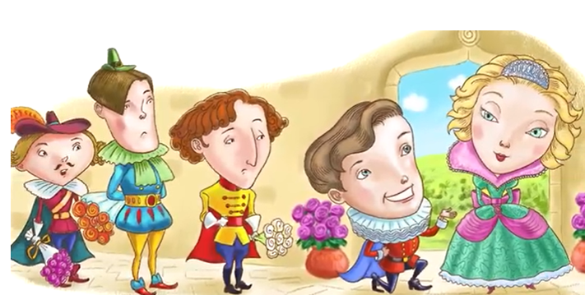
L.O. To orally retell a narrative.
The princess agreed to marry him in one year’s time and she instantly became as smart as he was. She returned to the palace and became very popular. Now everyone wanted to be friends with her. The princess soon forgot what she’d said and done when she was dumb.

Slide 10
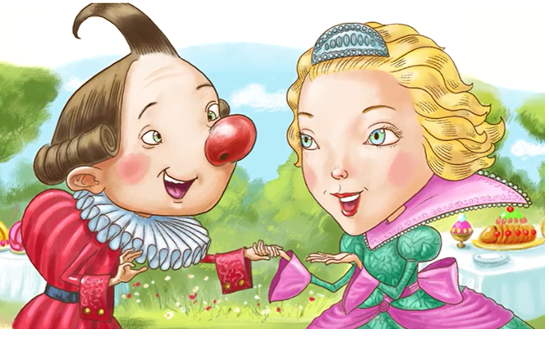
L.O. To orally retell a narrative.
One day, the princess took a walk in the woods along
the same path she took when she first met Tufty.
In fact, she had met him exactly one year before,
although she’d completely forgotten about it. She was surprised to see a lot of people in the woods setting up for a great celebration. Along came Tufty. “You came!” he cried happily, “Let us now get married!”
The princess was shocked and embarrassed.
How could she forget about his proposal? She admitted to him that she forgot and that did not know what to do—should she keep her promise to him?

Slide 11
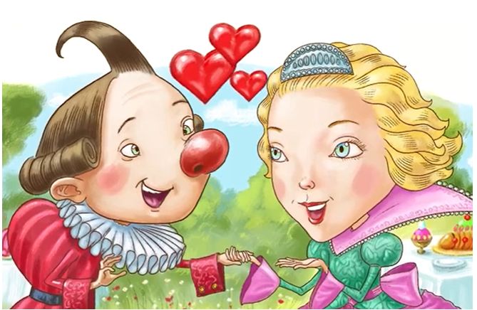
L.O. To orally retell a narrative.
“If you put aside my looks, how do you feel about me?” asked Tufty.
“I love and respect you,” said the princess.
“And I love and respect you,” said Tufty. “Let’s get
married like we planned. I will spend the rest of my life
making you happy.”
As soon as the princess agreed, something special happened. Suddenly, Tufty became the most handsome
person in the world to her. The couple married and lived happily ever after.

