Slide 1
SEND Coffee Afternoon Summer 2023
Supporting Learning at Home

Slide 2
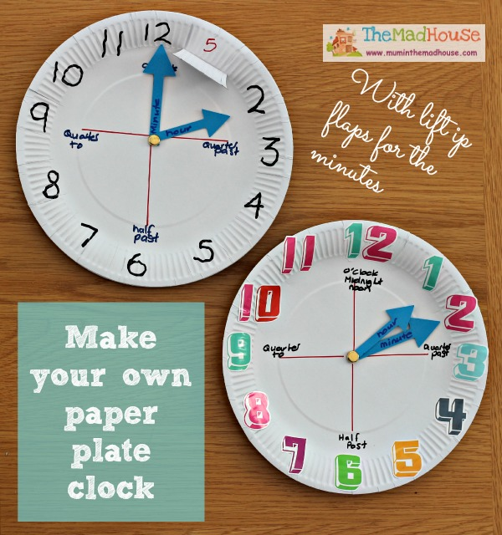
Make your own clock…

Slide 3
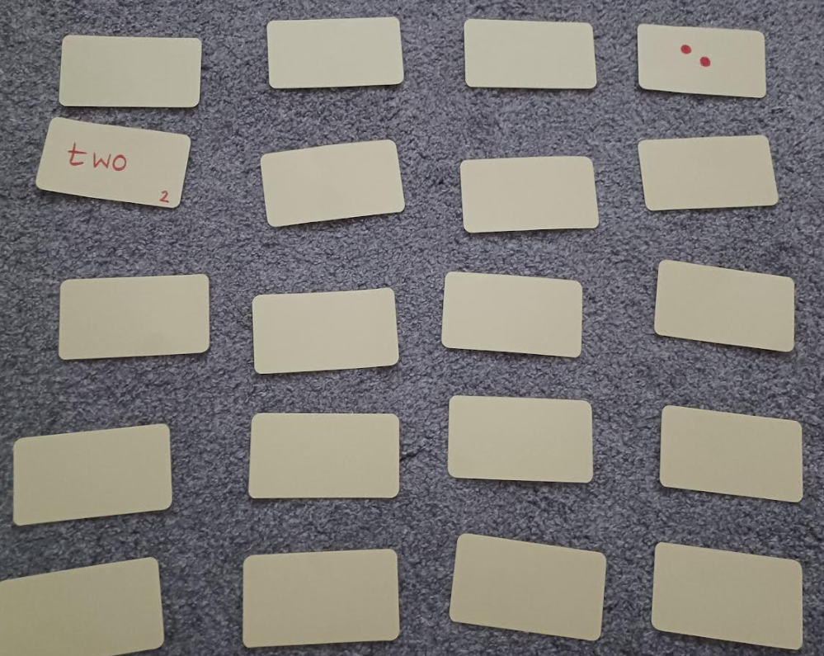
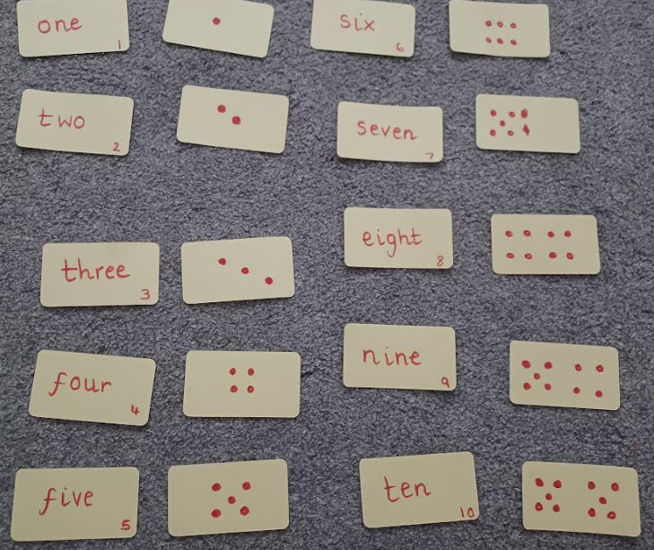
Make your own pairs game…
Choose the focus of your card game (letters, words, numbers)
Write each number/word on 2 separate cards
Turn the cards over and children can work to find pairs
This game could be changed to SNAP.
This came can be adapted for sounds, words, numbers or calculations.
There could be a question card that needs to be matched to an answer.

Slide 4
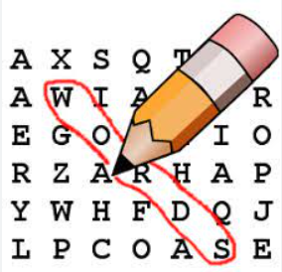
Make your own word search…
Choose the theme for your word search. This could be key spellings, topic words
Make a list of words your child will need find.
Write your words in the blank grid
Add other letters to fill the gaps
This can be adapted for all types of words linked to spellings, topics or personal targets.

Slide 5
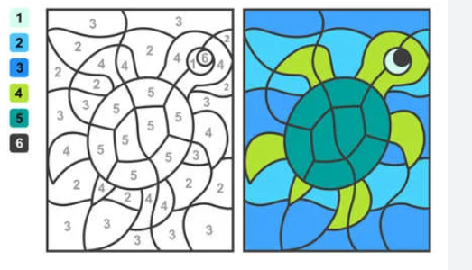
Make your own colour by…
Choose the focus of your colour by…
this could be + - x ÷
2. Decide what colour each part will be and give it a number.
3. Write a number or calculation in each part of the picture
4. You child can solve each part and colour the picture
This can be adapted for all maths calculations. You can even let you child make one for you to complete.

Slide 6
Make your own vocabulary game
Choose the focus of your vocabulary game e.g. vikings topic
Write your key words on the cards
Decorate with pictures or symbols to help the child remember the meaning or relevance
Playing options:
Turn over a card and explain the meaning.
Turn over two cards and say how they could be linked.
arrange the cards in a flow chart for the child to explain how each one links to the next
Sort the cards into given categories

Slide 7
Make your own board game…
Choose the style of game you would like (maybe in the style of snakes and ladders)
Choose a theme for your game – this could match your child’s interests: creatures, animals, weather, unicorns, magic
Decide the rules for your game:
Land on a spider = go down the web
Land on a butterfly = fly to the next spot
Land on a bee = another roll
Land on a puddle = miss a turn
4. Design and make you board game this can be brightly coloured and could be co-created with your child.

Slide 8
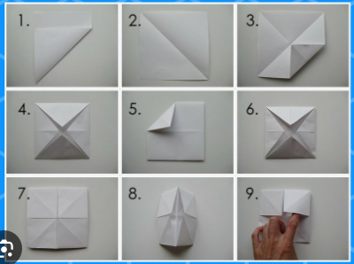
Make your own “fortune teller”…
This could be adapted to include sounds, words or key spellings
For maths you could include + - x ÷ calculations to be solved
The inner layer could be praise words or mini treats: wow, super star, high five!

Slide 9
Other fun things to learn at home…
Pairs
Memory games – I went to the shop and I bought (say an item for each letter of the alphabet – the list gets longer every time
Cooking or baking
I spy with my little eye
Scavenger hunt: how many cooking items can you find? How many clothes items can you find? Can you find any objects starting with (any letter)? Can you bring (any number) of (any object)?

