Slide 1
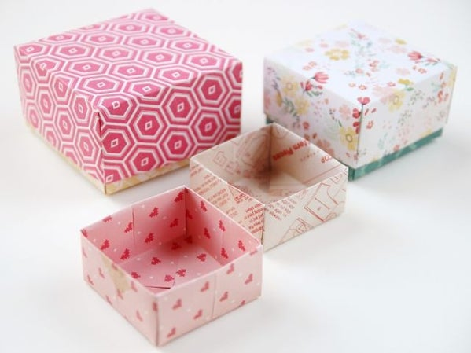
Origami Gift Boxes

Slide 2
I've been having fun making these origami gift boxes for years with various age groups. We’ve added a handle and filled them with chocolate eggs at Easter time and made lids and filled with sweet treats at Christmas but you could use them all year round to hold whatever you want. Have fun!!

Slide 3
Step 1:
Carefully measure and cut your paper to size. To make your origami box you are going to need 2 pieces of square paper, the second needs to be 1/2 inch smaller than the first. So if you are using a piece of 12 x 12 scrapbook paper the second piece needs to be 11.5 x 11.5. The larger piece will form the lid of your box.
Start by placing your paper pattern side down and fold in half. Make sure you press and crease the fold well. Open your paper out, turn it 90 degrees and fold in half again. This time when you open out your paper the creases should form a cross.
Next fold your paper corner to corner to form a triangle. Open it out, turn 90 degrees and repeat.
You now need to fold each corner into the center of your paper square.

Slide 4
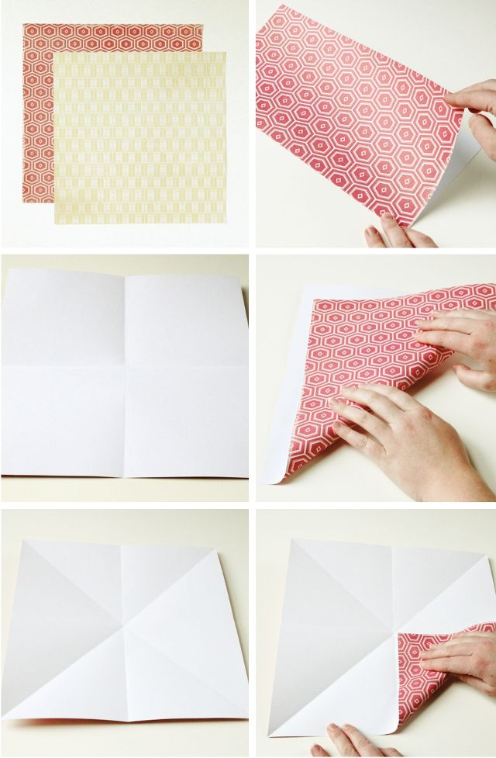
Step 1 pictures:

Slide 5
Step 2:
Your folded paper should look like the picture in the top left with all 4 corners meeting in the middle.
Take your square and fold the bottom edge to the center. Repeat for the other side. Your folded paper should now be a rectangle. Open it out, turn 90 degrees and repeat. It should now look like the picture 2nd down on the right.
Lift up 2 opposite triangles and lay them flat.
As you lift the sides your top flap should start to fold up. You need to lift this flap up and over to form the side of your box. This is the part where you might need to use some glue. If your triangle flaps aren't sitting flat apply a thin layer of glue to each one, press and leave to dry. (I have never use glue as long as your folds are really strong your box does not need glue)
Turn 180 degrees and repeat on the other side.
Repeat the whole process again this time using the smaller square of paper. Once finished the larger box should fit easily on top of the smaller to form your origami gift box.
To make the medium size box I used 10x10 inch and a 9.5x9.5 inch squares of paper, for the small box I used 8x8 inch and 7.5x.7.5 inch paper.

Slide 6
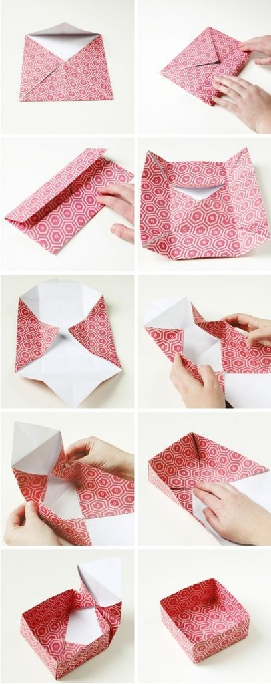
Step 2 pictures:
Your folded paper should look like the picture in the top left with all 4 corners meeting in the middle.

Slide 7
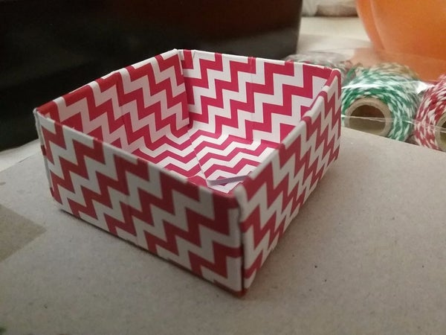
Your box is now ready to be filled with treats!

