Slide 1

Welcome to Reception 2025

Slide 2

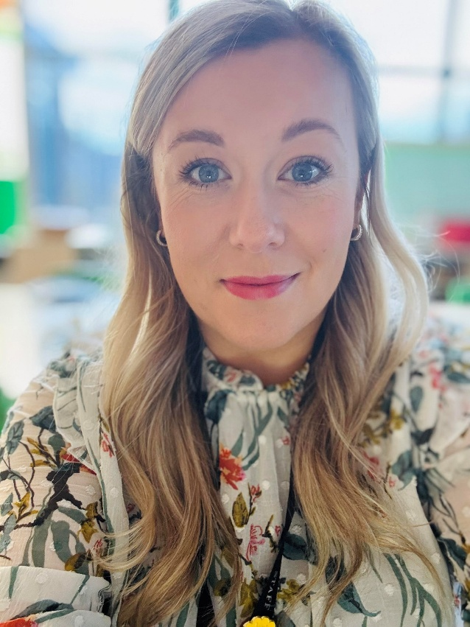
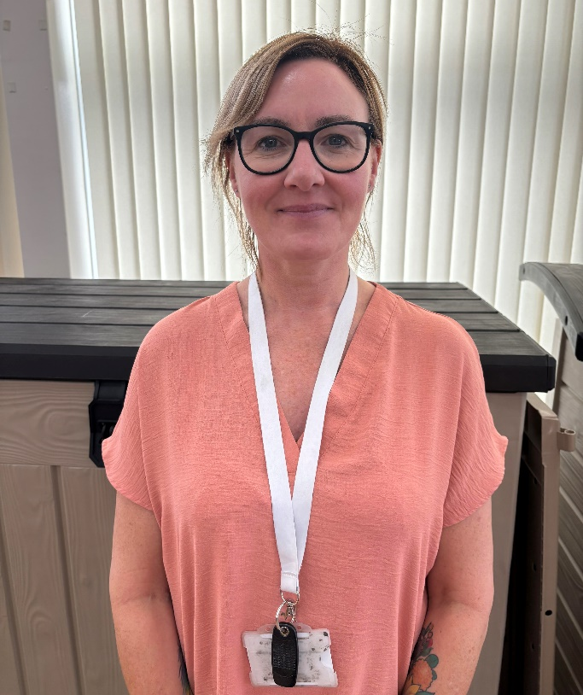
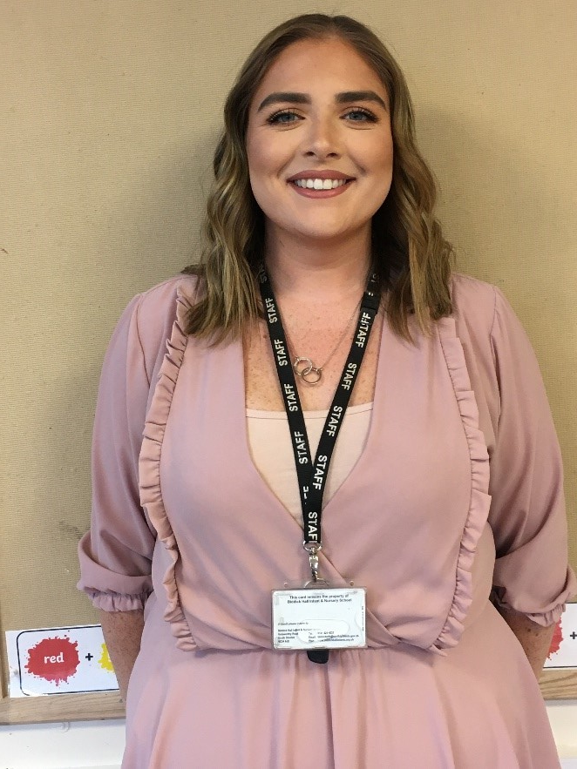
Meet the team!
Orange Class
Mrs Brayson
Orange Class Teacher
Miss Hogg
HLTA
Miss Elstob
TA

Slide 3
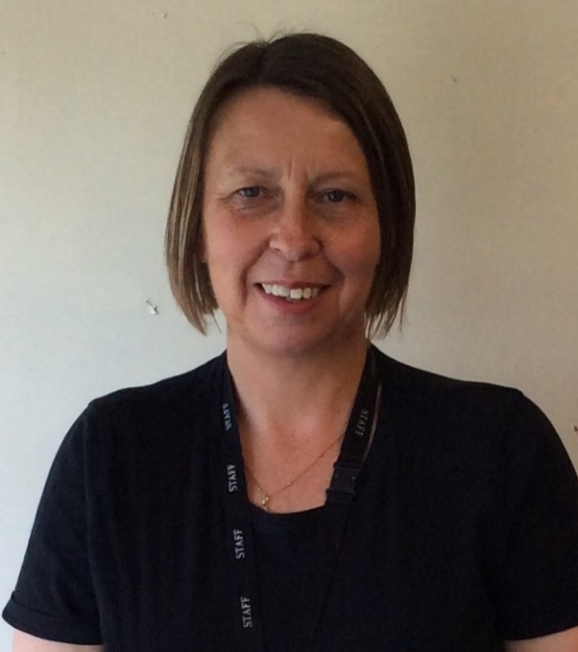
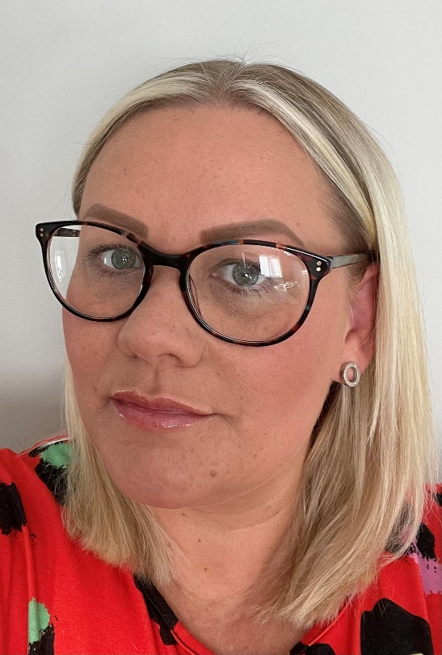
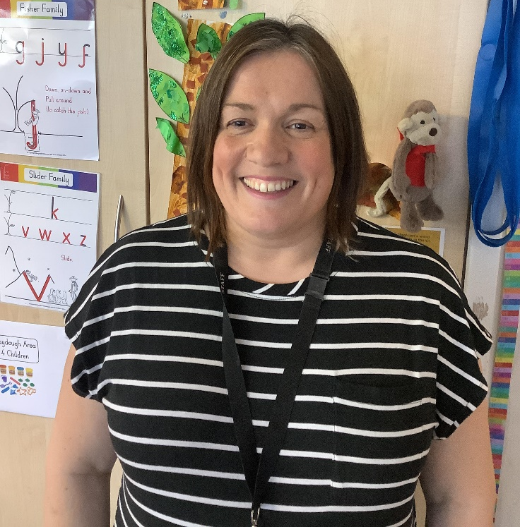
Meet the team!
Yellow Class
Mrs Lormor
Class Teacher
Miss Backhouse
TA
Mrs Anderson
HLTA

Slide 4
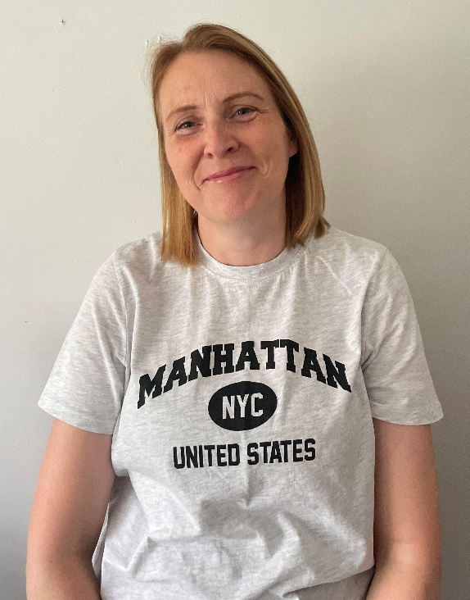
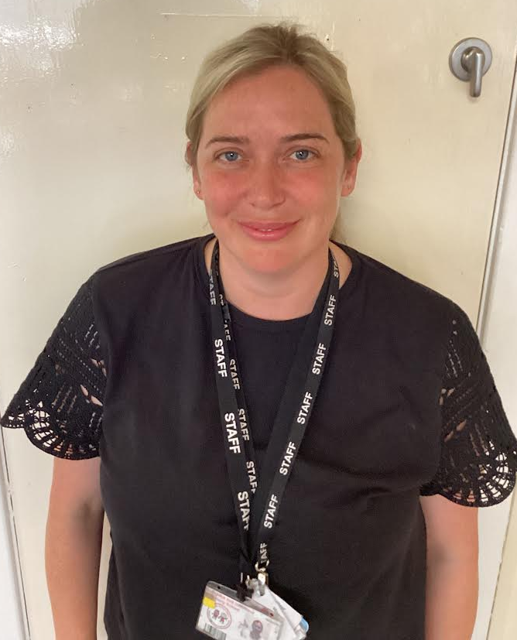
Mrs Abuzhara
TA
Mrs Wooler
TA

Slide 5
Transition Visits
Children who are currently in our nursery will have a story with their new teacher in nursery on Wednesday (9th July) and then they will be visiting their new classes on Monday 14th July (am, pm and 30hrs), Wednesday 16th July (pm and 30hrs only) Thursday 17th July (am and 30hrs only). Visits will last 1hr.
Your child will receive a letter following the visit which will inform you of their class and teacher.
Children who attend other nurseries will attend on the morning or afternoon of Monday 14th July. You will have received a letter about this detailing times and drop off/collection procedures. Your child will also receive a letter informing you of the class and teacher following the visit.

Slide 6
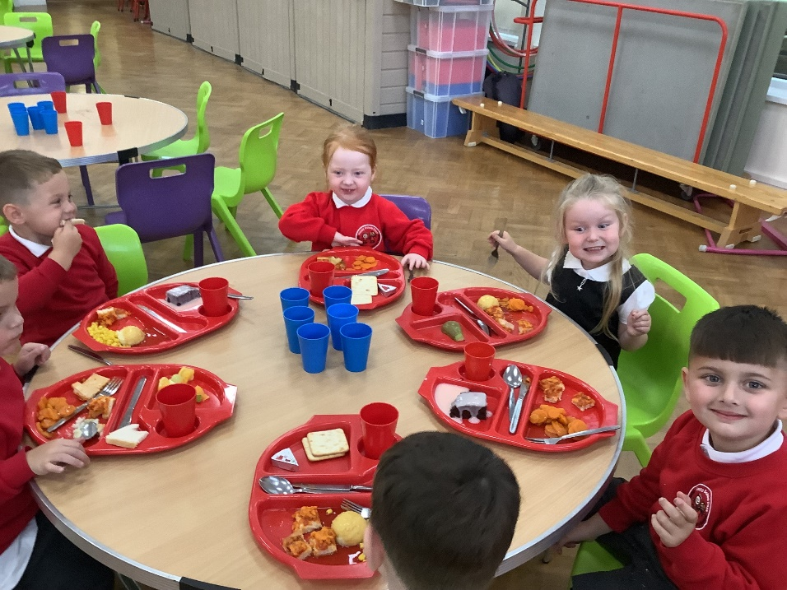
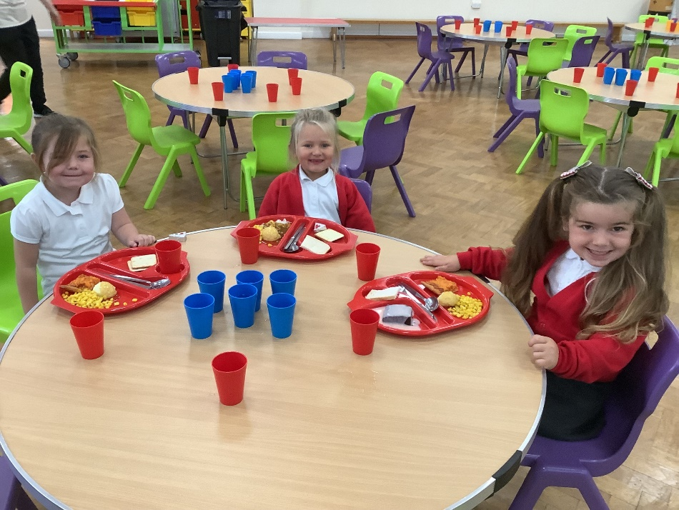
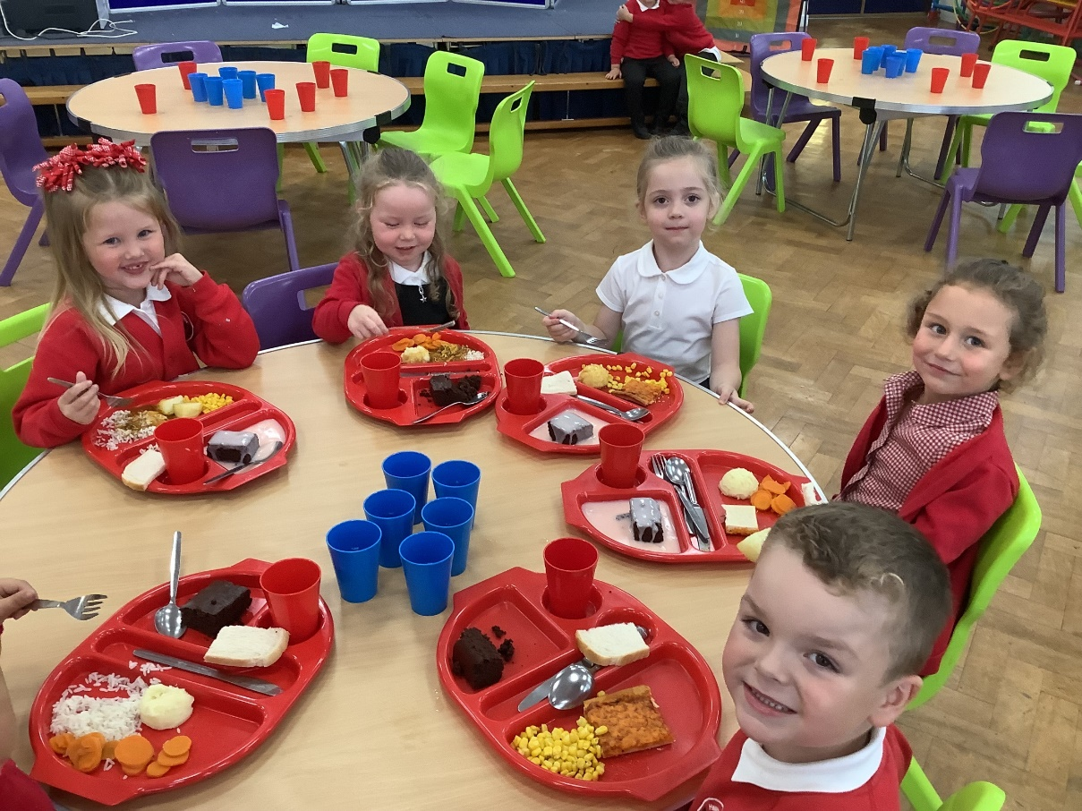
Lunchtime
Menu’s can be found on the school website.
Snack and milk will be offered in class daily.
Check the menu with your child, if there are days when you know your child will struggle you can contact the school office to order a packed lunch.

Slide 7
Phonics and Reading
Sounds write programme, teaches reading, writing and spelling. Taught daily.
There will be a separate reading talk in October but…
Children are given a reading book when they are ready and have early knowledge of some of the ‘initial code’ (letter sounds) please don’t worry if some children receive their reading book before yours child.
In the meantime, children might be given some reading homework, in the form of ‘sheets’. Glue, scissors and pencils may be needed.
When your receive a reading book it must be read daily please sign the reading diary and write a short comment.
You must also write a comment to state that you have completed a reading activity sheet.

Slide 8
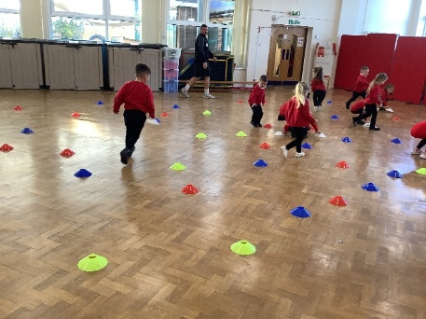
PE
Physical development is on of the three prime areas of the Early Years, opportunities for children to be physical are built into each day by exploring our reception environment both indoors and out.
Kinetic letter is our handwriting programme in school, through these sessions children work on their gross and fine motor skills. Strong bodies make strong writers!
Formal PE lessons begin after half term in small groups so please have a PE kit ready and labelled for then. Children come to school on PE days ready in their kit. You will receive notification when PE lessons will start.

Slide 9
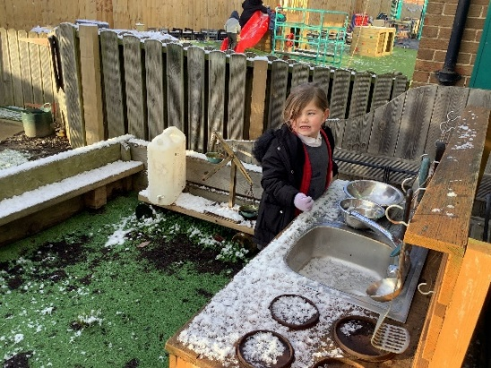
What does my child need to bring to school each day?
1. Warm waterproof coat (soon hats, gloves and scarves).
2. Their reading book and book bag (please keep water bottles out of the book bags)
3. A school water bottle filled with water. (No juice or flavoured water)

Slide 10
Please can you provide:
Spare clothes –there are occasional accidents and we do get messy! Children get the opportunity to be out in all weathers, they do play with mud and paints.
Wellies (labelled)
PE Kit once informed

Slide 11
Mrs Burdon
Is our Deputy Head teacher and SEND co.
If your child has any additional needs or difficulties you may already have met Mrs Burdon.
If your child’s class teacher identifies difficulties or additional needs they will liaise with you and may seek support and advice from other professionals. Mrs Burdon will work closely with you and your child’s class teacher.

Slide 12
Drop off/collection procedures
The school gate opens at 8:45am and closes at 8:55am.
If your child is late you must go to the school office, pick up a late slip and then return to the late gate. Lateness and attendance is rigorously monitored and challenged. It is vital children are on time and present when they are well.
The reception yard gate is accessed at the back of the school (next gate up from nursery)
Collection time is 3:15pm from the same gate.
Please enter the yard but stand behind the ‘line’ staff will dismiss children form their class door.
Please be patent especially at first while we get to know names and faces. –They leave one at a time.
Ensure collection records are up to date and that you let the office know any changes.
For safety reasons please ensure your child does not

Slide 13

Keeping in touch:
On the gate (please keep messages brief at drop off and collection as this can be a very busy time) phone the office any time to arrange an appointment to speak with a teacher.
Office e-mail: office@biddickhallinfants.co.uk facebook tapestry
Reach more parents app (please download this app as we are now ‘paperless’) all communication and consent is via this app.

Slide 14
Please ensure that if you have not returned your information packs (emergency contact and collection information) that you do so asap.

Slide 15
Anyone who receives free school meals/benefit entitlement can get a supermarket voucher to help with the cost of uniform. Please get in touch with the office if you think you are eligible and have not yet received one.

Slide 16
Please label all clothing and shoes

