Slide 1


St. Oswald visit to Newcastle DXC
As part of the Sunderland Software City Go Reboot Programme

Slide 2
Students taking part in STEM activities

Slide 3
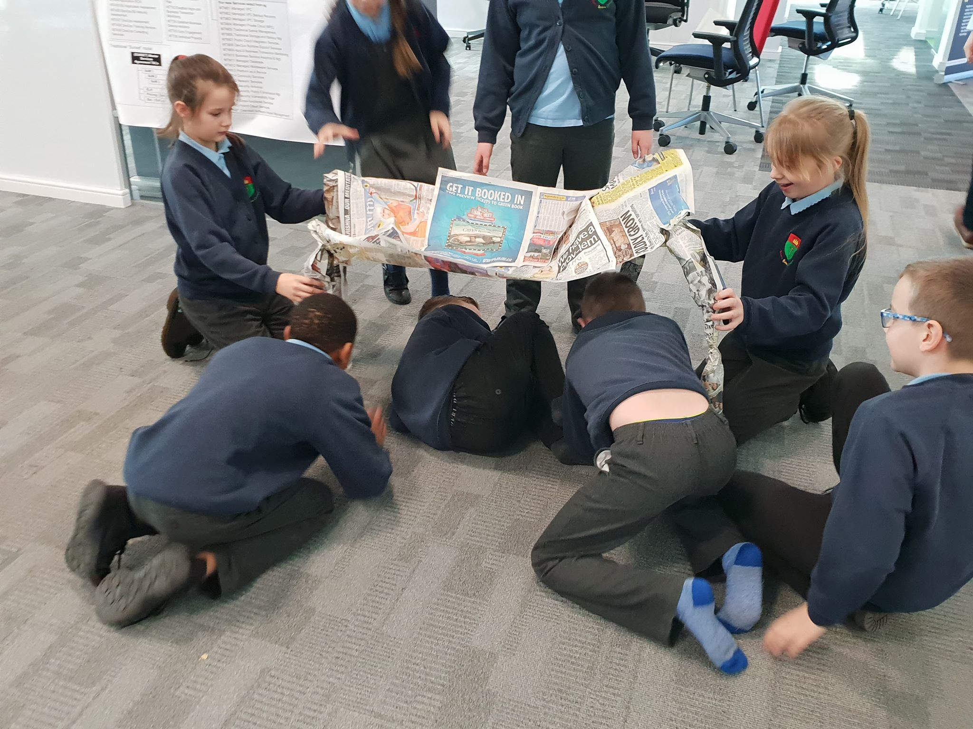
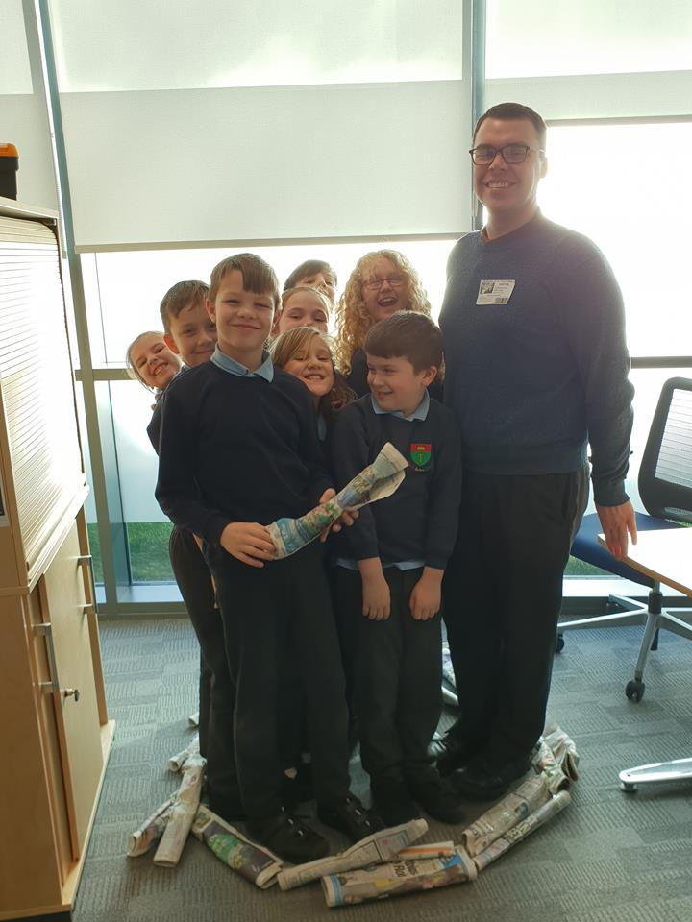

Slide 4
Our NEW Chill Out Room!
Thank you for your fantastic ideas….

Slide 5
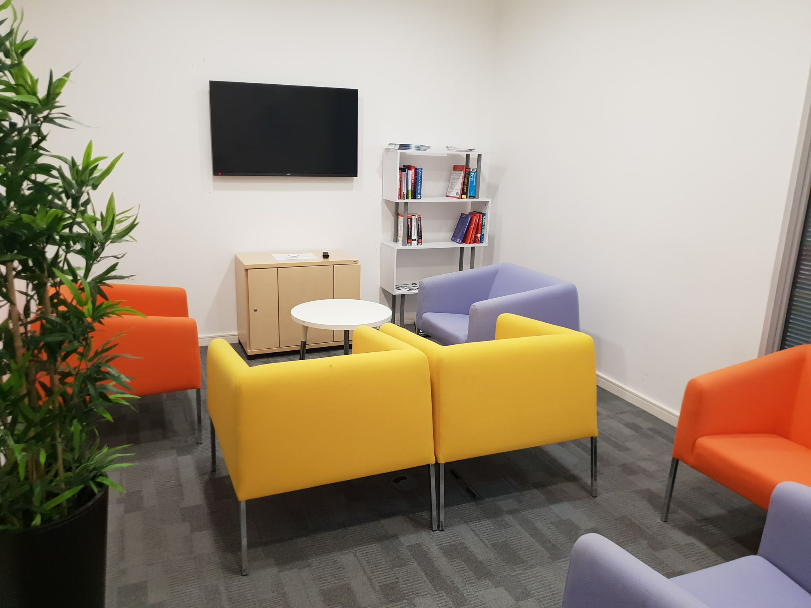
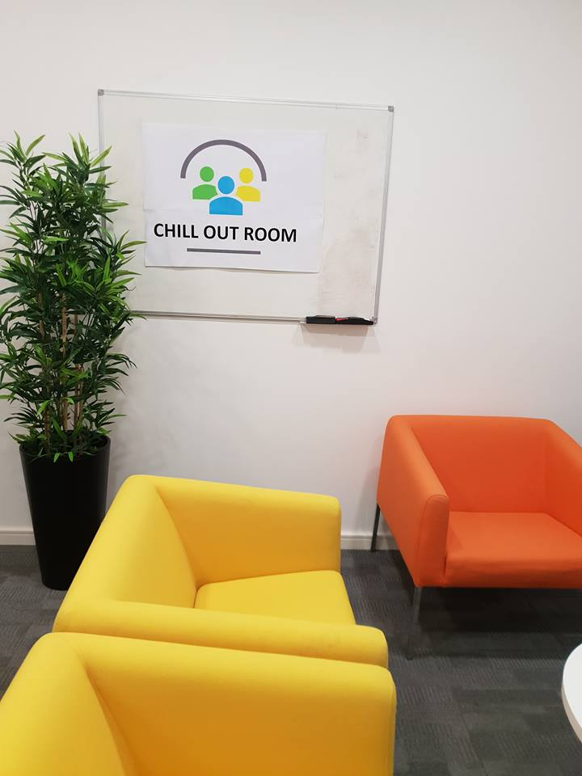
Our Chill Out Area!

Slide 6


