Slide 1
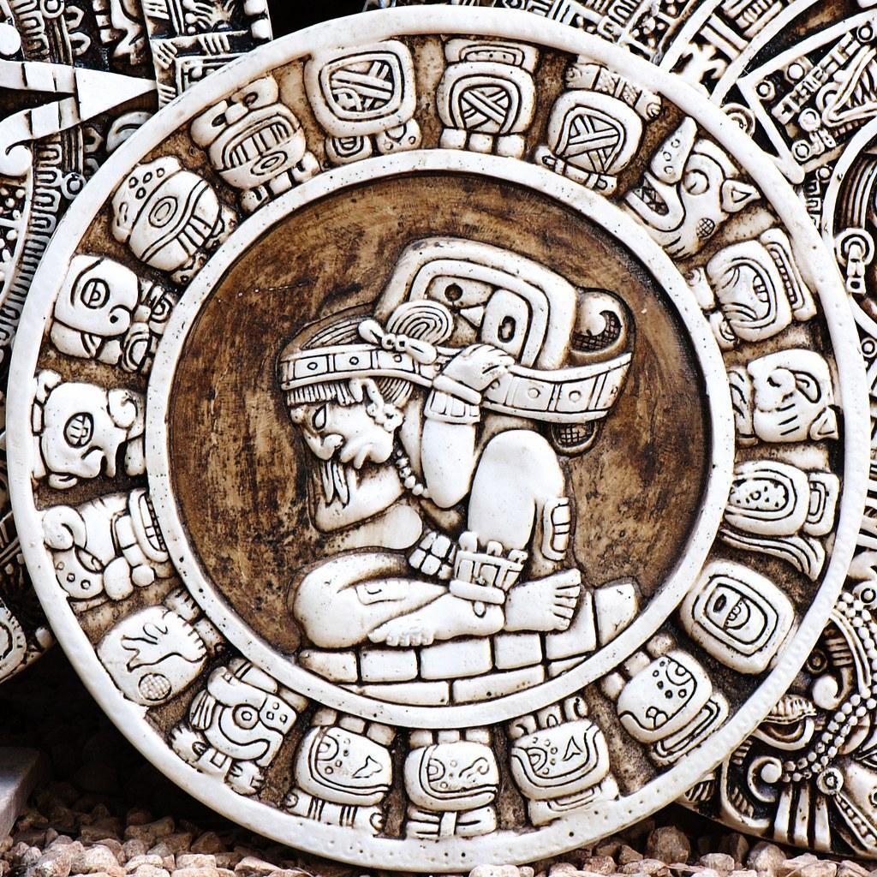
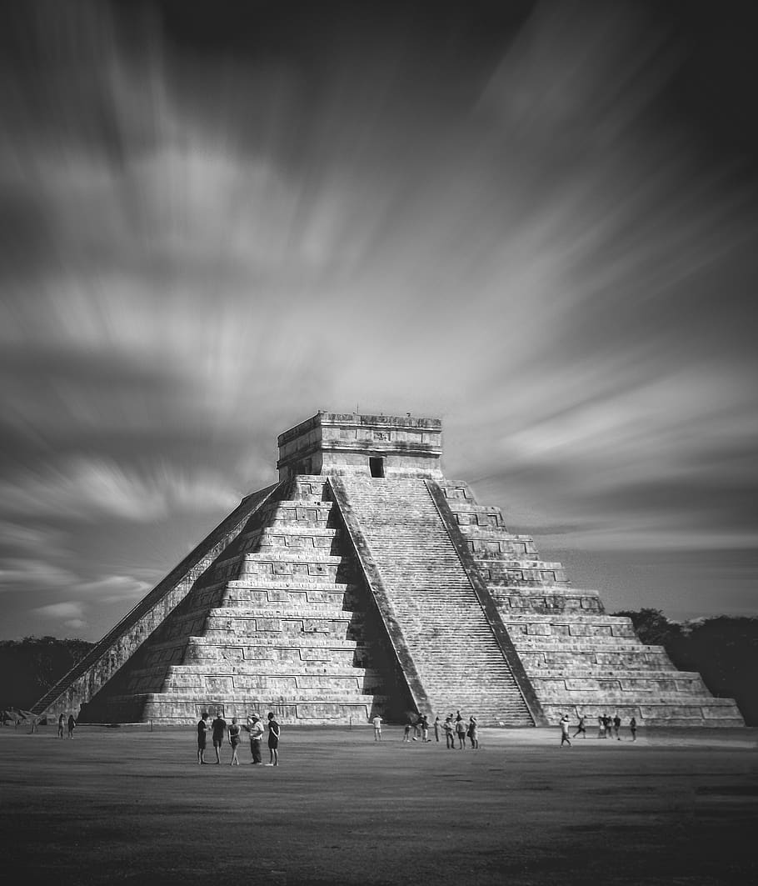
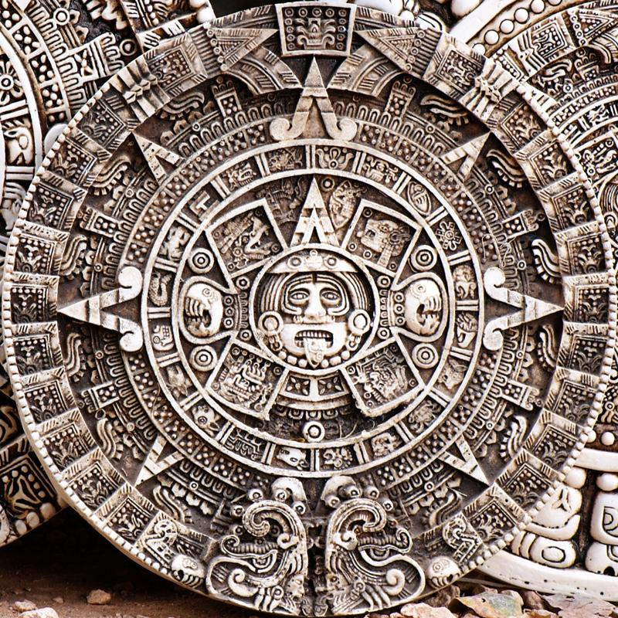
Mayans
Riayana
English

Slide 2
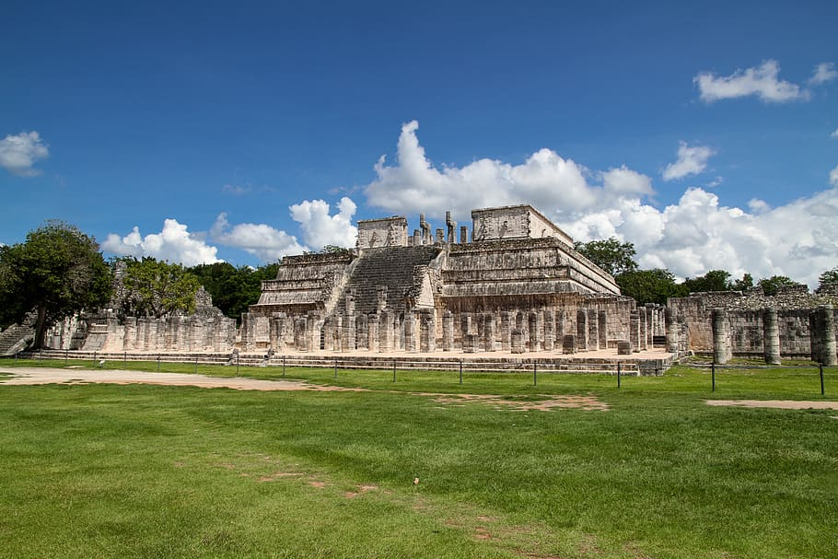
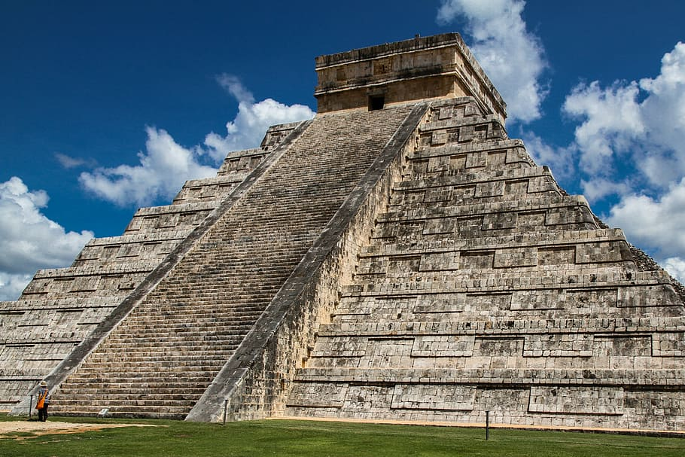
The Mayans
The Mayans civilization was a Mesoamerican civilization developed by the Mayans peoples.It is believed today that the Mayan peoples began to settle in the Yucatan area of what is now Mexico between 2600 BC and 1800 BC.
Europeans first discovered the Americas in 1492 when Christopher Columbus first sailed from Europe to America. He returned with tales of a rich and vast land filled with gold and other precious materials.After that,many other Europeans sailed to America in search of gold and glory.
The Ancient Mayans developed the science of astronomy,
Calendar systems,and hieroglyphic writing.They were also known for creating elaborate architecture ,such as pyramids,temples and palaces.
Did you know? The Mayan civilization were people who lived in Central America.They lived there for a long time.

