Slide 1
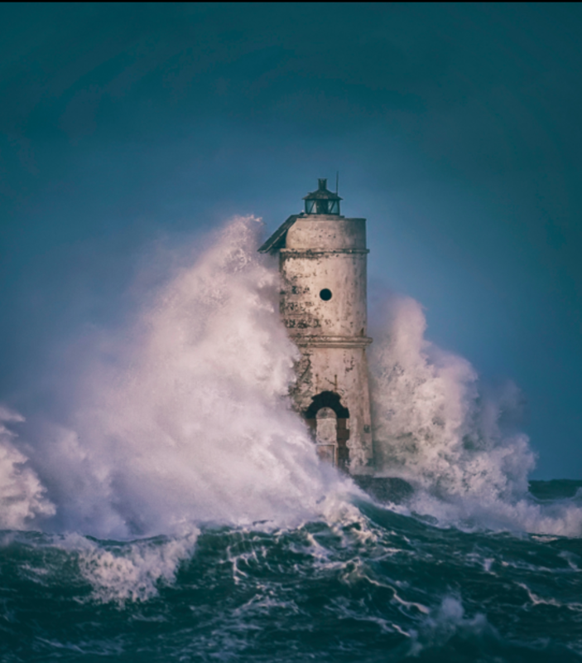
The Lighthouse

Slide 2
Can you describe what it feels like to be caught in a storm?
I think it would be scary because the lightning might strike and possibly electrocute you or me.

Slide 3
What do you think the men heard when they listened to the storm?
I think they heard the thunder.

Slide 4
Who might the men in the lighthouse be?
I think lifeguards

Slide 5
Why are they huddled together?
Because they are scared

Slide 6
What is the purpose of a lighthouse?
To tell the boats in the dark that there is rocks near by. They warn the boats by turning the light on.

Slide 7
What would happen if there were no lighthouses in the world?
All the boats would crash and sink.

Slide 8
How do you think someone first invented lighthouses?
By seeing titanic sink by crashing on the rocks

Slide 9
Can you think of an alternative way to guide ships?
Put lights on the front of the ship

Slide 10
Do modern lighthouses require people to work inside them?
Yes, of course most of them do.

