Slide 1
Mayans
By Cameron

Slide 2
introduction The ancient Maya were united by belief systems, cultural practices that included a distinct architectural style, and a writing system. They were also joined by political interaction in the form of warfare and intermarriage.

Slide 3
facts
The Maya civilization was a Mesoamerican civilization developed by the Maya peoples, and noted for its logo syllabic script—the most sophisticated and highly developed writing system in pre-Columbian Americas—as well as for its art, architecture, mathematics, calendar, and astronomical system.
Two thousand years ago, the ancient Maya developed one of the most advanced civilizations in the Americas. They developed a written language of hieroglyphs and invented the mathematical concept of zero. With their expertise in astronomy and mathematics, the Maya developed a complex and accurate calendar system.

Slide 4
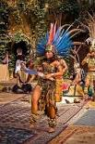
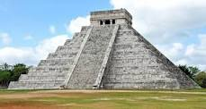
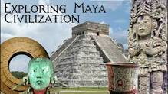
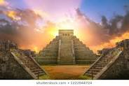
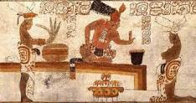
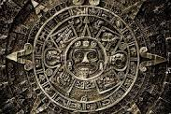
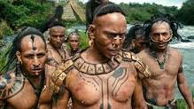

Slide 5
Did you know?
THEY HAD PRETTY INTENSE BEAUTY REGIMENS.
THEIR PYRAMIDS AND CITIES ARE STILL BEING DISCOVERED.
The Mayans were the indigenous people of Mexico and Central America. The term Maya came from the ancient Yucatan city of Mazapan, the capital of the last Mayan Kingdom.
Between 250 and 950 CE came to be known as the Classic Maya Period which saw the emergence of the great cities of the Yucatec Maya.
It was in this period that saw the height of the Mayan civilization when mathematics

