Slide 1
Welcome to Year 2
October 2018
Mrs Wann

Slide 2
Year 2
Reading
October 2018
Mrs Wann

Slide 3
Reading is the most important skill that children need to master in Primary school.
Reading unlocks the curriculum.

Slide 4
Children need to read : -
In Maths – instructions word problems , tasks,
To learn about History
To understand Science
To know how to use computers
To design and create
To discover Art
To communicate effectively
To follow instructions in PE
To learn about religions
To understand our world
To write

Slide 5
Guided Reading
At Stanhope Primary children have at least 1 guided reading session each week with their teacher.
Sometimes this is a taught comprehension, sometimes this is word based reading and sometimes this is based on a book which could be either fiction or information based.
Every day children will be involved with reading activities .

Slide 6
Children need to read words by sight
Practise every day
Common Exception words
Reading from a book
Reading by sight (not sounding out) words in our weekly spelling patterns – not just the ones on the list as many as you can find.

Slide 7
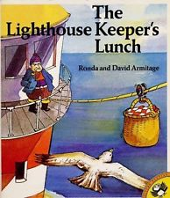
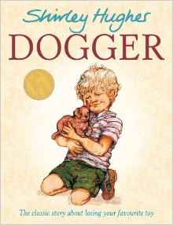
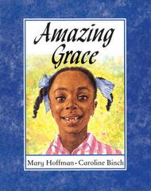
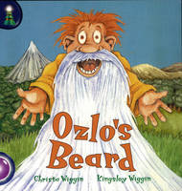
Where do we begin?
Prediction - what could be inside the book.
Use the title and the images on the front cover – allow the children to guess using what they can see and read - How many different ideas can they come up with?

Slide 8
To read a familiar book fluently with expression .
Once your child has read their book - ask them to practise again and read it out loud as if they were on a stage performing it for others to hear. This can be a lot of fun - especially if there are different characters in the story.
You might even find some dressing up clothes to add to the excitement.

Slide 9
Reading is not just reading words.
It is understanding what has been read.
This means - using punctuation correctly - a child who does not stop at a full stop - has not understood what is happening (and will not use full stops in their writing).
E.g.
The cat ran down the street there was a dog.
The cat ran. Down the street there was a dog.
It means understanding the words and explaining - e.g. the giant stomped down the road - question -How did the giant feel?
How does stomping mean you are feeling?
Lost in the jungle - e.g.

Slide 10
Children in year 2 need to explain about characters, setting, plot and be able to answer inference based questions.
Anna was waiting for a parcel. It was late. She was cross because the guests would be arriving soon.
Why was Anna cross?
Who might the guests be?
What might be in the parcel?
Why might the parcel be late?
What will happen next?
How old do you think Anna is? Why?
Which word tells you what Anna was doing? What type of word is it?
What adjectives could you add to improve the text?

Slide 11
Children will be challenged to locate words and phrases.
E.g. Find me the adjectives that describe the …….
Which phrase tells you where the character is?
Children who are able readers can – improve the story with more exciting words - write a book review for other children - create another story using the same characters turn it into a play research independently using index and contents page

Slide 12
The right level
Does your child understand the vocabulary - ask them to explain words - ask them to say the word in a sentence – to check understanding.
Just because they can read it does not mean they understand it.
It is vital that children remain on certain levels of books in school.
We work hard to fill in comprehension and understanding.
A child should be able to discuss a book that they have read without looking back at pages. The should be able to summarise a story and talk about facts that they have learned in an information book.

Slide 13
Working towards Year 2 comprehension – Mum’s new baby
Jenny’s Mum went to hospital to have the baby. It was a boy. Jenny was glad. Mum came home with the new baby.
“We will call him Joe,” she said.
“I wanted to call him Mark,” said Jenny.
Q. Where did Mum go with the new baby? to the hospital home shopping to school
Q. What did Jenny want to call the baby?
Joe Tom Mark Simon

Slide 14
Expected level.
Once upon a time there lived a blackbird and his wife. They sang so sweetly that everyone passing beneath the tree would stop and listen. It was the most beautiful music; it was as though gold and silver rain were falling into your ears. One day the king was passing and he heard the two birds singing. He said to his servants, “Catch those birds! I will keep them in a silver cage and they will sing to me.” So the servants set a trap, but they only caught one of the birds: the blackbird’s wife. They put her into a silver cage and hung her over the king’s bed. But she was so sad that she wouldn’t sing at all. As for the blackbird, when he saw that his wife had been trapped, he was angry. He took a sharp thorn for a sword and took half a walnut shell and wore it as a helmet. With the other half, he made himself a little drum. Soon he was marching towards the palace, beating the drum: rat-tat-tat.

Slide 15
How does the author describe the sound that the blackbirds made?
Why did the author use the sentence? it was as though gold and silver rain were falling into your ears.
Why did the king want to have the blackbirds?
Why was the blackbird’s wife sad?
What instrument did the blackbird play on the way to the palace?
Why was the blackbird drumming on his way to the palace?

Slide 16
Find a quiet time every day - make it a routine - make it fun. Reading is not just about listening . It is about reading to your child too. Share your love of reading.
Tell family tales
Children love to hear stories about their family. Talk about a funny thing that happened when you were young.
Create a writing toolbox
Fill a box with drawing and writing materials. Find opportunities for your child to write, such as the shopping list, thank you notes, or birthday cards.
Be your child's #1 fan
Ask your child to read aloud what he or she has written for school. Be an enthusiastic listener.
One more time with feeling
When your child has sounded out an unfamiliar word, have him or her re-read that sentence. Often kids are so busy figuring out a word they lose the meaning of what they've just read.
Create a book together
Fold pieces of paper in half and staple them to make a book. Ask your child to write sentences on each page and add his or her own illustrations.
Do storytelling on the go
Take turns adding to a story the two of you make up while riding in a car or bus. Try making the story funny or spooky.
Point out the relationship between words
Explain how related words have similar spellings and meanings. Show how a word like knowledge, for example, relates to a word like know.
Use a writing checklist
Have your child create a writing checklist with reminders such as, "Do all of my sentences start with a capital? Yes/No."
Quick, quick
Use new words your child has learned in lively flash card or computer drills. Sometimes these help kids automatically recognize and read words, especially those that are used frequently read anything any time anywhere - shopping lists, signs, letters, maps, museums,

Slide 17
Writing Meeting for Parents
Monday 1st October 2018

Slide 18
Year 2 expectations
Spelling
Grammar
Punctuation
Content
Handwriting

Slide 19
The Expected Year 2 writing curriculum.
Working at the expected standard
The pupil can, after discussion with the teacher:
• write simple, coherent narratives about personal experiences and those of others (real or fictional)
• write about real events, recording these simply and clearly
• demarcate most sentences in their writing with capital letters and full stops, and use question marks correctly when required
• use present and past tense mostly correctly and consistently
• use co-ordination (e.g. or / and / but) and some subordination (e.g. when / if / that / because) to join clauses
• segment spoken words into phonemes and represent these by graphemes, spelling many of these words correctly and making phonically-plausible attempts at others
• spell many common exception words*
• form capital letters and digits of the correct size, orientation and relationship to one another and to lower-case letters
• use spacing between words that reflects the size of the letters.

Slide 20
Spelling

Slide 21
Year 1 - spelling
Statutory requirements
all letters of the alphabet and the sounds which they most commonly represent.
consonant digraphs which have been taught and the sounds which they represent. sh, ch, th. ck, ll, ss, zz, ng
vowel digraphs which have been taught and the sounds which they represent. Phase 3 and 5 ai, ee, oi, or, ay, ea, ie, ou etc
the process of segmenting spoken words into sounds before choosing graphemes to represent the sounds.
words with adjacent consonants. phase 4 - must, crunch
guidance and rules which have been taught – ay at the end of words

Slide 22
Year 1 extract
Adding s and es to words (plural of nouns and the third person singular of verbs) If the ending sounds like /s/ or /z/, it is spelt as –s. If the ending sounds like /ɪz/ and forms an extra syllable or ‘beat’ in the word, it is spelt as –es. cats, dogs, spends, rocks, thanks, catches
Adding the endings –ing, –ed and –er to verbs walked talked played
The past tense of some verbs may sound as if it ends in /ɪd/ - wanted
If the verb ends in two consonant letters (the same or different), the ending is simply added on. hunting, hunted, hunter, buzzing, buzzed, buzzer, jumping, jumped, jumper
Adding –er and –est to adjectives where no change is needed to the root word grander, grandest, fresher, freshest, quicker, quickest

Slide 23
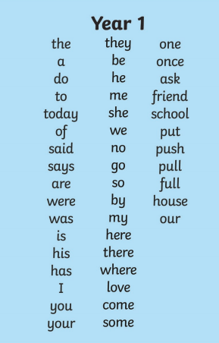
Common exception words Year 1

Slide 24
Spelling Year 2
This is a huge part
By now year 2 children believe that they spell words correctly - the de-learn re-learn process is very tricky and takes time .
High frequency words
Common exception words
Phase 6 words
Suffixes and prefixes

Slide 25
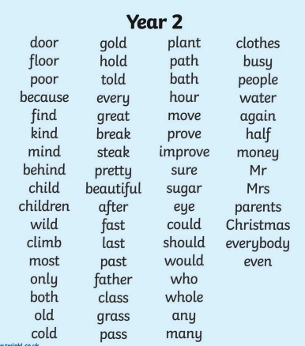
Common exception words Year 2

Slide 26
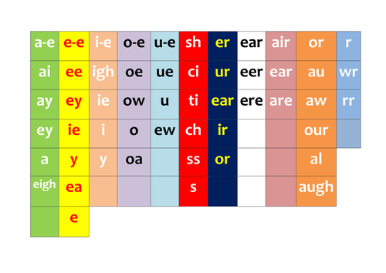
Spelling patterns - some

Slide 27
Homophones
there/their/they’re
here/hear
quite/quiet
see/sea
bare/bear,
one/won
sun/son
to/too/two
be/bee,
blue/blew
night/knight

Slide 28
Suffixes station, fiction, motion, national, section awful, beautiful, assessment, slowly, carefully merriment, happiness, plentiful, penniless, happily
Apostrophes
Belonging
Megan’s, Ravi’s, the girl’s, the child’s, the man’
Omission
can’t, didn’t, hasn’t, couldn’t, it’s, I’ll

Slide 29
Rules Rules Rules copied, copier, happier, happiest, cried, replied
…but copying, crying, replying
Adding the endings –ing, –ed, –er, –est and –y to words ending in –e with a consonant before it
The –e at the end of the root word is dropped before –ing, –ed, –er, –est, –y or any other suffix beginning with a vowel letter is added. Exception: being. hiking, hiked, hiker, nicer, nicest, shiny

Slide 30
Punctuation
Must - all capital letters and full stops must be accurate.
(reading to a full stop is essential for understanding. processing speech in sentences)
Children should also use ? !
Capital letters for proper nouns

Slide 31
Types of sentence
Children must use statement, question , exclamation and command in most pieces of work.

Slide 32




Sid’s Statements
A statement is an information sentence. It tells the reader something.
An example of a statement:
The ship sailed across the ocean.
A statement starts with a capital letter and ends with a full stop.

Slide 33
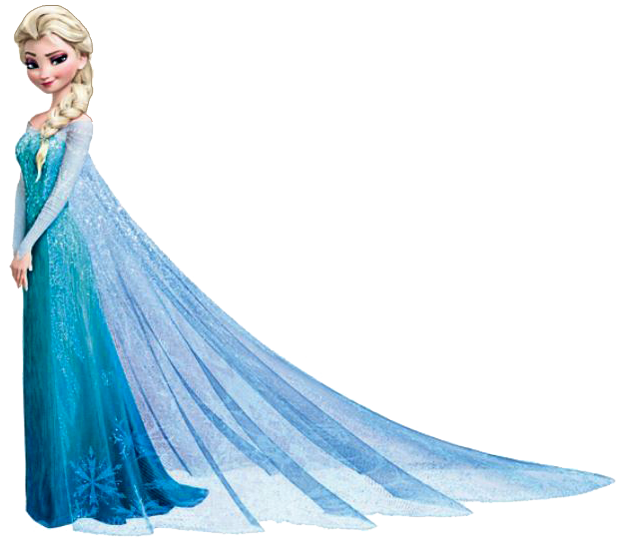

Question Queen
A question asks the reader something. It begins with a question word.
An example of a question:
What colour is the dog?
A question starts with a capital letter and ends with a question mark.

Slide 34


What are question words?
Here are a few:
Were?
Do?
Could?
Who?
Can?
What?
When?
Are?
May?
Where?
Why?
Should?
How?
Did?
Is?
Would?
Which?
Was?
Does?

Slide 35

Command
A command is an order.
A command usually starts with an imperative verb, which is a bossy verb, telling you what to do.
It can end with a full stop or an exclamation mark.
Do your homework!

Slide 36
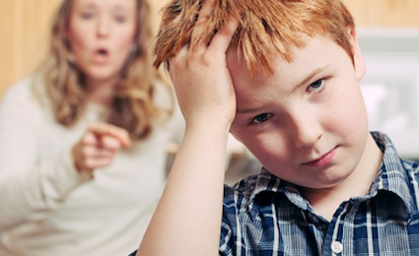
Walk quietly!
Close the door.
Tidy your room.

Slide 37
An exclamation
What a beautiful day it is!
How lovely you look today!
What an exciting adventure it was!
How fantastic is that!
What big eyes you have!

Slide 38
Content
Story, report, recount, instructions, letter, poetry.
Spelling and punctuation
Use of adjectives, range of verbs, time conjunctions, adverbs, apostrophe,
Time conjunction | adjective | noun | verb | adverb | conjucntion
One day Just then After that A few minutes later Suddenly | Red soft green crunchy wet slimy cold warm rough sweet floral | Table chair dog tiger house ship child pencil car lorry | Walk run scamper wander shout sleep carry | Slowly quickly carefully fast hastily | But so because when if or

Slide 39
Example:
One sunny day Jack , who was a small boy, was wandering along the dusty road when a bird fell out of the sky. “What was that?” he whispered. Just then the small, black bird jumped up and began to sing. How sweet the sound was! Immediately Jack sat down on a smooth, grey rock so he could listen to the beautiful song.

Slide 40
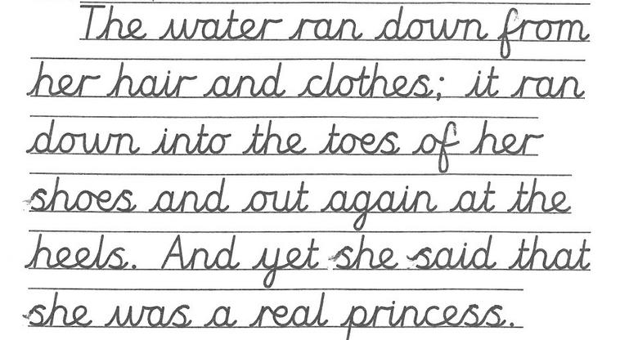
Handwriting
using the diagonal and horizontal strokes needed to join letters in some of their writing
writing capital letters and digits of the correct size, orientation and relationship to one another and to lower-case letters
using spacing between words that reflects the size of the letters.

Slide 41
Key areas to work on at home
Spelling - make it fun - BUT – children need to know the words that they spell incorrectly - identify the tricky bit - practise a few really well each day - keep recalling these to ensure the word is in their long term memory.
Handwriting - watch as they write, which letters are formed incorrectly - practise those letters repeatedly - 5 minutes each day - using gross physical movement first - use felt tips, sand, crayons for letter formation – then when the letter is formed correctly work on position on the line and size - 3 of the same letter are identical.
Finally join.

