Slide 1



Eggsters!
2018

Slide 2
FS1 - am
Best Trier
Tymon Drozdz

Slide 3
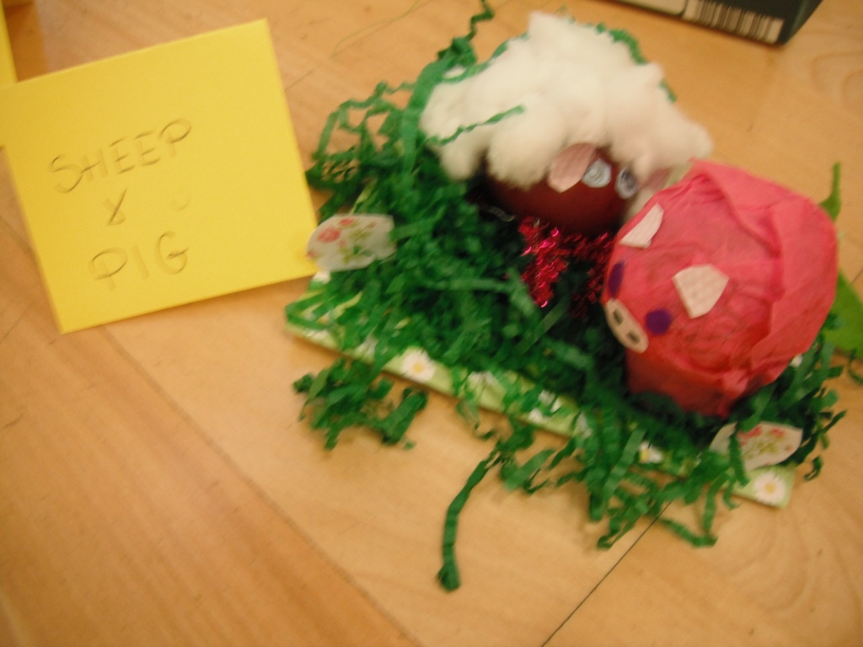
Sheep and Pig

Slide 4
FS1 - am
Winner
Ryan Mclaughlin

Slide 5
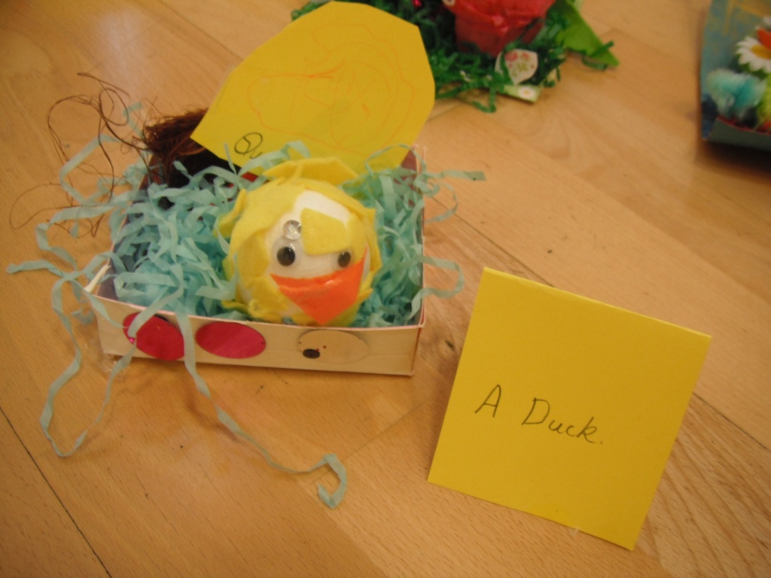
A Duck

Slide 6
FS1 - pm
Best Trier
Shinade Brennan

Slide 7
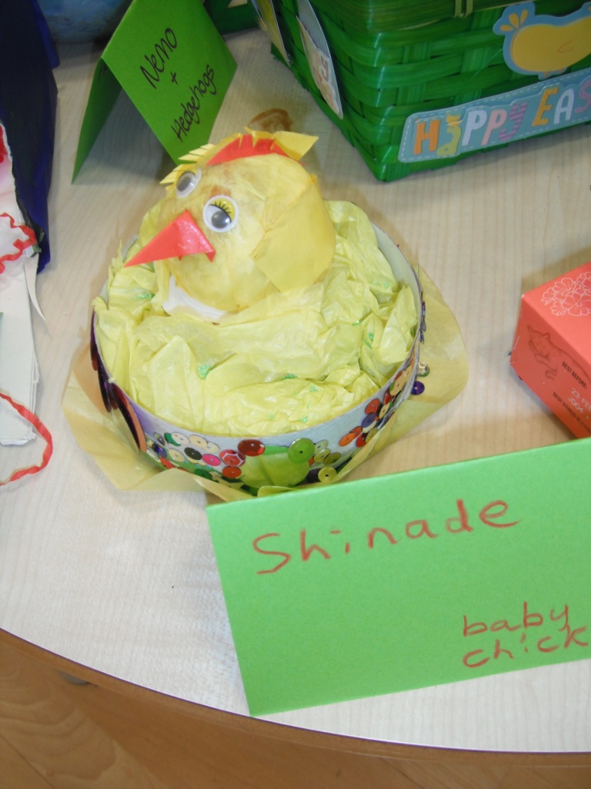
Baby Chick

Slide 8
FS1 - pm
Winner
Scarlett Neilson

Slide 9
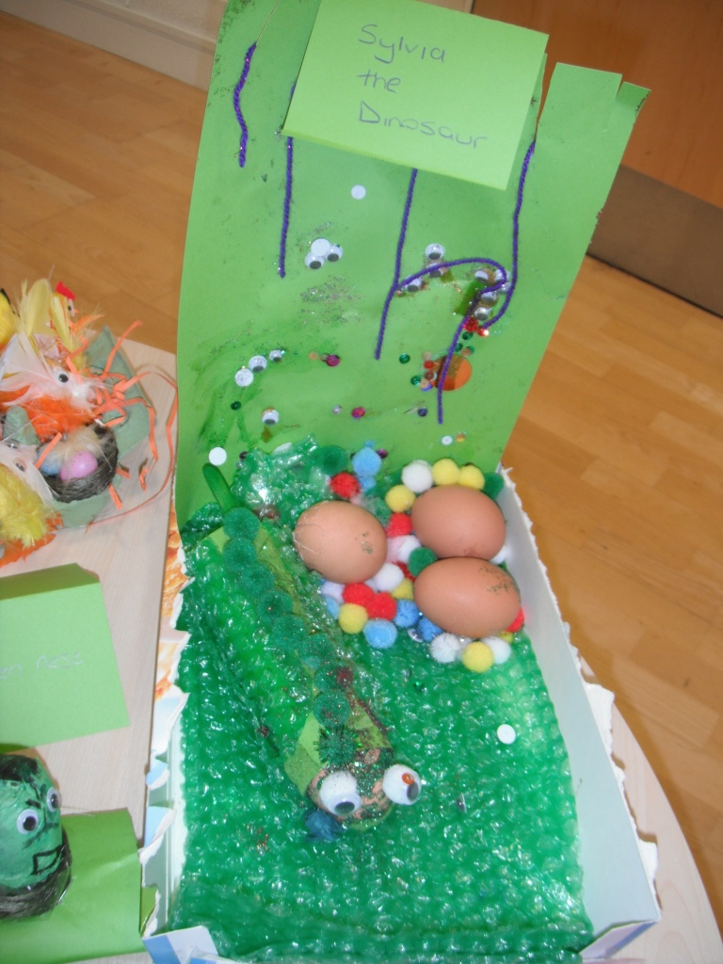
Sylvia
The
Dinosaur

Slide 10
FS2
Best Trier
Sophia Dharmalingham

Slide 11
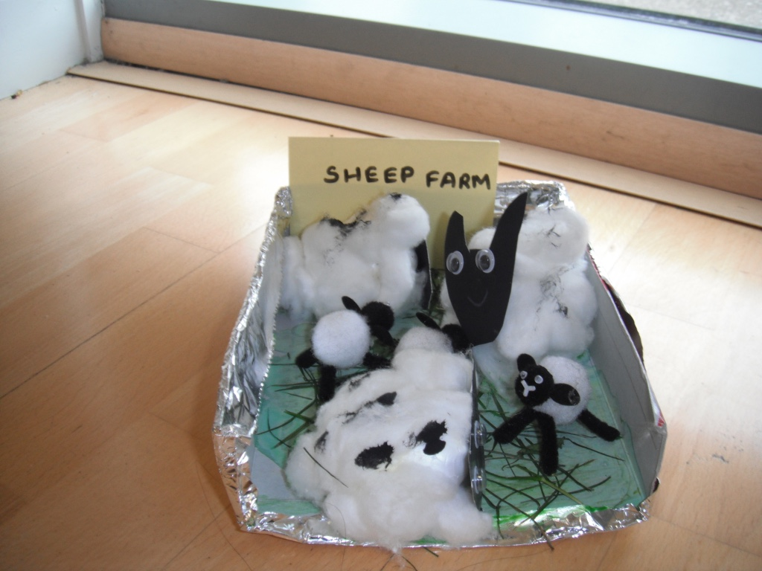
Sheep Farm

Slide 12
FS2
Winner
Lacey Mae Robson

Slide 13
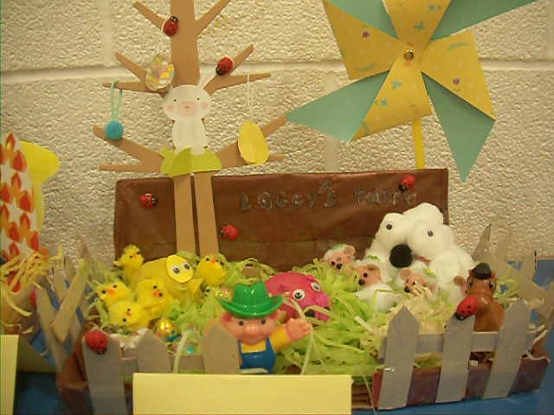
Lacey’s
Farm

Slide 14
1HB
Runner Up
Cody Hedley

Slide 15
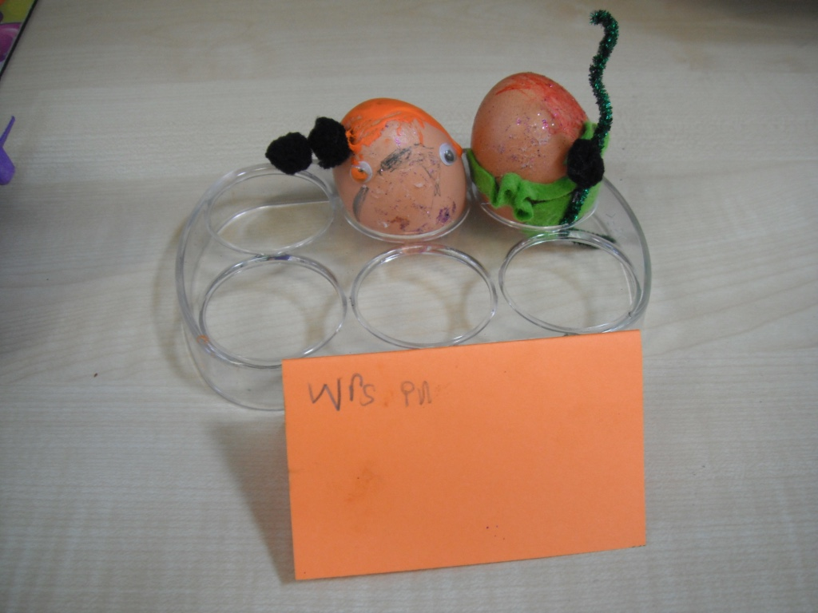
Wrestlers

Slide 16
1HB
Winner
Lily Rooke

Slide 17
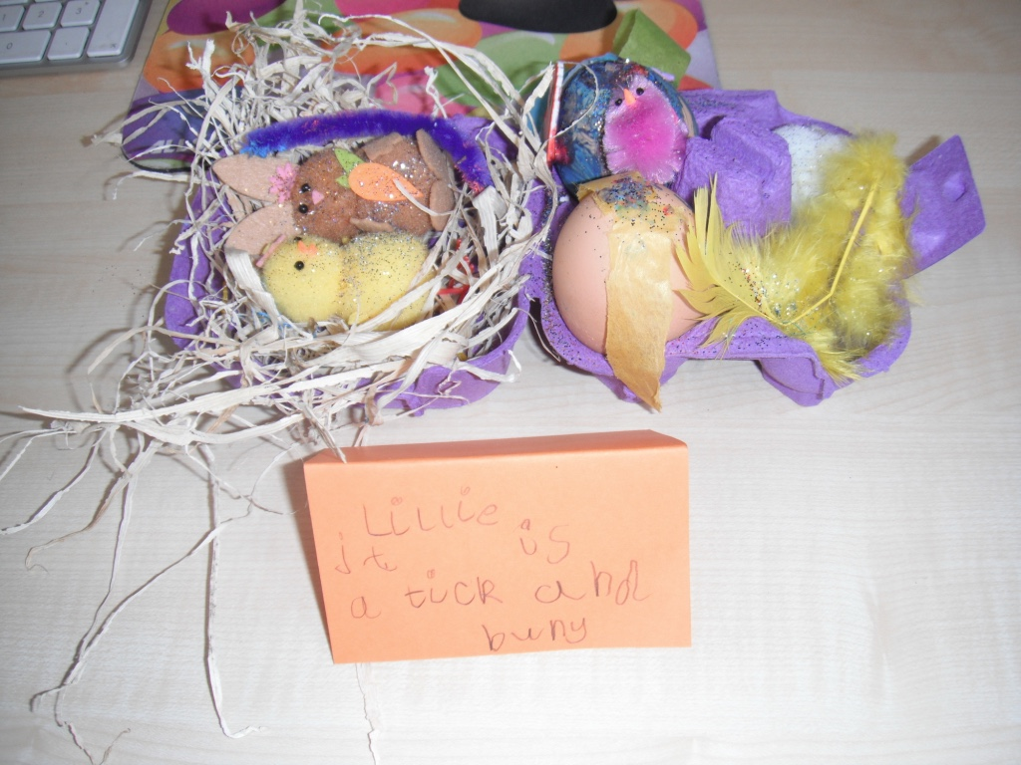
Chick and Bunny

Slide 18
2DW
Runner Up
Uzair Rana

Slide 19
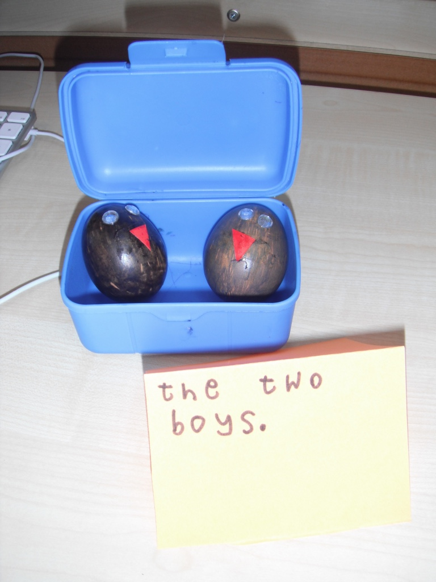
The Two Boys

Slide 20
2DW
Winner
Lewis Wardle

Slide 21
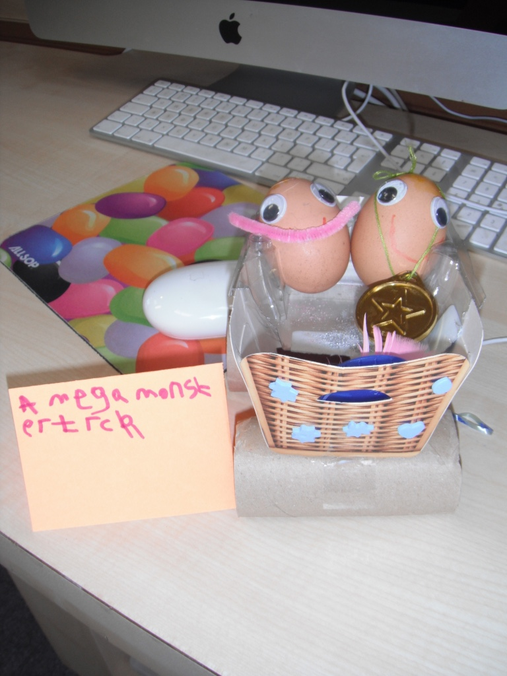
A Mega Monster
Truck

Slide 22
3GB
Runner Up
Maisie Bainbridge

Slide 23
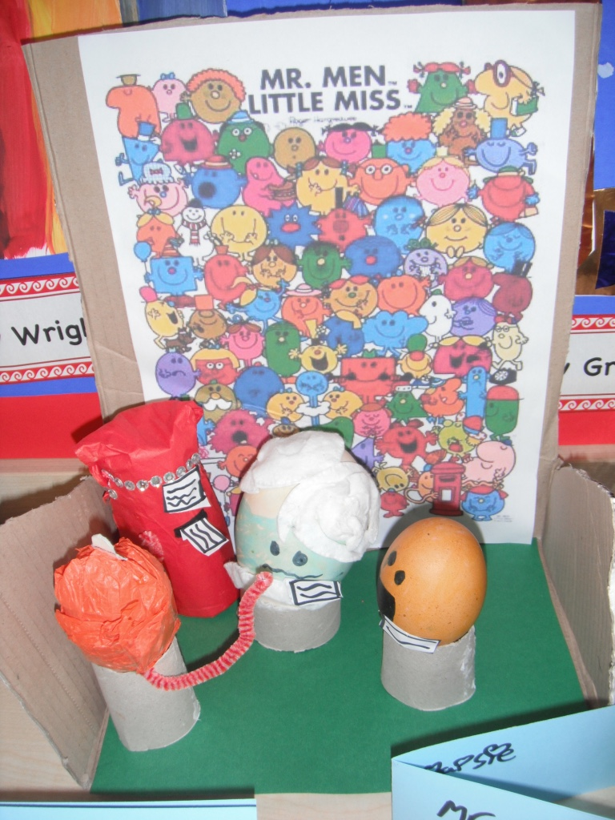
Mr Men

Slide 24
3GB
Winner
Ellie Frame

Slide 25
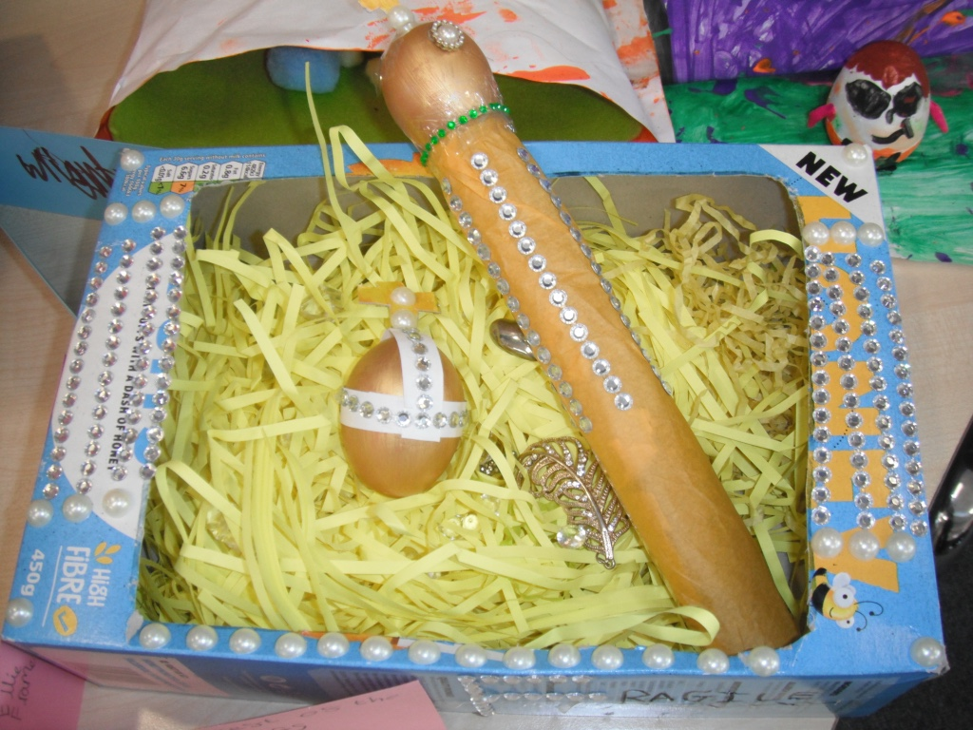
The amazing theft of the Crown Jewels.

Slide 26
4KA
Runner Up
Madison Greener

Slide 27
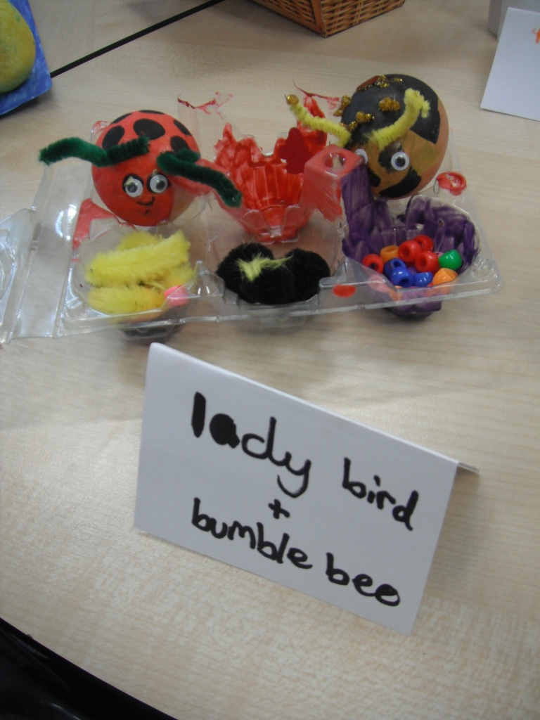
Ladybird and Bumblebee

Slide 28
4KA
Winner
Shari Viney

Slide 29
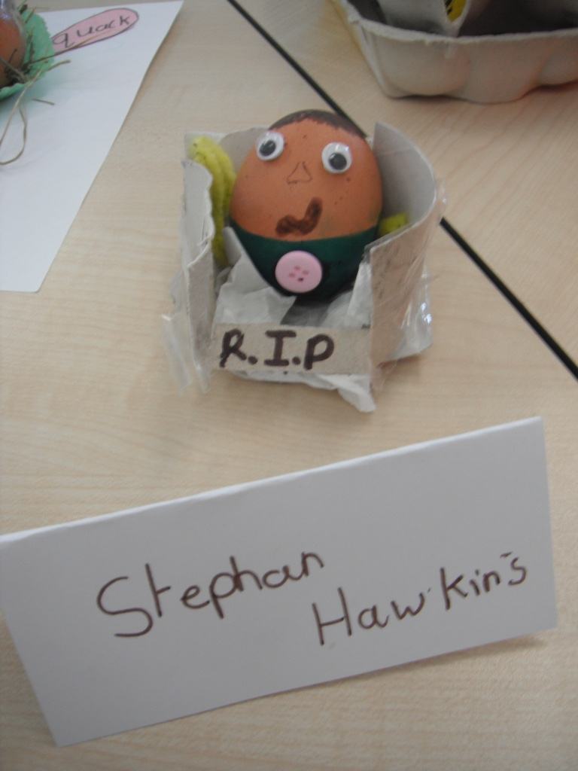
Stephen
Hawking

Slide 30
5JW
Runner Up
Robbie Frame

Slide 31
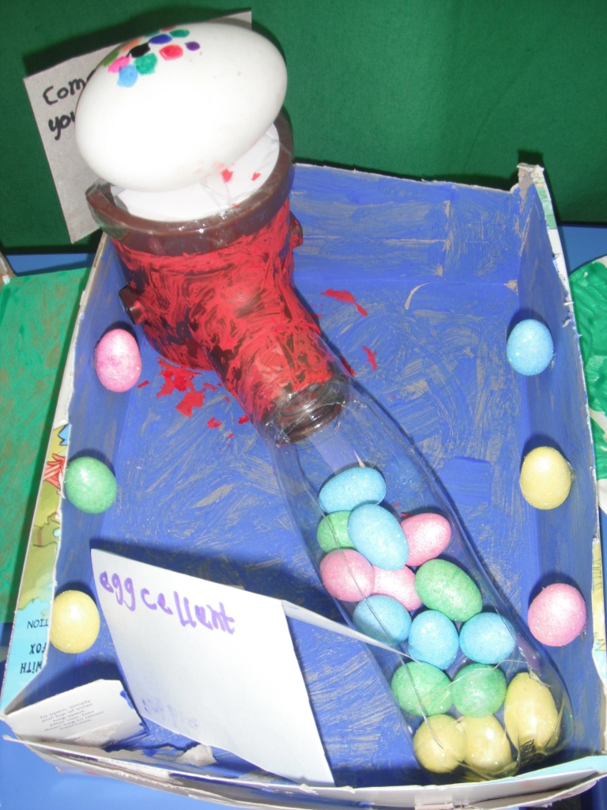
Eggcellent
Gumball
Machine

Slide 32
5JW
Winner
Habiba Khan

Slide 33
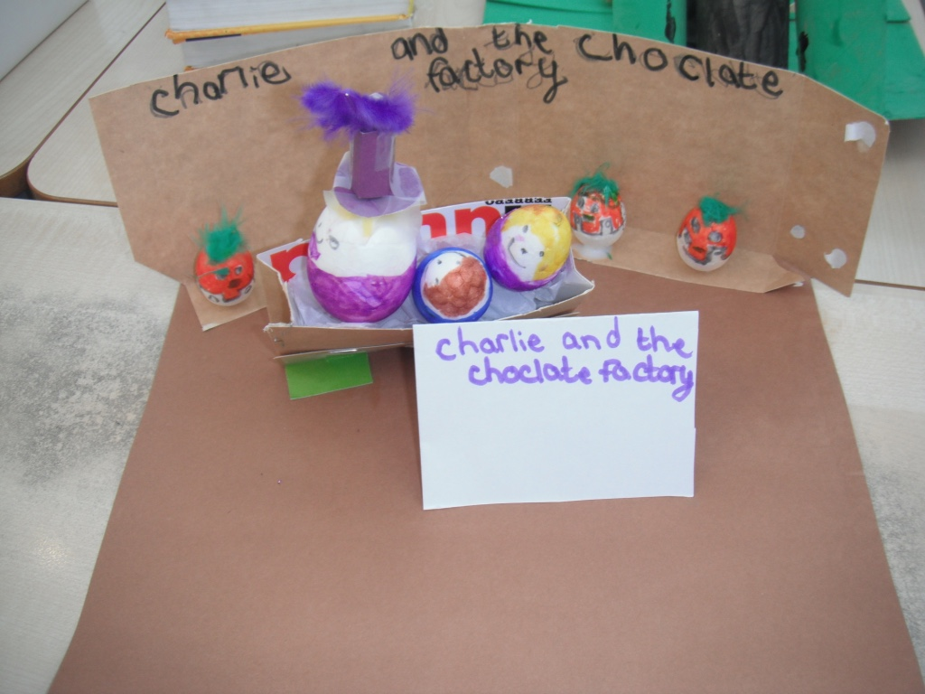
Charlie and the Chocolate Factory

Slide 34
6KH
Runner Up
Maddison Fontaine

Slide 35
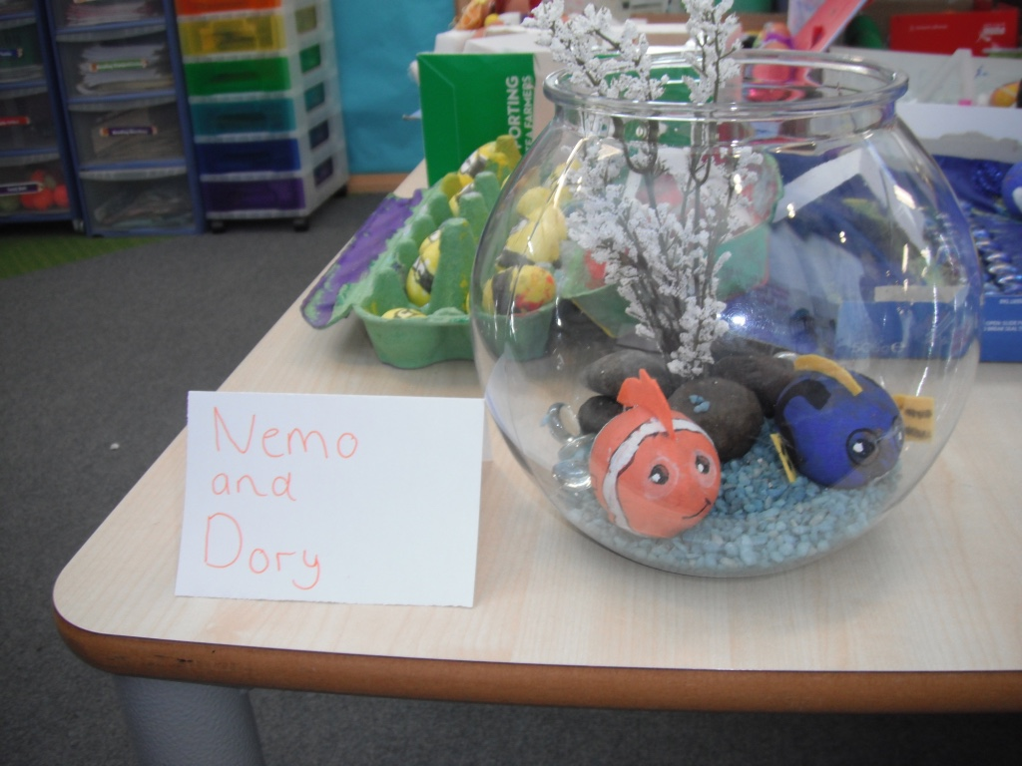
Nemo and Dory

Slide 36
6KH
Winner
Ellie Simpson

Slide 37
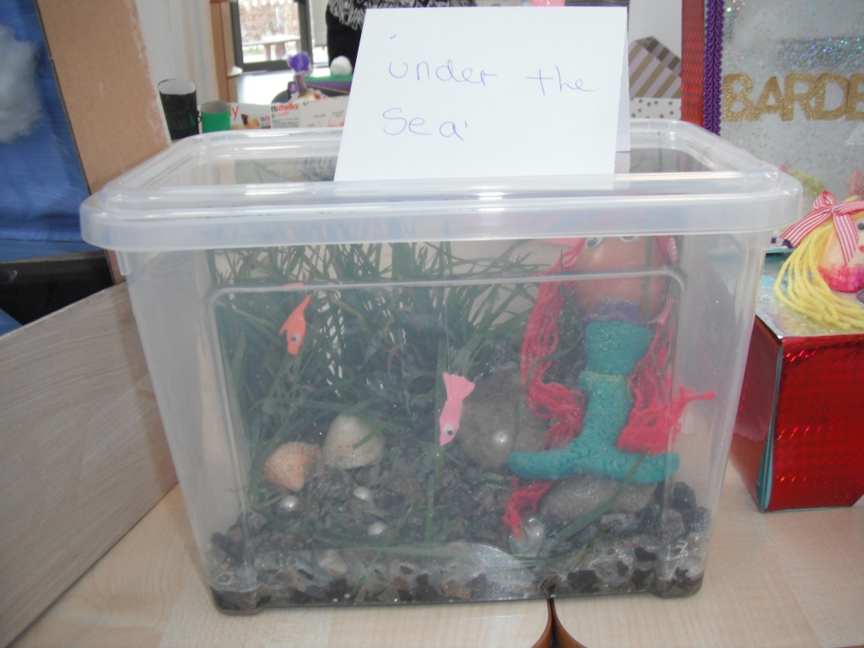
Under the Sea

