Slide 1
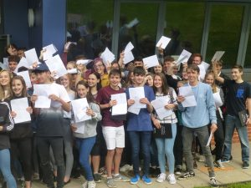
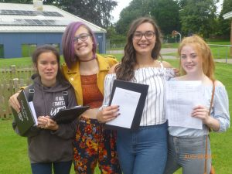
Welcome
2018 Leavers

Slide 2
2018 Leavers
Timeline
GCSEs the key changes
Key dates
Revision Tips
Stress Management
English
Maths
Science
Richard Huish College
Bridgwater and Taunton College
Close

Slide 3
Timeline
September 2006 – Primary Reception
June 2013 – SATs exams Year 6
September 2013 – Court Fields School
Now entering Year 11 September 2017
You have already had 9 years of compulsory education!
GCSEs National competition
Year 11. Total about 26 weeks.
Leavers 2018

Slide 4
Grade 9, top 20% nationally.
National context
Grade 7 = Grade A
Year 10 – Numerical grades for all subjects. Terminal exams end of Year 11.
4 Standard Pass
5 Strong Pass
Grade 5, slightly higher than current grade C.
Grade 1 = Current G.

Slide 5
Year 11 Key Dates
Wednesday 27 September – Curriculum Information Evening
Wednesday 1 November – Progress Report home
Thursday 16 November - Year 11 Parents’ Evening
Progress Report home
Week beginning 8 January - 6 week countdown to the PPEs
Week beginning 26 February – PPEs start for two weeks

Slide 6
Actual Exams/Pre-Public Exams (PPEs)
Actual VCert/BTEC Exams
Sport & Fitness - Tues 17 October at 1.30pm
Food & Cookery … Wed 1 November at 1.30pm
BTEC Music (resit) … Wed 10 January at 9am
PPEs – All in the morning:
Maths (Non-Calculator) – Thursday 2 November
English Language – Paper 1 – Friday 3 November
English Language Paper 2 - Monday 6 November
Maths (Calculator) – Tuesday 7 November
Maths (Calculator) - Wednesday 8 November.

Slide 7
PPEs February
6 week countdown – Week beginning January 8 2018
2/3 weeks of exams
Training for the real thing
Summer Exams – Start week beginning 14 May 2018

Slide 8
Stress Management
Make a list
Learn to relax

Slide 9
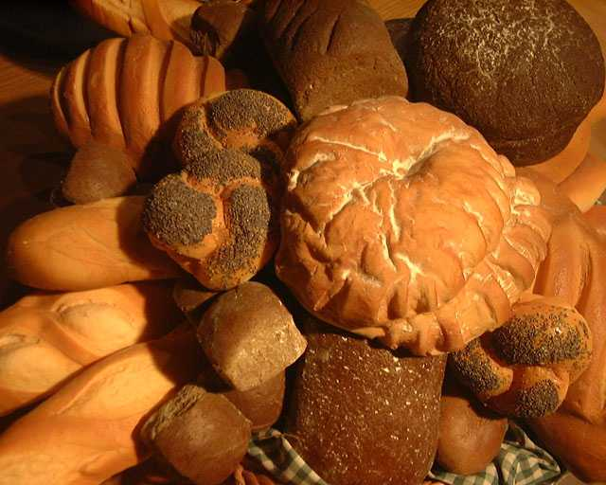
Healthy Body = Healthy Mind
Fruit and vegetables
Water
Bread, pasta, cereals and potatoes

Slide 10
Revision tips:
A quiet place to revise
Establish a routine e.g. revise then have relaxation time
Start revising now up to 2 hours a night 4 nights a week plus work at weekends
Create a revision plan covering all subjects and all topics, especially your weakest areas
Take short breaks
Check the revision timetable for extra revision sessions after half-term
Make revision cards, learn them, test your children on their revision cards
Reports-check current grades against target grades. Contact the school with any concerns
Mobile Phones!!!!☺

Slide 11
Look how much you have done
The course(s)
All exams will be closed text!
English Language
Paper 1 | Creative Reading & Writing (19, 20, 21 C) EXAM
Paper 2 | Non Fiction Reading & Writing (19, 20, 21 C) EXAM
English Literature
Paper 1 | Shakespeare and 19th century fiction EXAM
Paper 2 | Modern fiction and poetry EXAM
Notes:
Good evening.
A year ago I stood here and told you about how much you have to do – look how far you have come!
No into the revision stage!

Slide 12
How NOT to revise
Notes:
Hands up if this is you?
Where to start, what to revise,

Slide 13
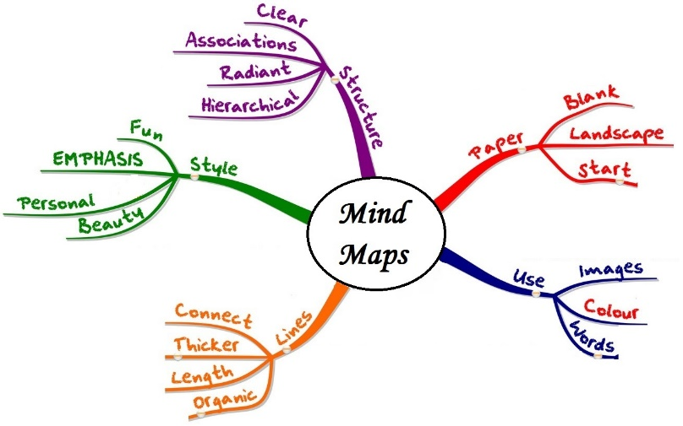
How do successful students revise?
Today’s Key Words
Revise
Your
Key
Words
Every
Lesson.
Check that you can spell your key words, you know what they mean and you can use them in a sentence.
Tell your parents how they relate to your learning from the lesson
GOLDEN RULES
Know the papers
Know your words
Know your gaps
Notes:
Student hand up – how many of you have resorted to ‘reading your text book’ or flicking through the set texts?

Slide 14
English Language – Where to find resources
Google Drive:
Instructions for each question
Read through the instructions. Make flashcards with success criteria and sentence stems
Annotated Exemplars
Read through these. Identify what the student has done well and how. Annotate with your own notes.
Practise Papers
Use your PLC. Focus on the questions you find hard
Mark-schemes (exam board and my version)
Have a go at marking your answer.
Key word lists (toolkits)
Make flash cards. Test yourself. Test each other. Ask your parents to test you. Read an article and find word types / devices / sentence forms

Slide 15
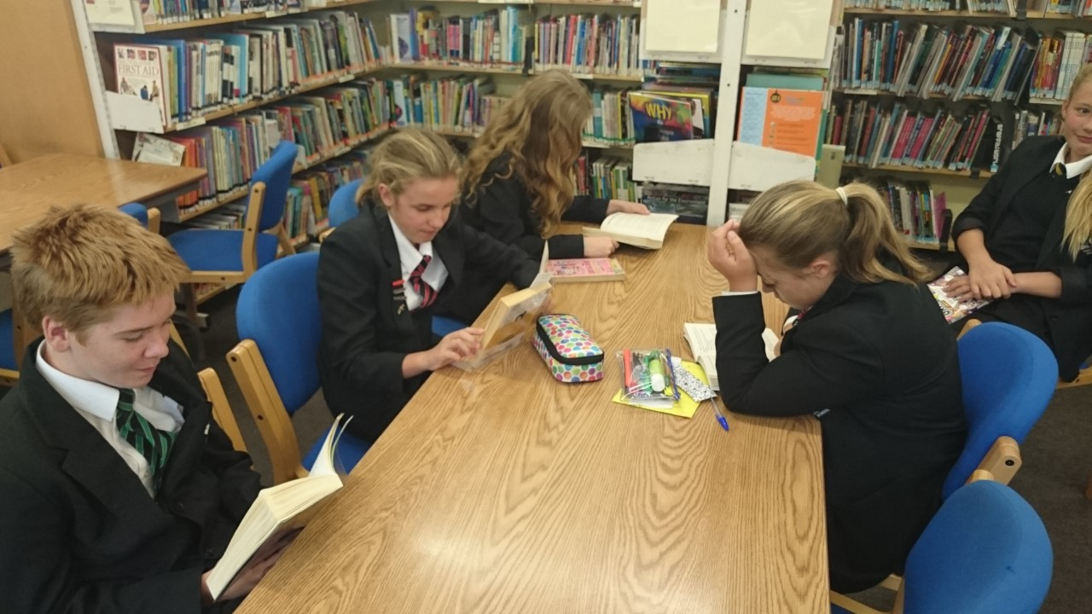
Successful Students READ

Slide 16
English Literature
PIXLIT app
Revision guides and workbooks
Google Drive

Slide 17
Timelines
The witches meet on a heath and plot
Macbeth and Banquo win a battle against a traitor to Scotland
Macbeth and Banquo meet the witches
“In thunder lightening or in rain”
Pathetic Fallacy – Evil

Slide 18
Flashcards
Play Games:
My Last Duchess
Themes = power, madness, control
“I gave commands” – shows power
“His daughters self…is my object”
CONTEXT – based on true historical figure
Ozymandias
Themes = power, power of nature, loss of power, insignificance of man
“Nothing besides remains”
“His daughters self…is my object”
Romantic poet – CONTEXT
Notes:
Match up. Sort based on theme, character, test each other, text yourself

Slide 19
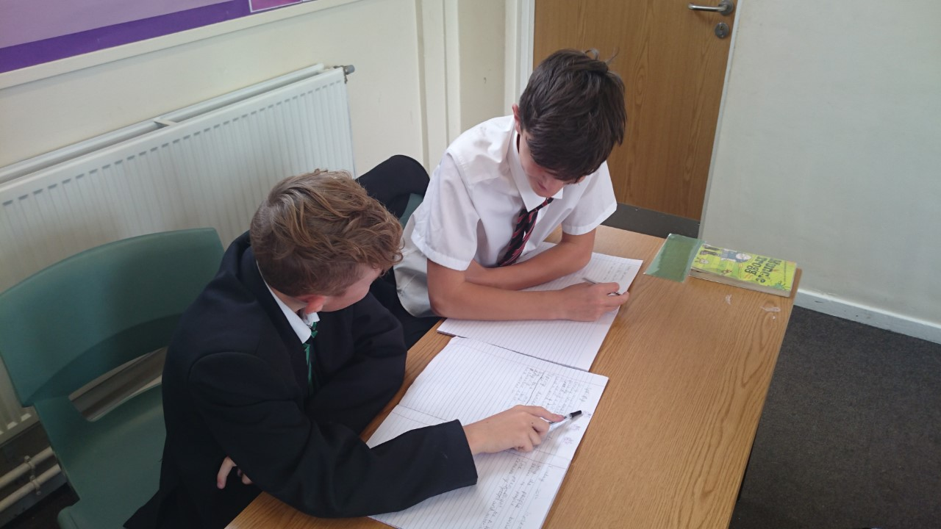
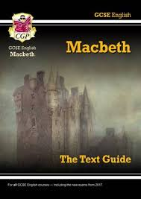
How we will help…

Slide 20
Year 11 Maths Information Evening
Andrew Saunders
asaunders1@educ.somerset.gov.uk
Key Stage 3 Coordinator
Charlotte Stamp
cstamp@educ.somerset.gov.u
Key Stage 4 Coordinator

Slide 21
Maths GCSE Changes
All students sitting their GCSE Maths exams from 2017 will be following a new curriculum. It will be a linear specification with students having one sitting at the end of year 11.
2 calculator papers and 1 non-calculator.
Broader and deeper mathematical content.
Designed to be more rigorous to allow stretch and challenge for both Higher and Foundation students.

Slide 22
Structure of the assessments
This course is a 2 year linear course.
It will be assessed externally with exams in June of year 11.
Students are either working towards the Foundation (1-5) or Higher (4-9) exam depending on their ability. The tier they sit will not be determined until the end of year 10, but may possibly still change in year 11.

Slide 23
S
M
A
R
T

Slide 24
Select the right questions
M
A
R
T

Slide 25
TOP SET HIGHER PAPER
Do the big mark questions first while you are still fresh
Make sure the first question you answer is on a topic that you are really secure with eg histograms

Slide 26
ALL OTHER SETS HIGHER PAPER & FOUNDATION PAPER
Do all the 1 and 2 mark questions first (particularly the multiple choice questions)
Look for easy marks
‘State your units’
‘Label axis’
‘Line of best fit’
Simplify your answer

Slide 27
BOTH TIERS
For the questions with multiple steps in context, you will need to write a sentence at the end giving your answer with a brief reason/justification.

Slide 28
S
Method marks
A
R
T

Slide 30
S
M
Act on weaknesses
R
T

Slide 31
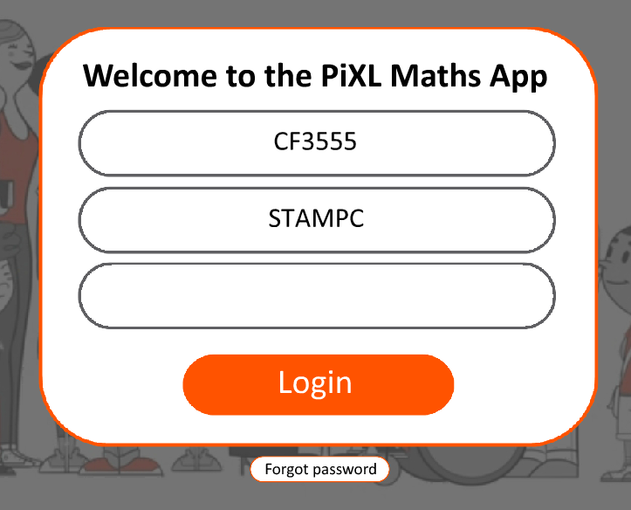
www.corbettmaths.com
SC

Slide 33
The Doughnut Challenge

Slide 34
You have between now and Friday 20th October to be the most improved maths class at using PIXL. The most improved class gets the doughnuts!

Slide 35
S
M
A
Regular exam practice
T

Slide 37
S
M
A
R
Time

Slide 38
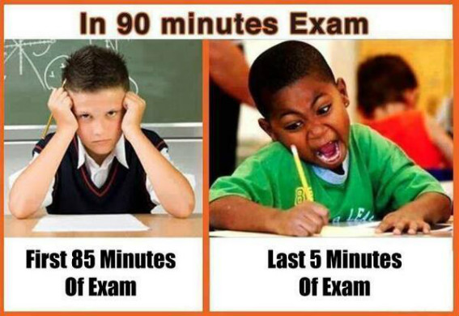

Slide 39
Select the right questions
Method marks
Act on weaknesses
Regular exam practice
Time

Slide 40
Regular work at home
PIXL Maths APP homework: aim to get 100% on all tasks
Half termly PIXL Maths APP prize winners
A revision guide will give an explanation, and a workbook has examination questions of the content needed (£5 for the pair from finance office)

Slide 41
Calculators
Students need their own calculator so that they can learn how to use the function keys and be confident in its use
Calculators cannot be borrowed for the examination – we do not have enough
A scientific calculator can be purchased from finance office cost £4.50

Slide 42
Revision in Mathematics
The best way to revise in Mathematics is by practicing GCSE questions.
The GCSE questions should be on topics causing difficulty not on ones where students are confident.
Remembering the meaning of key words is vital as invigilators are not able to explain the meaning of key words in the examination.

Slide 43
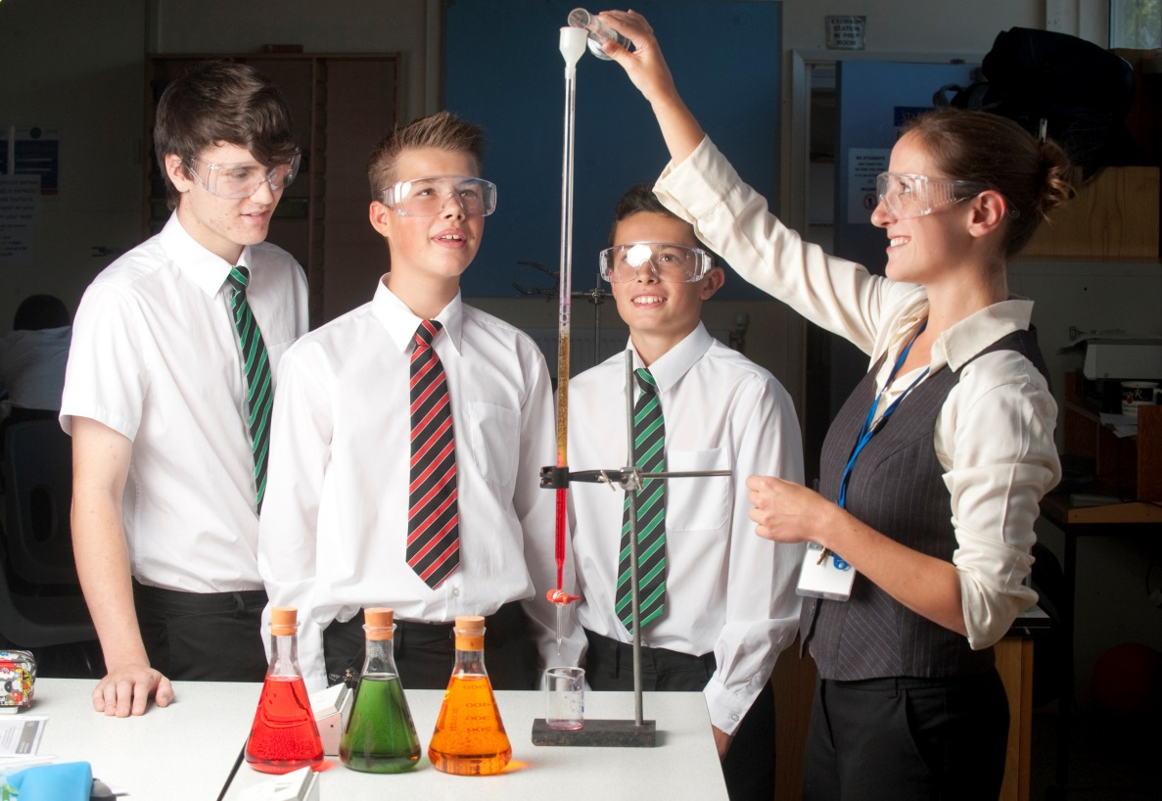
Details
Core Practicals have already been mostly completed. (there is no coursework anymore)
PPEs will be sat at January and in March.
Exam dates are – Biology 15/5 and 11/6, Chemistry 17/5 and 13/6 and Physics 23/5 and 15/6
It will come around quickly!

Slide 44
What successful students do…
Revise little and often (30 min chunks)
Use revision cards and keyword lists – recall alone gets you a grade C!
Practice the 6 mark questions (10% of each exam)
Use the checklists provided – they tell students what they need to know!
Attend revision classes when these begin.
Make a plan and stick to it.
Find teachers, and ask if you don’t understand – it’s your business!

Slide 45
Preparing your Next Steps

Slide 46
Work hard + good revision + good grades
= more choice!

Slide 47
The move to College
Research the type of courses you want to Study – A Levels or Vocational
Do you know what you want to do at university? www.UCAS.com
Collect and read prospectuses from surrounding colleges and sixth forms
Visit open days – very important! Get a feel for the college
Attend a taster or experience day

Slide 48
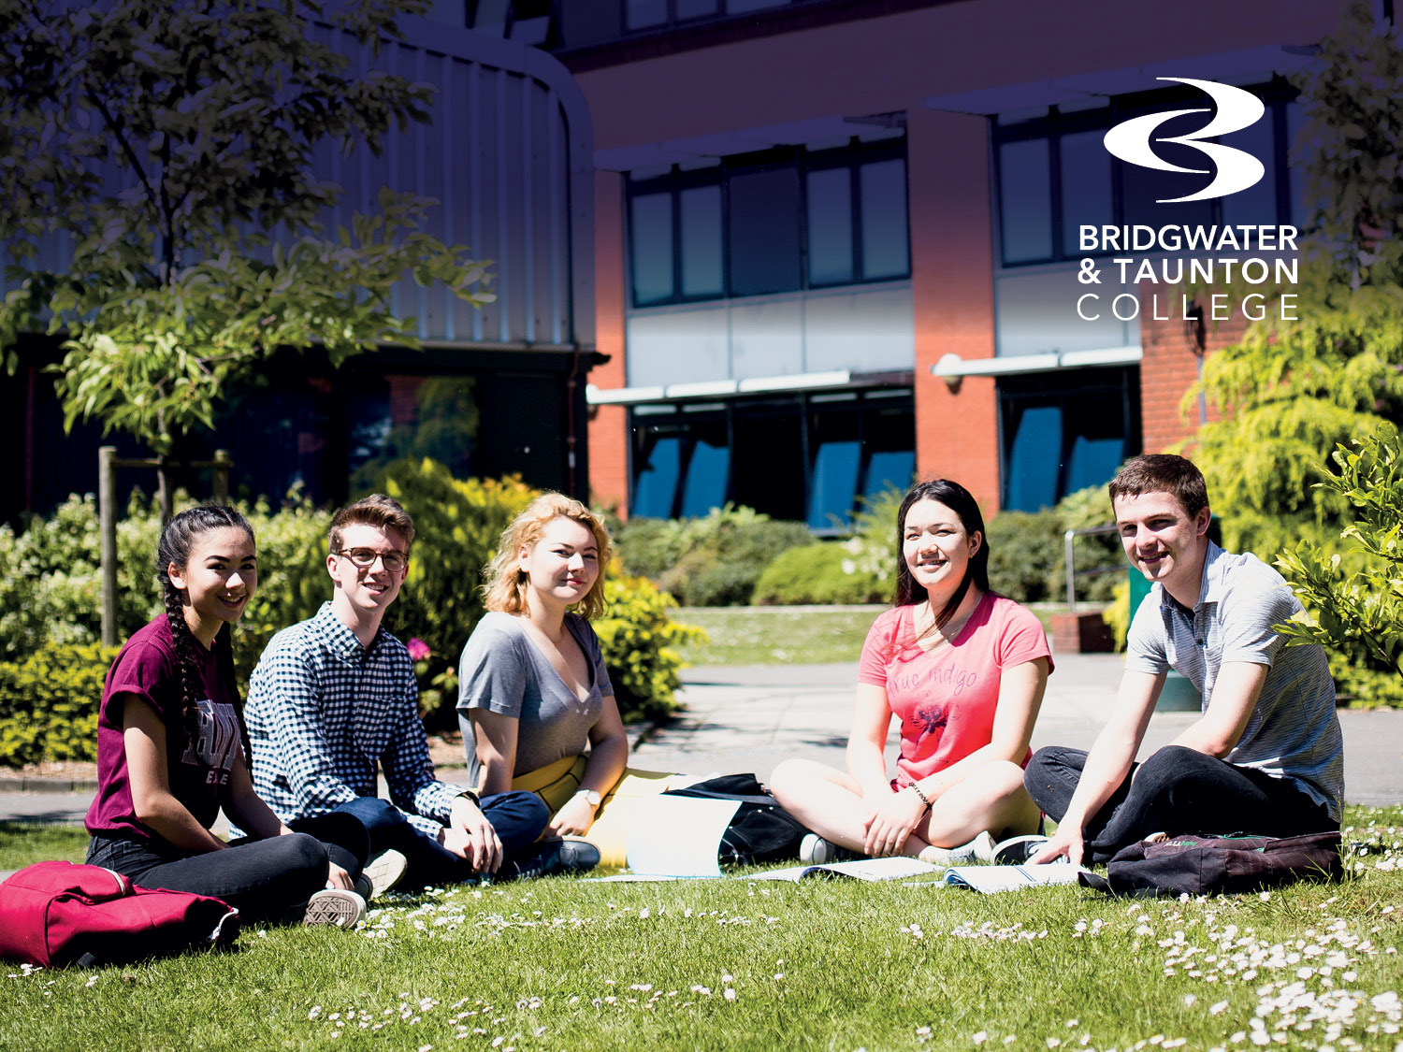

Slide 49
Coursework - written assignments
Examinations
In-class assessments
Practical assessments
Work placed assessments

Slide 50
Be clear on the requirements for your course
Understand your options
Natural progressions from GCSE is Level 3

Slide 51
Two important subjects that could affect your
future career choices
Make the most of support from your teachers
to beat your Maths and English targets
Grade 4 or below will require you to continue
study at college

Slide 52
Bridgwater & Cannington Campuses
Tuesday 3 October 2017 9.30am -2pm
Thursday 16 November 2017 9.30am-2pm
Taunton Campus
Thursday 5 October 2017 9.30am – 2pm
Tuesday 14 November 2017 9.30am – 2pm
Yeovil Centre
Thursday 15 February 2017 9.30am – 12.30pm

Slide 53
Bridgwater Campus
Wednesday 18 October 2017 5.30pm – 8.30pm
Thursday 23 November 2017 6pm – 8pm
Taunton Campus
Thursday 19 October 2017 6pm – 8pm
Wednesday 22 November 2017 6pm – 8pm
Cannington Campus
Saturday 11 November 2017 10am – 1pm
Yeovil Centre
Wednesday 1 November 2017 4.30pm – 6.30pm

