Slide 1

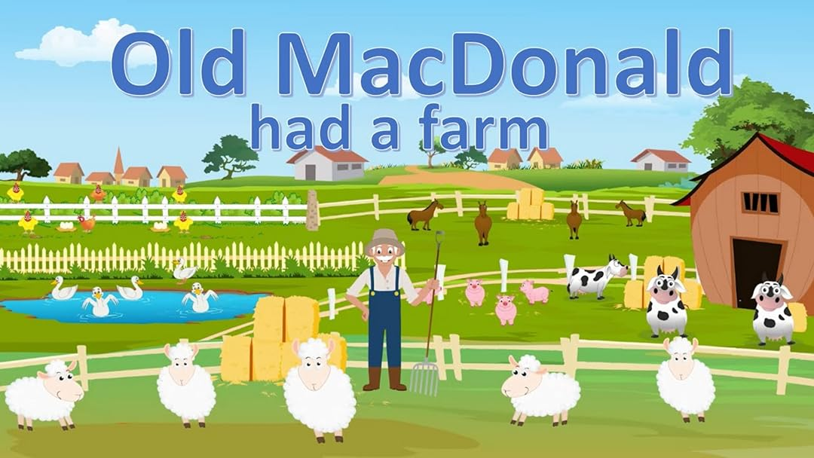
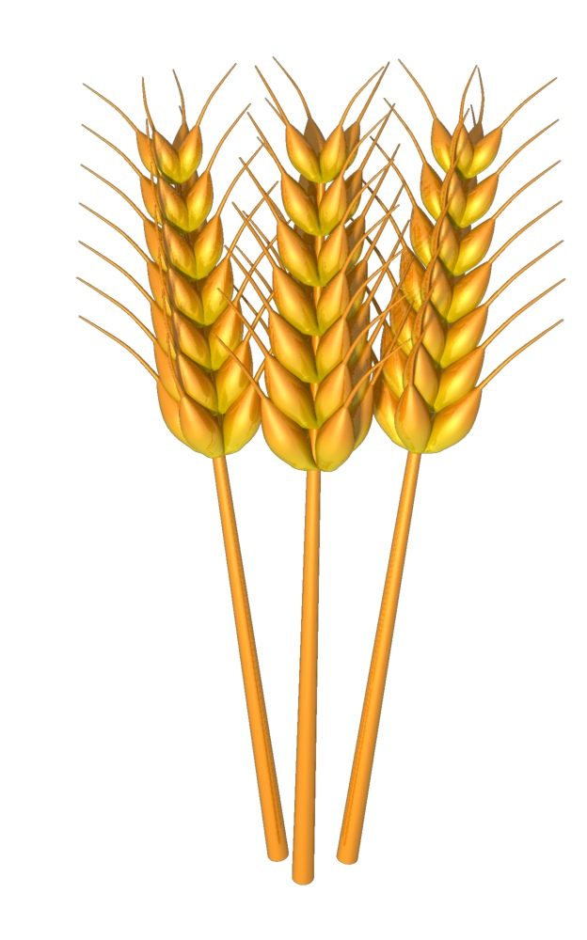
Week beginning ^{29th April 2024}
This week in F1…
This week in F1 we have been learning all about the story Old Macdonald had a farm. The children have been practising the Makaton signs for the different animals.
On Monday, the children were mixing the colours red and white in the creative area to make pink. We then painted pictures of pigs.
On Tuesday, the children enjoyed some vegetable printing. We used chopped vegetables in different coloured paints to print with.
On Wednesday, we made a delicious vegetable soup. We looked at the different ingredients we needed, and then discussed the method. Most of the children thought it tasted yummy!
On Thursday, we had our Farm Day. The children enjoyed visiting the farm animals from Purple Pig farm. The children were very gentle when holding the chicks and brushing the fluffy rabbits. We opened our outside area with F2 and the children enjoyed lots of different farm activities that were set up.
On Friday we read the story The Three Little Pigs. We then talked about the different homes that farm animals live in.

