Slide 1
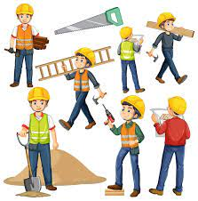
Week commencing 16th January 2023
F2 Home School Diary
This week we have continued with our story of the Three Little Pigs and have been putting pictures of the story in the correct order. We have been finding out about construction workers and building our own houses. In Maths we have been continuing doing the number 6.
This weeks challenge have a go at writing all he numbers you know.

