Slide 1
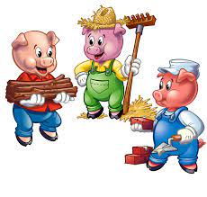
Week commencing 9th January 2023
F2 Home School Diary
This week we have continued with our story of the Three Little Pigs and have been acting out the story. On Monday we were Geography explorers and found our own houses on google maps, we looked at the different types of houses and other landmarks, it was lots of fun! In Maths we have been doing the number 6.
This weeks challenge can you find
6 objects in your house.

