Slide 1
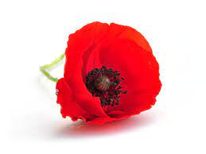
Week commencing 7th November 2022
F2 Home School Diary
This week we have been doing about Guy Fawkes, we have looked at pictures of him and learnt about what he did. It was very exciting on Tuesday when we had a visit from the fire men and saw their fire engine!
In Maths we have been doing the number 4 and finding 4 objects around the classroom.
Today we went to the special Remembrance day assembly and we have been making poppies in the classroom.
This weeks challenge – see if you can spot any poppies when you are out and about this weekend.

