Slide 1
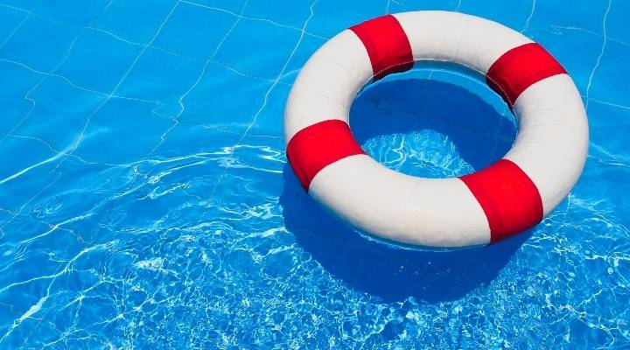
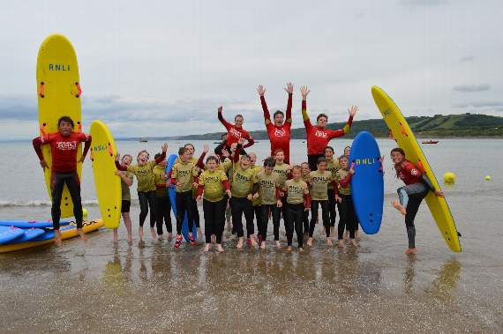
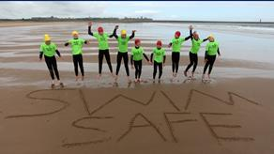
Bucks School Swimming Partnership
Drowning Prevention Week - Water Safety
Mrs Rogers
Notes:
Tell the children that they are going to be learning some important messages about staying safe when they are near water. In fact, there are four main safety messages that are all on the screen. By the end of the workshop the children will have completed four different water safety challenges.
Does anyone know the 4 water safety messages?
You might want to ask for a few volunteers to read out sections of the text about the RNLI. It’s important to highlight the fact that the RNLI also make rescues from other bodies of water- ask for the children to put their hands up to suggest other bodies of water where the RNLI provide rescue services i.e. rivers/ lakes etc children may also suggest canals/reservoirs/ponds etc.

Slide 2
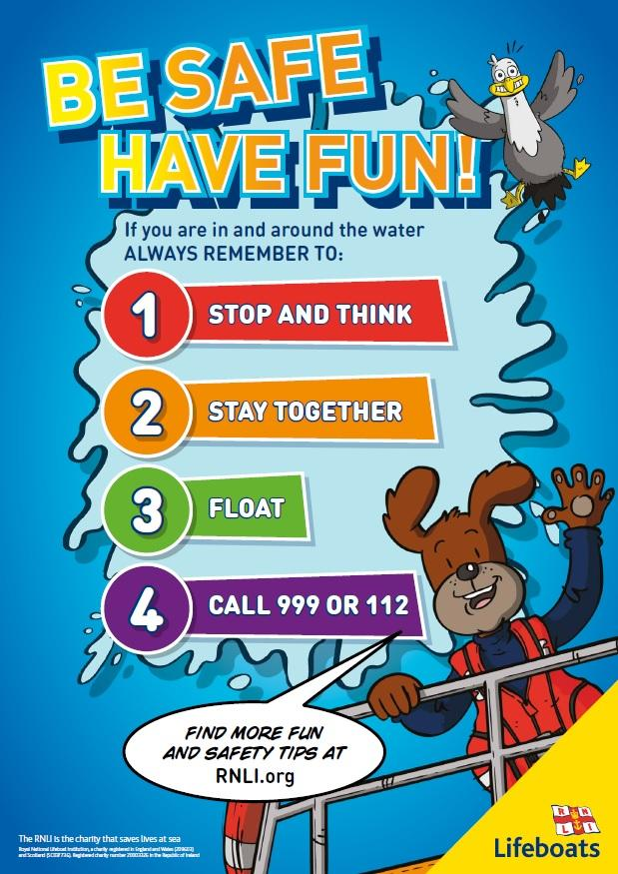
Key Water Safety Messages
‘Shout –throw- never go’
Notes:
This morning, we are going to think about what each of these mean and how you can keep yourself (and others) safe

Slide 3
Water is Fun!
Notes:
Explain to your pupils that water is fun, but that it is very important to stay safe near water.
What are some fun things that you can do in water?

Slide 4
Fun things you can do in the water
Swim with your friends
Play water polo
Snorkel
Body board and surf
Water slides and aqua parks

Slide 5
On your way to school
Canal
River
Stream
Reservoir
Lake
Sea
Notes:
Ask the pupils how many of them travelled past open water on their way to school and what kind of water was it?
Canal
River
Stream
Reservoir
Lake
Sea – not in Bucks! But we still have water everywhere

Slide 7
Challenge 1 - Stop and Think
Notes:
Explain that we are going to undertake a series of challenges this morning
Before you go near water, you need to stop and think – be prepared for any visit near or in water
Challenge 1:
Tell the children that they have got 30 seconds to spot as many hazards/dangers as they can. If they can spot some people being safety heroes too, then even better! • After 30 seconds ask the children to raise their hands if they have a danger they would like to share with everyone. Take several answers. Refer to the list below if needed. • Move onto the next slide and ask the children if any of them spotted some safer behaviours. Remind the children that the beach is a really fun place to go as long as they remember to keep their eyes peeled for potential dangers.

Slide 8
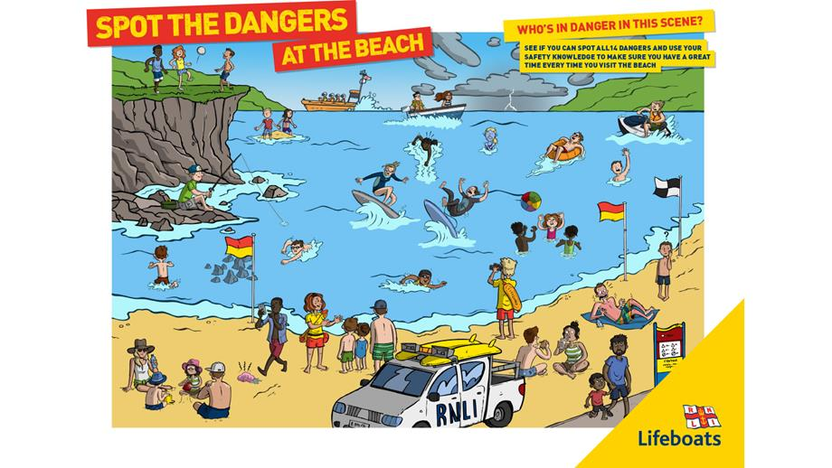
Notes:
You have 30 seconds in the chat to record as many hazards as you can

Slide 10
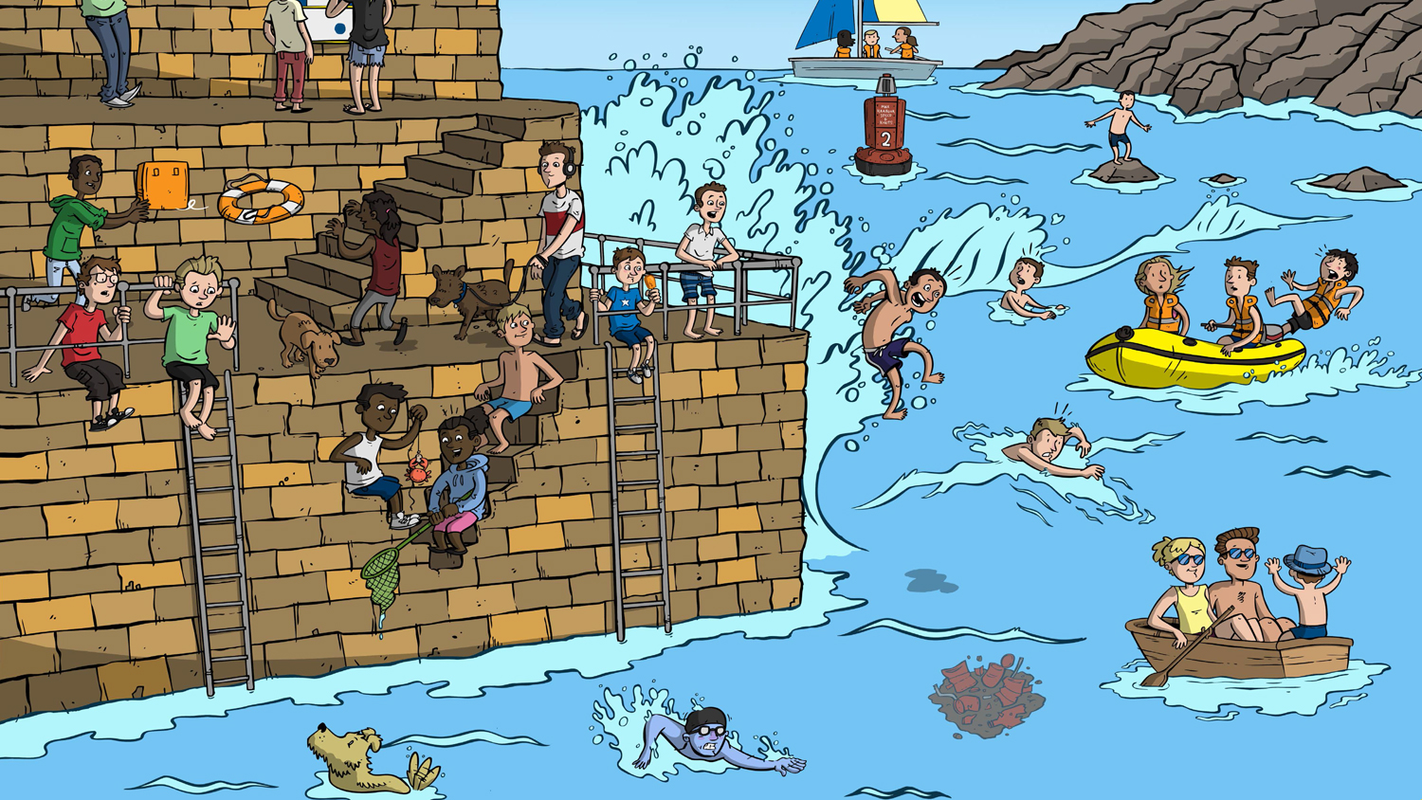

Slide 12
Notes:
It doesn’t matter how old you are – young and old – you should never go near water alone.
You may cycle to your next school – if it is along a canal and you fall in and are on your own, who is going to help you?
You are on the beach and want to go for a swim in the sea – always go in with somebody

Slide 13
Challenge 2 - Stay Together
Notes:
Onto the second challenge. Tell the children that this one is all about good planning. One of the most important
rules about being around water is planning to stay together with your parents/carers or teachers. On top of staying
together it’s important to plan sensibly for a day out near water.
• Bring up the slide with the four different locations 1) A very hot sunny day at the beach, 2) A wet and rainy walk by a
quarry 3) A very windy spring day at the beach 4) A day bodyboarding at the beach
Allocate locations to 4 different groups. Discuss what you will need to have a fun and safe day at your location

Slide 14
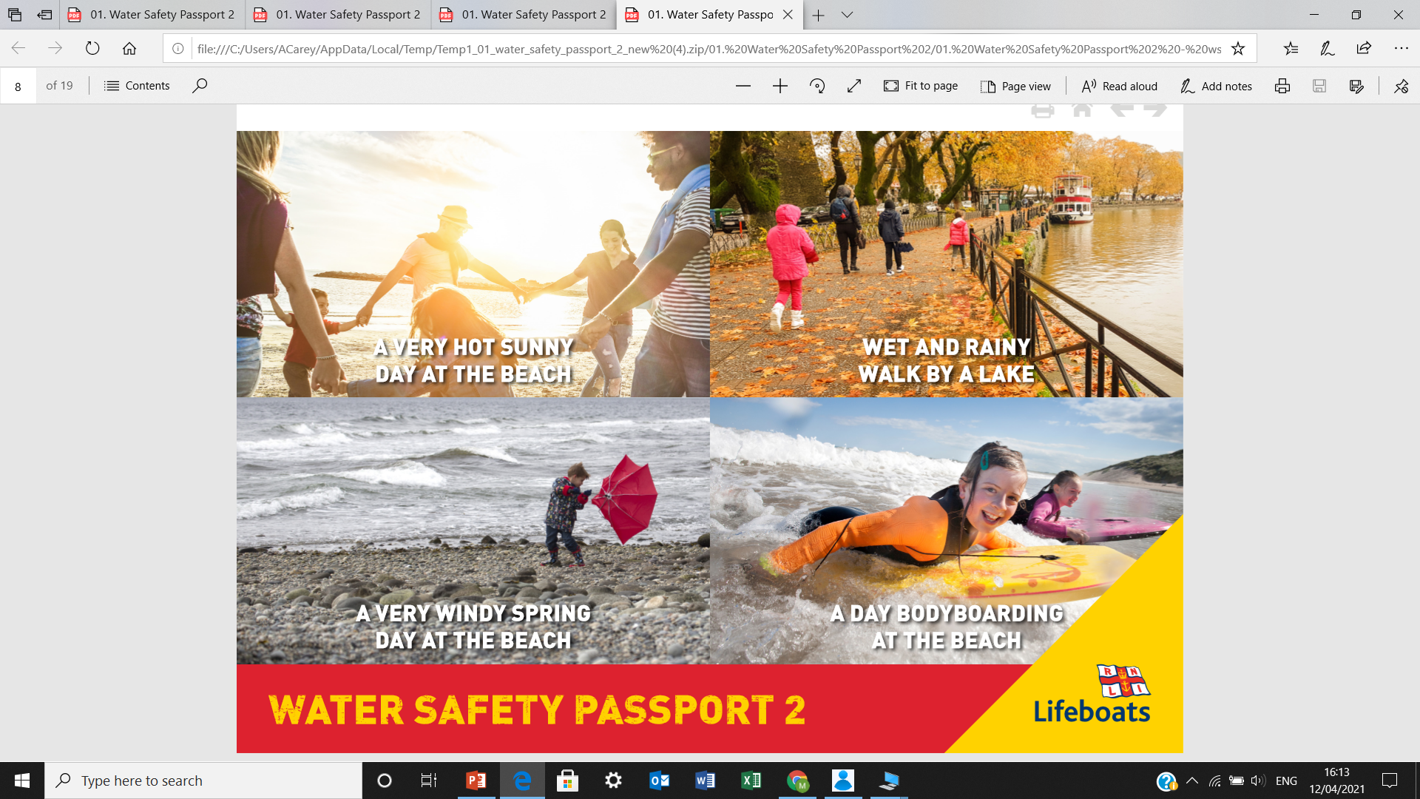
How can we have fun but stay safe?
Notes:
Sunny day at beach – suncream, hat, toys for beach, know tides, find out if it is lifeguarded; safe places to swim (will think about later)
Wet and rainy walk by lake – warm clothing, waterproofs, appropriate non slip footwear, with an adult: are there life rings along route; notice the barriers at this lake, if not,how close to the edge and slippery is it?
Windy spring day at beach – warm clothing, wellies/appropriate footwear – looks to rough to go in – also very cold (again, is it lifeguarded?)
Body boarding at beach – bodyboard, wet suit, suncream, hair tied back so can see; is it lifeguarded? Where is safe to body board (again will look at later
So you have stopped and thought about what you will need – Did you discuss that you should always be with an adult; never near or in water alone. Always stay near others

Slide 15
Suncream and hat
Toys for the beach
Water?
Tides - when?
Lifeguarded
Safe places to swim
Warm clothes and waterproof clothing
Appropriate footwear (non-slip)
Life rings around the route?
Barriers are there for a reason - don’t climb!
Warm clothing
Wellies / appropriate footwear
Sea looks rough - don’t go in
Bodyboard and wetsuit
Suncream
Hair tied back, so you can see!
Is this the right area?
Is it lifeguarded?
Notes:
Sunny day at beach – suncream, hat, toys for beach, know tides, find out if it is lifeguarded; safe places to swim (will think about later)
Wet and rainy walk by lake – warm clothing, waterproofs, appropriate non slip footwear, with an adult: are there life rings along route; notice the barriers at this lake, if not,how close to the edge and slippery is it?
Windy spring day at beach – warm clothing, wellies/appropriate footwear – looks to rough to go in – also very cold (again, is it lifeguarded?)
Body boarding at beach – bodyboard, wet suit, suncream, hair tied back so can see; is it lifeguarded? Where is safe to body board (again will look at later
So you have stopped and thought about what you will need – Did you discuss that you should always be with an adult; never near or in water alone. Always stay near others

Slide 16
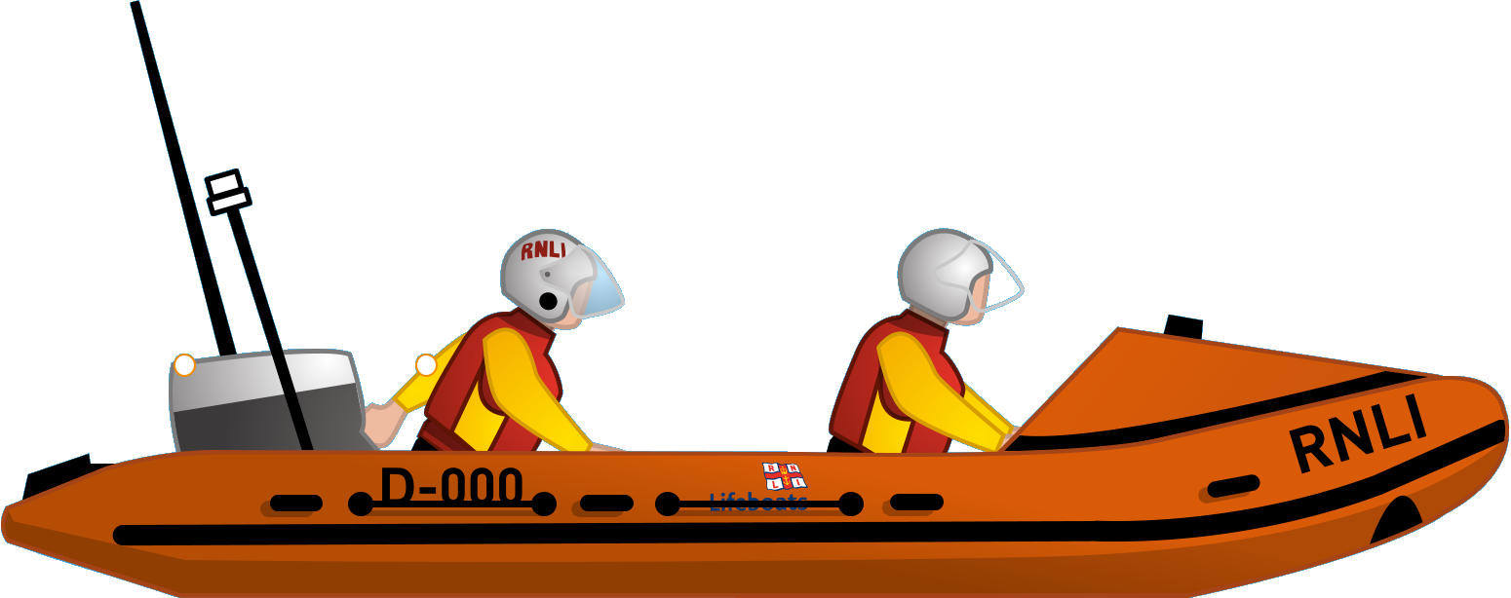
Challenge 3 - Float
Notes:
Onto the third challenge
FLOAT
• Tell the children that the RNLI spend a lot of time rescuing people from water – and that many of the people they rescue never expected to get wet! Over the years the RNLI has built up a lot of knowledge about what to do if you fall into cold water unexpectedly. It can cause something called cold water shock.

Slide 17
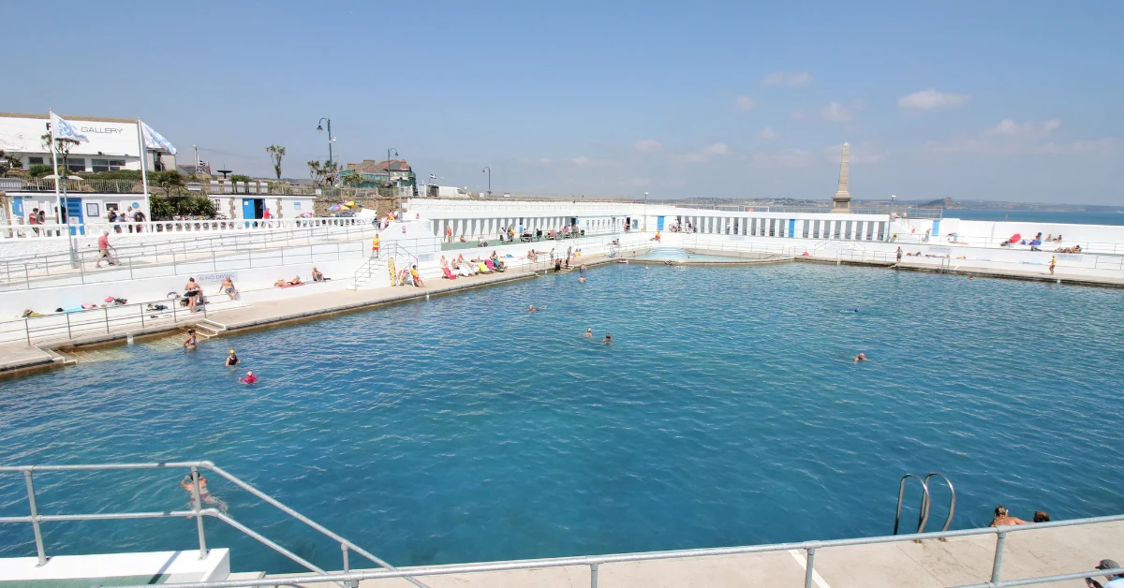

Slide 18
Notes:
Have you ever felt like this?

Slide 19
Notes:
Thumbs up if you have jumped into cold water? Get them to tell us how it feels
Breath away
Panic
Want to move quickly to warm up
Arms and legs stop working
Heart beats incredibly quickly

Slide 20
Notes:
This is actually what happens……

Slide 21
Notes:
• Tell the children that one of the things that can help is floating as soon as you fall into the water. In a moment the children will have an opportunity to practise the best position to float in. Before getting to that everyone is going to try and learn a little bit more about just how cold water can be. • Play Colder or Hotter • Show the children the different items on the screen they are going to have to try and guess the order from coldest to hottest. • Ask the children which item they think is the coldest (fridge 5 degrees). Then go through the next items i.e. So, is a swimming pool colder or hotter than a fridge? Thumbs up for hotter, thumbs down for colder? • For your information average temperatures are provided in Celsius: – Body temperature 37 degrees – Warm bath 37 degrees – Swimming pool 30 degrees – Reservoir in May 12 degrees – Lowestoft beach in March 8.5 degrees – Please research the temperature of a local water site to share with the group. – Fridge 5 degrees
Encourage the children to consider how cold it is inside a fridge….our beaches in March aren’t much warmer! To make this more relevant, find out the temperature of water nearest to the school, for example, a beach, river or lake

Slide 22
5
8.5
19
30
37

Slide 23
Notes:
To stop your body from suffering the effects of cold water shock which can be very dangerous, float for up to 2 mins

Slide 24
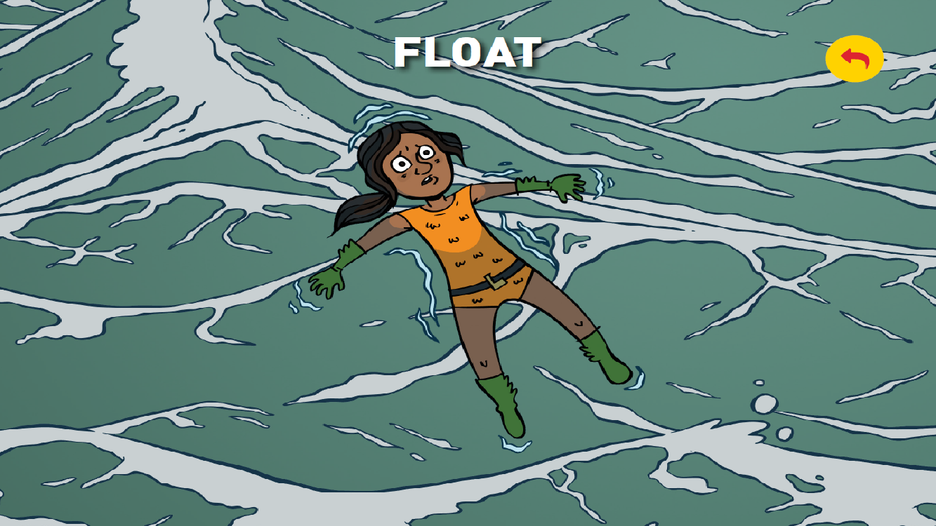
Notes:
You suddenly find yourself in cold water – you may have walked in, jumped off a boat, been blown off a cliff, jumped into a rock pool, fallen into a reservoir.
Let’s think about how we should float….. Ask for a volunteer to come to the front. Explain that when people fall into cold water their body can go into shock. Our first instinct is to swim really quickly and gasp for breath. Share the fact that the best thing you can do is to float and the best position is to float on your back and stretch out your arms and legs. Floating sometimes looks like a star shape. Ask your volunteer to get into a star shape – demonstrate how the neck should be slightly tilted upwards to allow for easy breathing. Float until you have controlled your breathing and are calm. Then raise your arm and shout for help or swim to safety if you can. • Celebrate with the children and ask them to raise their hands if they will share the information about float with someone else so they know what to do if they fall into cold water?

Slide 25
Notes:
To summarise…..

Slide 26
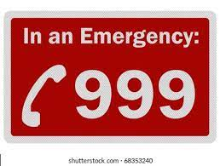
Challenge 4 – Call 999/112
Notes:
Onto the final challenge!
• Tell the children that it’s really important to call 999/112 as quickly as possible in an emergency situation. The next challenge is work out if you think you should call 999/112 or not. Remind the children what an emergency situation is: It is when someone is seriously ill, injured or their life is at risk.
• Ask for a volunteer to read out the first scenario: 1) You and your friend have gone for a walk along a river near your house. You are throwing a football to each other. The football falls in and the ball is near the edge. Your friend says they are going to get into the water to fetch the ball.
Ask the children to put their thumbs up if they think they should call 999/112 or to put their thumbs down if they think it’s best not to. This is not an emergency situation although if the friend does try to get into the water it could turn into one. The best course of action is to persuade your friend not to get into the river but to let an adult know what has happened. 2) You are on holiday with your family and some friends. You have been spending time building a bridge over some fast-moving water that leads down to the sea. The bridge is made from bits of old wood you have found. As a child is testing the bridge it breaks and they are plunged into the water which is deep and moving quickly. Ask the children to put their thumbs up if they think they should call 999/112 or to put their thumbs down if they think it’s best not to. This scenario is more serious. We know that the water is deep, quick moving and leads down to the sea. This child’s life could be in danger. It’s important to call for help immediately and to call 999/112. The children could reassure their friend that help is on its way and to look to see if there are any floatation aids they can throw into the water to help the child to float. E.G. SHOUT, THROW, NEVER GO!

Slide 29
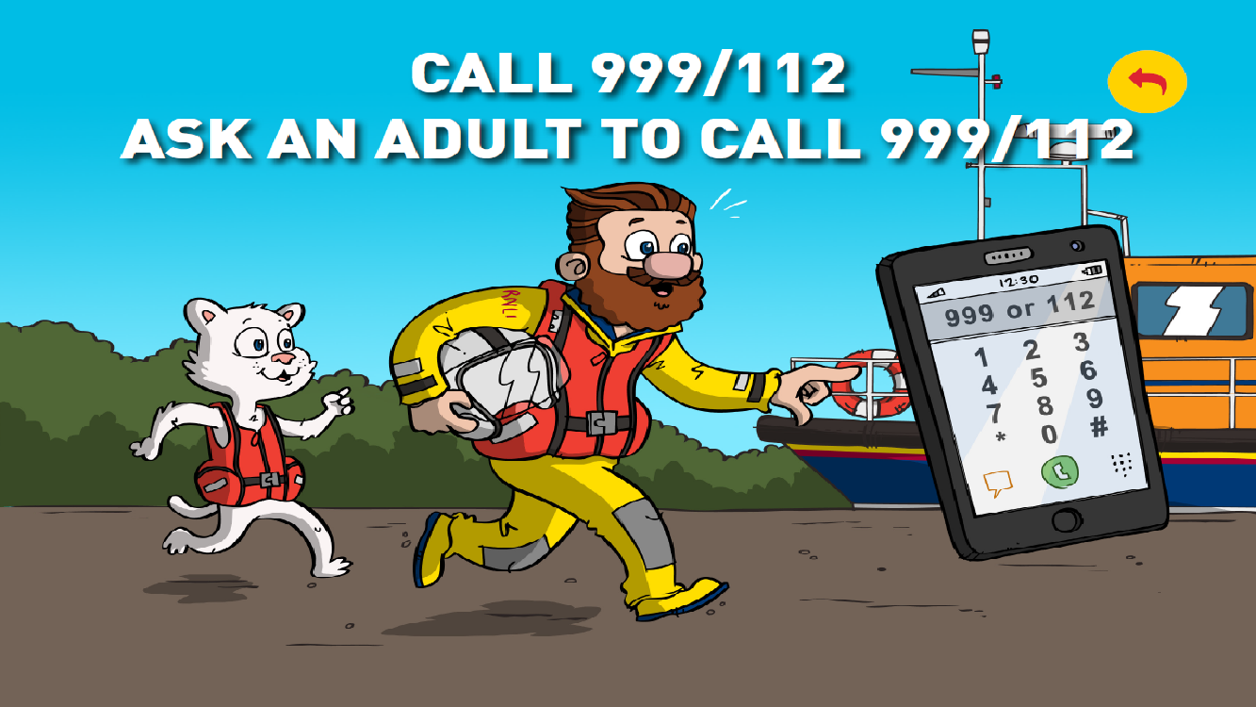
Notes:
So that was all about you – about how you can keep yourself safe. HOWEVER, If you see someone else in trouble in the water, how can you help?
Do you know how to make an emergency phone call? What information would you give the emergency services?
Once you have done this, what could you then do to help someone in trouble? YOU DON’T GO IN BUT WHAT COULD YOU DO? (ask group)
Shout and encourage them – use your arms to encourage them to the side - demonstrate
Throw a football/lifering to them to hold on to – tell them to kick their legs to the side – throw a ball to someone/noodle

Slide 30
Skills to keep you safe

Slide 31
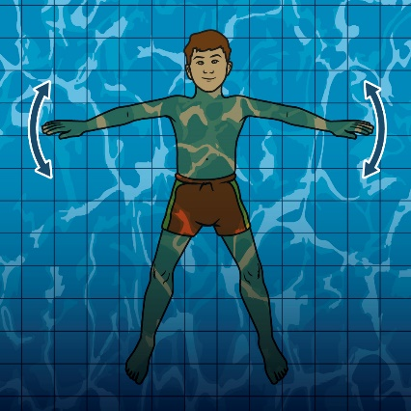
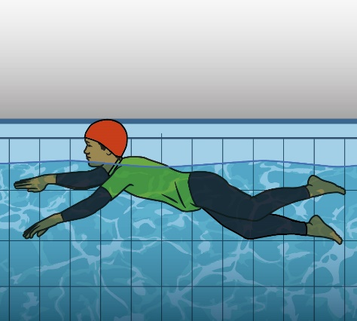
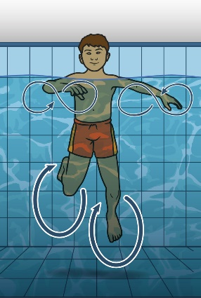
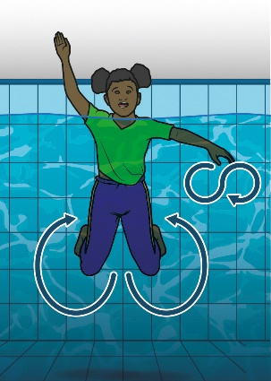
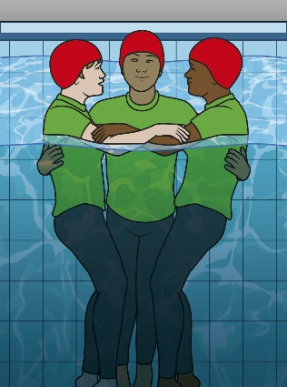
Skills to keep you safe
Float
Survival
Stroke
Heat Escape
Lessening
Position
(HELP)
Treading Water
Signal for help/Attract attention
Huddle

Slide 33
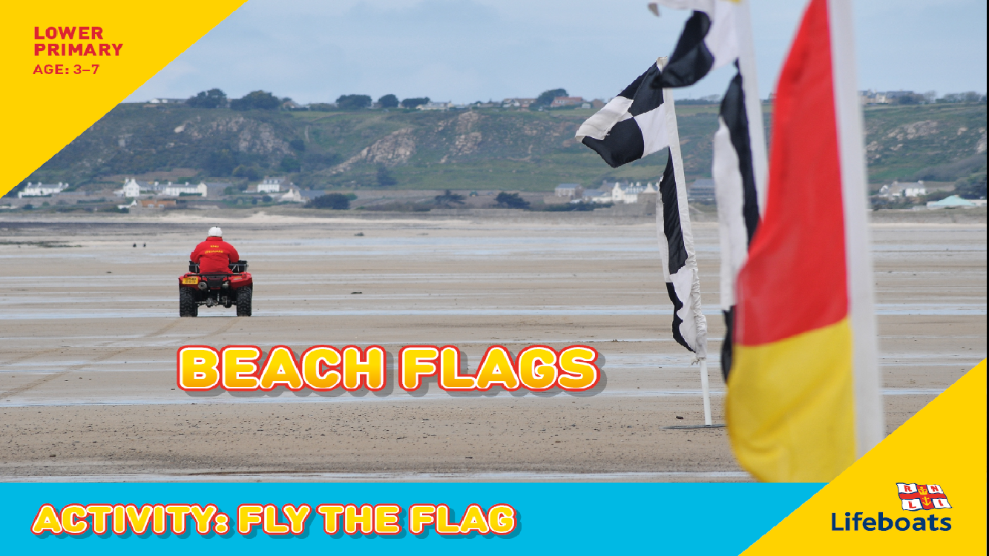
Notes:
We are going to learn about different beach flags

Slide 34
Notes:
Hold each flag up and ask pupils if they know what these stand for

Slide 42
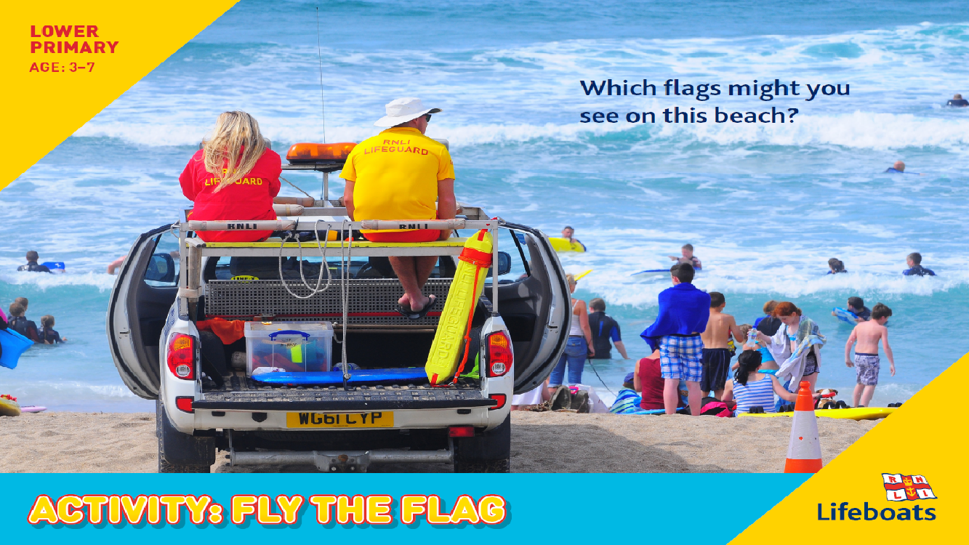

Slide 46
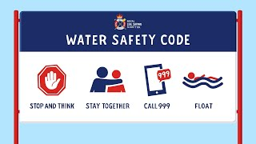
Notes:
https://www.youtube.com/watch?v=zwzB7So7jSM

Slide 47
What next?
Take part in Drowning Prevention Week – lead some activities to younger pupils in your school
Produce a water safety poster for children in the year below
Work in groups to produce a beach flag – and explain what it tells you about water safety

Slide 48
Other useful resources
Life Saving Society
RNLI - Water Safety Information
Video - Follow Up
RNLI: Float to Live
Float to Live: Evan's Story (Depending on age)
RLSS Drowning Prevention Week
INSERT WORDS

Slide 49
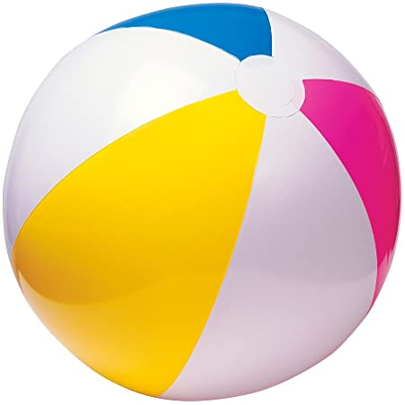
Impact of today’s session
I know that to minimise my chances of getting into danger in the water I need to identify potential hazards
I know that it is safer to enter the water when I am with an adult and I know my responsibilities as an individual and in a group when around water
If I fall into cold water, I know to float on my back until until I have controlled my breathing, then call for help and raise my hand to draw attention or swim to safety if I’m able to do so
I know how to respond if I see someone in danger in the water – either use my mobile phone or ask an adult to call 999/112 immediately
I am familiar with the work of the RNLI and their volunteers in providing lifeboat services and seasonal lifeguards
Notes:
PLENARY (CONTINUED) • Ask the children to turn to the person next to them – how many safety messages can they remember? As a group recap on the main messages. • Ask for a show of hands, how many of the children feel as if they have learnt more about water safety today? You may want to ask some children about what they are going to do with their new safety knowledge i.e. share it with family/friend/always look for hazards before engaging in an activity near water etc. (this information can be used for evaluation purposes) • Remind the children that lots of fun takes place around water but it’s important to be aware of the risks. • Tell the children that if they would like to know more about the work of the RNLI that they can go on to the website to watch rescues and to improve their water safety skills.

