Slide 2
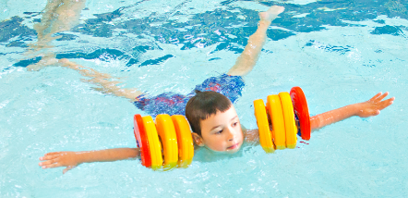
Buoyancy and balance
On the back.
On the front.
Tuck float.
In different shapes.
Linking shapes in pairs/groups.

Slide 4
Rotation and orientation
Turning.
Regaining standing.
Forward roll and backward roll.
Surface dive.
Orientation – knowing where and which way up you are.

Slide 6
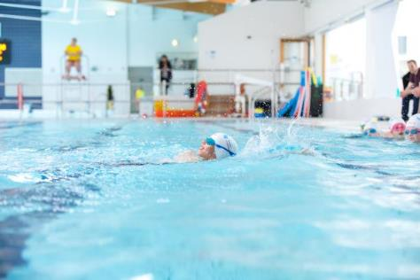
Streamlining
Long, flat body position.
Push and glide: on front, on back, on side, to the pool floor.
Key part of all strokes.

