Slide 1
Year 6 leavers 2020
SS Peter and Paul’s Primary School

Slide 2
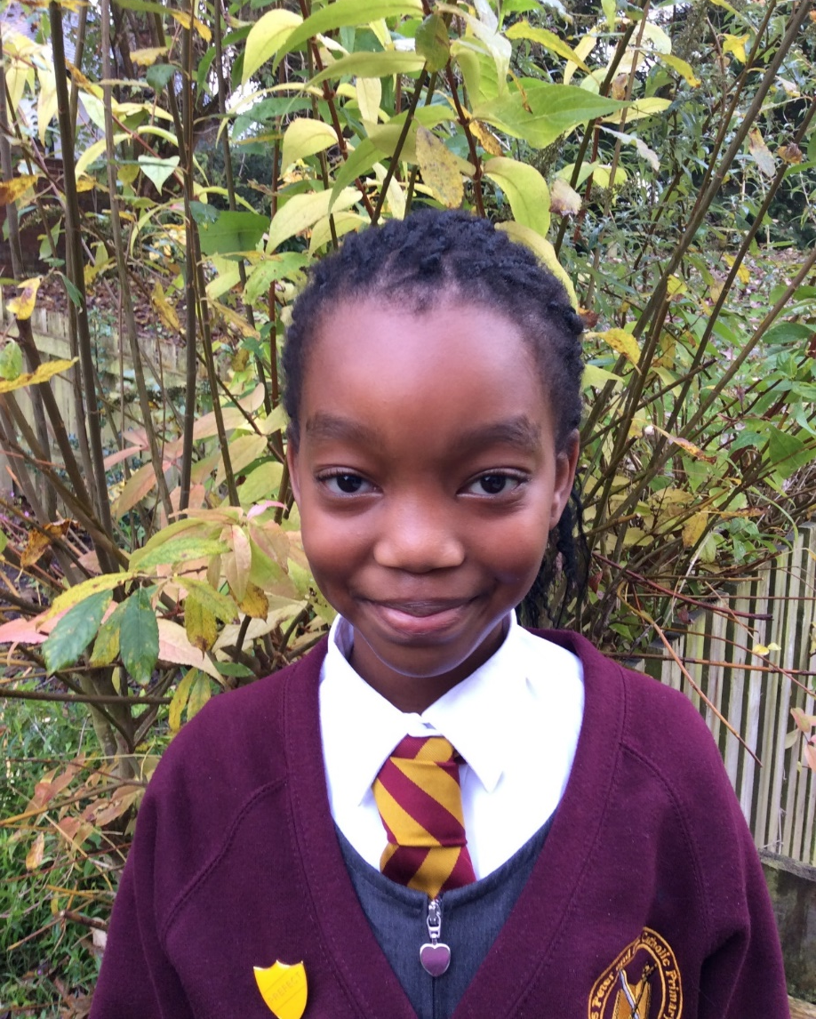
Katleho
One of my fondest memories…
Our residential trip to towers – Miss Higgins told us to stop singing so that we could go to sleep but Maja didn’t hear her and carried on singing really loudly ☺

Slide 3
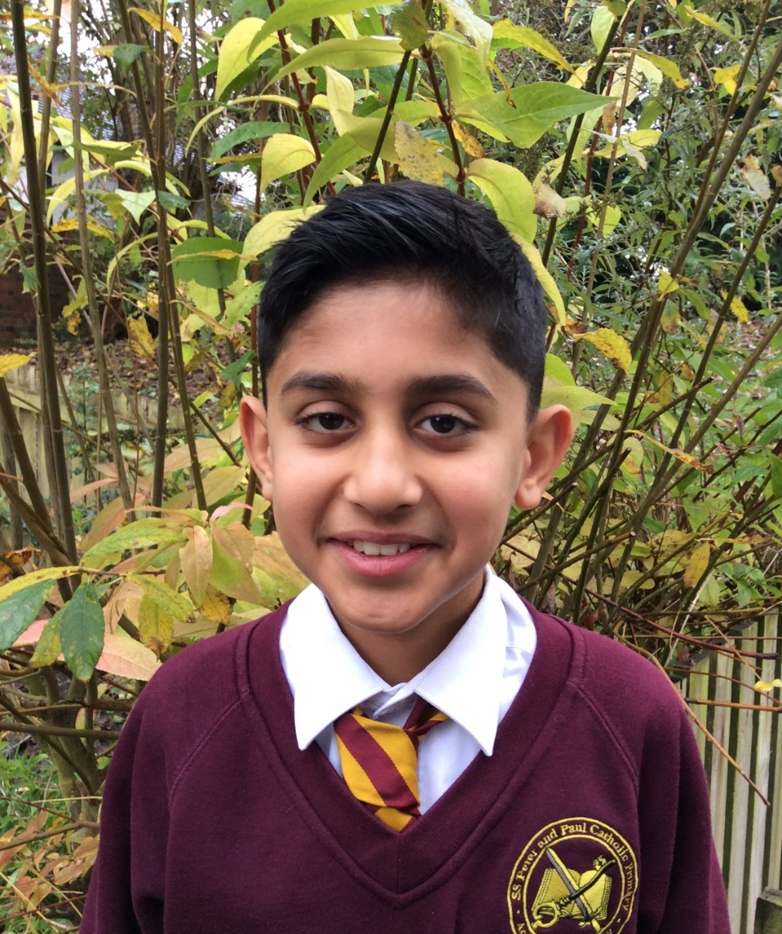
Sammy
One of my fondest memories…
DIG FOR VICTORY
I really enjoyed digging in the outside area and planting potatoes.

Slide 4
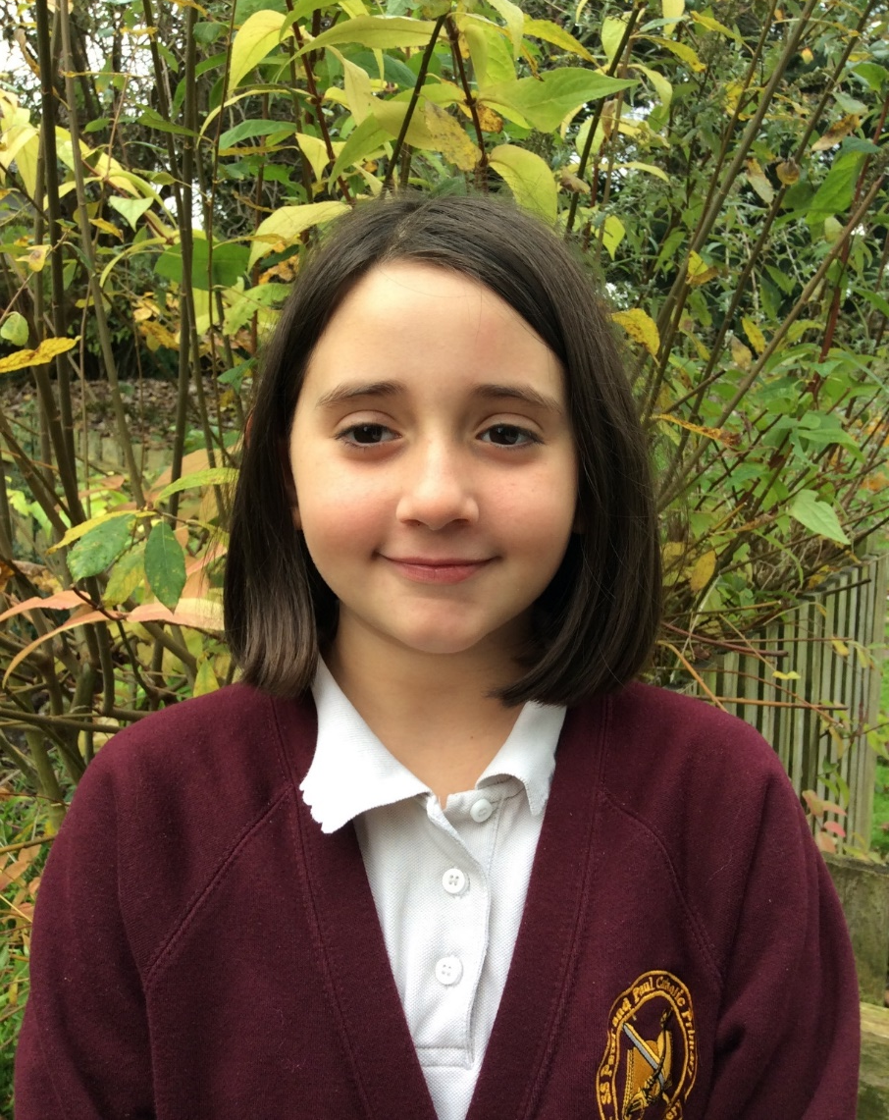
Gabriella
One of my fondest memories…
Dance Club with Nicole – when we danced to The Greatest Showman.
I had the best time ever.

Slide 5
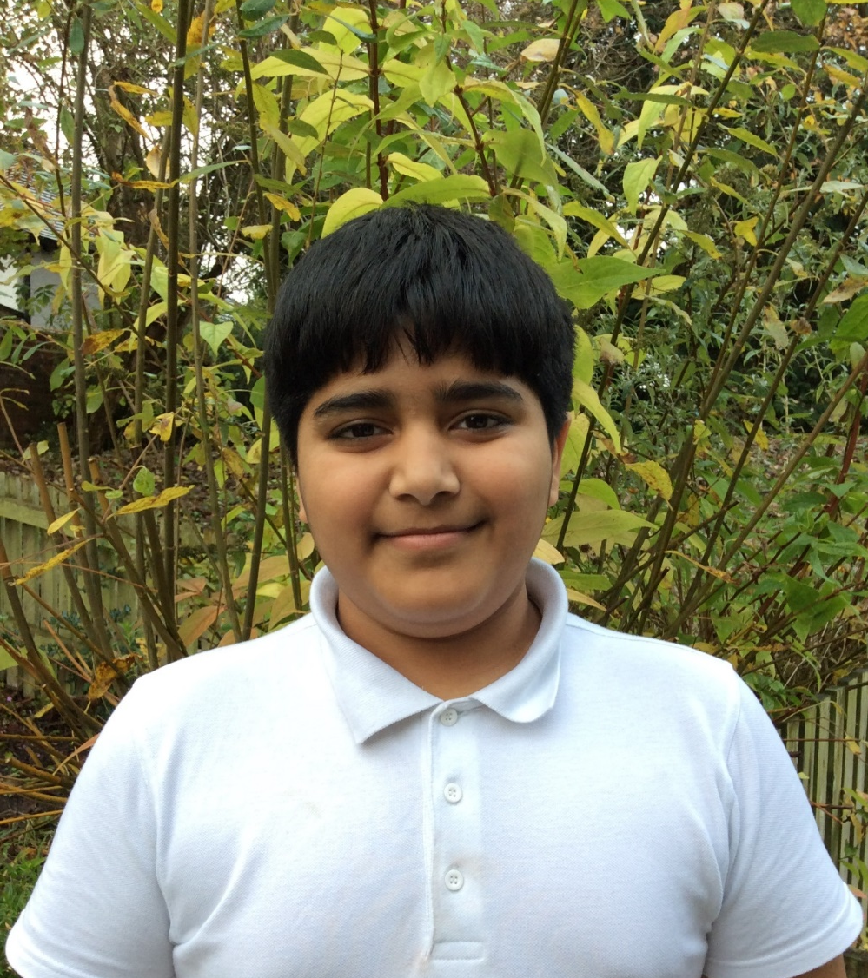
Aadam
One of my fondest memories…
The day that all of the families joined together at school for a Dig for Victory event.
We all worked together to plant lots of food.

Slide 6
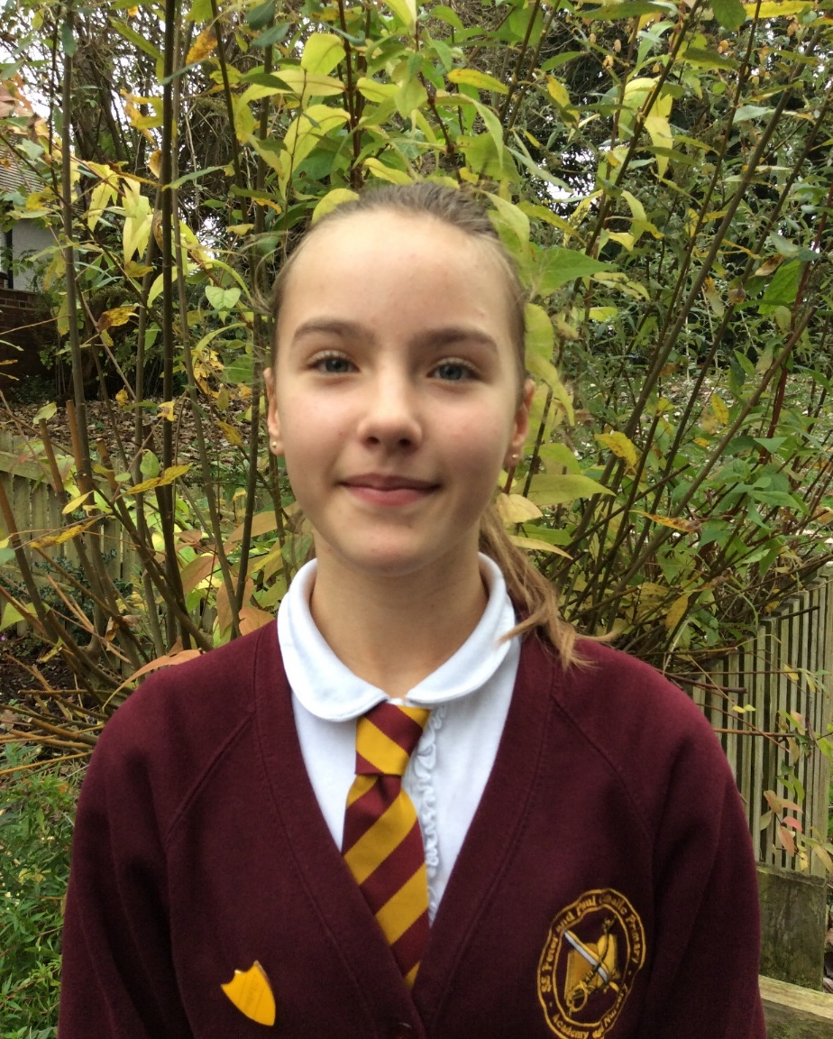
Olivia
One of my fondest memories…
When I woke Dior up during the night at Towers so that she could pass me my pretzels. She was not happy that I woke her up but it was so funny and we all laughed about it.

Slide 7
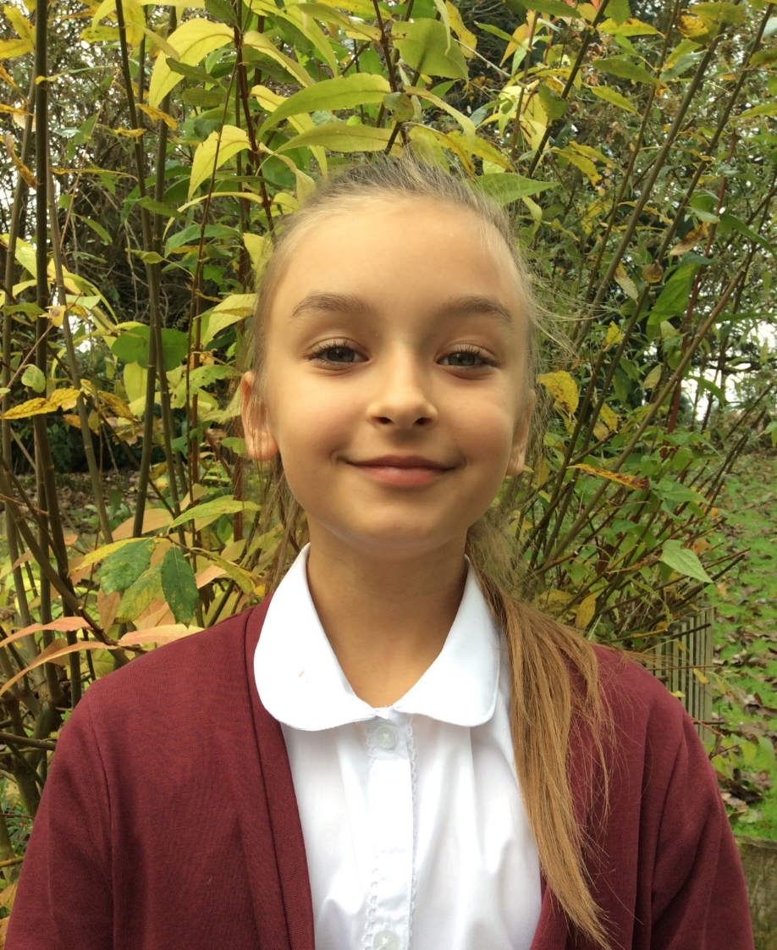
Zuza
One of my fondest memories…
Having P.E lessons where Miss Higgins showed us how to do gymnastics using the apparatus.

Slide 8
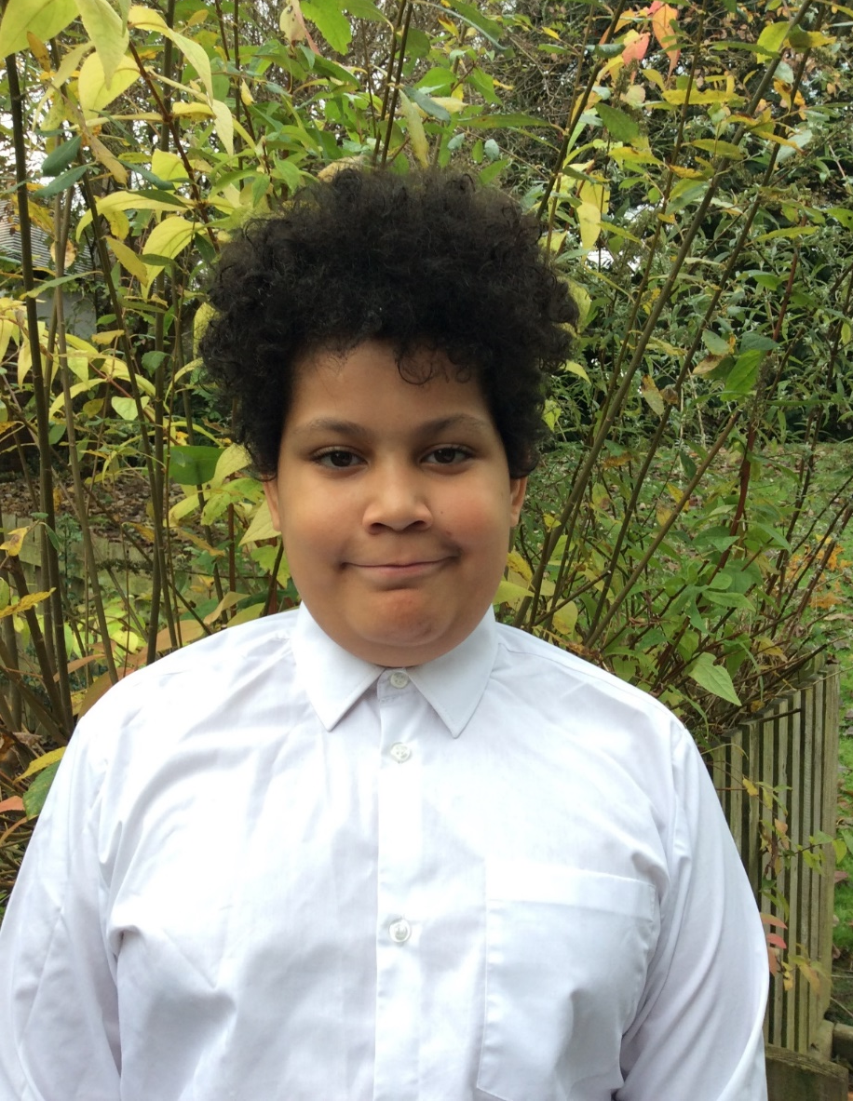
Riley
One of my fondest memories…
The Polar Express Day in school at Christmas time. It was amazing.

Slide 9
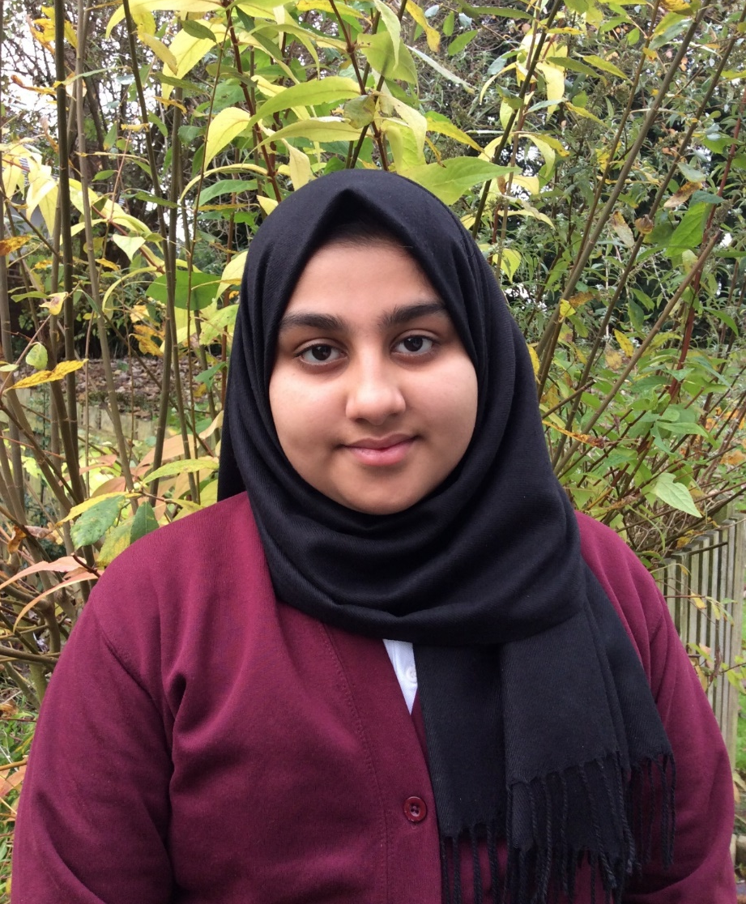
Alishba
One of my fondest memories…
At Kingswood, when we were supposed to be asleep, we stayed up and played with our friends until really late but it was so much fun ☺

Slide 10
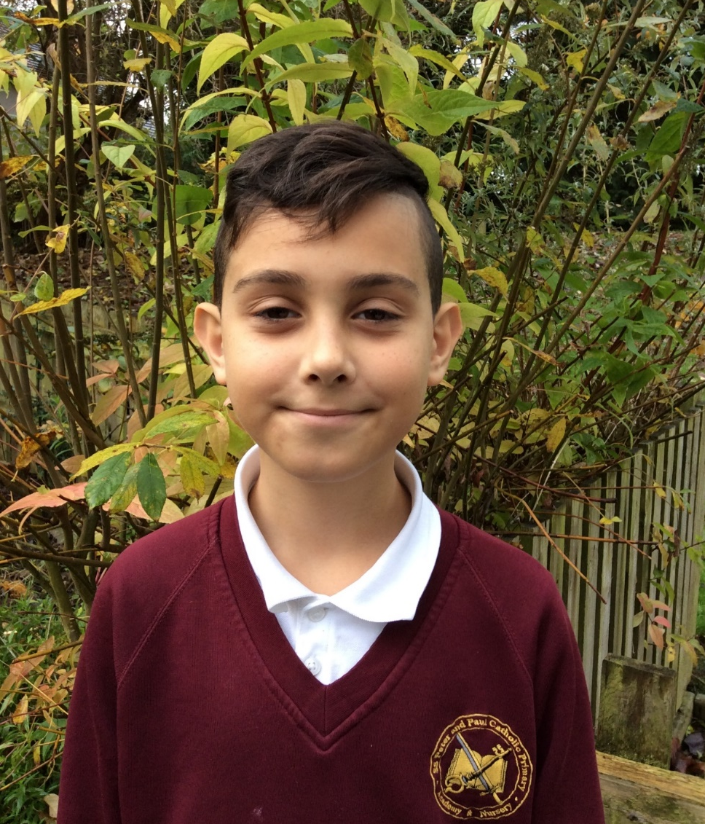
Brian
One of my fondest memories…
At Towers, during the night, someone opened the door and Jakub used his video recorder to try and catch who was disturbing us. It was REALLY funny.

Slide 11
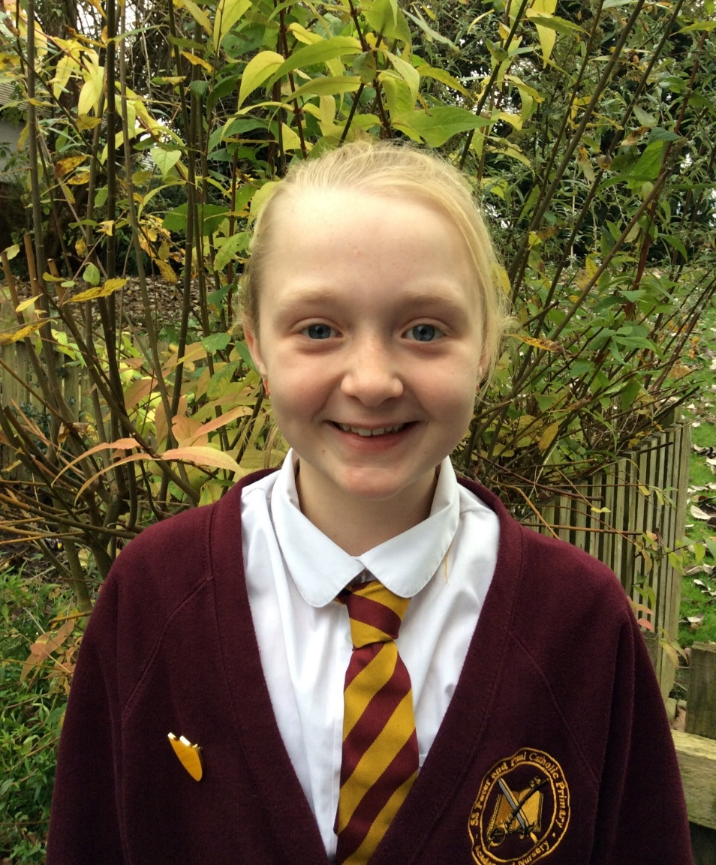
Ella
One of my fondest memories…
In Year 5, when we were at Towers, Miss Higgins knocked on the door…
Alsihba said, “YO, WHO’S THERE?”
Miss Higgins said, “YO, MISS HIGGINS”

Slide 12
Vicky
One of my fondest memories…
Receiving the Sacrament of Confirmation with my friends in Year 6.

Slide 13
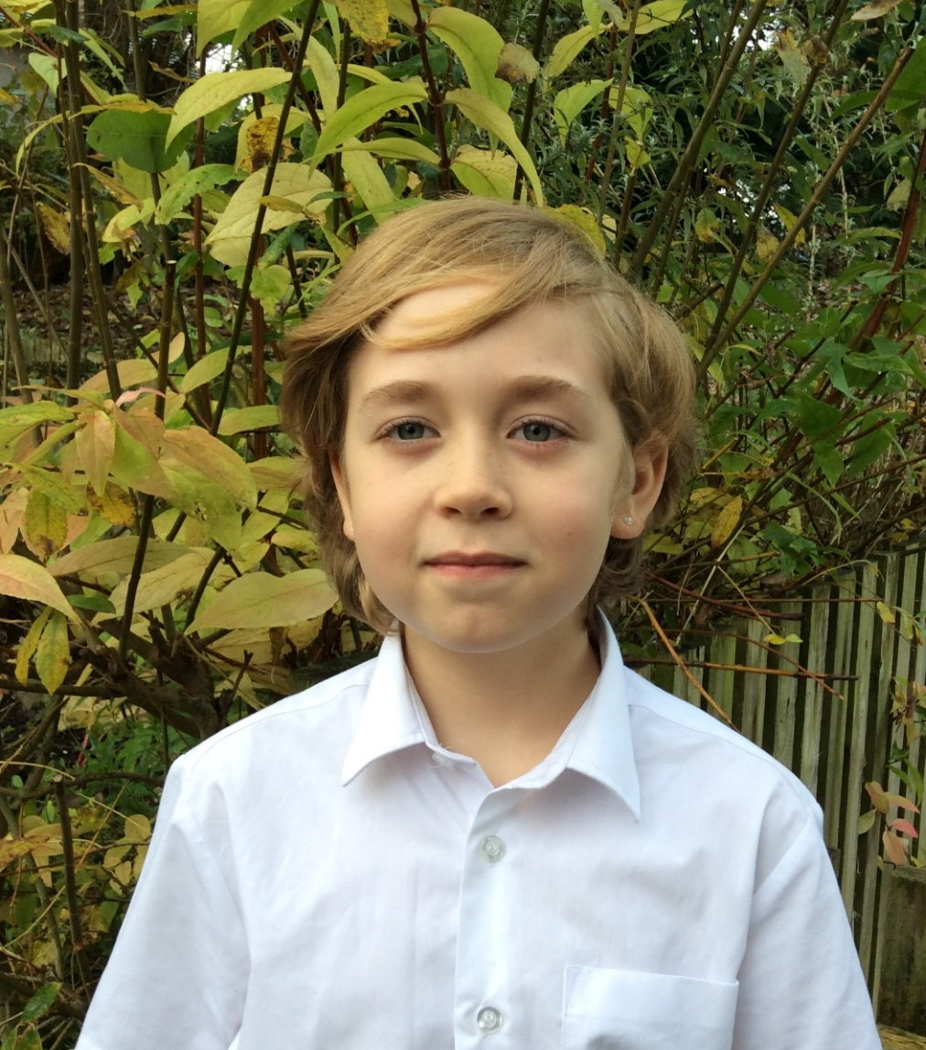
Tyler
One of my fondest memories…
Towers:
sharing a room with my friends
trying out new things like canoeing on the lakes in Wales ☺

Slide 14
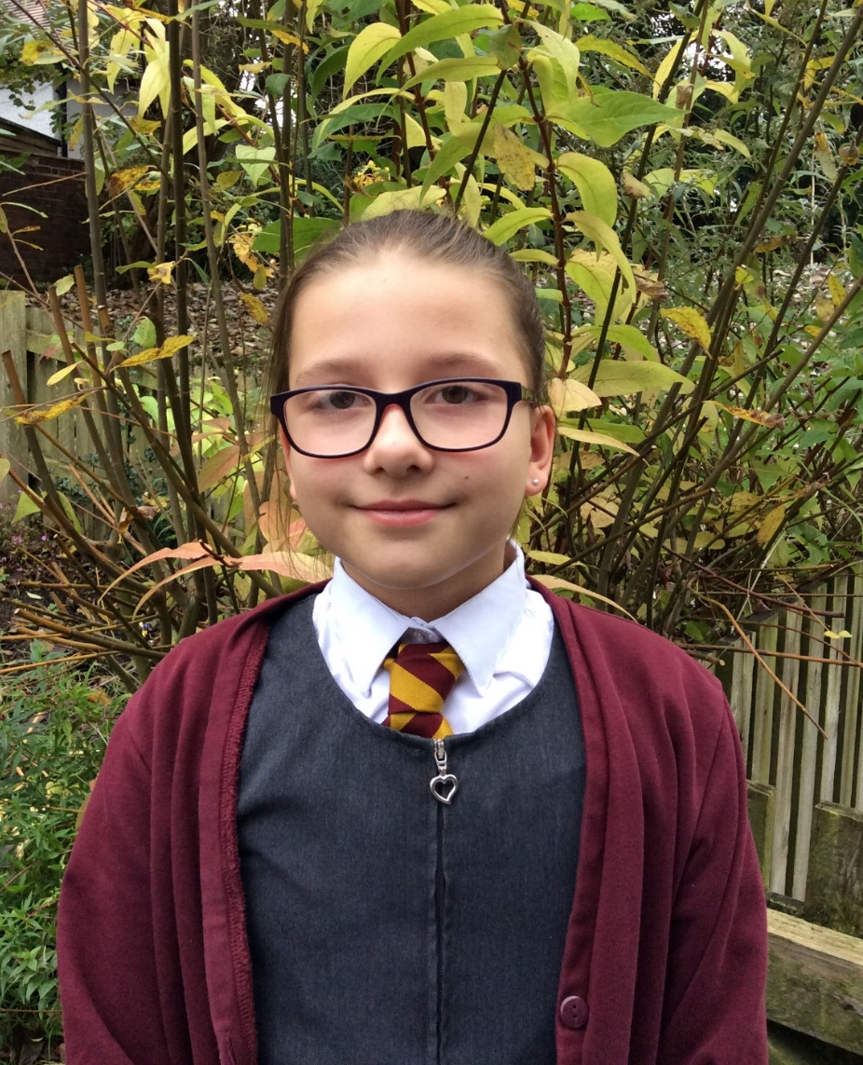
Lyra
One of my fondest memories…
When Ranita lost her welly in the middle of a waterfall in Wales and I gave her mine. So Miss Higgins had to carry me for 3 miles, all the way back to Towers.

Slide 15
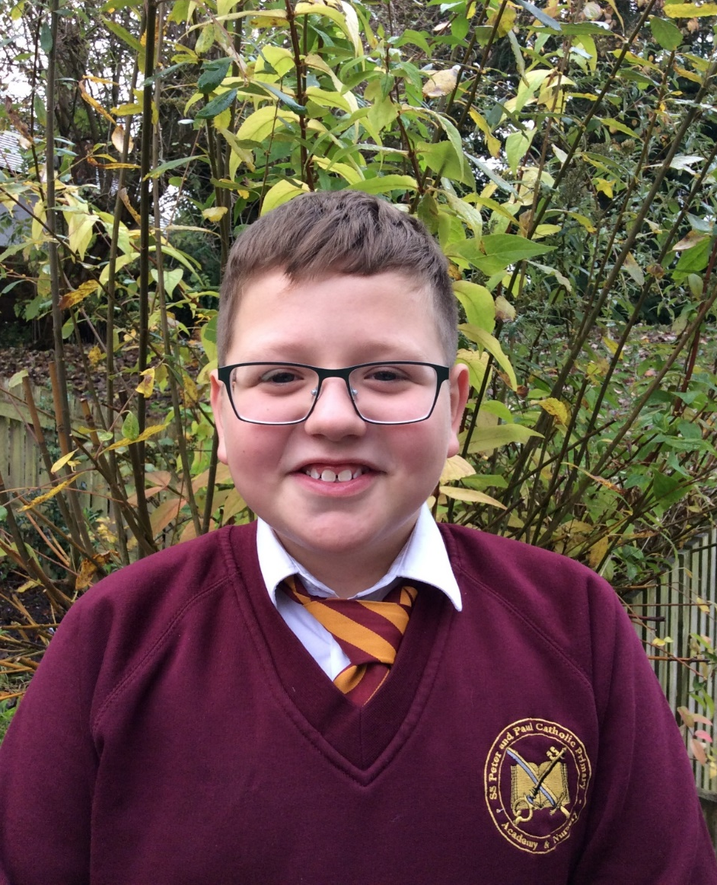
Oskar
One of my fondest memories…
The GREAT SCHOOL RUN last year when I crossed the finish line and everyone was cheering for me ☺

Slide 16
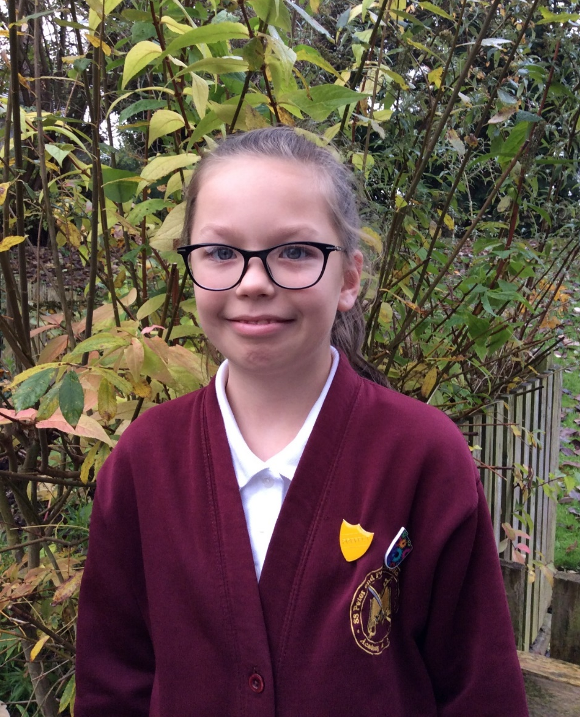
Maja
One of my fondest memories…
Learning to swim with my friends… I LOVED going swimming with school ☺

Slide 17
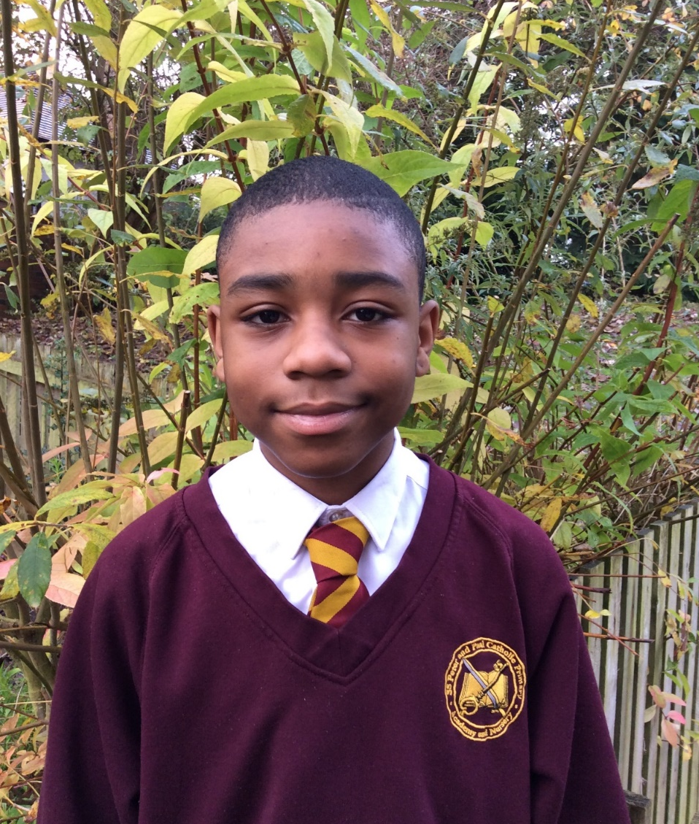
Michael
One of my fondest memories…
Climbing up the waterfall in Towers!

Slide 18
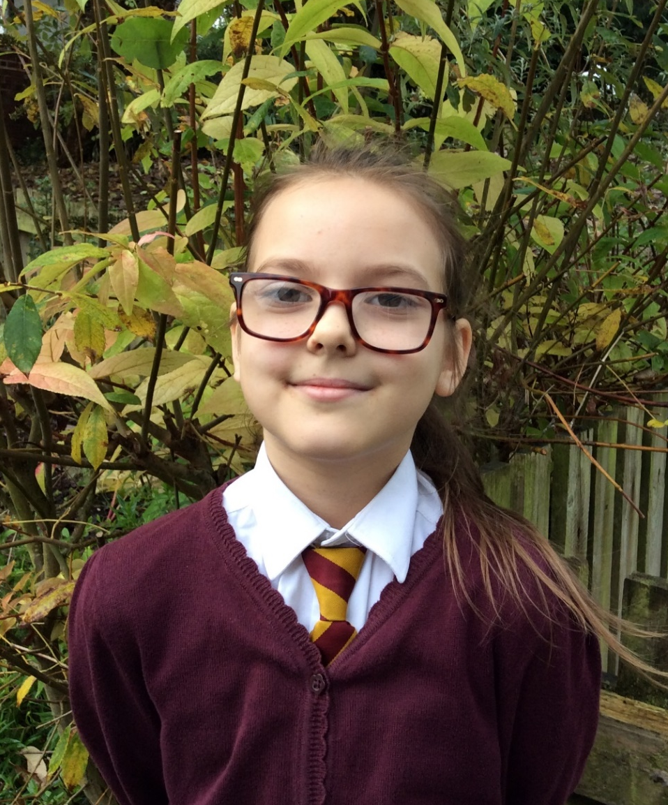
Meta
One of my fondest memories…
My time in Year 5, getting to know both of my teachers.
I loved learning Maths!

Slide 19
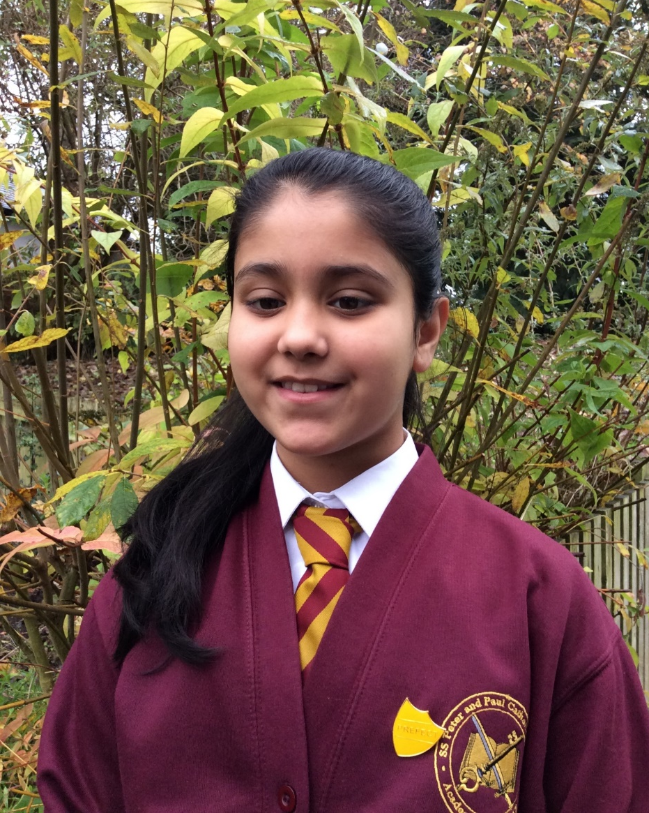
Ranita
One of my fondest memories…
When my welly fell off in a waterfall and floated off… I had to put my foot in a purple glove and have a piggy back from Miss Higgins and Mr Morgan all the way back to Towers.
It was so so funny.

Slide 20
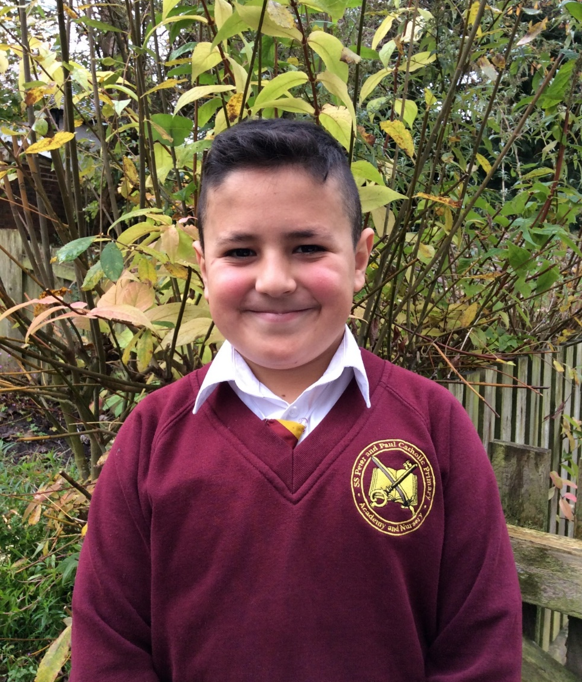
Adam
One of my fondest memories…
The Polar Express Day was so much fun. I had a great day in school.
I loved to see the reindeer and the decorations in the classroom.

Slide 21
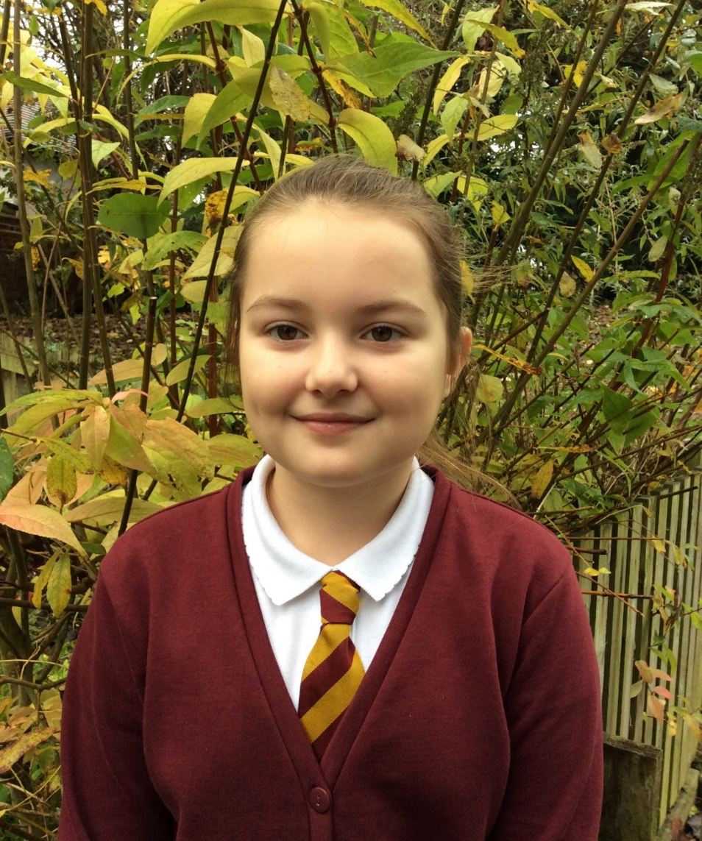
Daria
One of my fondest memories…
I have lots of great memories of my time at school, especially when we took the younger children to meet Father Christmas and the reindeers on the Polar Express Day.

Slide 22
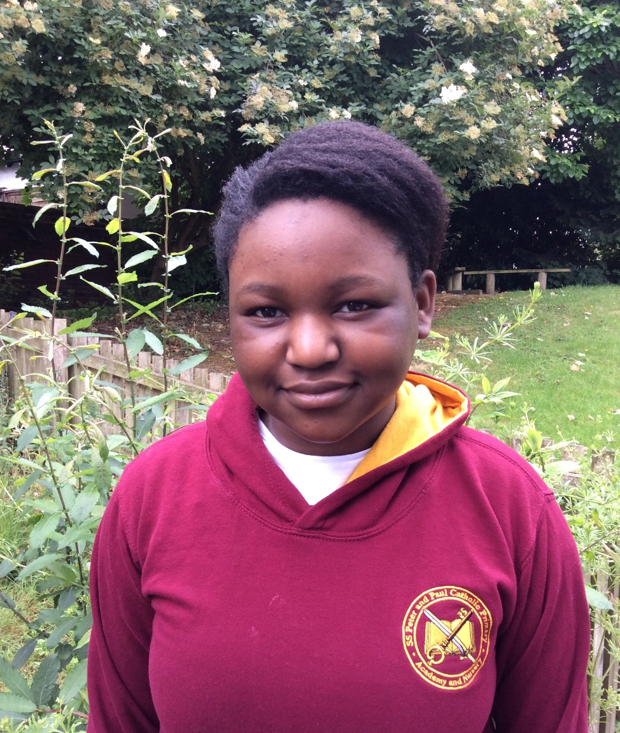
Angel
One of my fondest memories…
The Polar Express day was my favourite day ever.
I loved coming to school in my pyjamas and seeing all of the Christmas decorations.

Slide 23
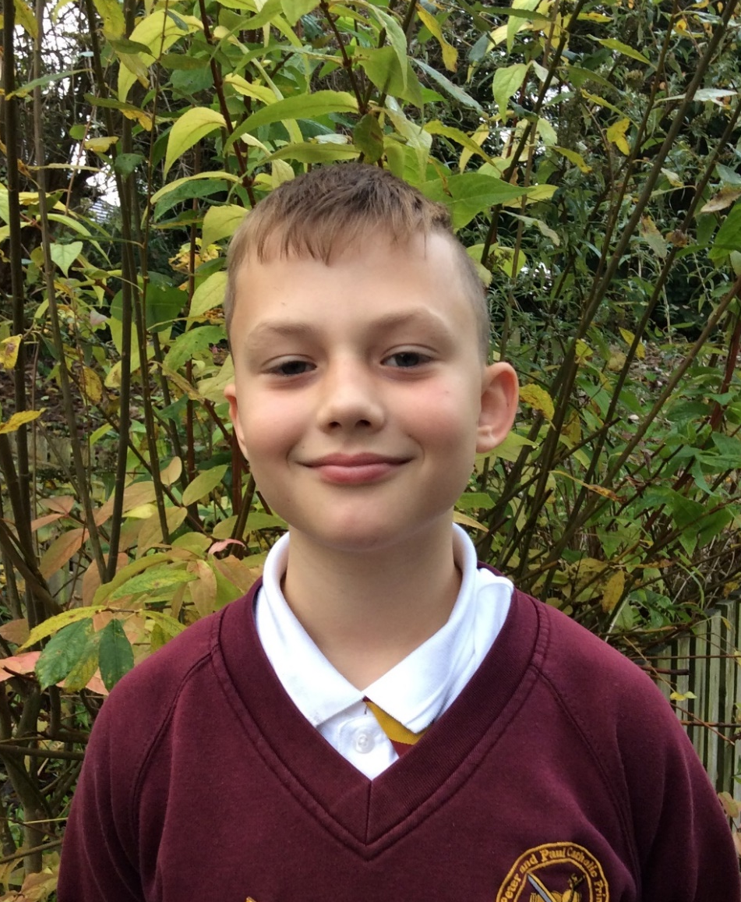
Jakub
One of my fondest memories…
In Nursery, I made my first friend who was Kacper…
…even though he kept hitting me with a play hammer.

Slide 24
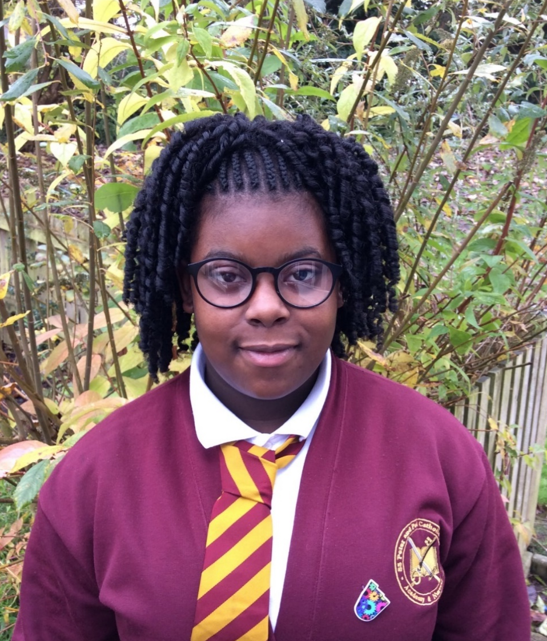
Dior
One of my fondest memories…
When we were in Year 2, on a trip in Wales…
A seagull landed on my head and took one of Daria’s sandwiches from her hand. This has always been a funny memory.

Slide 25
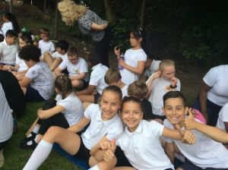
We will miss each and every one of you and the teachers will remember all of the memories made with you! Be good, have fun, work hard and good luck at your new schools! ☺

