Slide 1
We constantly focus on standards as we understand that outcomes are paramount. Our decision making is driven entirely by what is best for children

Slide 2
Our expectations.

Slide 3
Having a uniform demonstrated that students are a member of the school community, Denton Community College has high expectations for how the uniform is worn.

Slide 4
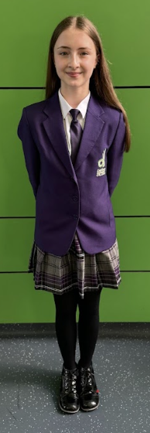
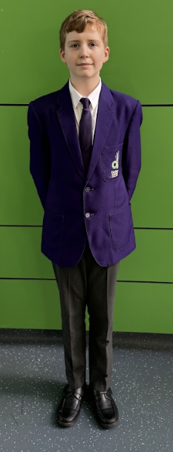
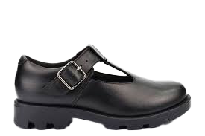
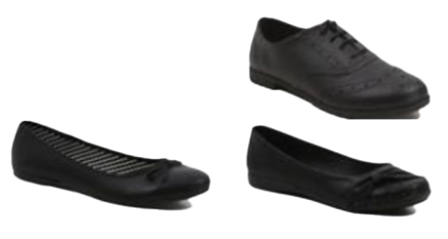
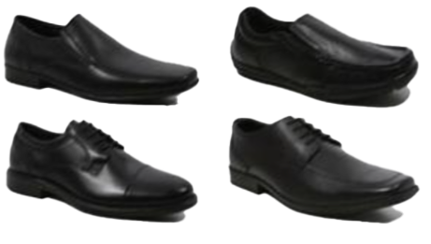
Uniform Expectations
ALL students are expected to wear FULL Uniform every day. Staff will check the quality of uniform on a daily basis. If there is a problem with your child’s uniform,
Please contact us as a matter of urgency to discuss.
ACCEPTABLE GIRLS SHOES
White shirt and college tie
Purple blazer with logo
ACCEPTABLE BOYS SHOES
Charcoal grey loose fitting plain trousers (No fashion trousers e.g. jeans / skinny fit / trousers tapered to the ankle)
OR purple & grey tartan knee length skirt and plain black tights (at least 60 denier)
ONLY LEATHER UPPER SCHOOL SHOES (not boots) which are professional and business like will be acceptable. Please purchase leather shoes in one of these ACCEPTABLE STYLES - see photographs above which are available from local stores.
Plain black socks
Grey v-neck jumper (optional)

Slide 5
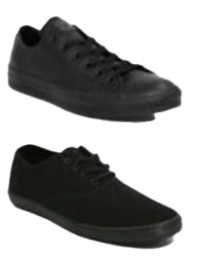
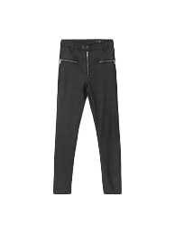
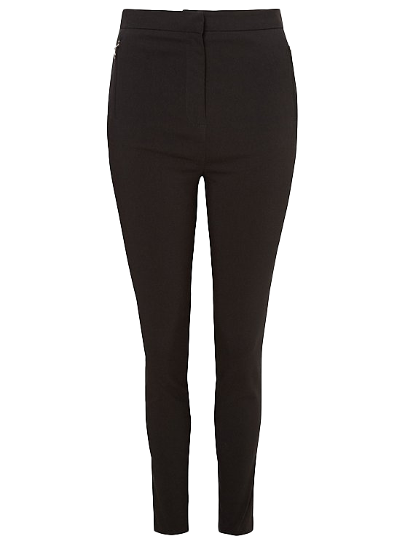
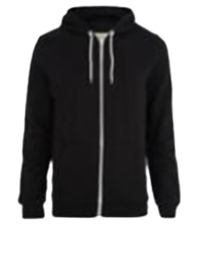
What does NOT meet our uniform Expectations:
Jewellery of any kind
Excessive make-up
Large hair bows
Nail enhancements Including but not limited to; acrylic, BIAB, gel, varnish
Extreme hair styles or colours
Extreme hair accessories
Outerwear inside the building, including but not limited to; coats, hats, scarves, gloves
NOT ACCEPTABLE

Slide 6
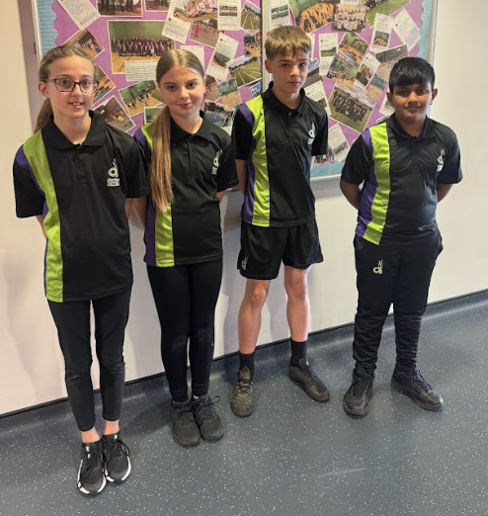
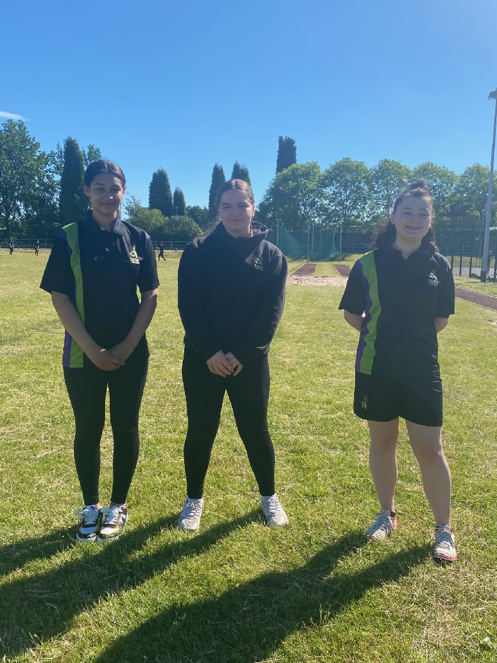
PE Kit Expectations
ALL students are expected to bring PE kit
for their PE lessons. PE Staff will check the
PE kit at the start of each lesson.
Denton Community College PE t-shirt, plain black t-shirts are also acceptable
Black hoodie
with the college logo, plain black is also acceptable
Plain black socks
Sports trainers, any brand and colour are acceptable. Canvas skate shoes (converse/vans) are not recommended
Black tracksuit bottoms with the college logo, plain black are also appropriate
Black short with the college logo, plain black shorts are also appropriate

