Slide 3
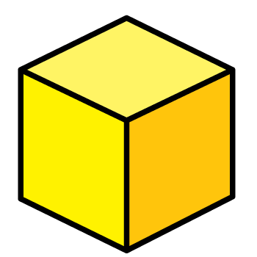
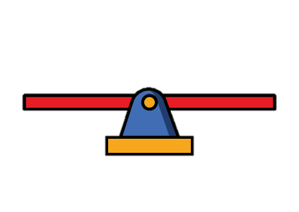
1) How do you spell 11 ?
2) What number comes next? 48, 49, __
3) What is this called?
4) What is this called?

Slide 4
1) How do you spell 11 ?
2) What number comes next? 48, 49, __
3) What is this called?
4) What is this called?
eleven
50
cube
Balance scale

Slide 6
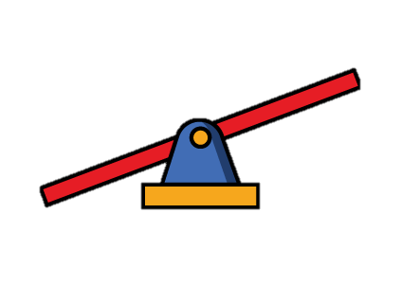
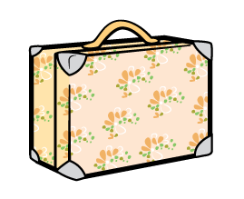
Which case is heavier?
is heavier than

Slide 7
Which case is lighter?
is lighter than

Slide 8
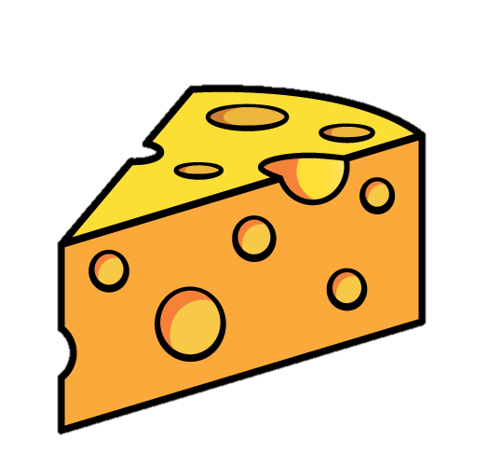
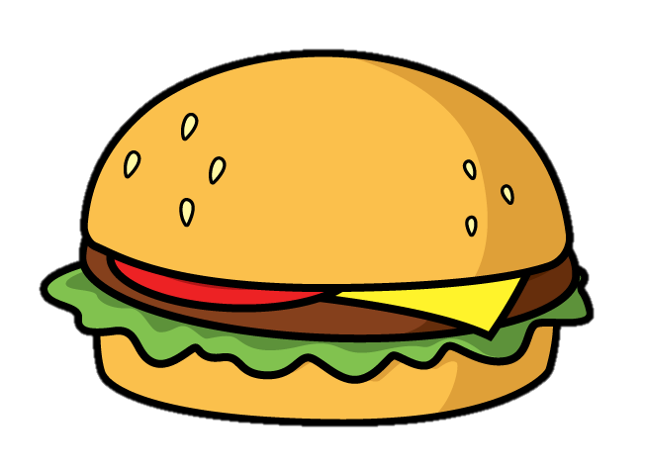
Have a think
When the scale is balanced…
The objects have the same mass.

Slide 9
Have a go at questions 1 and 2 on the worksheet

Slide 10
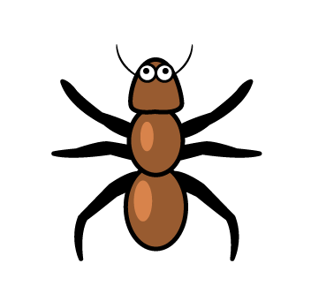
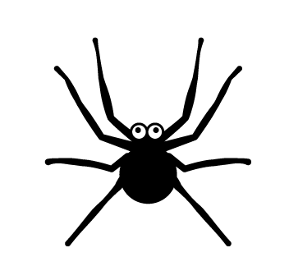
Have a think
What does the scale tell you?
The is heavier than the

Slide 11
Have a think
What does the scale tell you?
The is lighter than the

Slide 12
Have a think
What does the scale tell you?
The has the same mass as the

Slide 13
Have a go at question 3 on the worksheet

Slide 14
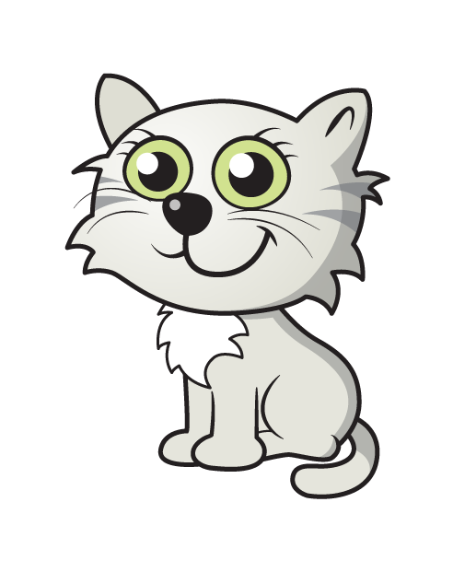
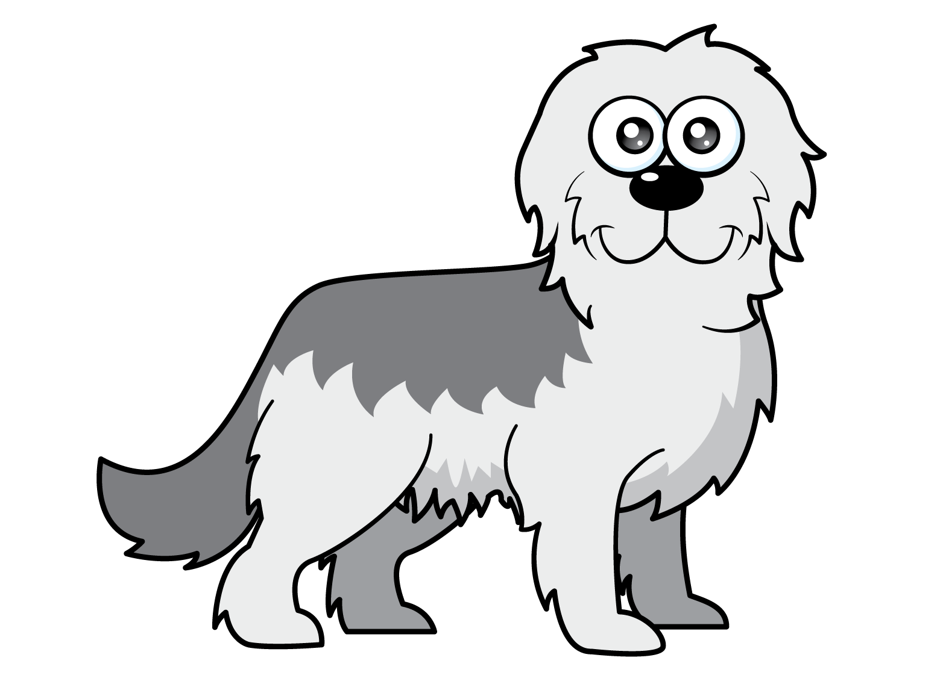
What do you think?
Have a think
The is heavier than the

Slide 15
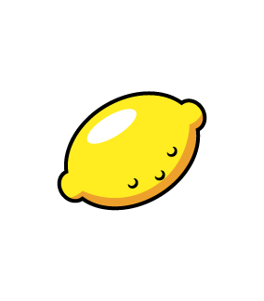
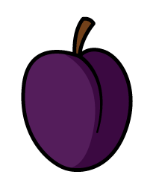
What do you think?
Have a think
The has the same mass as the

Slide 16
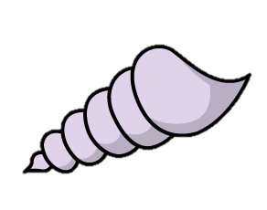
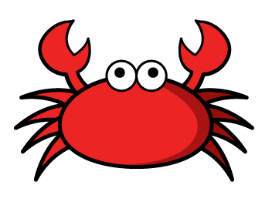
What do you think?
Have a think
The is lighter than the

Slide 17
Have a go at question 4 on the worksheet

