Slide 1
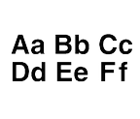
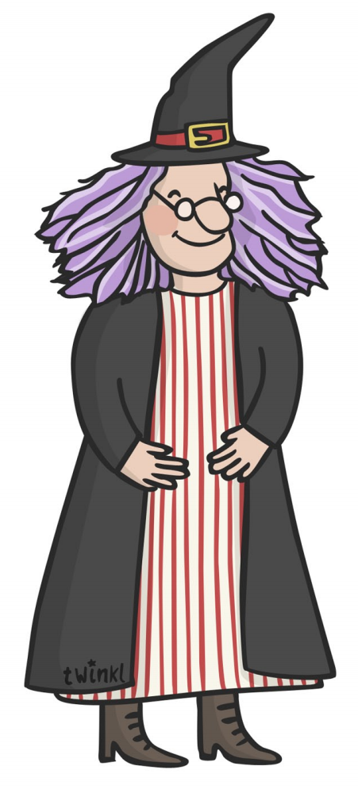
Write over each letter then have a go yourself underneath.
p p p p
____________________________
____________________________
____________________________
____________________________
b b b b
____________________________
____________________________
w w w w

Slide 2
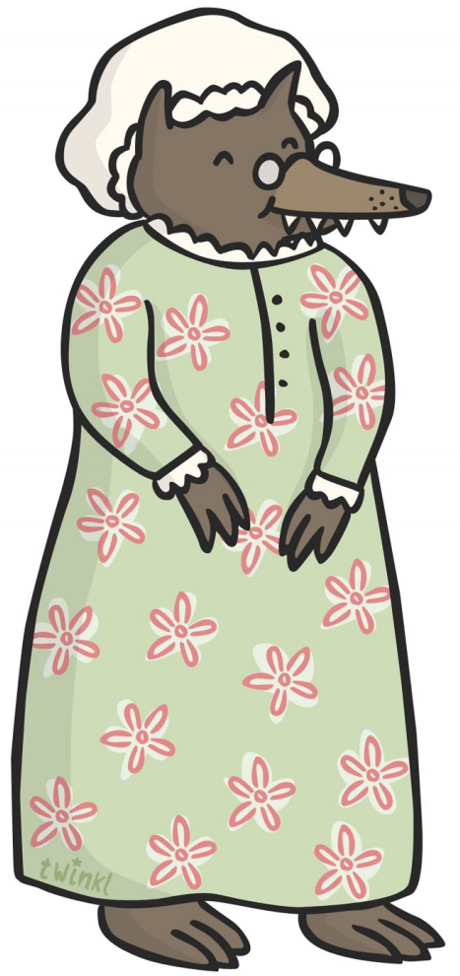
Write over each letter then have a go yourself underneath.
g g g g
____________________________
____________________________
____________________________
____________________________
c c c c
g g g g
____________________________
____________________________

Slide 3
Write over each word then have a go yourself underneath.
____________________________
____________________________
postman
____________________________
____________________________
bears
____________________________
____________________________
witch

Slide 4
Write over each word then have a go yourself underneath.
____________________________
____________________________
giant
____________________________
____________________________
Cinderella
____________________________
____________________________
grandma

Slide 5
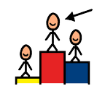
Use your best handwriting to name and label each picture.
____________________________
____________________________
____________________________
____________________________
____________________________
____________________________

Slide 6
Use your best handwriting to name and label each picture.
____________________________
____________________________
____________________________
____________________________
____________________________
____________________________

