Slide 1
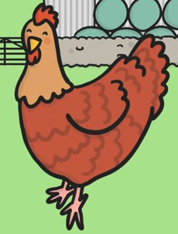
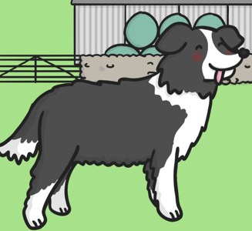
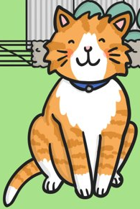
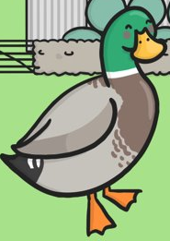
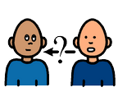
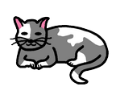
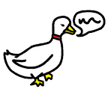
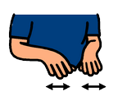
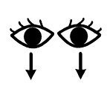
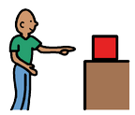
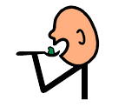
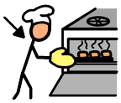
Who?
The little red hen
The dog
The cat
The duck
What doing?
is asking
is barking
is purring
is quacking
is cutting
has found
is eating
is baking
is looking at

Slide 2
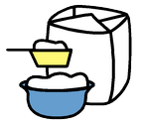
is saying
is planting
is making
What?
grains
wheat
bread
flour
Who will help me?
Not I!
I will!
No I will!

Slide 3
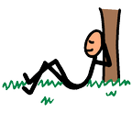
Where?
in the kitchen
at the mill
What like?
lazy
sleepy
noisy

Slide 4
Who?

Slide 5
Who?

Slide 6
Who?

Slide 7
Who?

Slide 8
Who?
is
The dog is lazy

Slide 9
Who?
is
The cat is sleepy

Slide 10
Who?
is
The duck is noisy

Slide 11
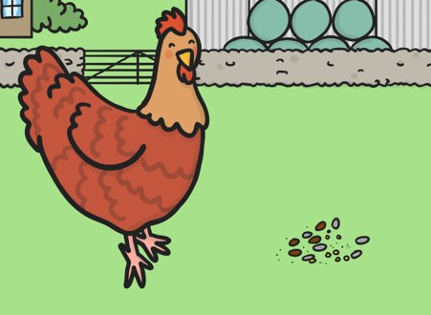
Who?
What doing?
What?
The little red hen has found/ is looking at the grain.

Slide 12
Who?
What doing?
‘Who will help me?’
The little red hen is asking ‘who will help me?’

Slide 13
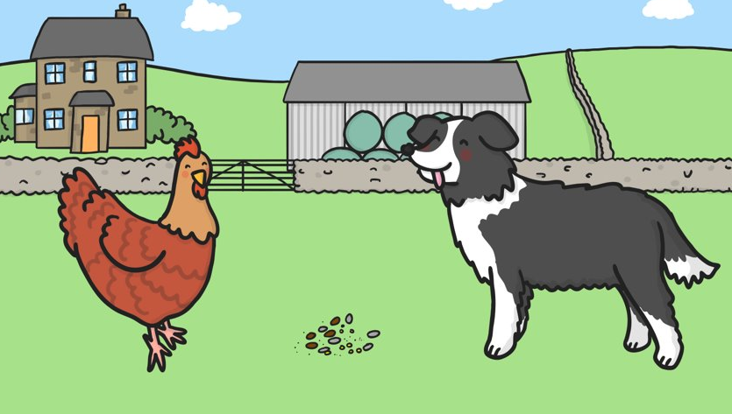
Who?
What doing?
‘Not I!’
The dog is barking ‘not I!’

Slide 14
Who?
What doing?
Example of how you could extend for your higher level if you wanted to
What like?
What?
‘Not I!’
The
The lazy dog is barking ‘not I’

Slide 15
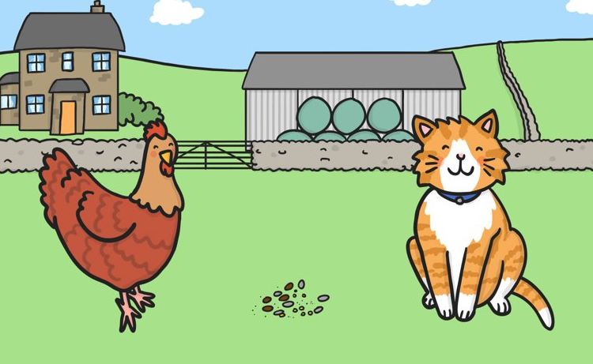
Who?
What doing?
‘Not I!’
The cat is purring ‘not I!’

Slide 16
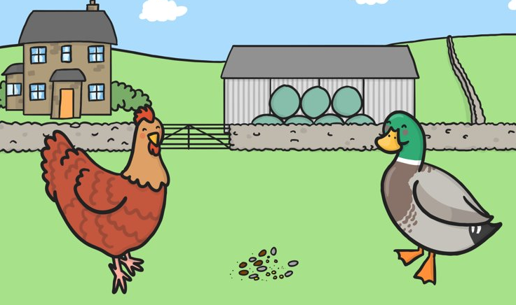
Who?
What doing?
‘Not I!’
The duck is quacking ‘not I!’

Slide 17
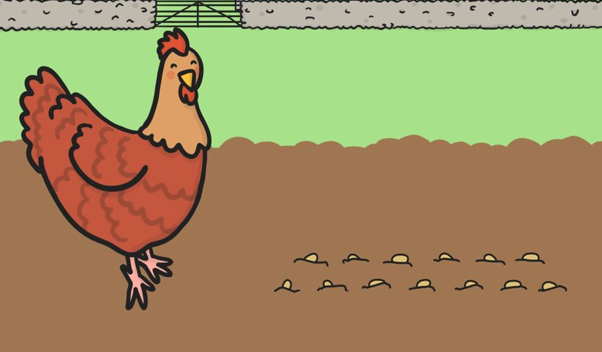
Who?
What doing?
What?
The little red hen is planting the grains.

Slide 18
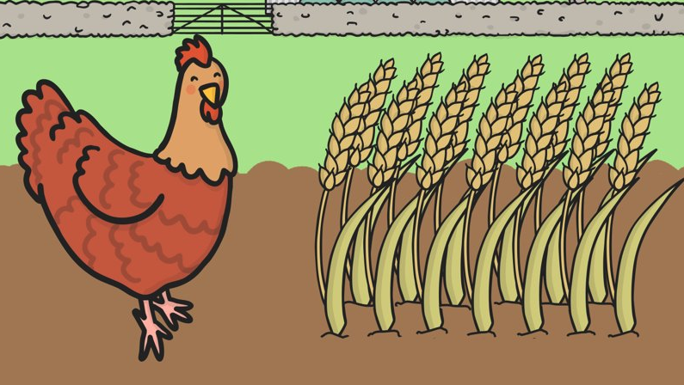
Who?
What doing?
‘Who will help me?’
The little red hen is asking ‘who will help me?’

Slide 19
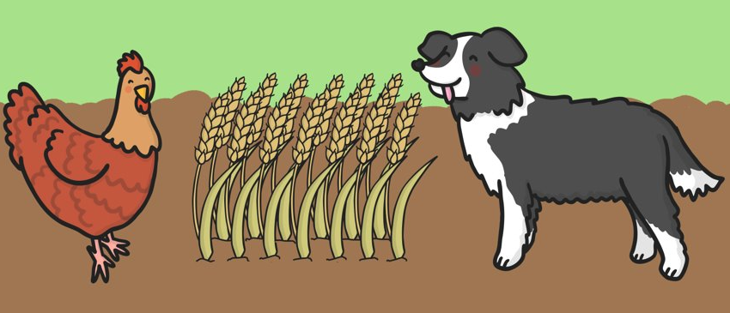
Who?
What doing?
‘Not I!’
The dog is barking ‘not I!’

Slide 20
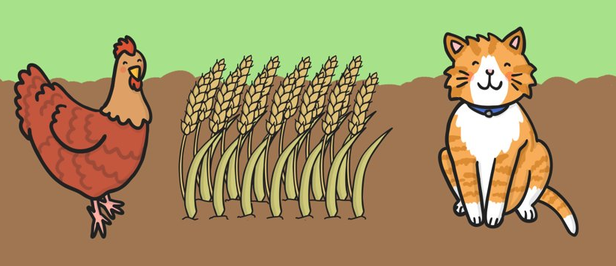
Who?
What doing?
‘Not I!’
The cat is purring ‘not I!’

Slide 21
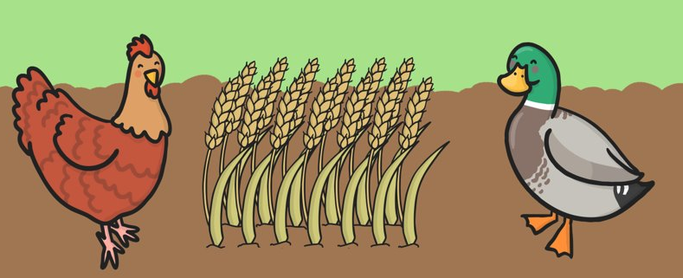
Who?
What doing?
‘Not I!’
The duck is quacking ‘not I!’

Slide 22
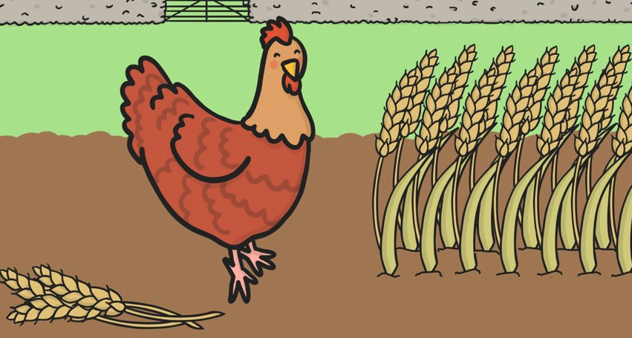
Who?
What doing?
What?
The little red hen is cutting the wheat

Slide 23
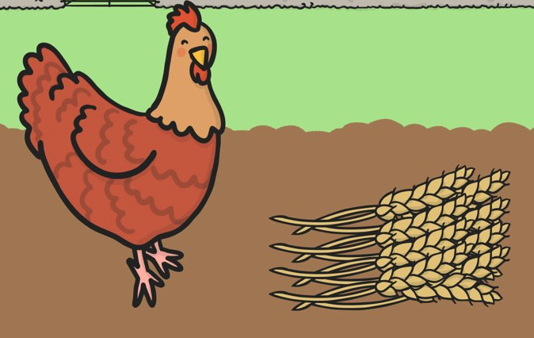
Who?
What doing?
‘Who will help me?’
The little red hen is asking ‘who will help me?’

Slide 24
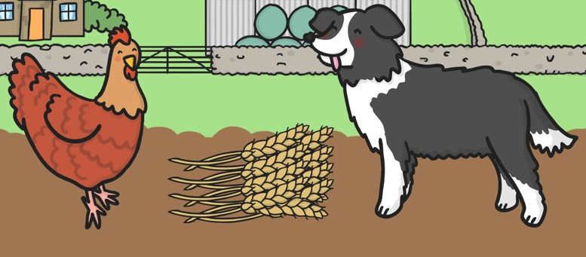
Who?
What doing?
‘Not I!’
The dog is barking ‘not I!’

Slide 25
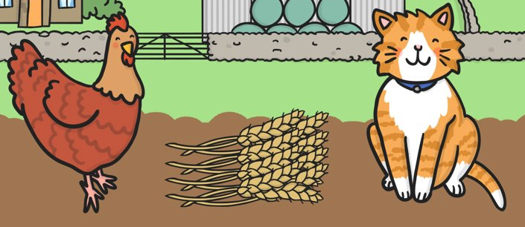
Who?
What doing?
‘Not I!’
The cat is purring ‘not I!’

Slide 26
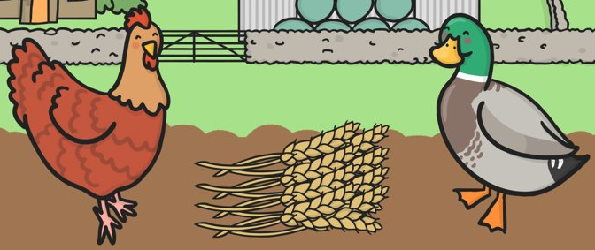
Who?
What doing?
‘Not I!’
The duck is quacking ‘not I!’

Slide 27
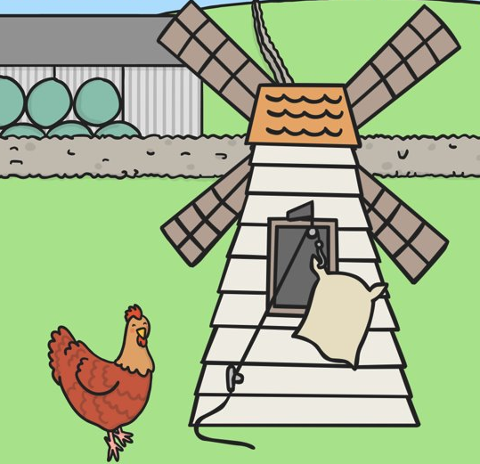
Who?
What doing?
What?
Where?
The little red hen is making flour at the mill

Slide 28
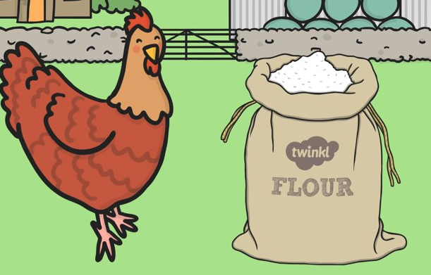
Who?
What doing?
‘Who will help me?’
The little red hen is asking ‘who will help me?’

Slide 29
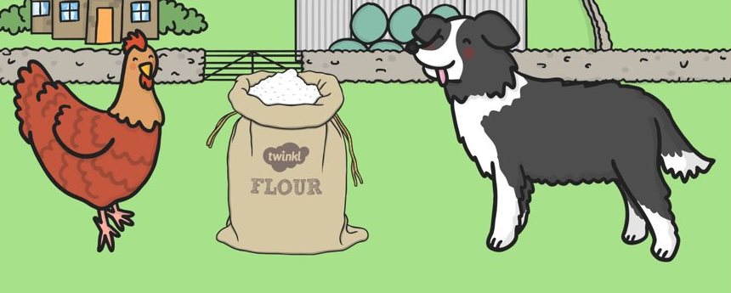
Who?
What doing?
‘Not I!’
The dog is barking ‘not I!’

Slide 30
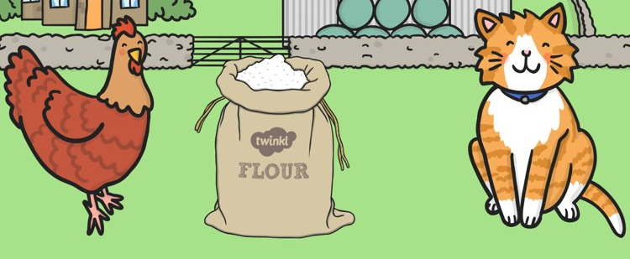
Who?
What doing?
‘Not I!’
The cat is purring ‘not I!’

Slide 31
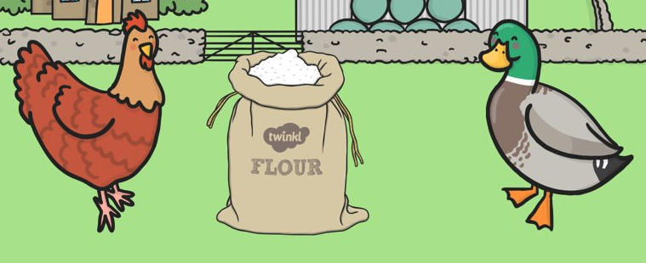
Who?
What doing?
‘Not I!’
The duck is quacking ‘not I!’

Slide 32
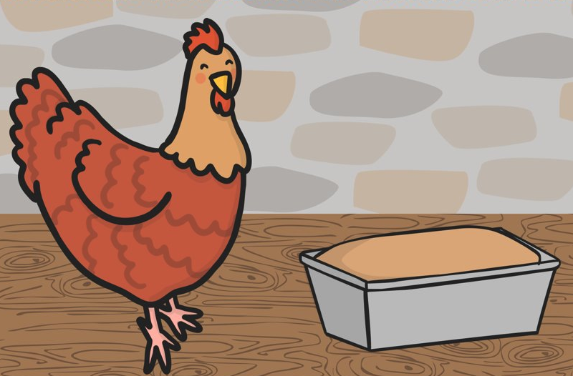
Who?
What doing?
What?
Where?
The little red hen is baking bread in the kitchen

Slide 33
Who?
What doing?
‘Who will help me?’
The little red hen is asking ‘who will help me?’

Slide 34
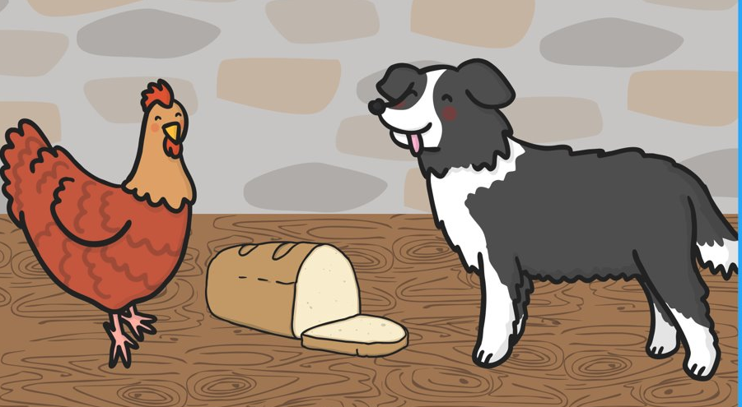
Who?
What doing?
‘I will!’
The dog is barking ‘I will!’

Slide 35
Who?
What doing?
Example of how you could extend for your higher level if you wanted to
What like?
What?
‘I will!’
The
The lazy dog is barking ‘I will’

Slide 36
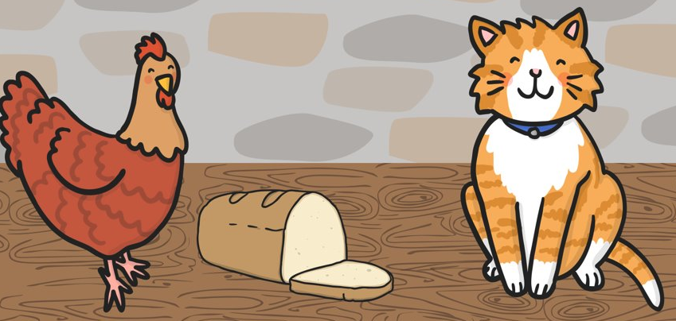
Who?
What doing?
‘I will!’
The cat is purring ‘I will!’

Slide 37
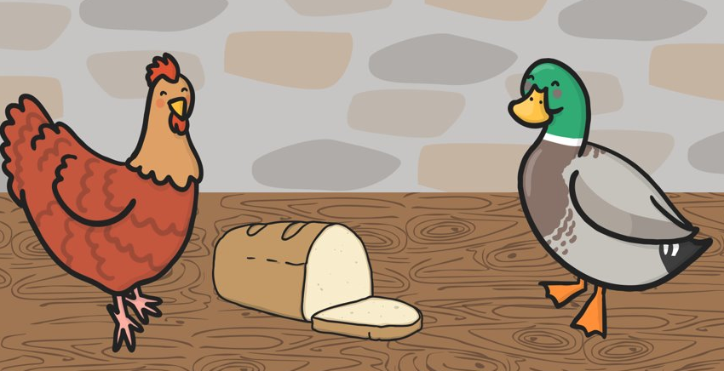
Who?
What doing?
‘I will!’
The duck is quacking ‘I will!’

Slide 38
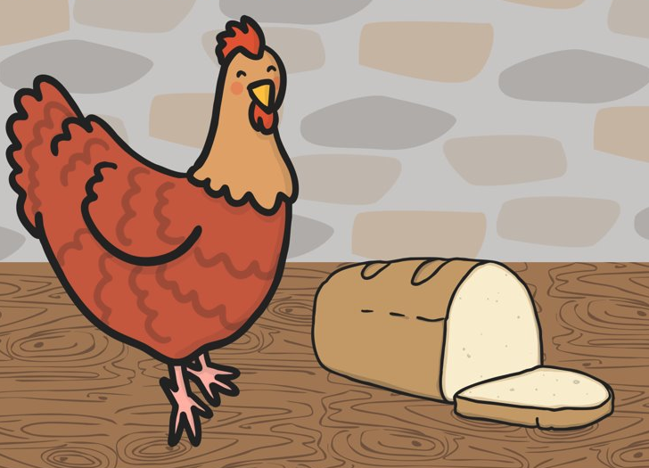
Who?
What doing?
‘No I will!’
The litte red hen is saying ‘no I will!’

Slide 39
Who?
What doing?
What?
The little red hen is eating the bread

