Slide 1
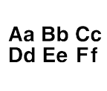
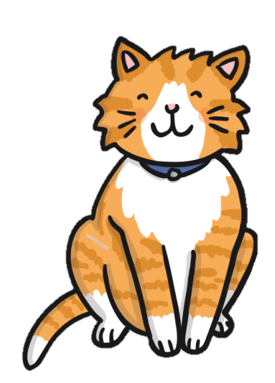
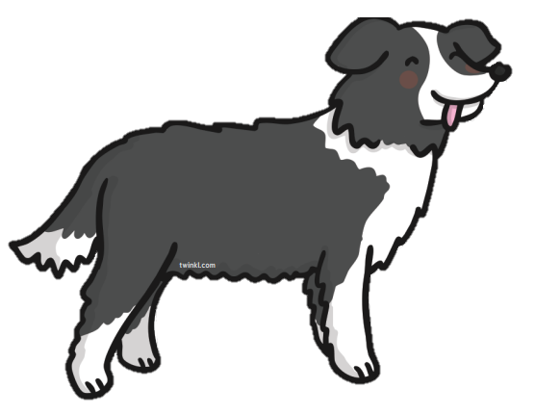
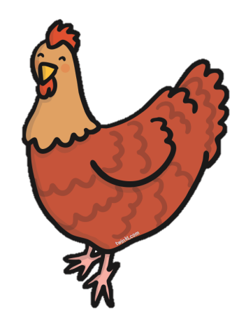
Write over each letter then have a go yourself underneath.
c c c c
____________________________
____________________________
____________________________
____________________________
d d d d
____________________________
____________________________
h h h h

Slide 2
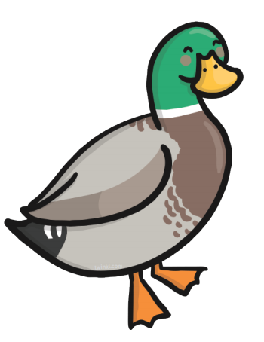
Write over each letter then have a go yourself underneath.
c c c c
____________________________
____________________________
____________________________
____________________________
d d d d
____________________________
____________________________
b b b b

Slide 3
Write over each word then have a go yourself underneath.
cat
____________________________
____________________________
____________________________
____________________________
dog
____________________________
____________________________
hen

Slide 4
Write over each word then have a go yourself underneath.
corn
____________________________
____________________________
____________________________
____________________________
duck
____________________________
____________________________
bread

Slide 5
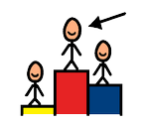
Use your best handwriting to name and label each picture.
____________________________
____________________________
____________________________
____________________________
____________________________
____________________________

Slide 6
Use your best handwriting to name and label each picture.
____________________________
____________________________
____________________________
____________________________
____________________________
____________________________

