Slide 1
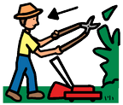
The gardener’s seeds

Slide 2
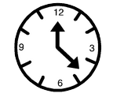
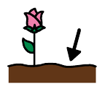
Once upon a time, there was a gardener who had six bags of seeds. She would plant them in soil and gave them lots of water and sunlight.
6

Slide 3
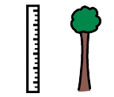
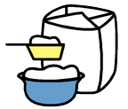
First, she planted the wheat. The wheat grew tall and the gardener made it into flour.

Slide 4
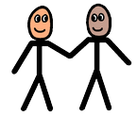
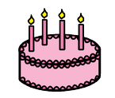
Next, she planted some flowers.
The gardener gave the big beautiful flowers
to her friend to celebrate her birthday.

Slide 5
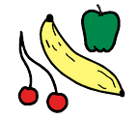
Next, she planted fruit seeds.
They grew into trees with apples and pears,
which were yummy!

Slide 6
Next, she planted wild flowers.
Bees buzzed around the pretty petals.

Slide 7
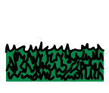
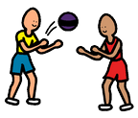
Finally, she planted grass seeds.
The garden grew into thick, green grass
where the children could play.

Slide 8
The end

