Slide 1
Autism resources: COVID19
Visual Schedules, Visual Calendars and Social Stories to support students in the event of school closure

Slide 2
Visual Schedules

Slide 3
I think in pictures. Words are like a second language to me…when somebody speaks to me, ​ his words are instantly translated into pictures…
Temple Grandin, 1995

Slide 4
Visual Schedules: How do I use them? ​
If your child is likely to find changes to routine difficult, in particular due to school closures, ​
Print the symbols relevant to your child’s daily routine and any activities they can do whilst at home. ​
Stick the symbols (using blue-tac or Velcro) to a blank strip of card (or down a door/wall) in the order that the routine will be carried out.
Copyright of The Talking House Limited 2020

Slide 5
Visual Schedules: Why should I use them?​
Visual aids provide consistent cues, which can support individuals to manage transitions and change by:​
reducing anxiety​
increasing predictability​
supporting understanding of routines and language​
The visual support remains fixed meaning that your child can refer back to this as often as needed.
Copyright of The Talking House Limited 2020

Slide 6
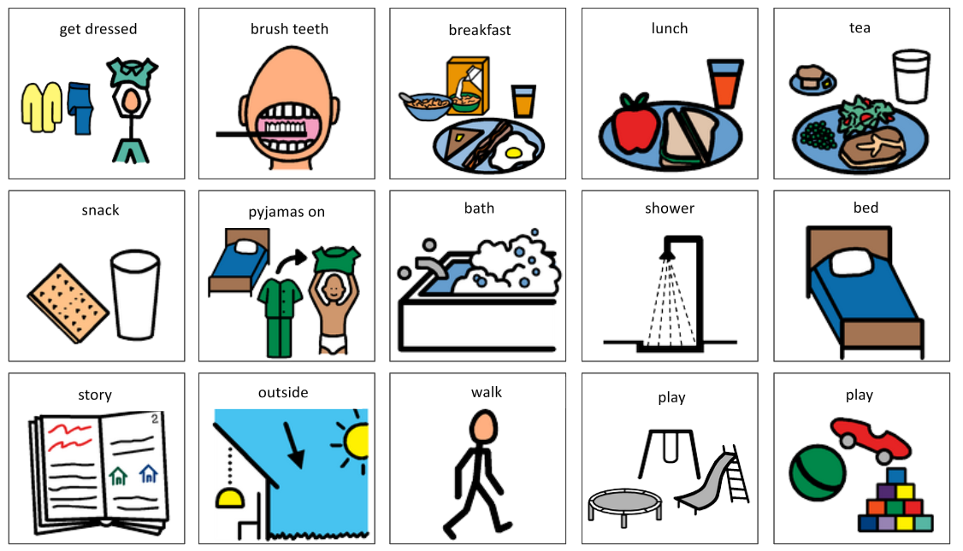
Copyright of The Talking House Limited 2020
*Symbols courtesy of Boardmaker

Slide 7
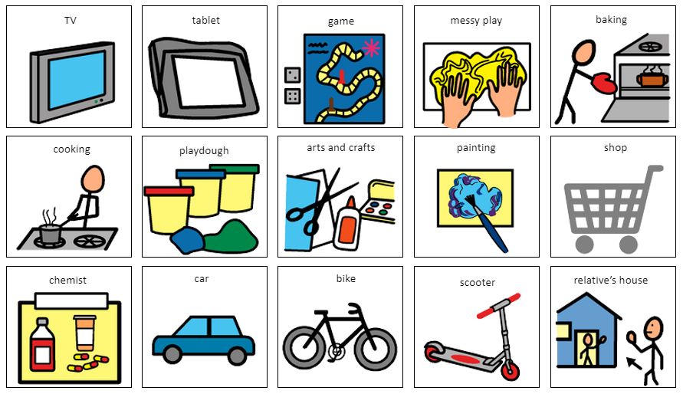
Copyright of The Talking House Limited 2020
*Symbols courtesy of Boardmaker

Slide 8
Differentiating Visual Schedules
If a whole visual schedule is too overwhelming for your child, try stepping this down to a now-next board or a ​
How do I do that?
Print the symbols relevant to your child’s daily routine and any activities they can do whilst at home. ​
Print the ‘now-next’ board.​
Stick the relevant symbols (using blue-tac or Velcro) in the order they will be carried out, for example:​
‘now – breakfast, next – outside play’
Copyright of The Talking House Limited 2020

Slide 9
Differentiating Visual Schedules
Copyright of The Talking House Limited 2020
*Symbols courtesy of Boardmaker

Slide 10
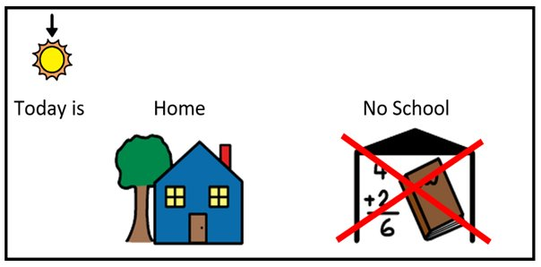
Differentiating Visual Schedules
Copyright of The Talking House Limited 2020
*Symbols courtesy of Boardmaker

Slide 11
Visual Calendars

Slide 12
Visual Calendars
If your child finds it difficult to understand that they’re not going to school during the holidays, a visual calendar can ​support their understanding of where they will be that day and when they will be returning to school.
In the event of school closures, the following calendars can be used to show your child that they will be staying at home.
Copyright of The Talking House Limited 2020

Slide 13
Visual Calendars: How Should I use the calendar
Suggestion 1: Use a pen to cross out school on the days in which school is closed/ your child is ill​
Suggestion 2: Print the ‘no’ symbols and stick them over the top of the school symbol​
Suggestion 3: Print additional home symbols and a blank calendar from Google to fill all boxes with ‘home’​
Additional symbols: print symbols for a relative’s house if your child will be looked after by someone else
Copyright of The Talking House Limited 2020

Slide 14
Visual Calendars: Why should I use them?
Visual aids provide consistent cues, which can support individuals to manage transitions and change by:​
reducing anxiety​
increasing predictability​
supporting understanding of routines and language​
The visual support remains fixed meaning that your child can refer back to this as often as needed.
Copyright of The Talking House Limited 2020

Slide 15
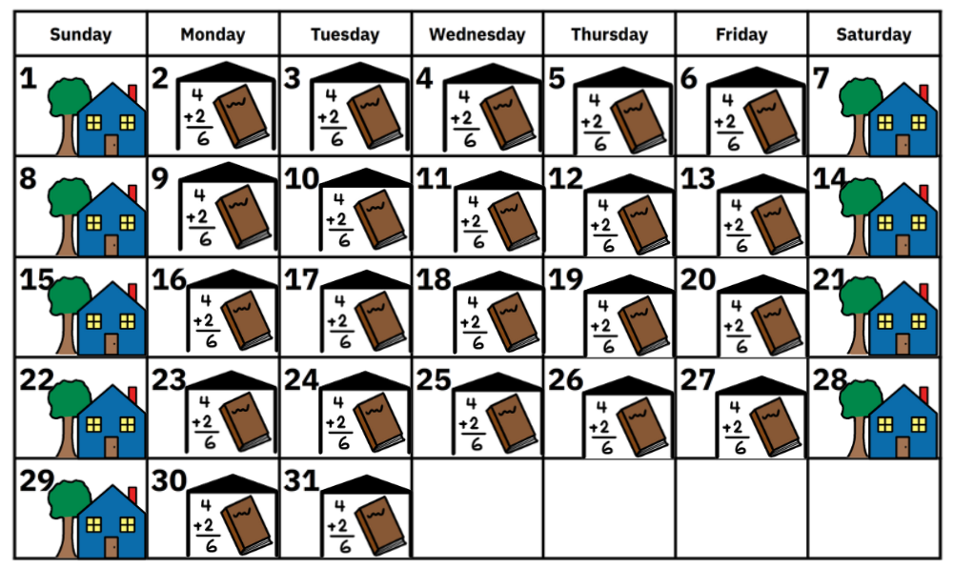
March 2020​
Copyright of The Talking House Limited 2020
*Symbols courtesy of Boardmaker

Slide 16
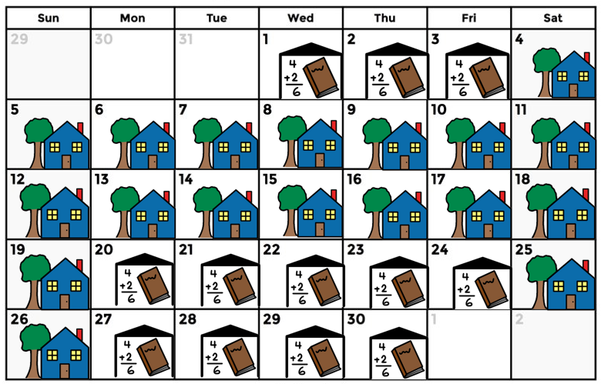
April 2020​
Copyright of The Talking House Limited 2020
*Symbols courtesy of Boardmaker

Slide 17
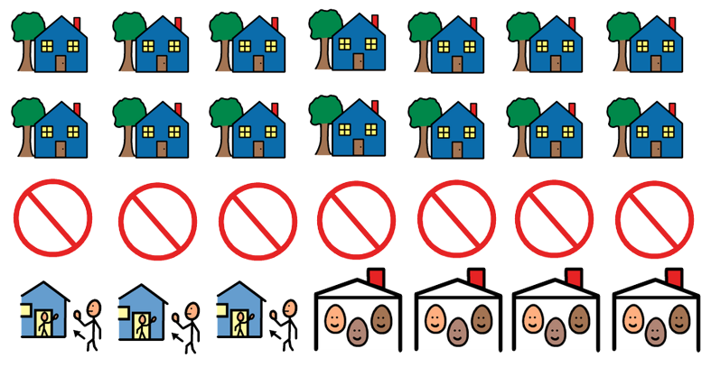
Copyright of The Talking House Limited 2020
*Symbols courtesy of Boardmaker

Slide 18
Social Stories

Slide 19
The goal of a Social Story is to share information using a content, format, and voice that is descriptive, meaningful, and physically, socially, and emotionally safe for the child
Carol Gray, 2015

Slide 20
Social Stories: What do they do?
A Social Story answers relevant ‘wh’ questions, describing:
the context (where)
time-related information (when)
relevant people (who)
important cues (what)
basic activities, behaviours, or statements (how)
the reasons or rationale behind them (why).
Copyright of The Talking House Limited 2020

Slide 21
Social Stories: How can they help my child?
Social Stories aim to improve an individual’s understanding of events and expectations on them. ​
Through supporting understanding of a situation, these resources aim to:​
Reduce anxiety around new and changing situations​
Support behaviour by explaining expectations and offering reassurance​
Act as a consistent reference point for you and your child to read as many times as needed
Copyright of The Talking House Limited 2020

Slide 22
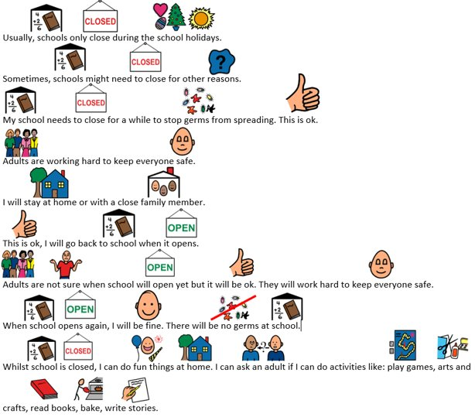
My school is closed: ​
Social Story – option 1 ​
You might choose this story if:​
Your child can understand the language that has been used​
Your child needs to know a reason for school being closed​
Your child will benefit from reassurance about what they can do whilst at home and to know that school will re-open
Copyright of The Talking House Limited 2020
*Symbols courtesy of Boardmaker

Slide 23
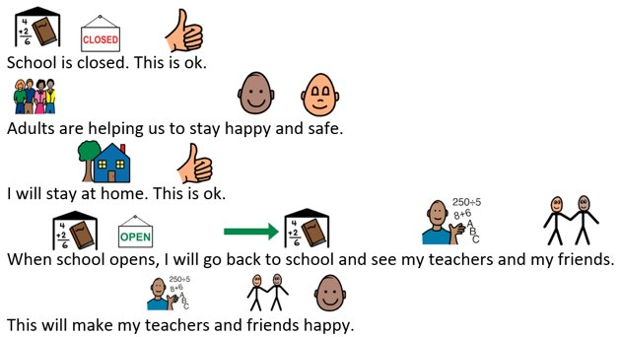
My school is closed: ​
Social Story – option 2
You might choose this story if:​
Your child needs simplified language​
Your child needs to know where they will be and that they will return to school​
Your child doesn’t understand the reasons behind the school closure
Copyright of The Talking House Limited 2020
*Symbols courtesy of Boardmaker

Slide 24
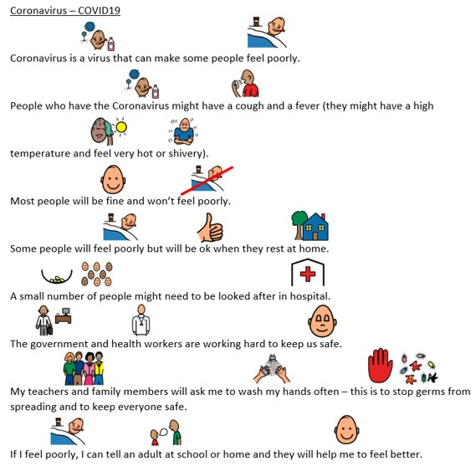
Coronavirus Social Story
You might choose to read this story with your child if:​
They can understand the language used ​
They are worried about Coronavirus​
They need reassurance about Coronavirus
Copyright of The Talking House Limited 2020
*Symbols courtesy of Boardmaker

Slide 25
We hope that you find this resource useful
Any questions:
info@thetalkinghouse.co.uk

