Slide 1
GOOD MORNING EVERYONE!
LET’S TALK REVISION

Slide 2
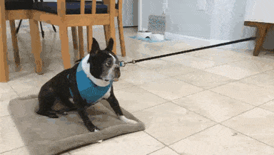
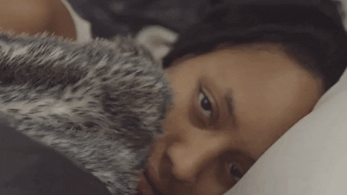
How are you feeling about revision for your exams in November?
FEAR NOT - IT DOESN’T HAVE TO BE THIS WAY!

Slide 3
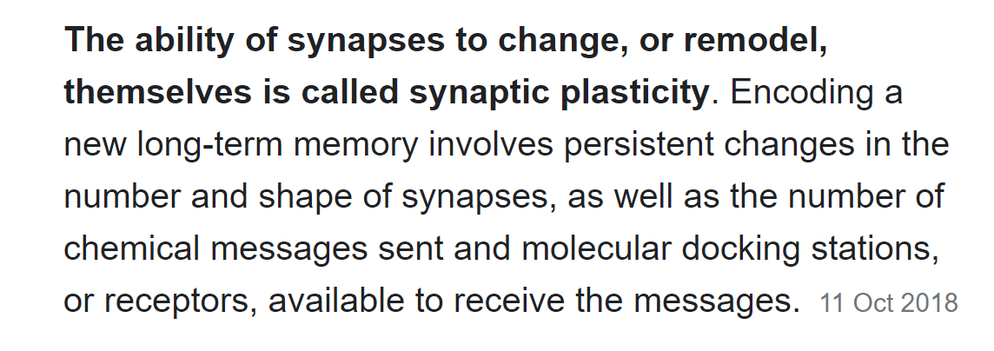
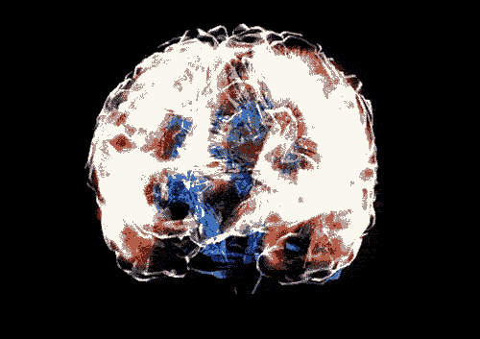
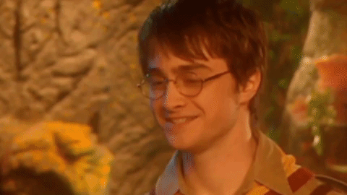
WHY DO I NEED TO REVISE?
Revision is important in two main ways. Firstly, it helps you to remember facts, figures, topics and methodologies that you have covered either recently of some time ago. Secondly, if done correctly it will help increase your confidence and reduce anxiety – you will be well prepared for your examination.

Slide 4
WHAT DO I NEED TO REVISE?
Your exam will consist of:
Language Paper 2: Non-fiction and Transactional Writing
You have been practising this paper in class. There will be :

Slide 5
Section A
In section A there are 2 texts to read and a series of questions designed to enable you to showcase your skills in comprehension, your ability to analyse, evaluate and compare.
Remember the chant:
Short answer - short answer - analysis
Short answer - short answer - evaluate
Compare

Slide 6
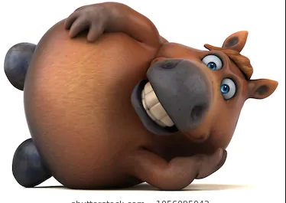
Section B
In section B you write a transactional piece, such as a letter, an article, a review or a speech. What’s the mnemonic we use?
A FART HORSE GLIDES
Anecdotes
Facts
Alliteration
Repetition
Triples
Hyperbole
Opinion
Rhetorical questions
Statistics
Emotive vocabulary
Group vocabulary (us, we, our)
Lists
Imperatives
Direct address
Expert opinions

Slide 7
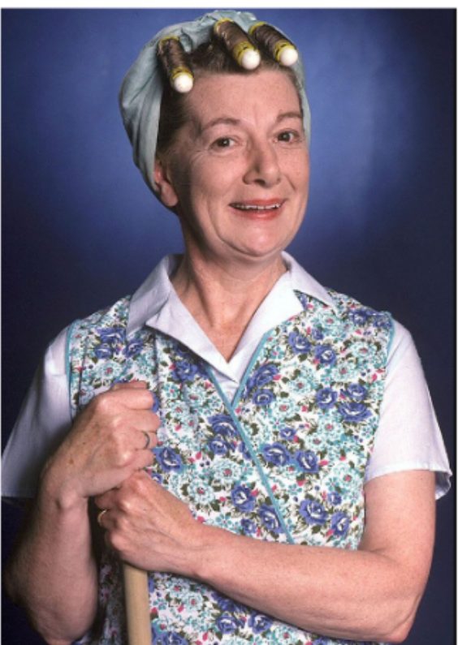
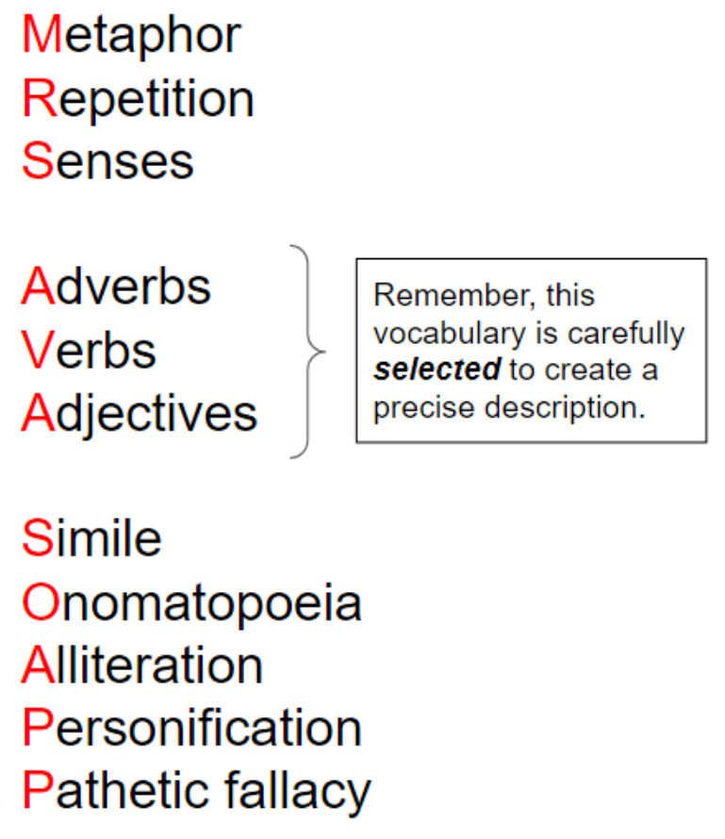
You are encouraged to use some other strategies to make your writing more engaging….what’s the other mnemonic that can help?
A note of caution:
Be very careful when selecting from this list. You want your writing to be engaging and credible. You are NOT to trying to write a work of fiction. So only use the devices that work for your purpose and audience.

Slide 8
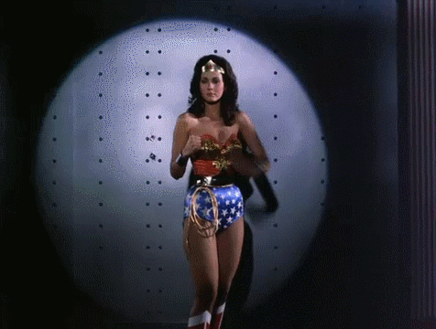
Mrs Shakespeare - Wonder woman!
has produced a revision booklet for you…..

Slide 9
So, HOW do I revise?
Make a firm commitment to START NOW
Set aside time at least 3 times a week to work on the booklet
Ensure you have a suitable place and no distractions…. yes, that does mean switching off your phone and dedicating the time to the work.
Work through your English Language Paper 2 Revision Booklet.
The booklet is carefully designed to guide you back through ALL the knowledge & skills you need for your exam.
Your teacher will be setting activities from the booklet as part of the homework. However, there will be other homework tasks to do as well.
You are encouraged to do more than you have been set, as this will allow you to work through particular questions at your own pace.

Slide 10
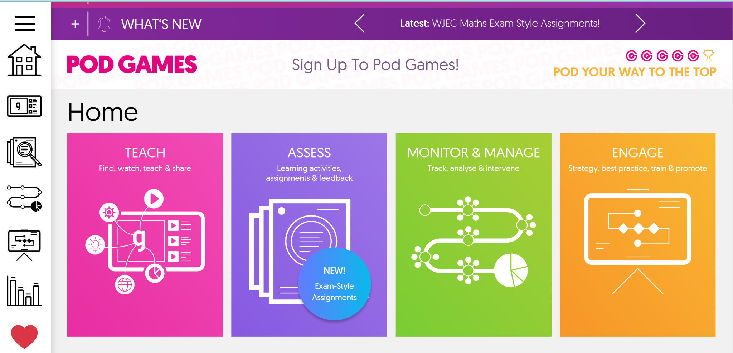
You should check that you can log onto GCSE Pod. You will need this to complete several tasks.

Slide 11
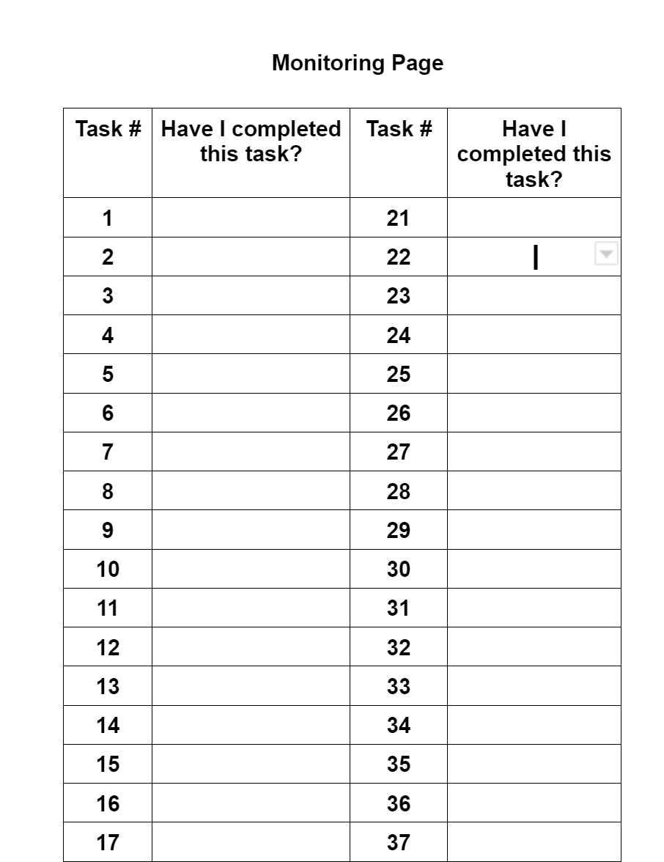
TOP TIPS:
The booklet is separated into 3 sections:
Language reading
Language writing
Punctuation
There are 26 tasks, but some tasks might have more than one activity. Every time you see a bullet point, there is an activity to complete.
On page 2 of your booklet there is a monitoring page to help you keep track of the areas you have revised. Colour code the tasks in 3 colours: reading tasks, writing tasks & punctuation on this monitoring sheet to show you are revising ALL 3 key areas for the exam.
What else can I do?

Slide 12
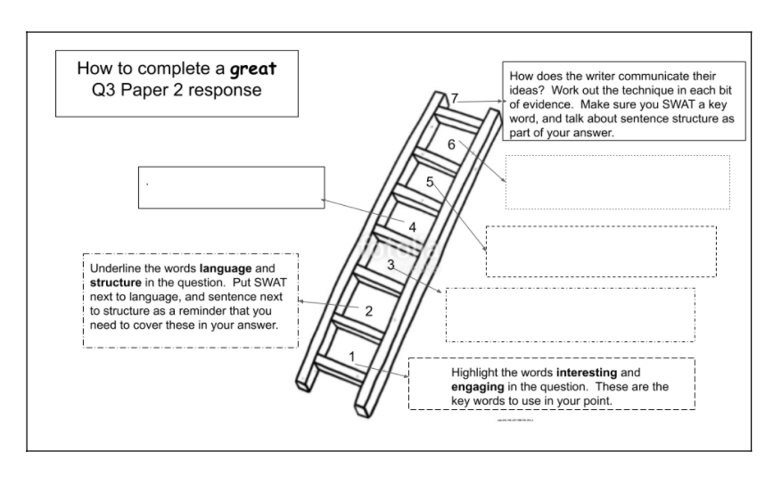
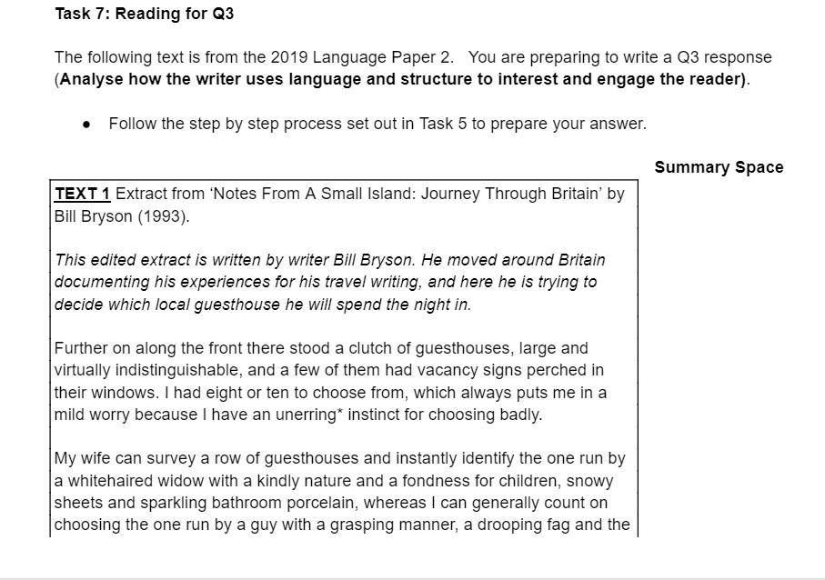
Read & Follow the instructions exactly.
For example, Task 7 asks you to follow the step by step process that was set out in Task 5. This means that you need to go back and check what the process was before attempting Task 7…..sounds obvious but you would be amazed at how many students don’t read the instructions properly and then struggle to complete the work.
Your task 5 answers will enable you…...
to tackle task 7!

Slide 13
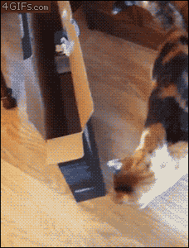
HELP!
I’M STUCK!

Slide 14
WHAT SHOULD I DO IF I’M STUCK…...
DON’T STAY STUCK - DO SOMETHING ABOUT IT!
ASK YOURSELF:
Am I really stuck or did I not read the instructions properly?
Can I find an example of this type of question in my exercise book and use my notes to help me work it out?
Can I use my Snap Revision Guide to help me?
Can I work with a classmate so we can help eachother out?
Can I look on GCSE Pod, Schmoop, BBC Bitesize, Mr Bruff….
If you are STILL unsure after trying ALL these options, ask your teacher for help.

Slide 15
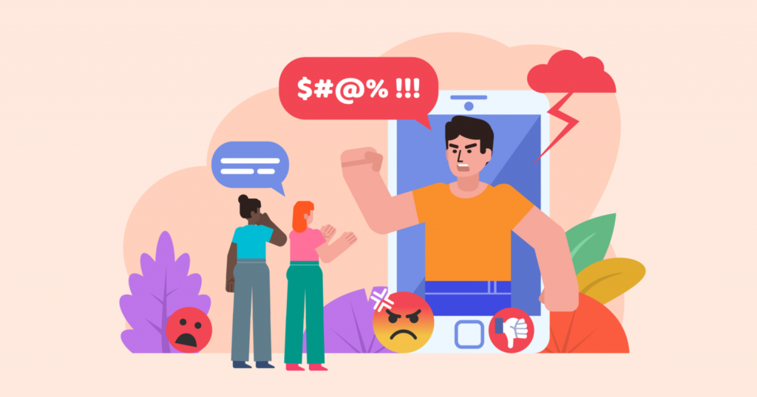
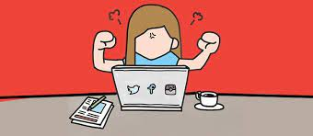
Why are these skills so important?
The ability to analyse, evaluate and develop a critical response to other people’s ideas is a fundamental life skill.
Just think about it - if we are unable to question what we hear and read and are unable to formulate an opinion of our own, based on well-researched facts and a clear and critical understanding of other points of view, then we will be seriously limiting ourselves…..Now, more than ever before we are able to voice our opinions publicly, so it is essential we are able to do it well.

Slide 16
When you apply for a college course or a job you need to present yourself and your ideas clearly so that you leave the right impression. Being able to do this really well, will give you confidence and self belief. These are the same skills that you are practising in the language paper 2 exam!

Slide 17
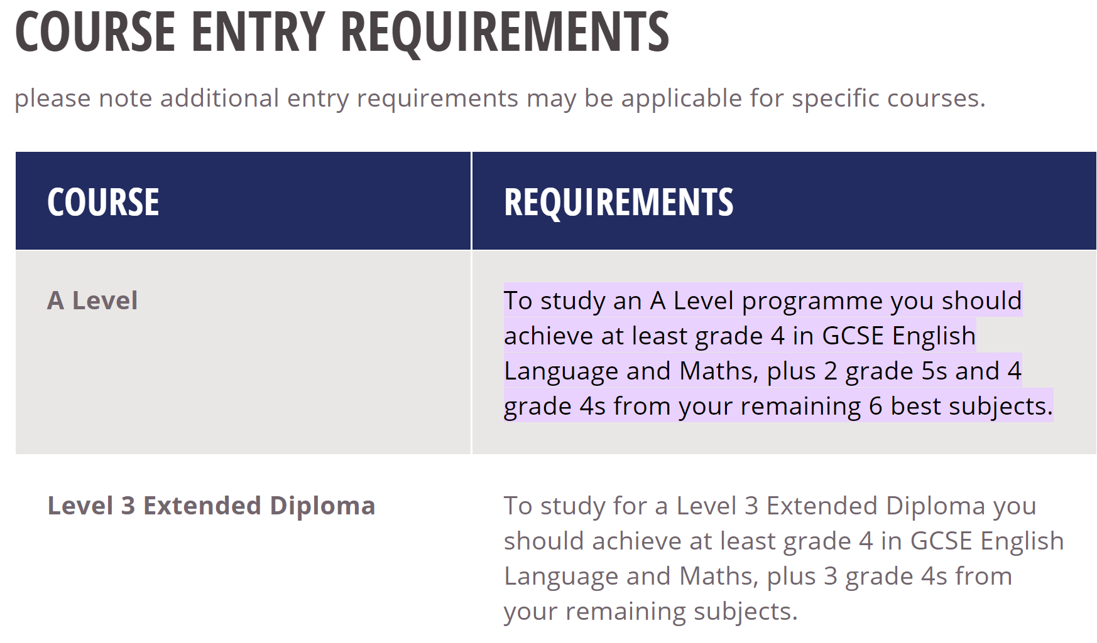
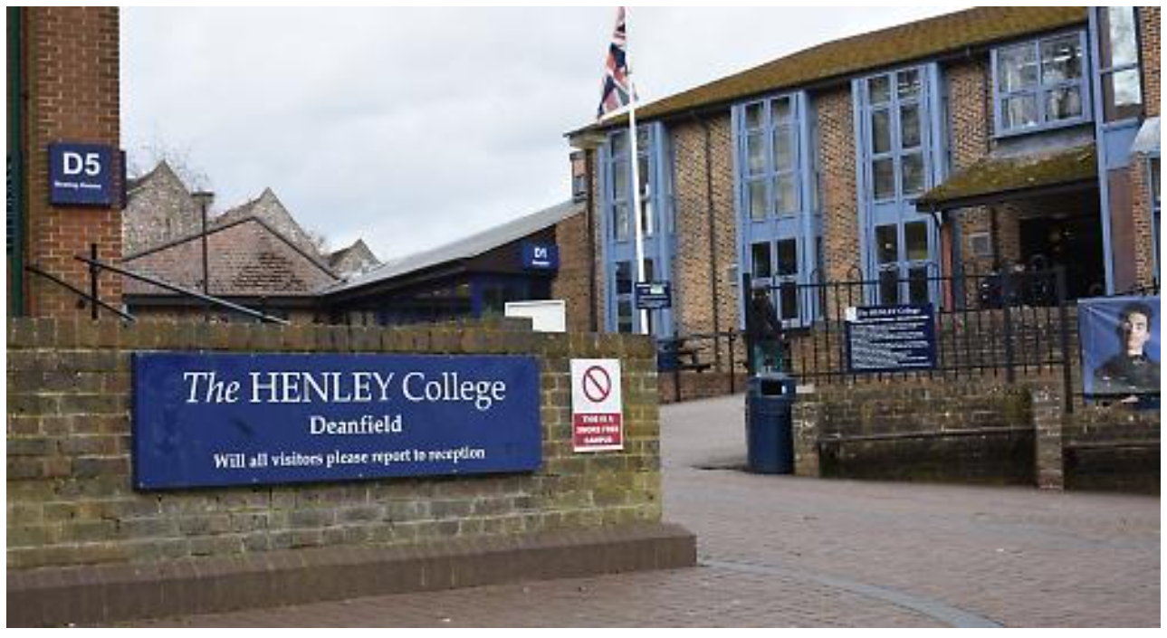

Slide 18
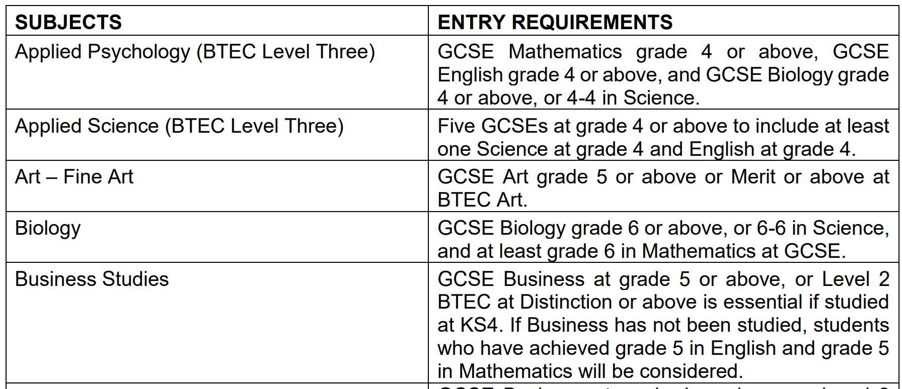

Slide 19
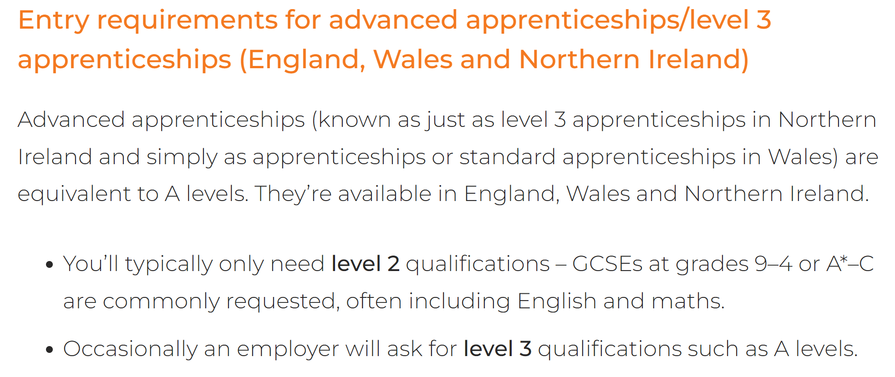
Perhaps you are considering an apprenticeship?

Slide 20
There are no magic wands, but being conscious about what you need to do is the best way to get to where you need to be:

Slide 21
Make a clear plan with specific goals and deadlines

Slide 22
Be prepared. Have all the books, notes, resources ready so you can work without interruptions

Slide 23
The only way to get better at these language paper questions is to keep practising and following the step by step approach that we teach you in class…..

Slide 24
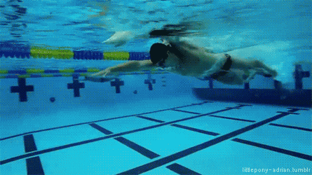
If you want to improve, you must follow the step by step processes we go through with you in class. It will get quicker and easier the more you do it.
People who follow the steps will, eventually, glide effortlessly through the answers.
People who ignore the step by step process will continue to struggle alone and won’t make any progress.

Slide 25
I’ll leave the final words to someone who knows quite a lot about the rewards that determination and hard work can bring:
The first few minutes are the most helpful. She talks about the importance of practising what you want to become good at.

