Slide 1

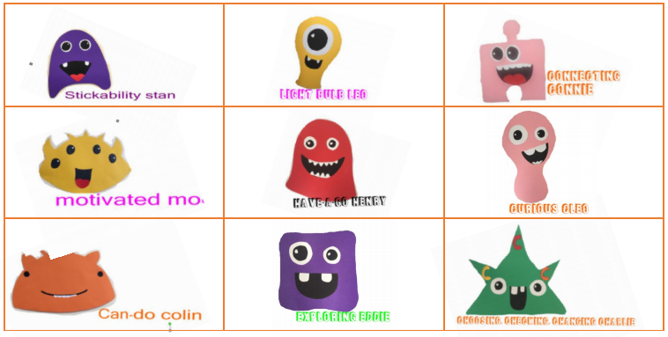
Learning Aliens

Slide 2
This week we will be focussing on one of our 9 learning aliens. Each week we will focus on one learning alien. Every learning alien has its own story that links to the aliens learning characteristics. After the story you can reflect on your own learning and try some new challenges.

Slide 3

Exploring Eddie!

Slide 4


Can you listen to my story?

Slide 5
I explore the world around me.
I am interested in people and things around me.
I use my senses to explore.
How was the boy an ‘Exploring Eddie’ in the story?
How will you been an exploring Eddie this week?

Slide 6
Can you think of a time where you have already been an exploring Eddie?
Draw or ask an adult to write your idea in here

Slide 7
Can you reflect on your activities today/over the school year and share what you found out and explored?
Activities you could try today!
Outdoor activities
Going on a walk
Use your senses in the garden
Make a sensory tray
Activities you you might have been an Exploring Eddie for!
Creative play
Outdoor play
School trips
Challenge!!!
You find think you like and don’t like for smell, touch, taste, and feel!

Slide 8
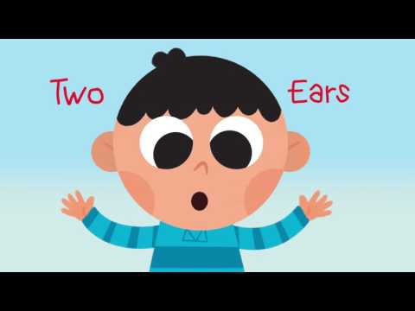
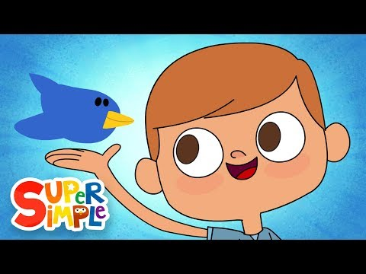
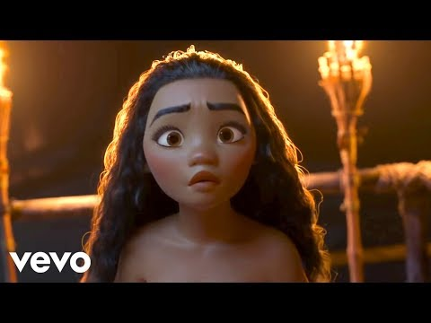
Songs for an Exploring Eddie!

