Slide 1
Times Tables in Year 6 SATs
Why children need to be fluent with times tables for the year 6 SATs

Slide 2
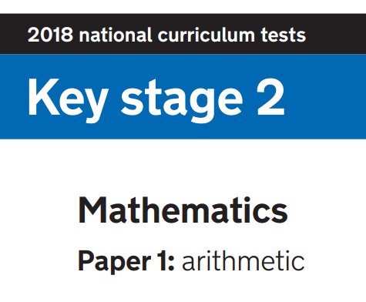

Slide 3
Why are times tables important for Paper 1?
19/36 questions in Paper 1 definitely require children to have fluent times tables knowledge
If times tables knowledge is not it will take them too long (some questions require 8 different times tables)
If it takes them too long they won’t finish
If they are not secure they may make mistakes

Slide 4
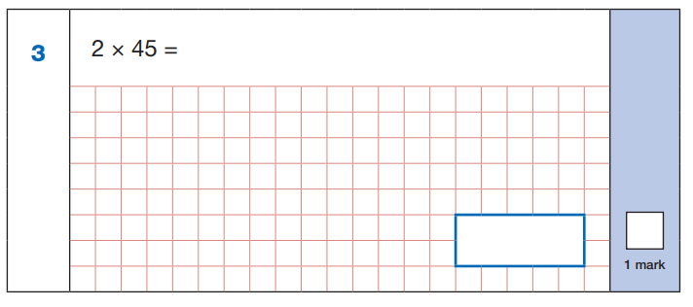
Year 3:
2 x 40 = 80
2 x 5 = 10
80 + 10 = 90
90
Children need to:
Know x2 is the same as double
Do 2 x 4 to help with 2 x 40; 2 x 5

Slide 5
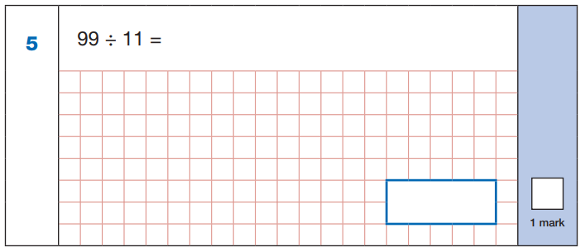
Year 4:
9 x 11 = 99
99 ÷ 11 = 9
9
Children need to:
Know x11 tables
Know that 9 x 11 = 99 so 99 ÷ 11 = 9 (inverse)

Slide 6
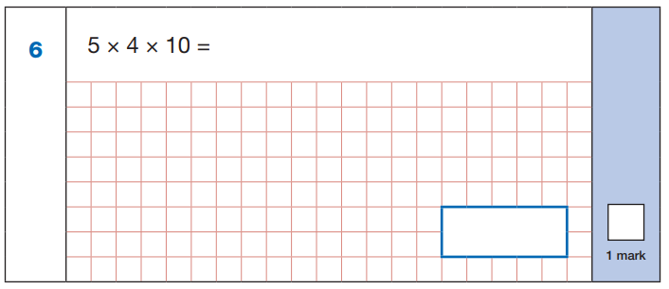
Year 4:
5 x 4 = 20
20 x 10 = 200
200
Children need to:
Know 5 x 4 = 20
Know 20 x 10 = 200 (2 x 10 = 20 helps with this)

Slide 7
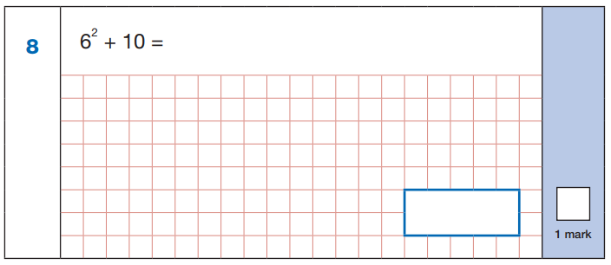
Year 4:
6 x 6 = 36
36 + 10 = 46
46
Children need to:
Know 6 squared is the same as 6 x 6 (= 36)

Slide 8
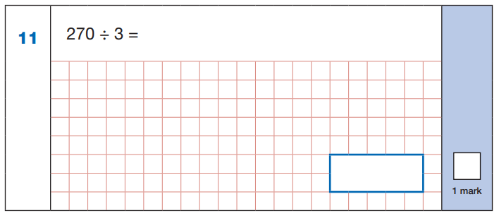
Year 4:
3 x 9 = 27
So 3 x 90 = 270
270 ÷ 3 = 90
90
Children need to:
Know 3 x 9 = 27 so 3 x 90 = 270
Know that 3 x 90 = 270 so 270 ÷ 3 = 90 (inverse

Slide 9
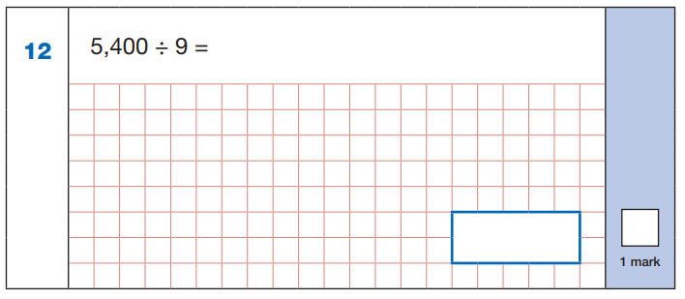
Year 4:
9 x 6 = 54
9 x 600 = 5,400
5,400 ÷ 9 = 600
600
Children need to:
Know 9 x 6 = 54 so 9 x 600 = 5,400
Know that 9 x 600 = 5,400 so 5,400 ÷ 9 = 600 (inverse)

Slide 10
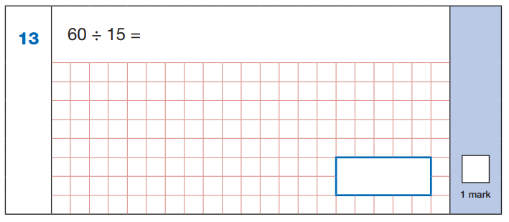
Year 5:
15 x 4 = 60
60 ÷ 15 = 4
4
Children need to:
Recognise that 15 is ¼ of 60
Know that 15 x 4 = 60 so 60 ÷ 15 = 4

Slide 11
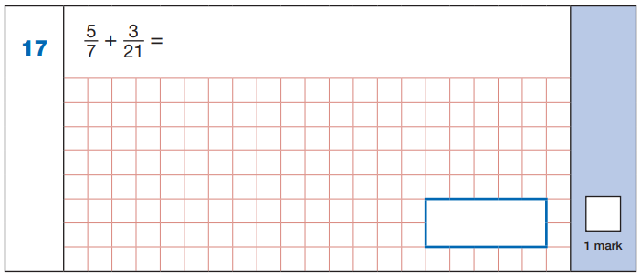
Year 5:
x3
5 =
7
15
21
x3
15 + 3 = 18
21 21 21
18
21
Children need to:
Know 21 = 7 x 3
Multiply the numerator by 3 (5 x 3 = 15) and the denominator by 3 (7 x 3 = 21) to create the equivalent fraction 15/21 to use in the calculation

Slide 12
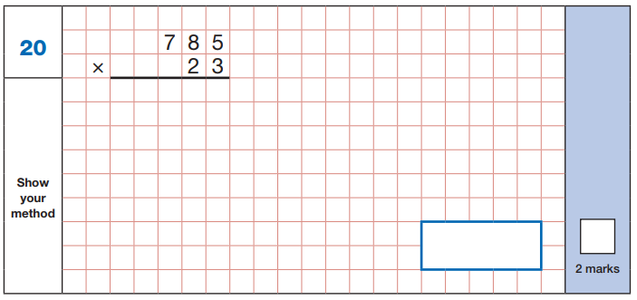
Year 6:
3 x 5
3 x 8
3 x 7
2 x 5
2 x 8
2 x 7
2
1
2 3
5
5
1
1
1 5
7
0
0
1
1
0
8
5
5
18055
Children need to:
Know 3 x 5; 3 x 8; 3 x 7; 2 x 5; 2 x 8; 2 x 7
(as well as how to carry out this procedure accurately)

Slide 13
Year 6:
1,200 ÷ 100 = 12
12 x 20 = 240
240
Children need to:
Divide by 100 (1,200 ÷ 100 = 12)
Do 12 x 20 (12 x 2 or 12 x 10 helps here)

Slide 14
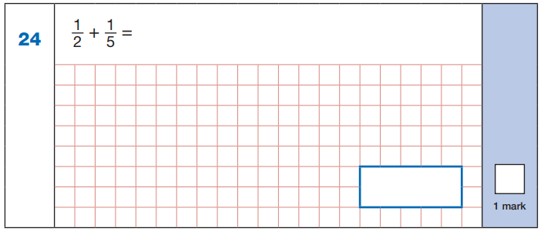
Year 6:
x5
x2
1 = 5
2 10
1 = 2
5 10
x5
x2
5 + 2 = 7
10 10 10
7
10
Children need to:
Know that 2 and 5 are both factors of 10
Multiply the numerators and denominators of the first fraction by 5 (1 x 5; 2 x 5)
Multiply the numerators and denominators of the second fraction by 2 (1 x 2; 5 x 2)

Slide 15
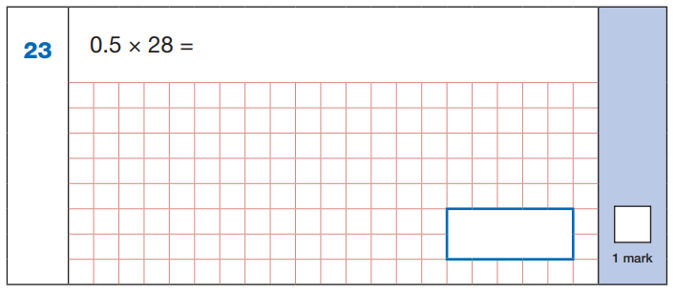
Year 6:
Half of 28 is 14
14
Children need to:
Know that 0.5 = ½
Know that multiplying a number by ½ halves it
Know not to try 5 x 28 or 5 x 20 and 5 x 8 and then divide that by 10)

Slide 16
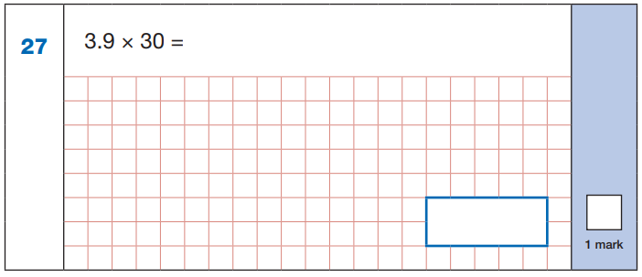
Year 6:
4 x 30 = 120
30 x 0.1 = 3.0 (3)
120 – 3 = 117
117
Children need to:
Know that 4 x 30 = 120 (4 x 3 = 12 helps with this)
Know that 30 x 0.1 = 3.0 (30 x 1 = 30 helps with this)

Slide 17
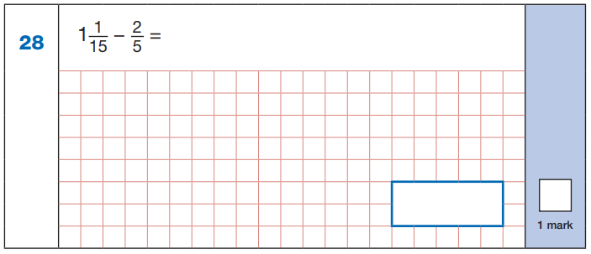
Year 6:
x3
2 =
5
1 1 = 16
15 15
6
15
x3
÷5
16 – 6 = 10 = 2
15 15 15 3
2
3
÷5
Children need to:
Know that 5 x 3 = 15 to make the second fraction into 6/15 (also 2 x 3 = 6)
Do 1 x 15 + 1 = 16 to make improper fraction 16/15
Know that both 10 and 15 are multiples of 5 so ÷ 5

Slide 18
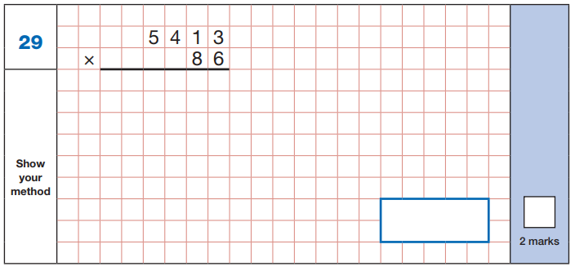
Year 6:
6 x 3
6 x 1
6 x 4
6 x 5
8 x 3
8 x 1
8 x 4
8 x 5
2
4
1
3 2
7
8
3
1
2
4 3
3
0
4
0
4 6
5
1
1
5
8
654418
Children need to:
Know 6 x 3; 6 x 1; 6 x 4; 6 x 5; 8 x 3; 8 x 1; 8 x 4; 8 x 5
(as well as how to carry out this procedure accurately)

Slide 19
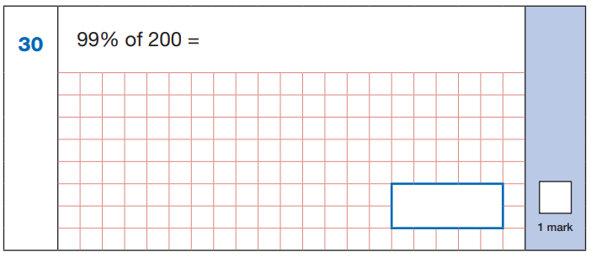
Year 6:
99% of 100 = 99
200 is double 100
double 99 is 198
198
Children need to:
Divide by 100 (200 ÷ 100 = 2)
Or to do it very quickly know that 200 is 100 x 2

Slide 20
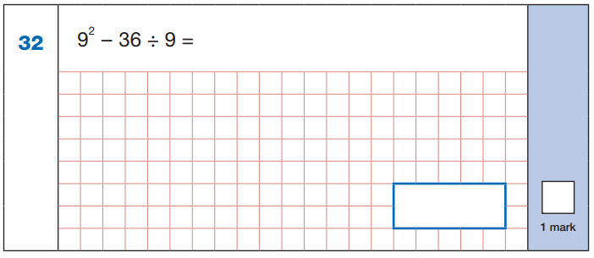
Year 5/6:
36 ÷ 9 = 4
9 x 9 = 81
81 – 4 = 77
77
Children need to:
Know that 9 squared is 9 x 9 = 81
Know that 9 x 4 = 36

Slide 21
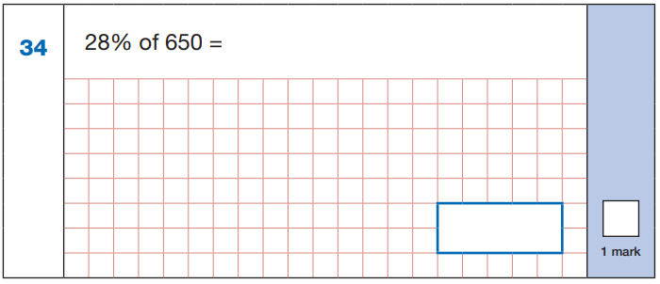
Year 6:
2 8
x 6.5
14.0
+ 168.0
182.0
650 ÷ 100 = 6.5
28 x 6.5 =
28 x 6 =
20 x 6 = 120
8 x 6 = 48
120 + 48 = 168
28 x 0.5 =
half of 28 = 14
168 + 14 = 182
168
182
Children need to:
Divide by 100 (650 ÷ 100 = 6.5)
For 28 x 6.5 use knowledge of 6 x 2, 6 x 8
Know that 0.5 x a number means to half it

Slide 22
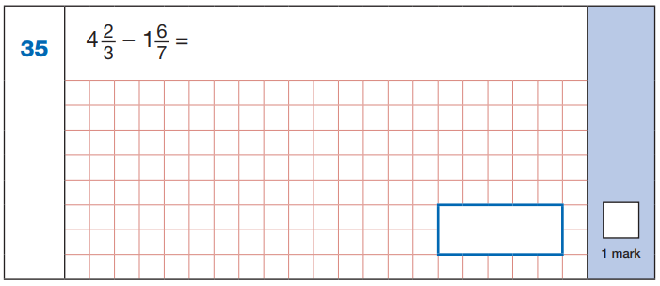
Year 6:
x7
4 x 21 = 84
84 + 14 = 98
98
21
2 = 14
3 21
98 – 39 = 59
21 21 21
x7
x3
6 = 18
7 21
1 x 21 = 21
21 + 18 = 39
39
21
59
21
x3
Children need to:
Know that 3 and 7 are both factors of 21 ( 3 x 7 = 21)
Do 2 x 7 and 3 x 7 to convert first fraction to 14/21
Do 6 x 3 and 7 x 3 to convert second fraction to 18/21
Do 4 x 21 (4 x 2 and 4 x 1 helps) to convert mixed number to improper fraction: 98/21
Do 1 x 21 to convert mixed number to improper fraction: 39/21

Slide 23
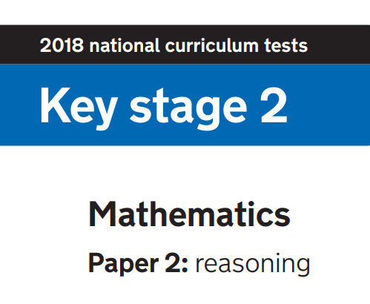
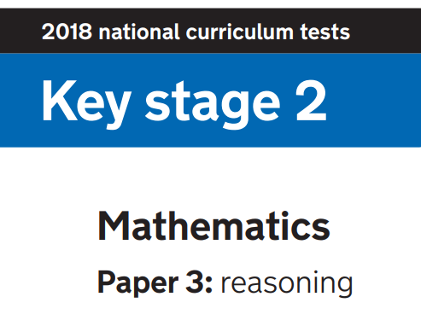

Slide 24
Why are times tables important for Papers 2 and 3?
18/44 questions in Papers 2 and 3 definitely require children to have fluent times tables knowledge
If times tables knowledge is not it will take them too long (some questions require 8 different times tables)
If it takes them too long they won’t finish
If they are not secure they may make mistakes

Slide 25
Timings
40 minutes per test
Roughly 1 question every 2 minutes
Children need to work quickly to complete the calculations – times tables fluency will make a huge difference

Slide 26
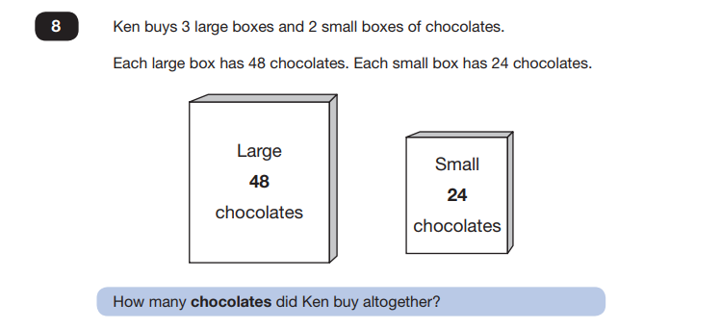
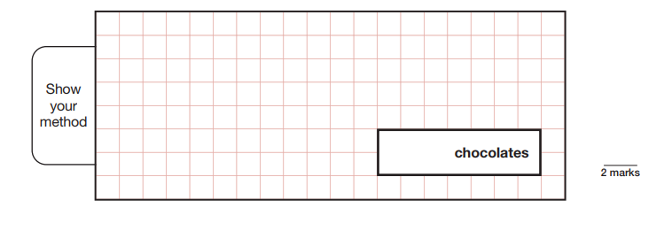
Year 3:
Large:
3 x 48 =
3 x 40 = 120
3 x 8 = 24
120 + 24 = 144
Small:
2 x 24 = 48
144 + 48 = 192
192
Children need to:
Know 3 x 4; 3 x 8; 2 x 2; 2 x 4 in order to work out 3 x 48 and 2 x 24
Or use knowledge of doubling/12 times tables for 2 x 24

Slide 27
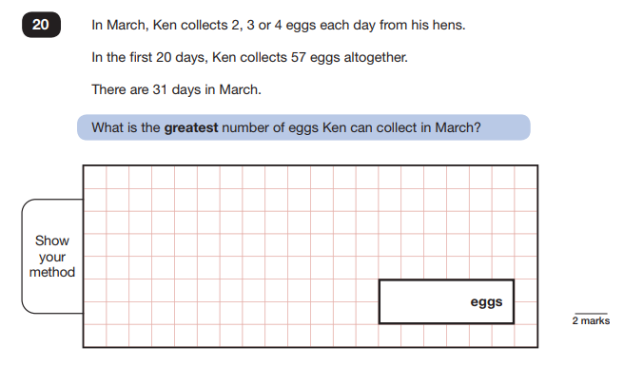
Year 3/4
31 – 20 = 11
11 x 4 = 44
44 + 57 = 101
101
Children need to:
Know 11 x 4

Slide 28
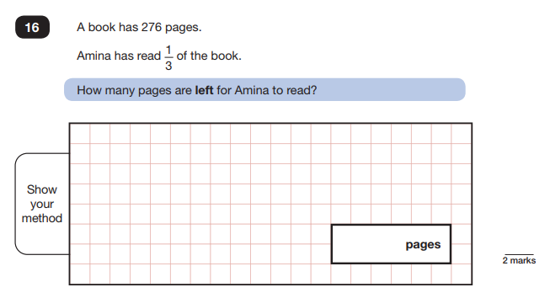
Year 4
276 ÷ 3 =
92 x 2 = 184
0
9
2
184
3
2 7 6
Children need to:
Know 3 x 9; 2 x 6; 9 x 2; 2 x 2

Slide 29
Year 5:
6 x 8 = 48
48 + 7 = 55
Children need to:
Know 6 x 8 = 48

Slide 30
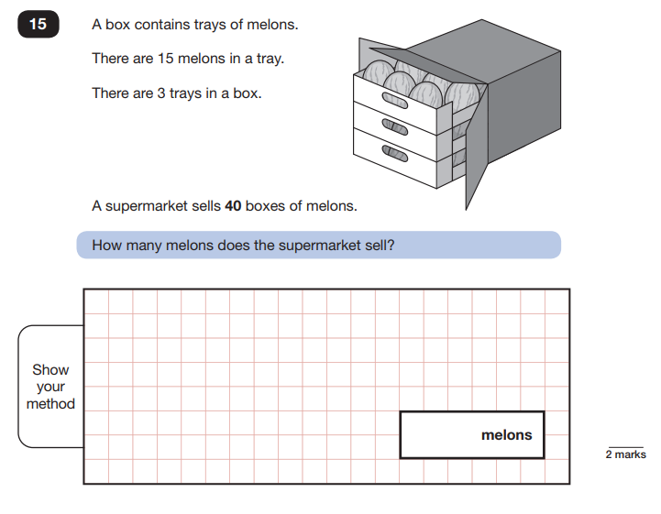
Year 5:
120
X 15
600
1200
1800
40 x 3 x 15
40 x 3 = 120
120 x 15 =
1800
Children need to:
Know 4 x 3; 5 x 0; 5 x 2; 5 x 1; 1 x 0; 1 x 2; 1 x 1

Slide 31
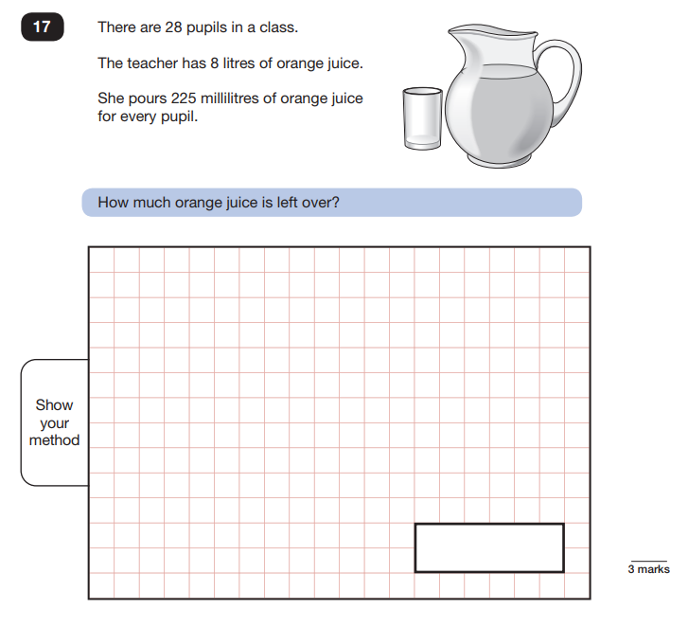
Year 5:
8l = 8000ml
225 x 28 =
8000
- 5300
2700
225
x 28
1800
4500
5300
2700ml = 2.7l
2.7l
Children need to:
Know 8 x 5; 8 x 2; 2 x 5; 2 x 2

Slide 32
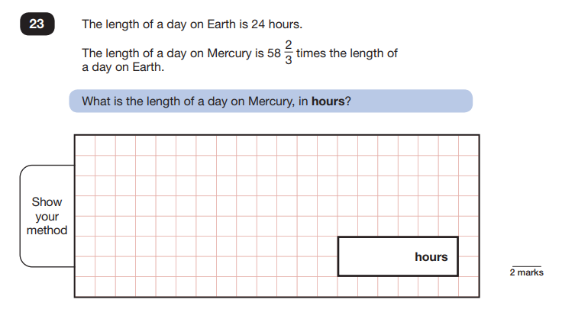
Year 5:
24 x 58 2/3 =
24 x 58 =
24 x 2/3 = 2/3 of 24 = 16
24
X 58
192
1200
1392
1392 + 16 = 1408
1408
Children need to:
Know 8 x 4; 8 x 2; 5 x 4; 5 x 2
To multiply by 2/3 you find 2/3 of a number (divide by 3 and times by 2)

Slide 33
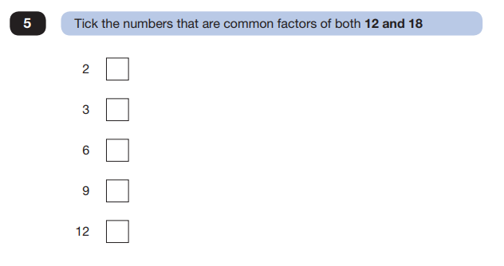
Year 5:
Children need to:
Know that 12 and 18 both appear in 2, 3 and 6 times tables
Know 2 x 6; 3 x 4; 2 x 9; 3 x 6

Slide 34
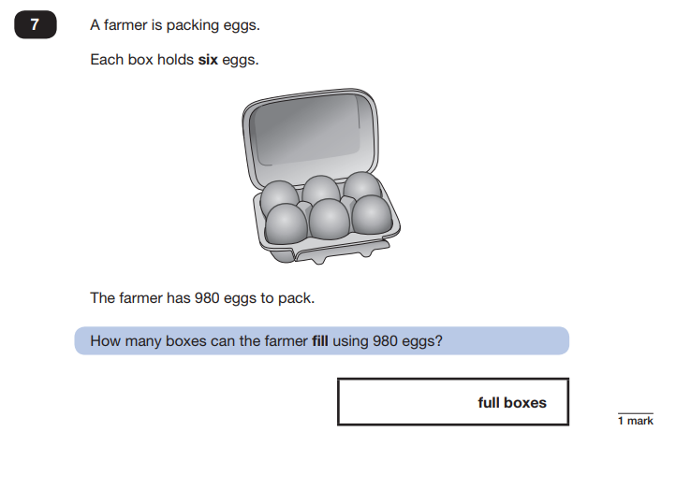
Year 5:
980 ÷ 6 =
1
6
3
r2
6
3
2
9 8 0
163
Children need to:
Know 6 x 1; 6 x 6; 6 x 3

Slide 35
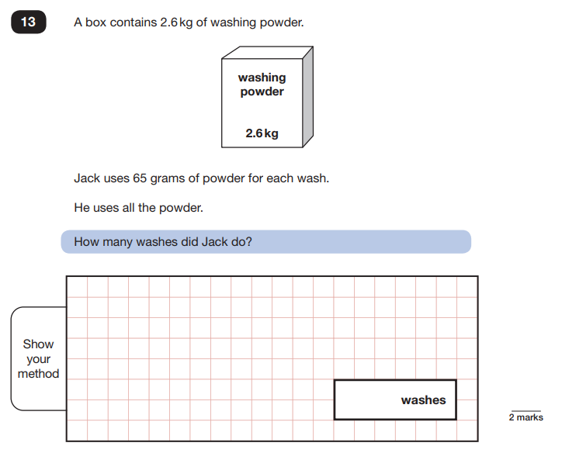
Year 5:
2.6kg = 2600g
2600 ÷ 65
65 x 4 = 260
So
65 x 4 = 2600
Children need to:
Use times tables knowledge to multiply bigger numbers
6 x 4; 5 x 4

Slide 36
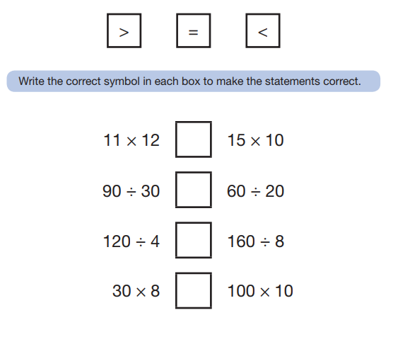
Year 6:
132 =
<
= 150
3 =
=
= 3
30 =
>
= 20
240 =
<
= 1,000
Children need to:
Know 11 x 12; 15 x 10; 3 x 3; 2 x 3; 4 x 3; 2 x 8; 3 x 8; 10(0) x 10
Use knowledge of multiples of 10 and inverse

Slide 37
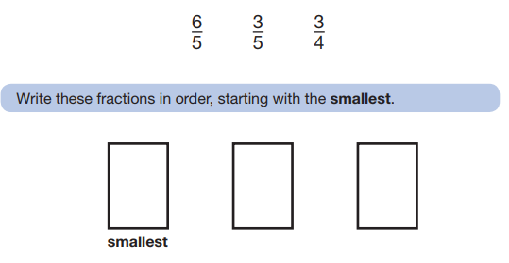
Year 6:
x4
3 = 12
5 20
x4
x5
Improper so is more than one whole so must be the largest
3 = 15
4 20
x5
Children need to:
Know 5 x 4; 3 x 4; 3 x 5; 4 x 5

Slide 38
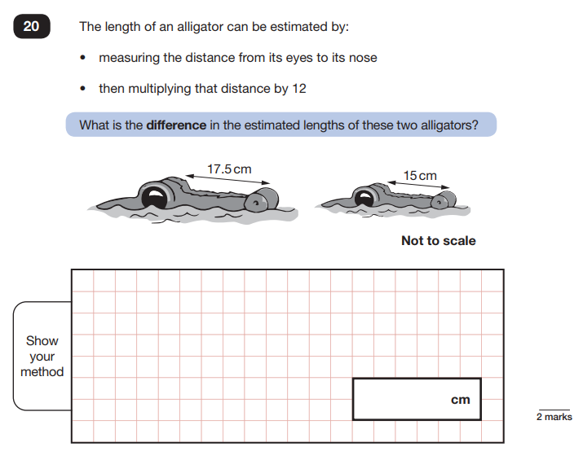
Year 6:
17.5 – 15 = 2.5cm
2.5 cm x 12 =
2 x 12 = 24
Half of 12 = 6
24 + 6 = 30cm
30cm
Children need to:
Know 2 x 5
Multiplying a number by 0.5 is the same as halving it

Slide 39
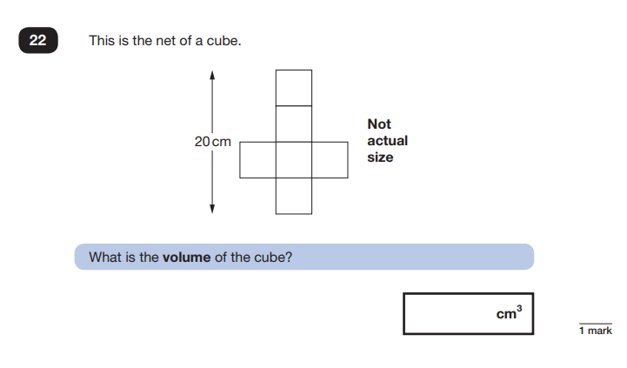
Year 6:
20cm ÷ 4 = 5cm
So each face is 5cm x 5cm
5 x 5 x 5 =
5 x 5 = 25
25 x 5 = 125cm3
125
Children need to:
Know 5 x 5 and to use tables knowledge to do 25 x 5
Cubed means multiply a number itself and then by itself again

Slide 40
Year 6:
35% of 400 =
400 ÷ 100 = 4
35 x 4 =
30 x 4 = 120
5 x 4 = 20
120 + 20 = £140
£140
Children need to:
Know 3 x 4; 5 x 4

Slide 41
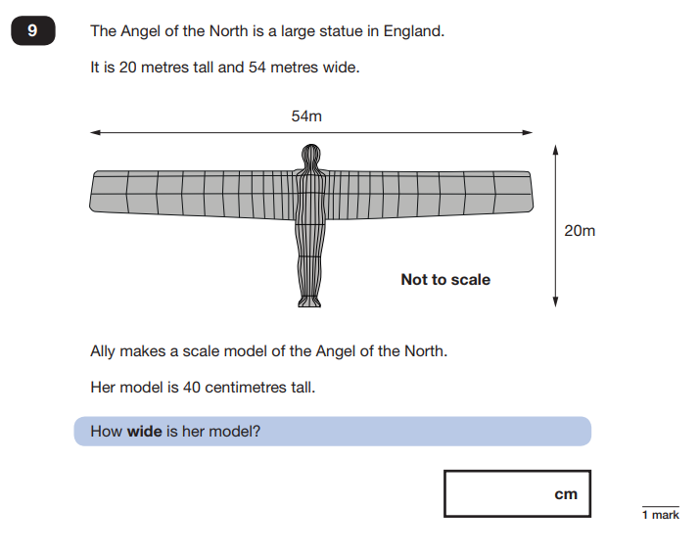
Year 6:
20m x 2 = 40m
54 m x 2 = 108m
So if the model is 40cm tall it should be 108cm wide
108
Children need to:
Be able to double numbers
Recognise relationships between numbers e.g. 20m and 40cm

Slide 42
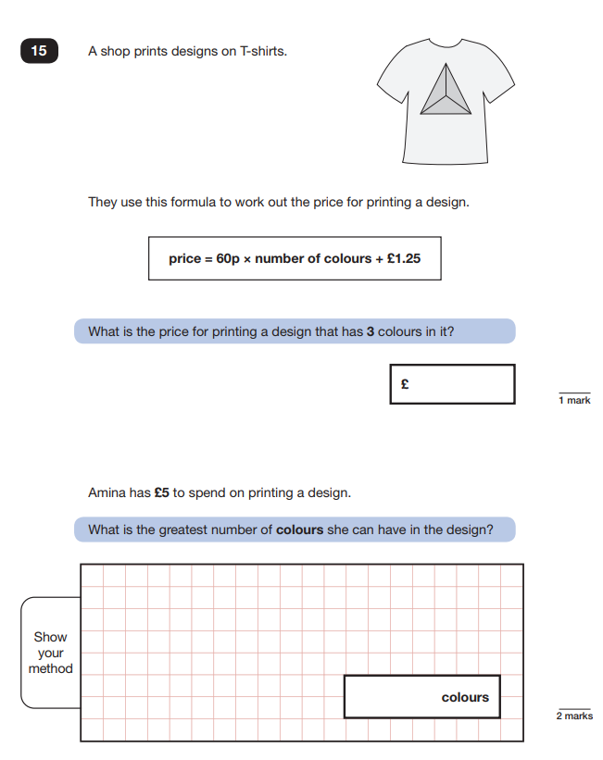
Year 6:
60p x 3 + £1.25
60p x 3 = £1.80
£1.80 + £1.25 = £3.05
3.05
£5 - £1.25 = £3.75
6 x 6 = 36
6 x 60p = £3.60
6
Children need to:
Know 6 x 3; 6 x 6

Slide 43
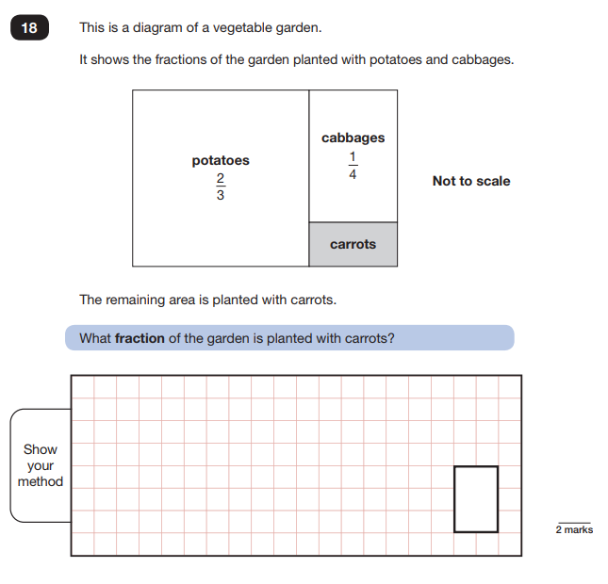
Year 6:
x4
x3
2 = 8
3 12
1 = 3
4 12
x4
x3
Children need to:
Know 2 x 4; 3 x 4; 1 x 3
8 + 3 = 11
12 12 12
11
12

